Slide 1
DATA ANALYTICS PROJECT
14.94%
SaaS Customer Churn Analysis
Customer churn
10.51%
Why customers cancel, how much revenue it costs, and who is likely to leave next
MRR churn
$14.44M
MRR lost
Sunny Yadav
Python | MySQL | Power BI
Notes:
Intro: end-to-end churn project using Python, MySQL and Power BI.

Slide 2





The Business Problem
Project goals
The situation
Find the main reasons customers cancel
A B2B SaaS company keeps acquiring new customers, but many cancel their paid subscriptions every month. The result is steady loss of Monthly Recurring Revenue (MRR).
Analyse usage, support and payment patterns
Flag high-risk customers before they leave
Help the Customer Success team act early

Slide 3



Dataset and Tools
44,440
43,912
24
2024-25
raw rows
clean rows
columns
signup period
Each row is one customer: plan, industry, company size, seats, MRR, onboarding, logins, features used, support tickets, CSAT, failed payments, status and churn reason.
Python (Pandas)
Data cleaning
MySQL
Analysis queries
Power BI
Executive dashboard

Slide 4






Data Cleaning with Python
440 duplicate rows removed
Text standardised
44,440 to 44,000 rows
Country, plan and payment labels fixed (USA, UK, UAE, UPI)
Missing values handled
Dates fixed
Industry and channel set to Unknown; blank churn reasons set to Not Recorded
Mixed formats parsed; 88 rows with churn before signup dropped
Tenure_Months created
Final check
Signup to churn date, or to 30 Nov 2025 for active customers
43,912 unique customers, ready for SQL

Slide 5
Headline KPIs
43,912
14.94%
$137.39M
$14.44M
10.51%
Total customers
Customer churn rate
(6,559 customers)
Total MRR
MRR lost
MRR churn rate
Revenue churn (10.51%) is lower than customer churn (14.94%), which means smaller accounts leave more often. Even so, $14.44M of monthly revenue is leaking and needs a retention focus.

Slide 6
Why Customers Churn
Key insight
Low product usage (2,123 customers) and high pricing (1,491) together cause over 55% of cancellations.
This points to gaps in product adoption and perceived value, not just price.

Slide 7
Early Tenure and Onboarding Are the Danger Zone
Churn rate by tenure
Churn by onboarding status
About 5x higher churn without onboarding. This is the biggest controllable driver.
Peaks at 52.35% in month 1 and falls to about 10% by month 5.

Slide 8
Engagement, Features and Seat Usage
Metric | Churned | Active
Avg monthly logins | 10.62 | 22.52
Features used | 4.22 | 6.84
Days since last login | 17.81 | 7.68
Seat utilisation | 57.0% | 77.2%
What it means
Churned users log in about half as often
They use fewer features: weak adoption
Inactivity is an early warning sign
Unused seats (shelfware) make customers feel they overpay
Seats: churned accounts averaged 30.9 active of 56.6 purchased seats.

Slide 9
Support Experience and Satisfaction
Churn rate by support tickets (90 days)
Churned vs Active
CSAT score
2.85
3.43
Resolution time
13.5 hrs
11.0 hrs
Tickets per 90 days
1.44
1.21
Churned
Active

Slide 10
Churn by Plan, Billing and Company Size
Plan type
Billing cycle
Company size
Enterprise churns least (8.8%) yet loses the most revenue ($7.31M). Small, monthly-billed Basic accounts churn most. Annual contracts retain better (10.2% vs 17.5%).

Slide 11



Early Warning: Churn Risk Scoring
Active customers are scored with SQL rules and sorted by MRR so the biggest accounts get attention first.
High Risk
Medium Risk
Low Risk
Inactive more than 30 days, or fewer than 3 logins a month, or CSAT of 2 or less, or 2+ failed payments
Inactive 15 to 30 days, or CSAT of 3
Engaged, satisfied, payments stable
Urgent outreach
Proactive check-in
Routine monitoring

Slide 12
The Most Vulnerable Segment
Churn rate: onboarding status x billing cycle
Annual
Monthly
Monthly plan + no onboarding: 44.5% churn, about 10x the best segment.
Onboarding not completed
30.2%
44.5%
Onboarding completed
4.5%
9.9%

Slide 13
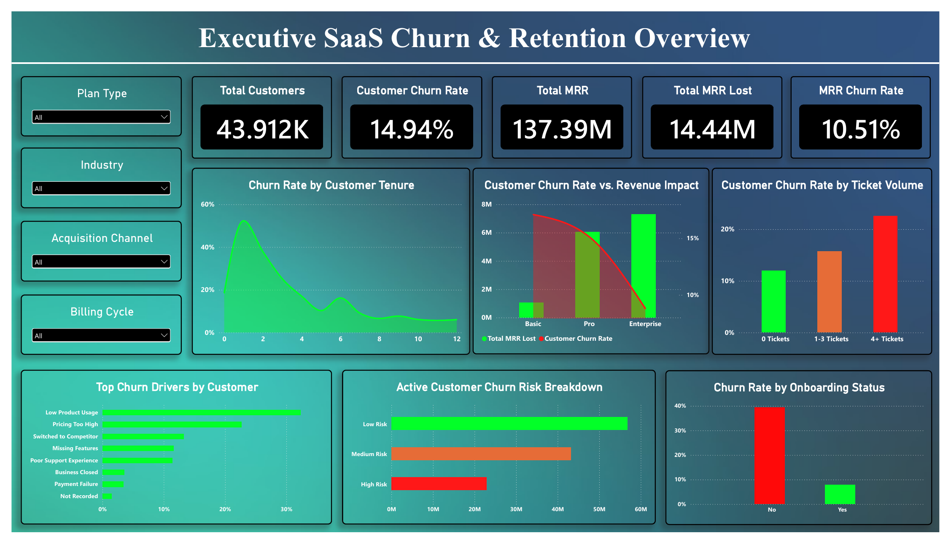
Power BI Executive Dashboard
KPI cards, churn drivers, tenure curve, plan impact, ticket volume, onboarding and risk breakdown, with filters for plan, industry, channel and billing cycle.

Slide 14





Recommendations
Fix onboarding
Push annual plans
Act on risk scores
Guided setup and a check-in call in the first 30 days; make completion a priority.
Offer a discount to move monthly customers to annual billing.
Customer Success contacts High Risk accounts first, ordered by MRR.
Tighten support SLAs
Drive adoption
Prove value
Prioritise accounts with 4+ tickets and slow resolution.
Seat and feature nudges, team training, or downsell offers for unused licences.
Address pricing objections by showing ROI; use low-touch automation for small accounts.

Slide 15



Thank you
Sunny Yadav | Data Analyst
ysunny7600@gmail.com
github.com/Sunny7600
linkedin.com/in/sunny-yadav-180ba2227
Full SQL, Python notebook, Power BI file and dataset are on my GitHub.

