Slide 1
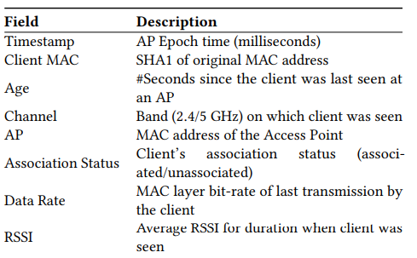

Server side Wi-Fi Indoor Localization Using Existing infrastructure
1
Introduce
Non modified client-server both side.
Offline fingerprint-based(based on ground truth mapping) approach with RSSI.
Two commercial bandwidth 2.4Ghz and 5Ghz.
Unaccuracy result. Because of Cardinality Mismatch.
The RTLS data table.
Dheryta Jaisinghani, Rajesh Krishna Balan, Vinayak Naik, Archan Misra, Youngki Lee
2018, Experiences & Challenges with Server-Side WiFi Indoor Localization Using Existing Infrastructure

Slide 2
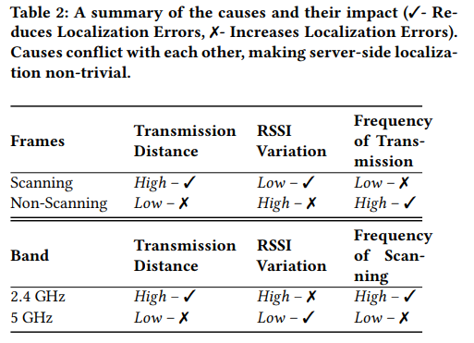
Server side Wi-Fi Indoor Localization Using Existing infrastructure
2
Fingerprint data
Two type of MAC layer frame. And bandwidth shows different aspect.
Scanning Frames : high power and low bit rate, Offline fingerprint
Data reported client as unassociated.
Non-Scanning Frames : All other MAC layer frames. Data reported client as associated. Data rate is fixed at 1,6,24Mbps.
Online fingerprint has Scanning and Non-Scanning both.
2.4Ghz unstable, So, long transmit distance, high frequency.
5Ghz stable, So, short transmit distance, low frequency, low interference.
Dheryta Jaisinghani, Rajesh Krishna Balan, Vinayak Naik, Archan Misra, Youngki Lee
2018, Experiences & Challenges with Server-Side WiFi Indoor Localization Using Existing Infrastructure

Slide 3
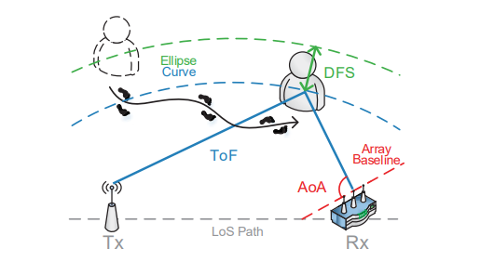
Widar2.0
3
Introduce
Widar2.0 aimed at passive-human tracking in the state of free devices.
Also, only uses easiest way which is commodity off-the-shelf(COTS) WiFi devices.
It only require one transmitter and one receiver with 3 antenna.
It used Time of Flight, Angle of Arrival, Doppler Frequency shift.
Kun Qian, Chenshu Wu, Yi Zhang, Guidong Zhang, Zheng Yang, Yunhao Liu
MobiSys ’18 Widar2.0: Passive Human Tracking with a Single Wi-Fi Link

Slide 4
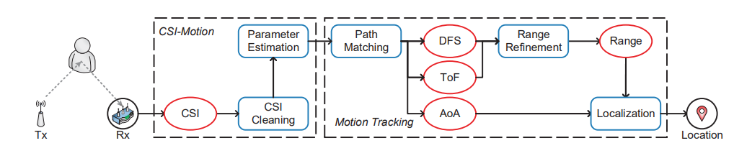
Widar2.0
4
Concept overview
Channel State Information has a lot of noises. So, It need Cleaning phase.
After cleaning, Estimate multidimensional parameters.
By DFS and ToF, find range and combine it with AoA for localization.
Kun Qian, Chenshu Wu, Yi Zhang, Guidong Zhang, Zheng Yang, Yunhao Liu
MobiSys ’18 Widar2.0: Passive Human Tracking with a Single Wi-Fi Link

Slide 5
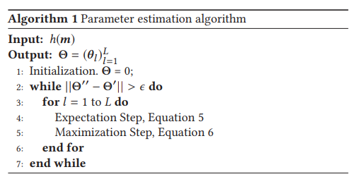
Widar2.0
5
CSI
Multiparameter effect : The delay of a path is cluttering by ToF, DFS, AoA.
Maximum likelihood estimation : complex to compute.
SAGE(Space-Alternating Generalized Expectation-Maximization) algorithm
For CSI cleaning Widar2.0 used conjugate multiplication. Between, reference
sensor and other sensors.
Static signals can be removed by high-pass filter. Also, conjugate of dynamic signal is small enough to omit.
And the by-product of static group and dynamic group star is fake Mirror Entity.
So, the only summation of this groups is remain.
Kun Qian, Chenshu Wu, Yi Zhang, Guidong Zhang, Zheng Yang, Yunhao Liu
MobiSys ’18 Widar2.0: Passive Human Tracking with a Single Wi-Fi Link

Slide 6

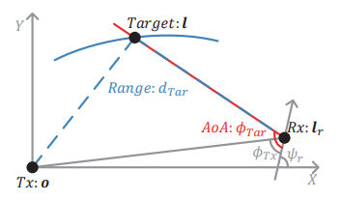


Widar2.0
6
Localization
Path matching : use Hungarian algorithm to match adjacent parameters causes severe fluctuating.
Since, Widar2.0 use graph based-path matching.
Estimate small group matching by binary integer program. And using it as the new
estimation for path matching in next group.
Range : estimate by ToF. But the result have noises and low resolution.
So, adding DFS 1Hz of DFS is 0.05m/s. Using this figure, Widar2.0 use the Kalman fixed-interval filter.
Distance of parameters
Kun Qian, Chenshu Wu, Yi Zhang, Guidong Zhang, Zheng Yang, Yunhao Liu
MobiSys ’18 Widar2.0: Passive Human Tracking with a Single Wi-Fi Link

Slide 7
Widar2.0
7
Result and Limit
Average error 0.75m with single Wi-Fi link.
Using two link, it reduced to 0.63m.
Multi-person : hard to separate reflect point
NLoS condition : reflection signal is
Kun Qian, Chenshu Wu, Yi Zhang, Guidong Zhang, Zheng Yang, Yunhao Liu
MobiSys ’18 Widar2.0: Passive Human Tracking with a Single Wi-Fi Link

