Slide 1

1
CONTENTS
1. Experiences & Challenges with Server-Side WiFi Indoor Localization
Using Existing Infrastructure
03
- Introduction
- System Architecture and Data Collection
- Challenges Discovered
- Conclusion
2. Widar2.0: Passive Human Tracking with a Single Wi-Fi Link
15
- Introduction

Slide 2
Experiences & Challenges with Server-Side WiFi Indoor Localization
Using Existing Infrastructure
2
Introduction
Early study, A number of ways of Indoor Localization have been introduced.
There are four options : server-based and client-side, fingerprinting and model-based.
Server-based Indoor Localization
Client-side Indoor
Localization
Fingerprint
Model-based Indoor Localization
Notes:
이부분 수정 여러 개 존재하는식으로
이거만 존재한다는 느낌받을수있음

Slide 3
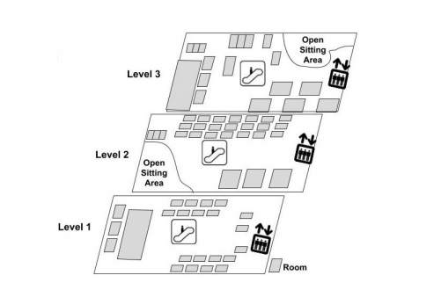
3
Introduction
Introduction
In this paper, they try to highlight challenges and propose easy to integrate solutions to build a universal indoor localization system – without any modifications whether client or infrastructure-side.
They adopted fingerprint infrastructure base solution.
Fingerprint
Infrastructure
Base
Notes:
인프라스트럭쳐베이스 서버베이스 용어통일

Slide 4
Problem
4
Introduction
Problem
Server-based indoor location tracking system have limitations in terms of accuracy comparing to tradition client-side tracking system.
In this paper, It focus two unique challenges ‘Cardinality Mismatch’ and ‘High Client Scan Latency’ associated with it’s approach.
Server-based indoor localization
Inaccuracy
Unrealistic paths
Cardinality
Mismatch
High Client
Scan Latency
Notes:
여기서 인어큐러시가 존재한다는건데 이거랑 위에슬라이드 전에 클라이언트방식과 서버베이스방식 차이 알려줘야됨

Slide 5
5
Introduction
Two challenges to overcome
Cardinality
Mismatch
Cardinality means the number of APs which reported a client located at a specific landmark.
Cardinality Mismatch is different Cardinality with offline fingerprints and online fingerprints.
Due to dynamic power of client and client management performed by a centralized controller in commercial grade WiFi networks.
High Client
Scan Latency
If Client-side localization techniques where clients actively scan the network when they need location fix.
But in Server-side, the system can only ‘see’ sended signal.
In this paper’s report, 90% of client scan interval to be 20 minutes.
So, there is a situation of ‘teleporting’ of clients across the location.

Slide 6
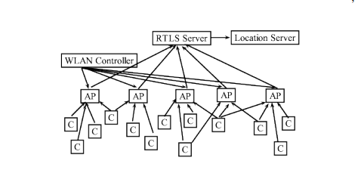
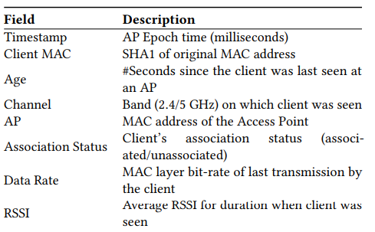
6
System Architecture and Data Collection
Idea
Each AP send RTLS data feeds every 5seconds to the RTLS Server.
In this work, RTLS Server send each data to Location Server.
The Location Server analyzes these RTLS data feeds for the signal strengths reported by different APs to estimate the location of a client.
The below table presents all the fields contained in an RTLS data feed per client.
System overview
Data of RTLS
Notes:
소제목 변경필요 RTLS용어 풀어서 쓰는것도 필요

Slide 7
7
System Architecture and Data Collection
Fingerprints
Offline Phase
In Offline fingerprinting, two-dimensional map is prepared for each landmark on the per-floor basis.
For each landmark, the device(dual-band Android phones) collected data for 5 minutes.
While the clients scan, APS collate RSSI reports for the client and send their measurements as RTLS data feeds to the Location Server.
L : Landmark, B : 2.4 or 5 GHz, AP : specific ID of AP, RSSI : the RSSI value of that RTLS data
Online Phase
In Online fingerprinting, Localization of a client is done with online fingerprints.
On localization estimation, match online fingerprint with offline fingerprints of each landmark to calculate the distance in signal space.
By difference of Signal strength(RSSI), It can estimate the difference of distance with landmarks.

Slide 8
8
System Architecture and Data Collection
Pre-processing of the data
Filter the raw RTLS data feed for latest values, with age less than or equal to 15 sec, RSSI should greater than or equal to -72 dBm. When client loses association when RSSI is below -72 dBm.
For analysis, Classify MAC layer frames in two classes.
Scanning-Frames : High power and low bit rate probe requests.
Non-Scanning-Frames : All other MAC layer frames.
Offline Fingerprints are derived from the scanning frames, which are known to provide accurate distance estimates as they transmitted at full power.
Online Fingerprints are mixed of scanning and non-scanning frames. Due to It is real world device operation.
So, It need to match by different type of frame.
But, in RTLS data feeds don’t report the type of frame.
Notes:
15초 부분 자세히 파악필요
이게 알고리즘이 순간적으로 같은타임스템프를 찍는지 아니면 15초내의것들을 다 동시에 합하여 계산하는지 알아볼필요가 있음
이부분에서 초안발표때 문제가 많이됬음
15초가 정확히 어떤부분에서 다합해서 15초인가
아니면 단순한 오래된 값을 계산하지 않기위한 15초인가
아니면 5분에 한번찍히는 90%의 평균값이 있으므로 인하여 15초내의 것들을 합산해도 무방한가

Slide 9
9
System Architecture and Data Collection
Pre-processing of the data
So, They design controlled experiments, a)send scanning frames only and b)send non-scanning frames only.
Scanning frame only
All report RTLS data is Unassociated.
Data rates fixed 1,6, 24 Mbps, probe response rate.
Non-Scanning
frame only
There is associated report RTLS data.
Data rates various rate. Ex) 1, 2, 5.5, … ,54 Mbps.
By this two fact, It can classify with high probability.
Notes:
왜 굳이 데이터레이트와 언어소시에이티드인가
다른데도 굳이 어소시에이티드 있으면 거르면되지않나?
데이터전송을할때 연결된데만 어소시에이티드가 뜨는가
아니면 논스캐닝을뿌릴때 연결된 ap에서는 어소시에이티드뜨고 다른데서는 데이터레이트는1~54가 뜨는데 언어소시에이티드가 뜨는가

Slide 10
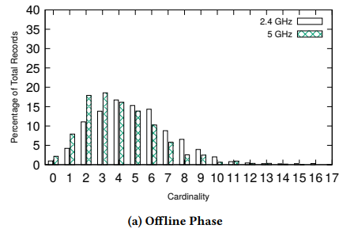
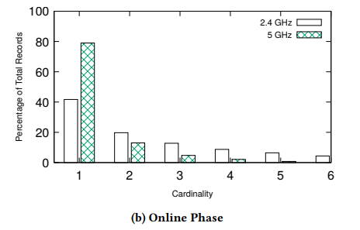
10
Challenges Discovered
Evidence of the Issues
This graphs shows the Cardinality Mismatch on Offline and Online Phases.
Also, the Cardinality is different with Band.
Across all the cardinalities, 2.4 GHz has 57.30% mismatches and 5 GHz has 30.6% mismatches.
5 GHz band is more affected by the Cardinality Mismatch issue because it experiences lower cardinality, which increases the chances of error.
2 GHz band is traveling more distance and transmitting more scanning frames. So, High number of Cardinality is recorded then 5 GHz band.
Notes:
이부분 그래프가 좀 이상함
한자리에서 측정한것인가
아니면 여기서 왜 카디널리티 미스매치라고 표현이 되는가
단순한 실험방법의 오류가 아니인가?
다른방식으로 설명할수도 있지않은가?
이런식의 접근법이 필요함
여기서의 그래프는 오프라인은 5분씩 측정한거고 온라인은 아닌건데 그러면 오프라인에서 충분한 테이터수집이되서 한자리당 여러가지의 경우의수를 만들면 되지않을까?
이부분은 데이터 학습의 정도의 문제가 아닐까?
아니면 실험설계의 미스가 아닐까?

Slide 11
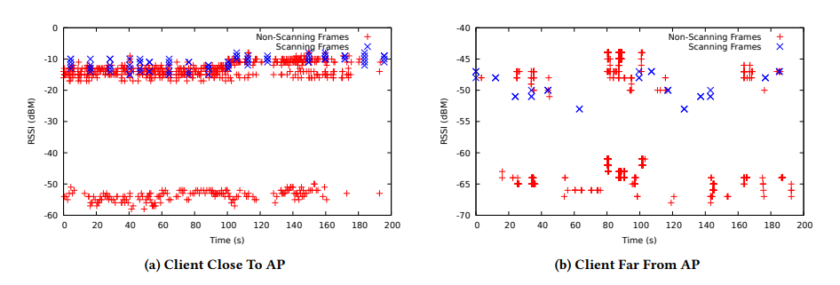
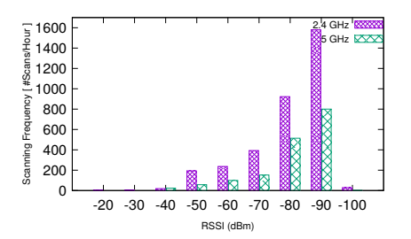
11
Challenges Discovered
Evidence of the Issues
1. Experiment of find difference of RSSI strength with close to AP and far from AP.
2. Experiment of difference of Scanning Frequency by Band and RSSI strength for 6 hours.
Scanning frame has only 10 dB gap in close to AP and 5 dB gap in far from AP.
Non-scanning frame has 50 dB gap in close to AP and 30 dB gap in for from AP.
It shows Scanning frame is more reliable indicator.
90% of scanning intervals is in the order of few 1000 sec, and 5GHz is less preferred band with scanning.
Notes:
첫번째 실험에서는 15초간격으로 패킷을 보냈고 패킷캡쳐링으로 프레임별 RSSI 신호를 기록하였다.
두번째 실험은 6시간동안 신호강도에 따른 스캐닝을 관찰하였는데 스캐닝에는 5ghz가 덜 선호되는 경향이 있었음
또한 scanning frequency가 클수록 cardinality mismatch경향이 줄어들었고 연결의 질이 안좋을수록 자주 scannin을 하였는데 5ghz에서 스캐닝횟수가 적은 이유는 5ghz 밴드에서 간섭이 더 적기때문에 연결의 질이 2.4ghz 밴드보다 좋게 되고 따라서 스캐닝횟수가 2.4ghz보다 적게 나타남.
피드백
이거 논스캐닝이 두개의 층으로 나눠지는거는?
이거 이유 꼭나옴
그리고 클로즈투랑 파프롬이랑 실험을 설명할때 ap에 까까워지는게아닌 가까이에서 서서 측정한거라는 설명이 필요함

Slide 12
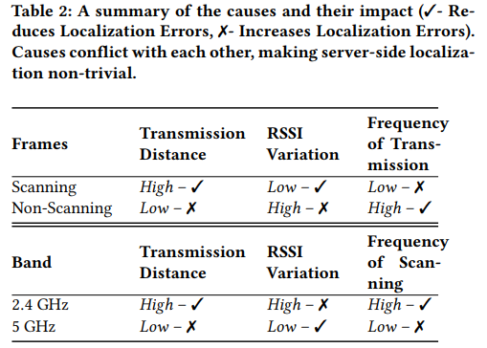
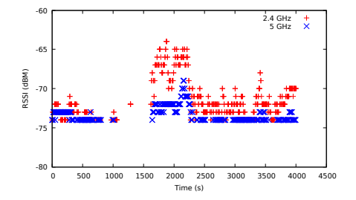
12
Challenges Discovered
Evidence of the Issues
Even though the Cardinality Mismatch is lower, the RSSI will differ more in 2.4 GHz.
By experiment, a stationary client RSSI recorded at the RTLS server data for 1hour.
Difference with RSSI strength is 2.4 GHz has more gap.
The table shows summary of all experiments data.
Notes:
이부분 설명을할때 100초에서 1500초 사이에 값이 왜없음?
사실 이부분 이유가 없긴한데 한번더 확인해보자

Slide 13
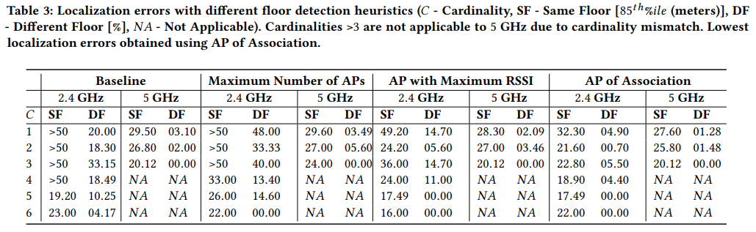
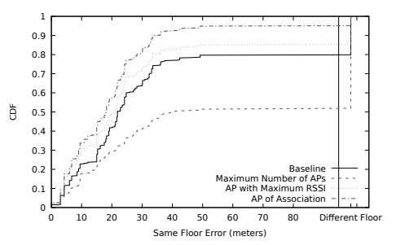
13
Conclusion
Impact of Causes on Localization Errors
The algorithm first selects a floor and then shortlists all the APs that are located on the same floor. And then matching with offline fingerprints.
There are three methods it explored.
(a)Maximum Number of APs – the floor for which the maximum APs are reporting the client.
(b)AP with Maximum RSSI – the floor from which the strongest RSSI is received.
(c)AP of Association – the floor of AP to which the client is presently associated with.
The (c) shows most accurate tendency, and in 5 GHz shows more accurate tendency.
2.4Ghz Cardinality 1
Notes:
알고리즘 설명을 할때 좀더 찾아보자
카디널리티는 그럼 같은층의 카디널리티만 측정이되는가?
이를 포함하여 전체적인 설명의 얼개를 새로 맞출 필요가 있음

Slide 14
14
Conclusion
Limitation and Conclusion
First, they only used fixed set of devices(one iPhone and one Android Phone).
By difference tendency with various devices, It is most big limitation of fingerprinting method.
Second, they collected the data for lightly(few people situation) and heavily loaded(many people situation).
But, in test, they only tested in lightly loaded situation.
To conclude, In this paper, they presented two major issues.
Most of this work provides real-world evidence of “where” and “what” may go wrong for practically localizing clients in a device agnostic manner.
Notes:
결론을 내자면 이 논문에서는 두가지의 이슈에 대해 설명을 하였습니다.
대부분의 작업은 실제 세상에서 기기의 변경없이 로컬라이징을 할 때 어디에서 또는 무엇이 잘못 될 것인지 보여주는 증거가 될 것입니다..
위의 한계점에서 나오는 방식에 대한 증거를 찾아보자
다른 논문에 기기마다의 차이가 난다고 나오는데 이에대한 내용도 찾아보고 추가하는게 좋을것

Slide 15
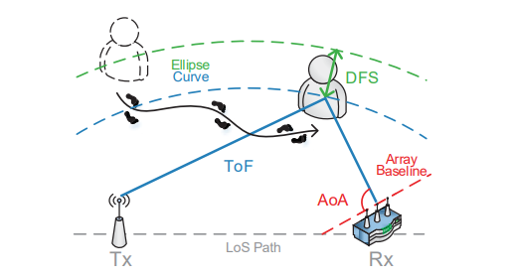
15
Widar2.0: Passive Human Tracking with a Single Wi-Fi Link
Introduction
In this paper, They try to figure out human tracking without carrying device on human side.
Also, construct system with a single commercial Wi-Fi devices.
They adopted LOS(Line-Of-Sight) situation scenario and model-based localization.
Estimate the cluttering signal which reflected by human body.
Widar2.0 tracking with ToF(Time of Flight), AoA(Angle of Array) and DFS(Doppler Frequency Shift).
Notes:
LOS 시나리오는 가로막는 벽이없는 뻥뚫린 공간에서의 시나리오입니다.
이거 그림세분화해서 좀 알아보기 편하게 바꿔보는건어떨까 그 그림 계속 바뀌는거 집어넣기

Slide 16
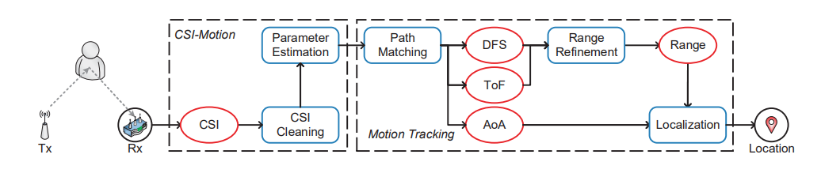
15
Introduction
System overview
First, they build a unified model for simultaneous and joint estimation of multiple parameters including ToF, AoA, DFS, and attenuation.
Second, they configure how to automatic calibrate CSI phase noises.
Third, The way of derive locations from unmatched parameters.
Notes:
세번째 언매치드가 무엇인가?
여기에대해서 설명필요

Slide 17



17
Architecture and Algorithm
CSI Model
Multipath problem : the received signal is multipath parameters are cluttered together.
is the signal of the l-th path. and is propagation delay and complex attenuation factor of l-th path. N is the complex white Gaussian noise capturing
Wi-Fi NICs(Network Interface Controller) measure channel discretely in time(packet), frequency(subcarrier) and space(sensor).
i-th packet, j-th subcarrier and k-th sensor as H(i, j, k) and H(0, 0, 0) as reference.
The signal phase of the l-path in H(i, j, k) is transformed as :
=
ToF
AoA
DFS
Notes:
와이파이 네트워크 컨트롤러는 패킷, 프리퀀시 그리고 센서에따라서 채널을 측정하는데
이 l번째 패스에대한 시그널 페이즈는 아래와 같은식으로 바꿀수 있다.
여기서 타우 L은 ToF을 뜻하고 파이L은 AoA 에프디L은 DFS를 의미한다.
이거식 직접 수식입력으로 하자 프레젠테이션 키면 화면이 문제가 있다

Slide 18



18
Architecture and Algorithm
Parameter Estimation
denoted multidimensional l-th path signal parameter.
is MLE(Maximum Likelihood Estimation) is formulated as :
And the MLE of big theta is the solution that maximizes Λ:
Notes:
Big theta
설명하는게 중요
Hm 에서 pl을 빼면 나머지 부분이 남는데 그게 최소가 되는 값이 되어야 빅세타가 최대가 된다 왜냐하면 마이너스가 붙기때문
더 자세한부분 설명필요

Slide 19

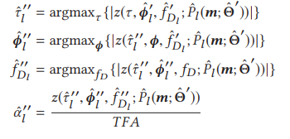

19
Architecture and Algorithm
SAGE Algorithm
SAGE(Space-Alternating Generalized Expectation-Maximization) Algorithm is generalized version of EM algorithm.
E – step : decompose CSI and calculate each multipath signals with the parameters estimated in the last iteration.
M – step : SAGE searches for the optimal parameters with minimal error using the multipath signal estimate and calculated in E-step

Slide 20

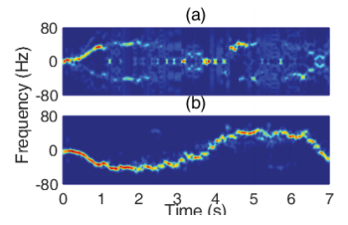
20
Architecture and Algorithm
CSI Cleaning
CSI contains not only channel response, but also various unknown phase noises.
The erroneous version of CSI measurement H(m) is:
To adapt linear calibration is impossible. Because the reflected signal to body is much weaker than static signal.
So, in this work, they adopted different solution which is conjugate multiplication.
a) linear calibration result
b) conjugate multiplication
Notes:
클리닝 저위에 hm이 물결표가 붙은건가 아닌가
저뒤에 e의 2파이부분이 대충 무엇을 나타내는지 설명을 해야한다

Slide 21
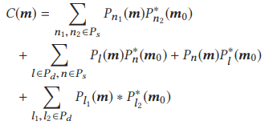
21
Architecture and Algorithm
Conjugate Multiplication
They observe phase noises is only changes with time and frequency.
So, choose one antenna as reference and conjugate multiplication between reference and other antenna each.
Further, classify multipath into static signals and dynamic signals.
S is static d is dynamic.
Target
This target term is same structure with Original CSI structure then It can be used in SAGE algorhytm.
Notes:
여기 컨쥬게이트를 하게되면 어떻게 된느가
피라는 그룹의 정확한 데이터값이 어떻게 되는가 데이터의 묶음? 서브케리어들의 묶음을 이야기하는가? 그룹이라고 표현이 되어있는데 정확한 표현을 알수가 없다.
따라서 이부분을 찾아봐야한다
가운데 타겟부분을 찾는것 중요한데 저기에 타겟옆에것은 어떻게 지우는가?
타우부분이 마이너스가 되긴하는데 지우는 방법을 모르겠다 코드를 참고하자

Slide 22
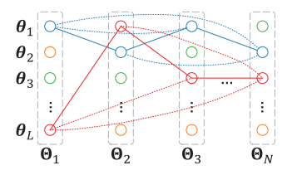
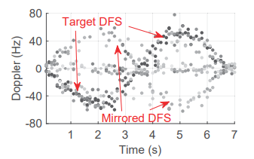
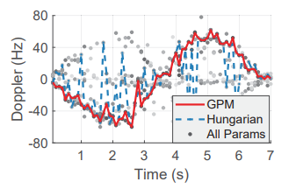
22
Architecture and Algorithm
Path Matching
The graph has all multipath parameters are cluttering together.
Notes:
점의 색은 attenuation(감쇠)에 따라 색이 다르다.
그래프 저거 그리는 방법을 표현해보자
하나하나 순서대로 그림이 나오는 방식으로 표현을 해보자
어떤데이터가 저기에 들어가고 그 선을 잇는 방식을 표현해보자 한 세장정도로 세분하여 나타내야 가능할 것이다
또한 헝가리안 알고리즘과 비교를 했는데 이부분에 대해서도 좀더 공부를 해야한다
헝가리안과 이것의 차이점이 있어야 저 우측그래프의 차이점도 표현이 가능하다

Slide 23
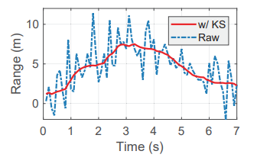
23
Architecture and Algorithm
Range Refinement
Theoretically, the relative range between the reflection path and the LoS path can be calculated by multiplying estimated ToF with the speed of light.
But, It has many fluctuation only using estimated ToF.
It apply Kalman Smoother to refine ranges from ToF estimations with the change rates of path range from DFS estimations.
Notes:
DFS를 통하여 속도를 가늠할수 있다. 이를통해 path range의 변화율을 추정할수있는데 칼만스무서를 통하여 변동이 덜한 거리를 구할수 있다.
칼만스무서를 좀더 찾아보자
레인지는 tof를 가지고 계산해서 만든게 맞는데 거기에 칼만스무스에 어떻게 속도에 관한식이 추가가 되는가?

Slide 24

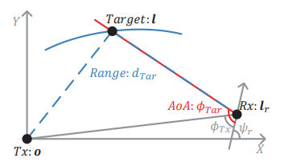

24
Architecture and Algorithm
Localization
They find the range which refined and angle of the receiver and target.
So, By calculating inversely, Finally it can estimate the target’s location.
Notes:
여기는 딱히 추가할점이 없는듯?

Slide 25
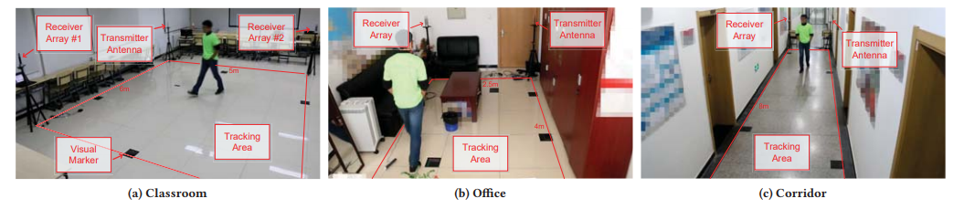
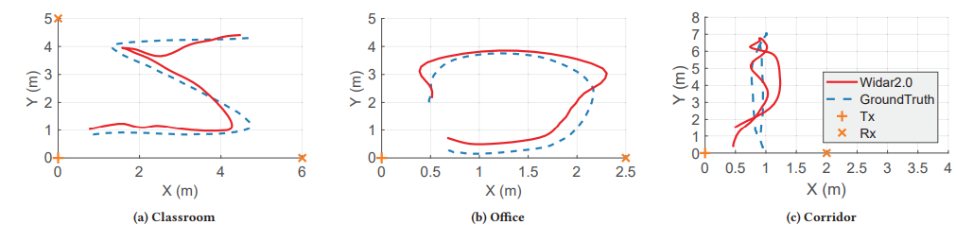
25
Experiment
The way of experiment
3 scenarios : Classroom, Office, Corridor
Notes:
실험내용 설명만 하면될듯

Slide 26
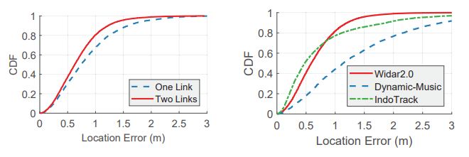
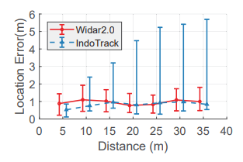
26
Experiment
Overall Performance
Over all performance of this work’s accuracy is 0.75m in one link and 0.63m in two link
Compared with other early proposed works Widar2.0 is better overall then Dynamic-Music. And, in long distance, Widar2.0 is better than IndoTrack.
IndoTrack is WiFi based, using parameters AoA, DFS and accuracy is 0.48m.
But, It uses more infrastructure devices then Widar2.0 (1 additional receiver and 2 more links)
Notes:
여기도 딱히 설명할게 없긴한데 인두트랙에 대해서 좀더 설명이 ㅁ필요하다

Slide 27
27
Conclusion
Conclusion and Limitation
Achievements.
A unified model of ToF, AoA and DFS.
Average error 0.75m with single Wi-Fi link.
Using two link, it reduced to 0.63m.
Limitation of this work.
Multi-person problem : hard to separate reflect point in CSI.
Non-LoS condition problem : reflection signal is too weak to recognize in Non-LoS condition.
Notes:
여기도 딱히 없는듯
멀티퍼슨 조건에 관하여도 필요함

Slide 28

THANK YOU

