Slide 1
Infra WIFI Indoor localization: Multiverse with 0 speed
20131329 신선우

Slide 2

1
CONTENTS
1. Motivation and Previous Work
2. System Overview
3. Implementation and Experiments
4. Evaluation
5. Conclusion

Slide 3
2
Introduction
Introduction
There has been a long and rich history of WiFi-based indoor localization research.
Each works have trade-off. So, to reduce limitation and increase advantage, Many studies have used various combinations.
Client-base
Localization
Server-base
Localization
Fingerprint
Localization
Model-base
Localization
Etc.
Dheryta Jaisinghani, Rajesh Krishna Balan, Vinayak Naik, Archan Misra, Youngki Lee
2018, Experiences & Challenges with Server-Side WiFi Indoor Localization Using Existing Infrastructure

Slide 4
3
Introduction
Introduction
Client-base
Localization
Client-base methods tend to have the highest accuracy. Users can actively send out RF(Radio-Frequency) signal to locate them when they want to.
But, It have to install specific programs to a user’s device or modify OS.
Server-base
Localization
Server-base methods tend to have more inaccuracy then client-base. But, It don’t need to modify user’s devices.
The system can only ‘see’ sended unmodified signal. So, It works with passive way.

Slide 5
4
Introduction
Introduction
Fingerprint
Localization
Fingerprint methods is pre-mapping the real space and specific data(ex: RF-signal).
And matching the map and a newly accepted signal data to find where the signal located.
This way is easy to integrate compared with model-base. But, It need to pre-mapping before process.
Model-base
Localization
Model-base method analyzes signals that are complex parameters and based on them, perform localization.
This method analyzes a signal that combines the time the signal reaches, the strength of the signal, and so on in many ways to derive a general result.
This way is hard to implement. Because constructing model and analyzing signal is too complex.

Slide 6
5
Multiverse trajectory trace
Introduction
In previous work, it choose ‘server-base localization’ and ‘fingerprint localization’. Also, it implement new idea concept which is ‘Multiverse trajectory trace’.
Server-base
Localization
Fingerprint
Localization

Slide 7
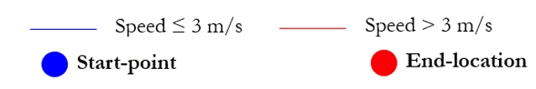
5
Multiverse trajectory trace
Introduction
The work adopt human walking pattern by trajectory trace. Which is connecting all points of probable location to the true location. And discard impossible trajectory.

Slide 8
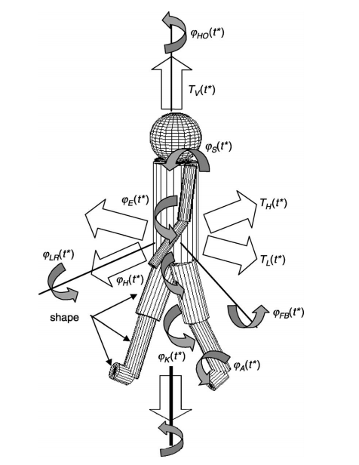
5
Limitation
Introduction
The Multiverse is attractive approach which makes more accuracy then old works.
But, it has limitation which assume that human’s walking speed is consistent with all trajectory path.
In real world, human can stop at some point and walking again.
So, I try to improve this Multiverse algorithm with 0 speed.
van Dorp, Ph, and F. C. A. Groen., "Human walking estimation with radar." IEE Proceedings-Radar, Sonar and Navigation, 150.5, pp. 356-365., 2003.

Slide 9
5
System Overview
Introduction
RSSI DATA
(AP_name, RSSI value)

Slide 10
5
System Overview
Introduction
RSSI DATA
(AP_name, RSSI value)
Offline Fingerprint
Mapping
Online Fingerprint
Raw Data

Slide 11
5
System Overview
Introduction
RSSI DATA
(AP_name, RSSI value)
Offline Fingerprint
Mapping
Online Fingerprint
Raw Data
Location Estimate
Matching
Offline-Online

Slide 12
5
System Overview
Introduction
RSSI DATA
(AP_name, RSSI value)
Offline Fingerprint
Mapping
Path Tree Constructor
Online Fingerprint
Raw Data
Location Estimator
Tree Filtering

Slide 13
5
System Overview
Introduction
Trajectory Path
RSSI DATA
(AP_name, RSSI value)
Offline Fingerprint
Mapping
Path Tree Constructor
Online Fingerprint
Raw Data
Location Estimator
Tree Filtering

Slide 14
2
Path Tree Constructor
Possible
Location
Path Tree
Constructor
Possible
Path
Time Line
t0
t1
t2
t3
t4
t5
0
0
Both Filter
Filtering impossible speed
And hang around behavior fluctuating.
Previous work’s Compressor Can occurred removing stand state position
Also, speed filter pass 0 speed which can permit adding same location and it has more narrow speed allowed.
Speed Filter
1
2
1
2
3
4
6
3
4
6
12
27
6
Hang around
Filter
12
27
6
12
37
6
12
37
6
29
72
51
29
72
51

Slide 15
2
Comparing Compressor vs New Filtering
Path Tree Compressor
Number of Path
New Filtering
Previous work reduce a lot of path every 5sec.
This work with combine all adjacent node with one node.
It causes delete stand state. So, in new filtering didn’t this step.
Stand with 6time path
Non-stop walking path

Slide 16
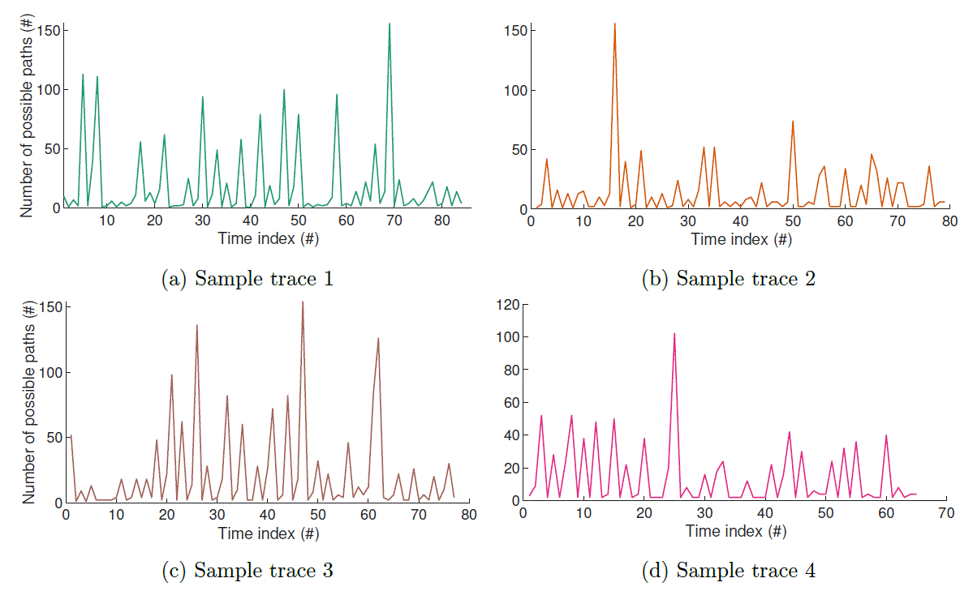
2
Comparing Compressor vs New Filtering
Path Tree Compressor

Slide 17
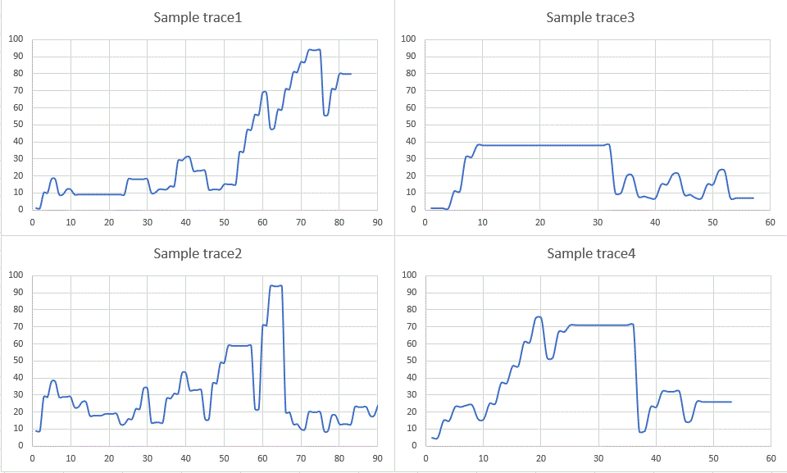
2
Comparing Compressor vs New Filtering
New Filtering
Number of
Possible path
Number of
Possible path
Time Index number

Slide 18
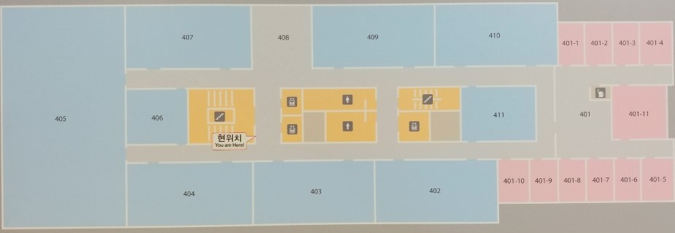
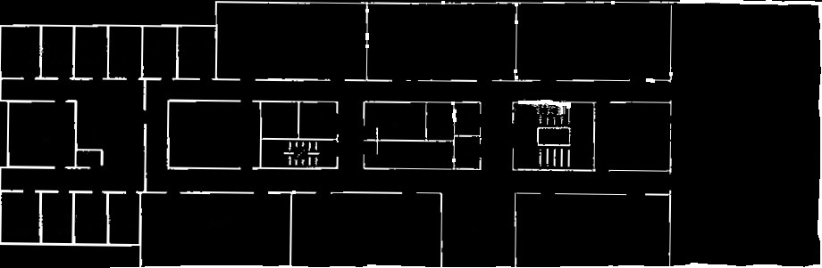
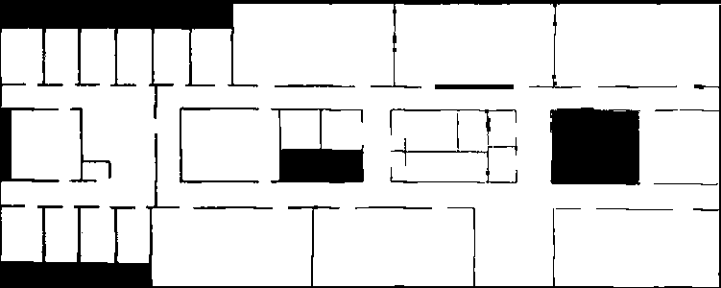

2
Map Processing Building 106 floor 4
In Fingerprinting base localization, Firstly, It have to need image map to fingerprinting.
By MATLAB function rgb2gray and im2bw, convert camera image to grayscale image and binarize image.
By python, flip the image bit and make image to node grid.

Slide 19
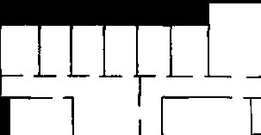
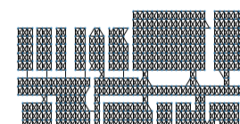
2
Map Processing Building 106 floor 4
Firstly, Grid map converted as graph nodes.
Secondly, All node liked with adjacent nodes.
If there is wall then didn’t linked.
This method can prevent checking impossible trajectories by only linking these nodes.

Slide 20
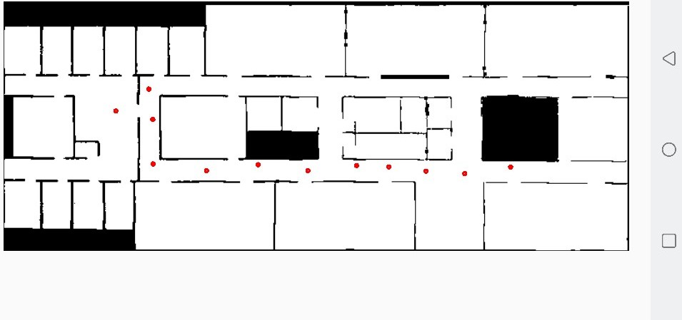
2
Android Application
In early exist research ‘1)’, Scan signal is the most suitable signal in WIFI indoor localization.
Because, The signal is the strongest signal and stable.
But, It makes hard to make fingerprint in real world.
Our device don’t send signal as we want.
So, I have to develop android application which send a scan signal manually.
1)Dheryta Jaisinghani, Rajesh Krishna Balan, Vinayak Naik, Archan Misra, Youngki Lee
2018, Experiences & Challenges with Server-Side WiFi Indoor Localization Using Existing Infrastructure

Slide 21
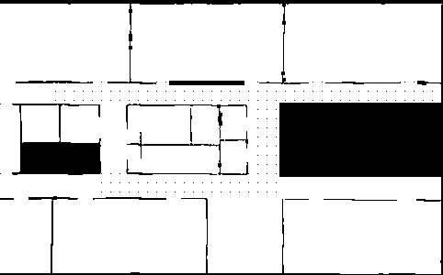

2
Possible Location Estimation
Find each ap’s signal location. And find common ground points.
But this process need to discard less then -86 RSSI. ’1)’ in this paper if RSSI is less then -86 then it has high possibility to loss WIFI connection. So, I discard too weak RSSI.
Common Ground
1)Dheryta Jaisinghani, Rajesh Krishna Balan, Vinayak Naik, Archan Misra, Youngki Lee
2018, Experiences & Challenges with Server-Side WiFi Indoor Localization Using Existing Infrastructure

Slide 22
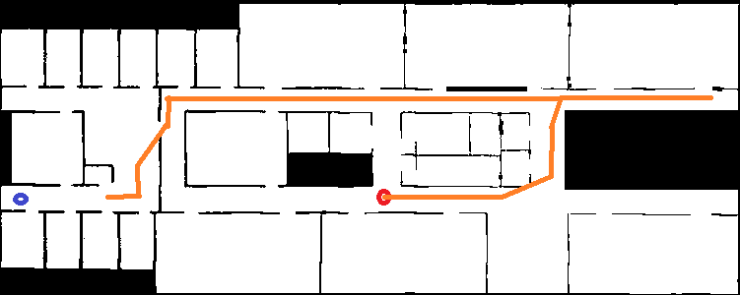
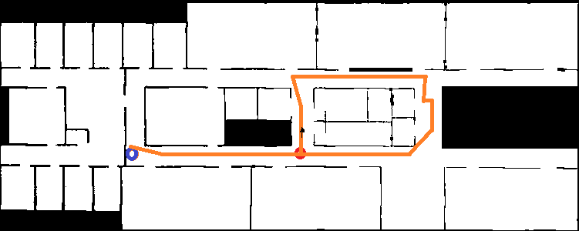
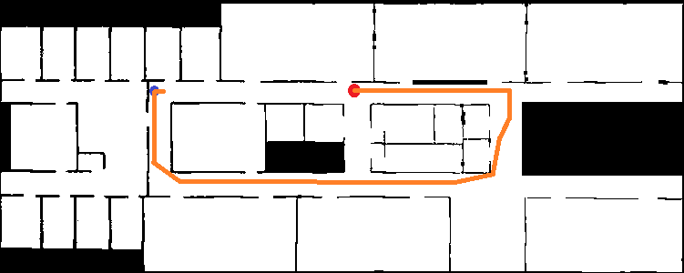
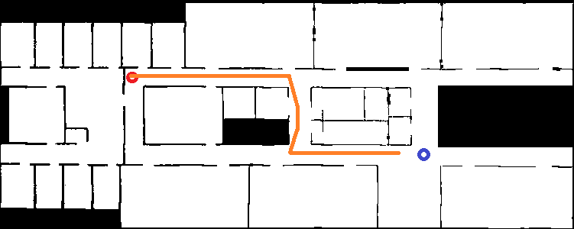
2
Result of Path
Walking path 1 and 2
Walking Standing
Combination path 1 and 2
Start Point
End Point
Estimated Path
Ground Truth

Slide 23
2
0 Speed Result
Walking Standing
Combination path 1 and 2
Configure Standing position is almost same.
In above path, the matching with real and estimated path in standing point is perfectly matched.
In below path, the matching has only difference with 2sec’s time reg.
Start Point
End Point
Estimated Path
Ground Truth

Slide 24

2
0 Speed Result
This is the image of last candidate to select.
Most of data is same with small difference

Slide 25

2
Selecting Last Path
To select one last path, I used consistency of speed in multipath.
In previous work, Original Multiverse, it used speed consistency in path compressor step.
But it is not much affect to my paths. And it takes a lot of calculation.
So, I this concept to select Last Path.
Without this concept, the result is quit different through all paths.
<- Most max standard deviation of node
<- Most min standard deviation of node

Slide 26
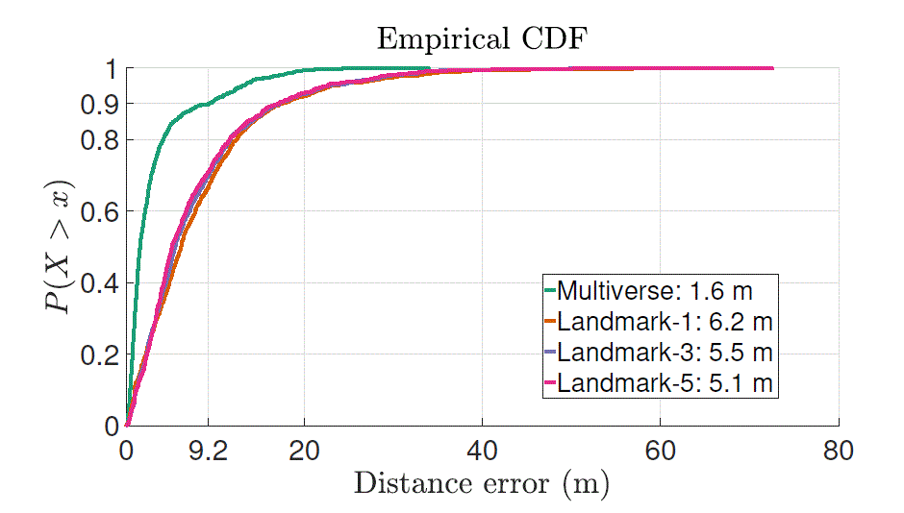
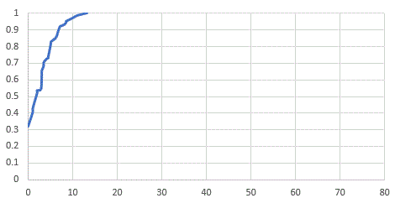

2
CDF of Point wise difference
Original CDF of Point wise error
New CDF of Point wise error

Slide 27
2
Conclusion
The achieved mean accuracy [~ 1.6m]
Previous one’s mean accuracy [~ 1.6m]
The achieved 90% accuracy [~ 6.8m]
Previous one’s 90% accuracy [~ 9.2m]
The short 0speed is hard to figure out.
This experiment is assumed we know start point.
The heterogeneous device can bring different accuracy.

