Slide 1

1
CONTENTS
1. Map processing Building 106 floor 4
2. Android Application
3. Extra Data collection

Slide 2
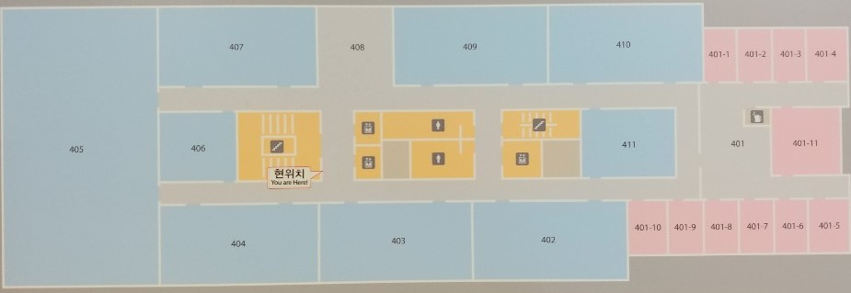
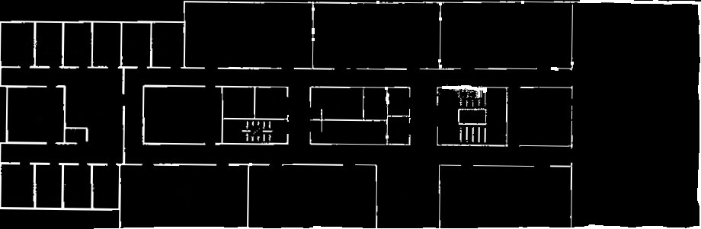
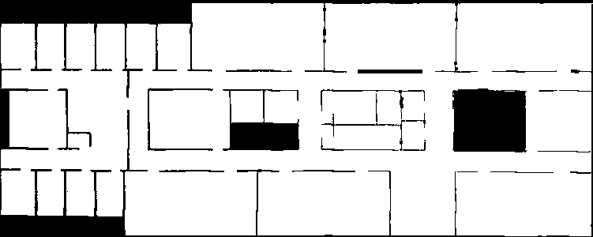

2
Map Processing Building 106 floor 4
In Fingerprinting base localization, Firstly, It have to need image map to fingerprinting.
By MATLAB function rgb2gray and im2bw, convert camera image to grayscale image and binarize image.
By python, flip the image bit and make image to node grid.

Slide 3
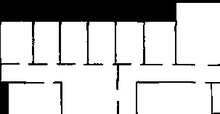
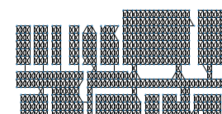
2
Map Processing Building 106 floor 4
Firstly, Grid map converted as graph nodes.
Secondly, All node liked with adjacent nodes.
If there is wall then didn’t linked.

Slide 4
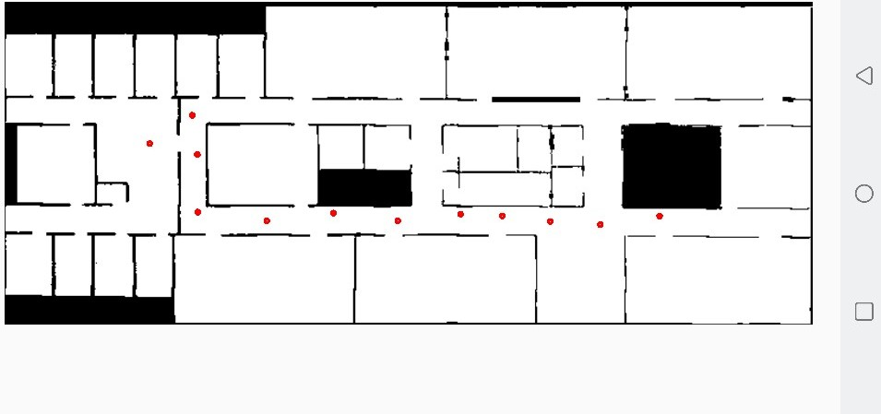
2
Android Application
In early exist research ‘1)’, Scan signal is the most suitable signal in wifi indoor localization.
Because, The signal is the strongest signal and stable.
But, It makes hard to make fingerprint in real world.
Our device don’t send signal as we want.
So, I have to develop android application which send a scan signal manually.
1)Dheryta Jaisinghani, Rajesh Krishna Balan, Vinayak Naik, Archan Misra, Youngki Lee
2018, Experiences & Challenges with Server-Side WiFi Indoor Localization Using Existing Infrastructure

Slide 5
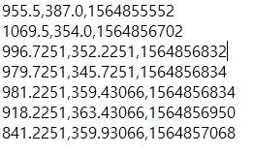
2
Android Application
It scanning as it run and record point’s x,y coordinate and epochTime by tap screen.
The data save as txt file with (x,y,epochTime) form.

Slide 6
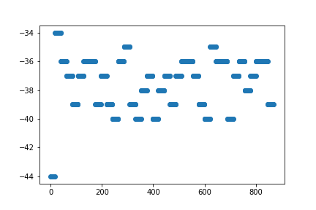
2
Extra Data collection
To know difference of wifi signal, find tendency of standing same position and to test my android app.
Collected extra information.
Nothing to do 1hour with screen off
RSSI difference biggest is 10, discard top value and bottom value then difference is 5
There is no ‘Heard by’ value. Only few data have one ‘Heard by’ value.

Slide 7
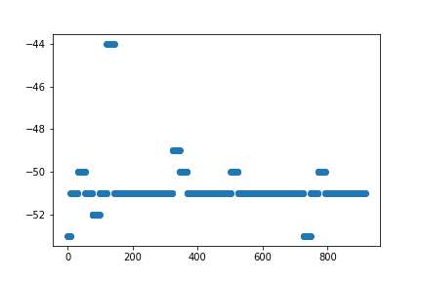
2
Extra Data collection
2. Streaming 1 hour.
Experiment with youtube live streaming.
RSSI difference biggest one is 9 and ignore peak value then score 4. The most stable data which I collect.
‘Heard by’ value is also recorded few number.
Connection Score all recorded 60%. In other experiment there is a lot of 1 or 3 percent value.
By this, If there is data transform Connection Score value goes high. Also, Spatial Stream value shows same tend.

Slide 8
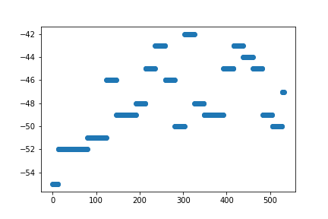
2
Extra Data collection
3. Scanning 30min
Using app scanning 30min.
Difference of signal is 13 regard bottom value then 10.
Full ‘Heard by’ value with 3 ap listen signal.

Slide 9

2
localization
Algorithm is constructed but have hard with offline fingerprinting.
Path construct with imaginary data.

