Slide 1

1
CONTENTS
1. Map processing Building 106 floor 4
2. Android Application
3. Extra Data collection

Slide 2
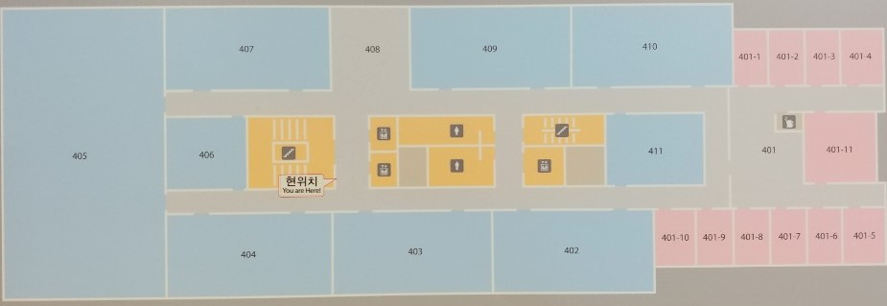
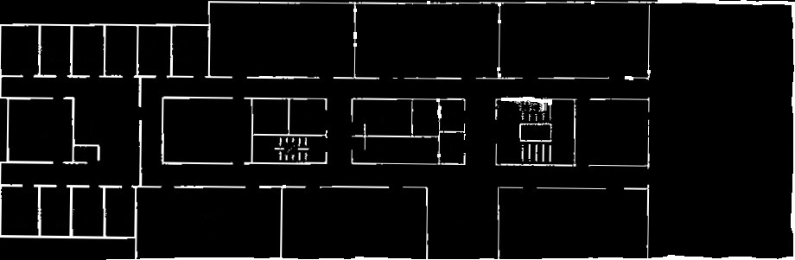
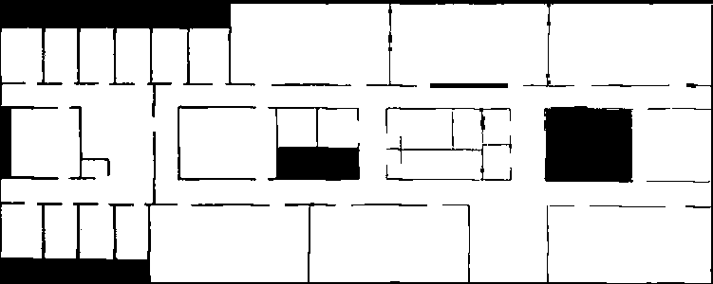

2
Map Processing Building 106 floor 4
In Fingerprinting base localization, Firstly, It have to need image map to fingerprinting.
By MATLAB function rgb2gray and im2bw, convert camera image to grayscale image and binarize image.
By python, flip the image bit and make image to node grid.

Slide 3

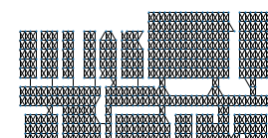
2
Map Processing Building 106 floor 4
Firstly, Grid map converted as graph nodes.
Secondly, All node liked with adjacent nodes.
If there is wall then didn’t linked.

Slide 4
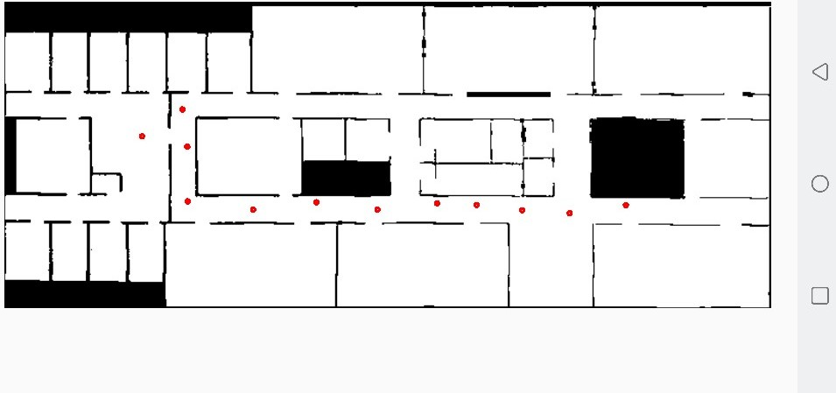
2
Android Application
In early exist research ‘1)’, Scan signal is the most suitable signal in wifi indoor localization.
Because, The signal is the strongest signal and stable.
But, It makes hard to make fingerprint in real world.
Our device don’t send signal as we want.
So, I have to develop android application which send a scan signal manually.
1)Dheryta Jaisinghani, Rajesh Krishna Balan, Vinayak Naik, Archan Misra, Youngki Lee
2018, Experiences & Challenges with Server-Side WiFi Indoor Localization Using Existing Infrastructure

Slide 5
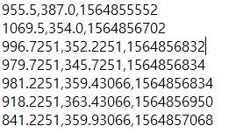
2
Android Application
It scanning as it run and record point’s x,y coordinate and epochTime by tap screen.
The data save as txt file with (x,y,epochTime) form.

Slide 6
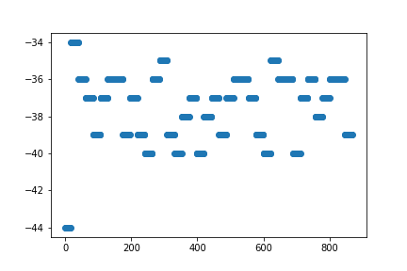
2
Extra Data collection
To know difference of wifi signal, find tendency of standing same position and to test my android app.
Collected extra information.
Nothing to do 1hour with screen off
RSSI difference biggest is 10, discard top value and bottom value then difference is 5
There is no ‘Heard by’ value. Only few data have one ‘Heard by’ value.

Slide 7
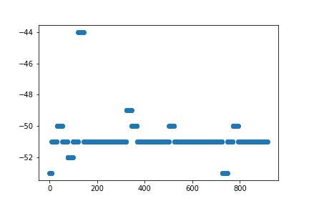
2
Extra Data collection
2. Streaming 1 hour.
Experiment with youtube live streaming.
RSSI difference biggest one is 9 and ignore peak value then score 4. The most stable data which I collect.
‘Heard by’ value is also recorded few number.
Connection Score all recorded 60%. In other experiment there is a lot of 1 or 3 percent value.
By this, If there is data transform Connection Score value goes high. Also, Spatial Stream value shows same tend.

Slide 8
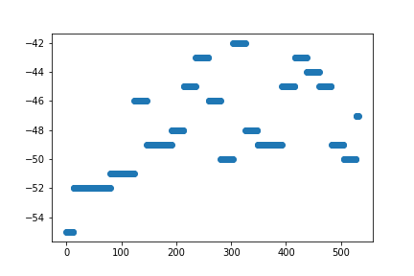
2
Extra Data collection
3. Scanning 30min
Using app scanning 30min.
Difference of signal is 13 regard bottom value then 10.
Full ‘Heard by’ value with 3 ap listen signal.

Slide 9
2
Extra Data collection
4. WIFI off test.
To figure what happen if user shut down wifi signal.
Then the Controller keeps connection with user’s device for 5 miniutes.
By this factor, the controller keeps high connection score for few miniutes if there is no data transport.
5. WIFI controller data update time check.
Until 4th test, data collecting period is 4s. To find how often it update data, I reduce collecting period to 1s.
Most of data have 2s period but there is few change in 1s.
So, It is estimated that 1s data collection will be more accurate.

Slide 10
2
교수님면담 내용
테스트용 패스도 스캔시그널로 측정
패킷을 상황별로 나누어 tendency 분석해보기 -> 스캔시그널이아닌 일반 상황에서도 찾는게 가능하도록
AP가 주기적으로 alive check 패킷을 보내는데 이 주기를 측정해 보는것.
이용자 수에 따른 rssi 변화량 체크
새 알고리즘을 만들어보기, 아래 방법들을 비교하여 보여주기
1. 실시간 위치추적
2. 누적데이터로 패스이용하여 어큐러시를 높이는 방법 ex) 5min past, 15min pase, 30min past, etc…
3. 어큐러시가 높은 미래의 위치를 이용하여 이를 역산하여 과거의 위치의 정확도를 높이는법

