Slide 1


Slide 2
Introduction
Recommender systems
Recommender System models provide personalized recommendations based on user’s profile and interest.
It not only help the user find the best item/movie but also bring potential profits to online service providers like Netflix, Amazon, YouTube.
Applied in variety of applications like movies, songs, research articles, books, etc
Motivation:
Challenging for the users to select which movies to watch given millions of movies.
Recommender systems minimizes the options based on the user’s profile and interest thereby reducing the need for the user to scroll a bunch of website pages.
Applied traditional as well as Deep Learning architectures for efficiently finding the best-matched movies to watch.

Slide 3
Dataset and Features
We have used MovieLens Datasets by GroupLens
This dataset consists of:
100,000 ratings (1-5) from 943 users on 1682 movies.
Each user has rated atleast 20 movies.
There are two files which consist of features like:
u.data -> user_id, movie_id, ratings, timestamp
u.item -> movie_id, title, release_date, genre, imdb_url
Source Link - https://grouplens.org/datasets/movielens/100k/

Slide 4
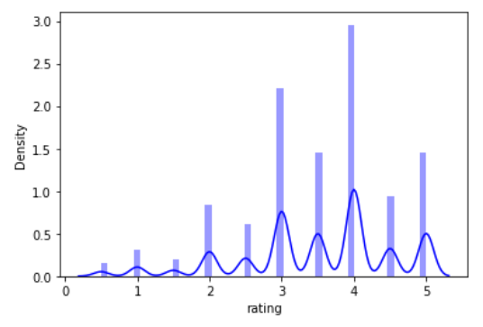
Exploratory Data Analysis
How are the ratings distributed?
The average rating is 3.9.
Majority of the users give ratings of 3 and 4.
Users usually tend to give higher ratings.

Slide 5
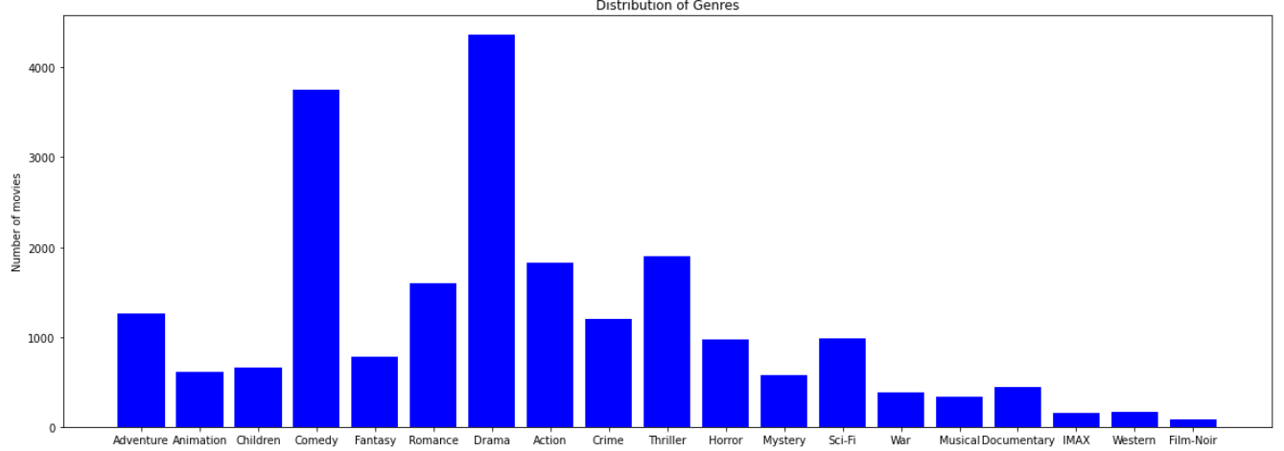
Exploratory Data Analysis

Slide 6
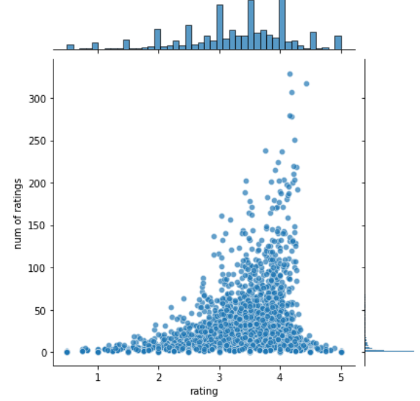
Exploratory Data Analysis
The plot shows that as the rating increases, the number of ratings of that movie also increases.
In addition to it, the figure clearly depicts the movies which have been rated by very few people by isolated dots (ends of the x-axis).

Slide 7
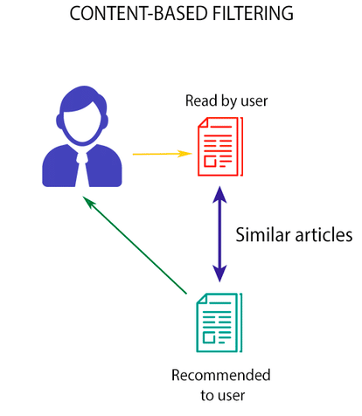
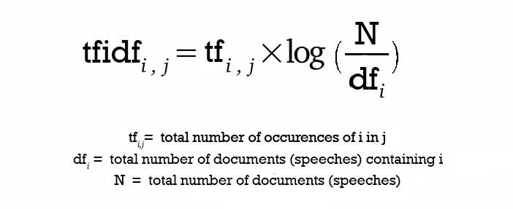
Methodology
Content-based filtering (Traditional Method)
Recommend new movies based on similarity in
movie features like Genre.
Used term-frequency/inverse-document-frequency
(tf-idf) weighting technique.
Cosine similarity is used to find similar movies by
computing dot product on the non-zero vectors.
Cold-Start problem is resolved.

Slide 8
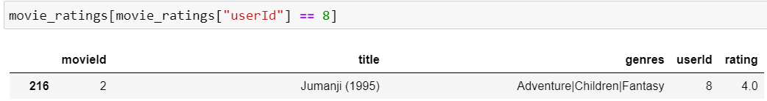
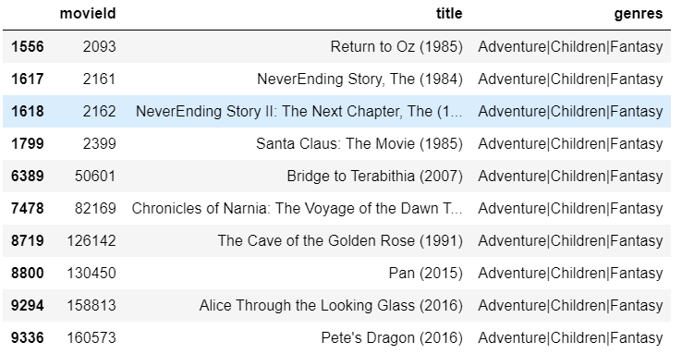
Results
Recommendations

Slide 9
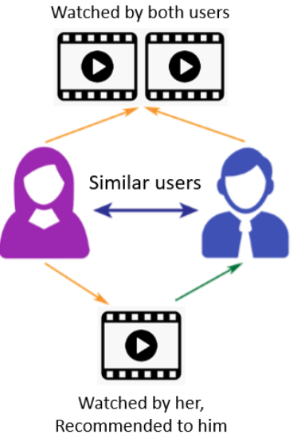
Methodology
Collaborative-based filtering (Deep Learning)
Finds similar users to the concerned user and
recommends new movies similar users liked
or rated.
Utilize the underlying structure of users’ preference.
Popular methods in collaborative filtering
Item-Item filtering
User-item filtering

Slide 10
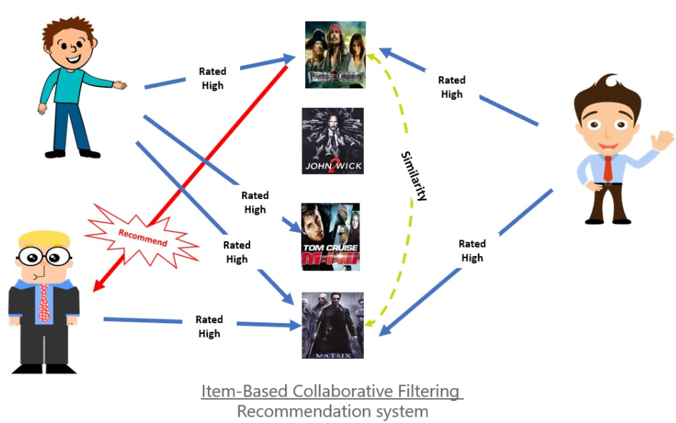
Methodology
Item-item based collaborative filtering

Slide 11
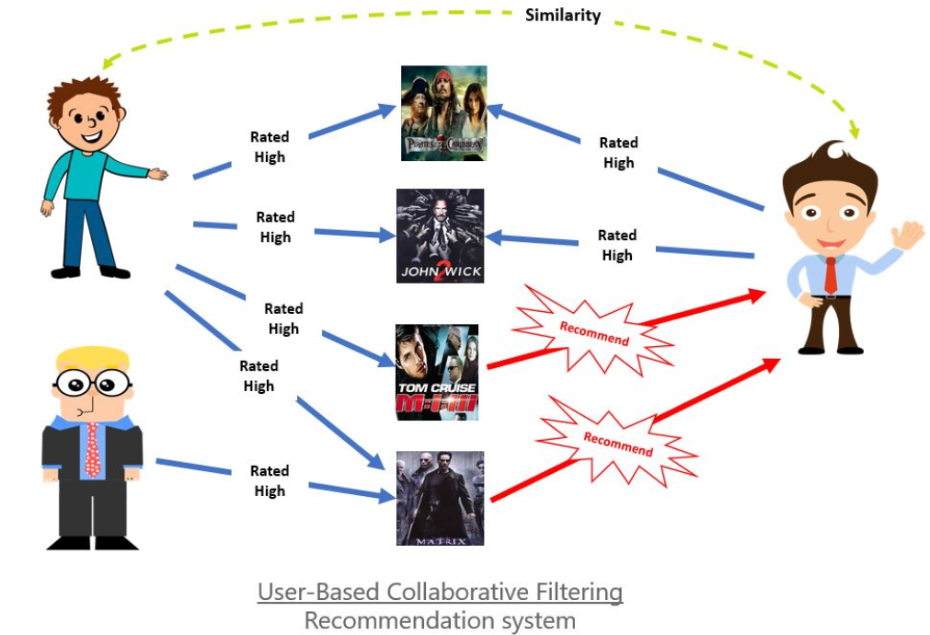
Methodology
User-item based collaborative filtering

Slide 12
Deep Learning
We implement the Neural Collaborative Filtering (NCF) which is a fusion of:
GMF (Generalised Matrix Factorization)
MLP (Multi Layer Perceptron)
We compare the three methods NCF, MLP and GMF and tune the hyperparameters.
The paper focuses on implicit feedback which indirectly reflects user preference through behaviours such as click or videos watched.
The paper explores the central theme of how to utilise deep neural networks to model noisy implicit feedback signals.

Slide 13
Methodology
Implement a neural network architecture to model the latent feature of users and items and create a general framework NCF for collaborative filtering based on DNN.
We show that Neural Collaborative Filtering performs better than GMF and MLP .
Using pretrained models and the pretrained user embedding and item embedding, the prediction increases.
We use two different metrics to measure the performance of the model:
Hit Ratio: 1 if the test item is present in the top K predicted items.
NDCG: measure of ranking quality.Mathematically, defined as log(2)/log(2+i), where i is the rank of the item in topK predictions.

Slide 14





Preliminaries
Assuming , M be the number of user and N be the number of items (movies). Based on the paper, the user item interaction matrix, from user’s implicit feedback is defined as :
Here a value of 1 for for indicates there is an interaction between user and item; however it does not mean u likes i .
The recommendation problem with implicit feedback is formulated as the problem of estimating the scores of observed entries in Y, which are used for ranking the items.
Where - predicted score of the interaction,
- the model parameters
where yˆui denote

Slide 15






Generalized Matrix Factorization
User and item are encoded as one -hot vector representation
The mapping function of the first neural layer is defined as:
Where, = (latent user vector) and = is the latent item vector.
Finally, the vector is projected to predict the score:

Slide 16
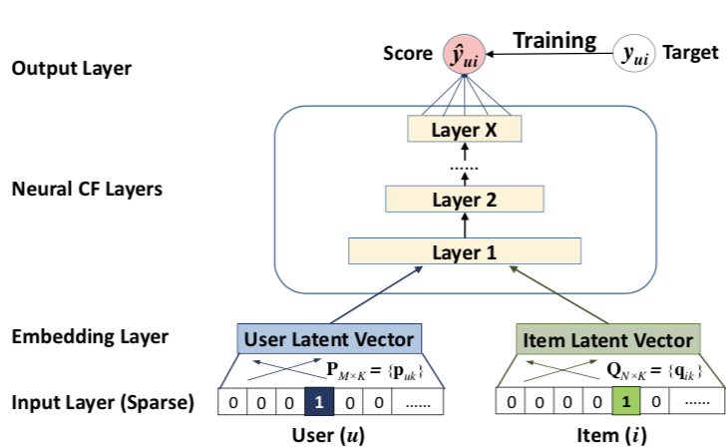

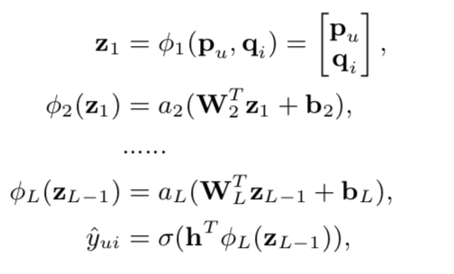
Multi-Layer Perceptron
Hidden layers on the concatenated vector
provide flexibility and non-linearity to learn
the interaction function between
Mathematically,

Slide 17
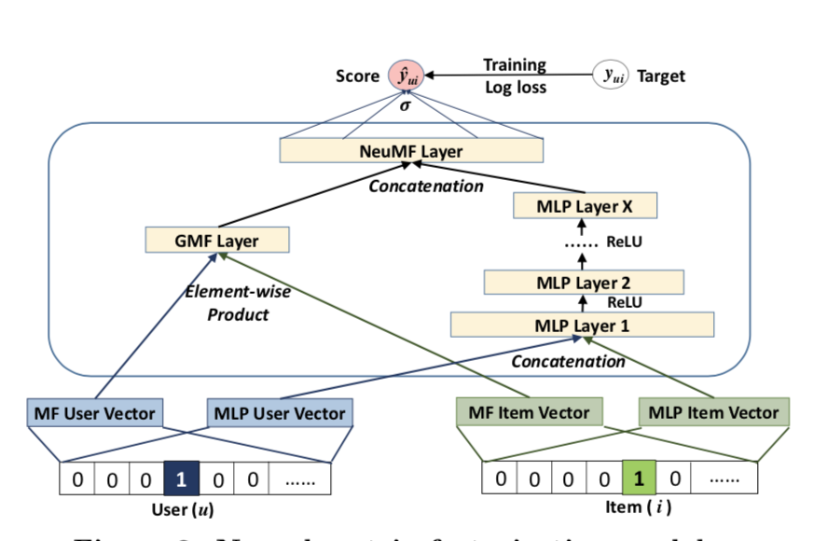
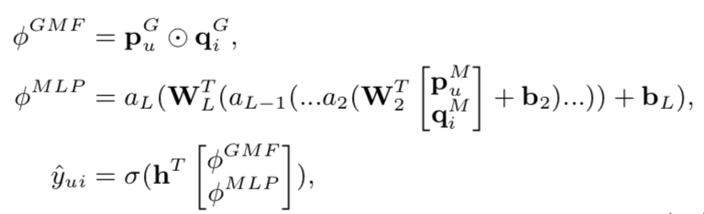
NCF (Fusion of GMF and MLP)
Both MLP and GMF share different embeddings and
we combine the two models by concatenating
the last layer.
The formulation is as follows:

Slide 18
Training Procedure
We select the training as (u,i) pair. For every (u,i) interaction pair, we randomly select 4 negative sampling for the user u (movies that the user has not interacted).
Optimized using Binary Cross Entropy Loss
For test data, we use leave-one-out evaluation method:
For each user, we held out the latest interaction as the test set and utilized the remaining data for training
We rank the test set among the randomly sampled 100 items that are not interacted by the user
The performance of a ranked list is measured by Hit Ratio and NDCG
Optimized using Binary Cross Entropy Loss
We have used two different architecture for MLP and NCF to evaluate the performance.

Slide 19
Training Procedure Contd
We have used two architecture combinations [16,64,32,16,8] and [16,32,16,8] to assess the performance of the model.
We have also used different regularization coefficient , in addition to the architecture to assess the performance of the model.

Slide 20
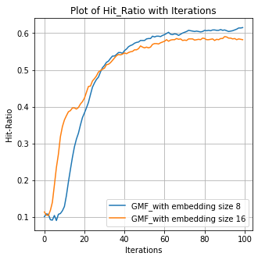
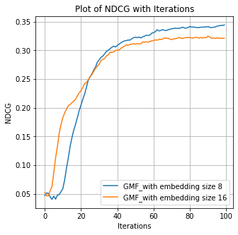
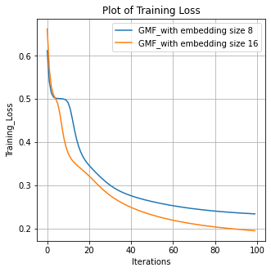
Experimental Results GMF
We experimented with two different embedding size for GMF:
Based on the graphs above, the evaluation metrics are higher for GMF with embedding size 8.

Slide 21
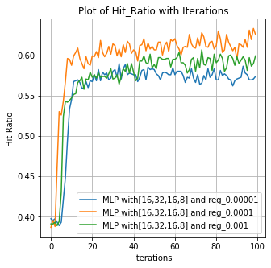
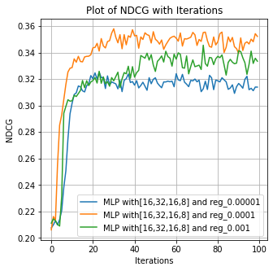
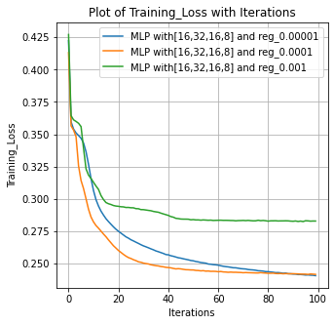
MLP- Trained from Scratch-Architecture 1[16,32,16,8]:
Architecture 1 works well with regularisation coefficient 0.0001

Slide 22
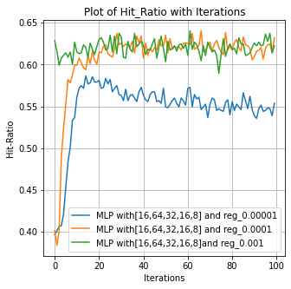
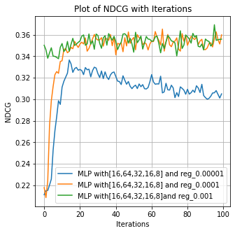
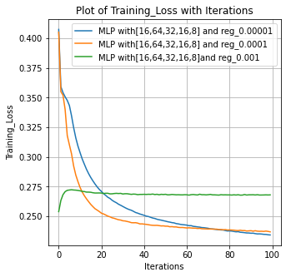
MLP-Trained From Scratch-Arc-2 [16,64,32,16,8]:
We can see that the algorithms works better for 0.0001 regularisation coefficient

Slide 23
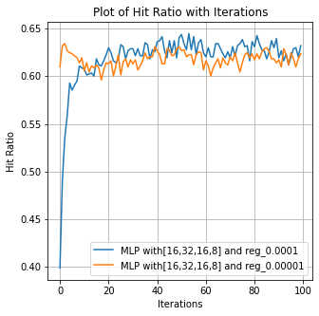
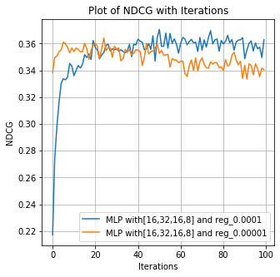
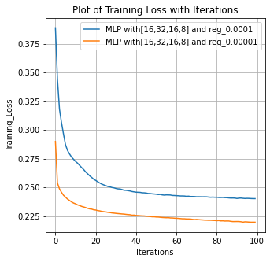
MLP- Pretrained from GMF embedding- Architecture 1
Based on the below graph, we can see the following architecture works well for 0.0001 regularisation coefficient

Slide 24
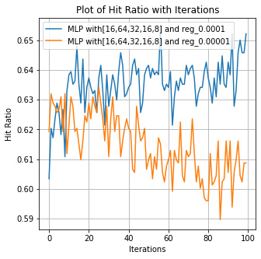
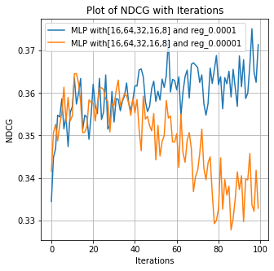
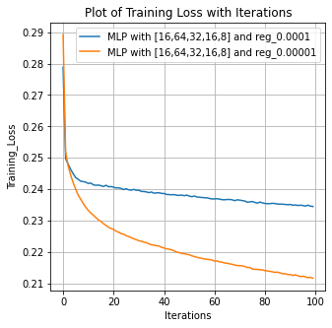
MLP- Pretrained from GMF embedding- Architecture 2
Based on the below graph, we can see the following architecture works well for 0.0001 regularisation coefficient

Slide 25
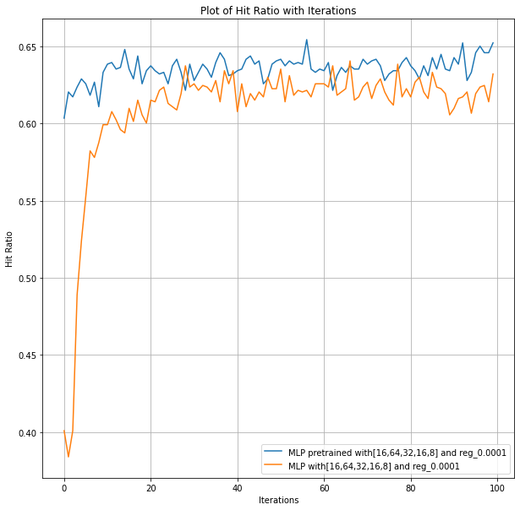
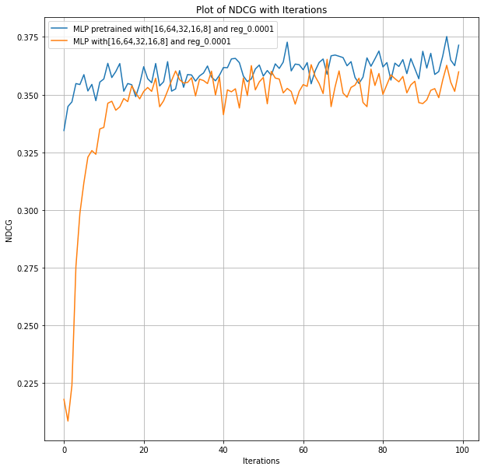
Comparison of pre trained-MLP vs MLP- from scratch
We have compared the pre trained-MLP for both the architecture 1 and 2 with regularisation coefficient 0.0001.

Slide 26
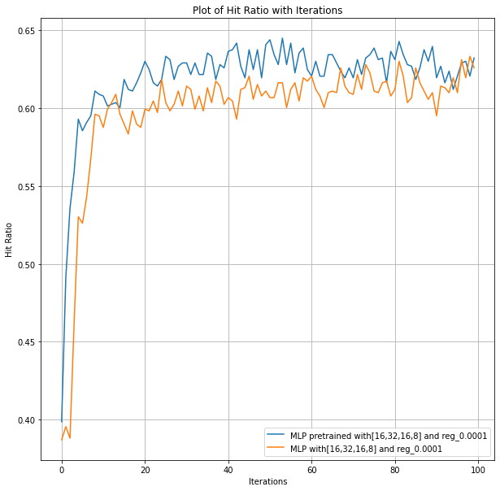
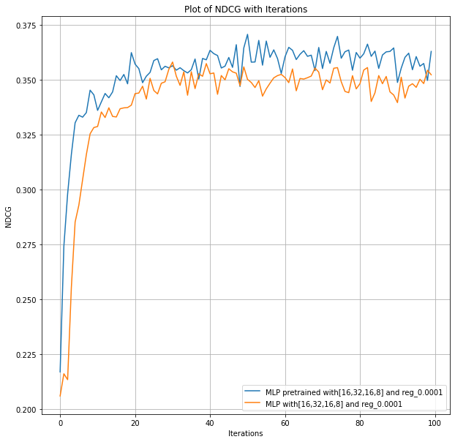
Contd.
We can pre training boosts the performance of the model.

Slide 27
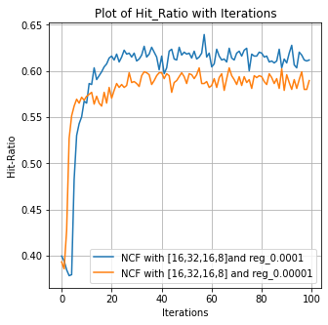
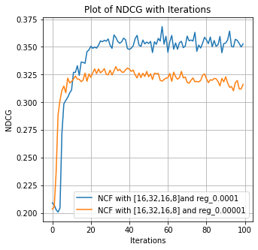
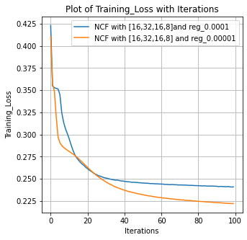
NCF from Scratch-Architecture 1
We see the performance is better for 0.0001 regularisation coefficient.

Slide 28
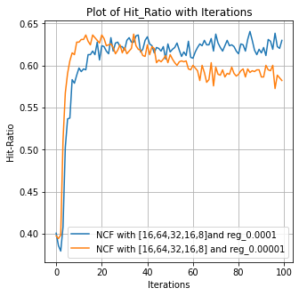
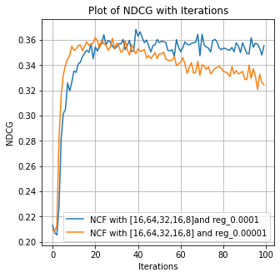
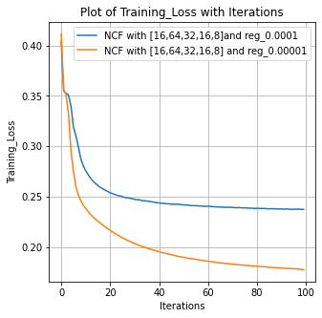
NCF from Scratch-Architecture 2
We can observe that the performance is better for 0.0001 regularisation coefficient.

Slide 29
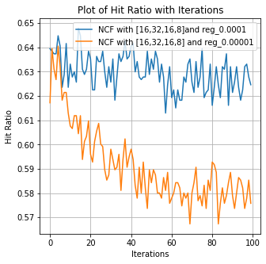
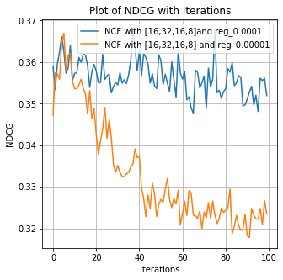
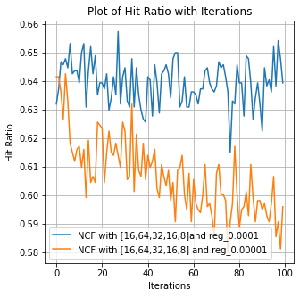
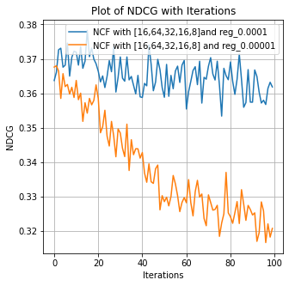
NCF pre trained using GMF and MLP for Arch-1 & 2
We can observe that the both the architecture work well for regularisation coefficient 0.0001.
We also can see that both the metrics NDCG and HitRatio are quite stable from the start of the iteration due to pretraining.

Slide 30
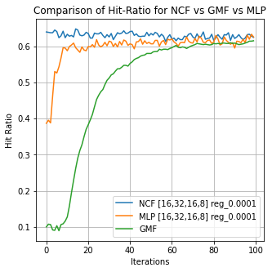
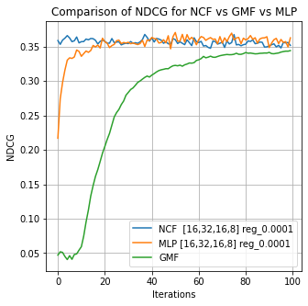
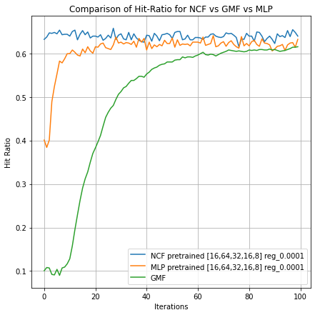
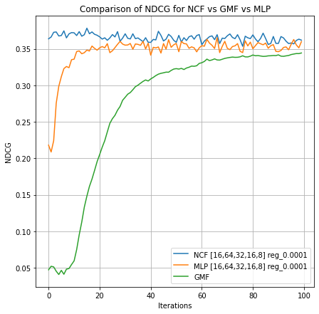
Comparison of NCF vs GMF vs MLP
We can observe that NCF works well for both the architecture better than MLP and GMF.
We can also observe that MLP works better than GMF due to the non-linear linearity and flexibility that MLP provides.

Slide 31
Reference
http://sumanthrb.com/ml/recommendation-techniques/
https://arxiv.org/abs/1708.05031
https://www.ijcai.org/Proceedings/2018/0308.pdf

