Slide 1
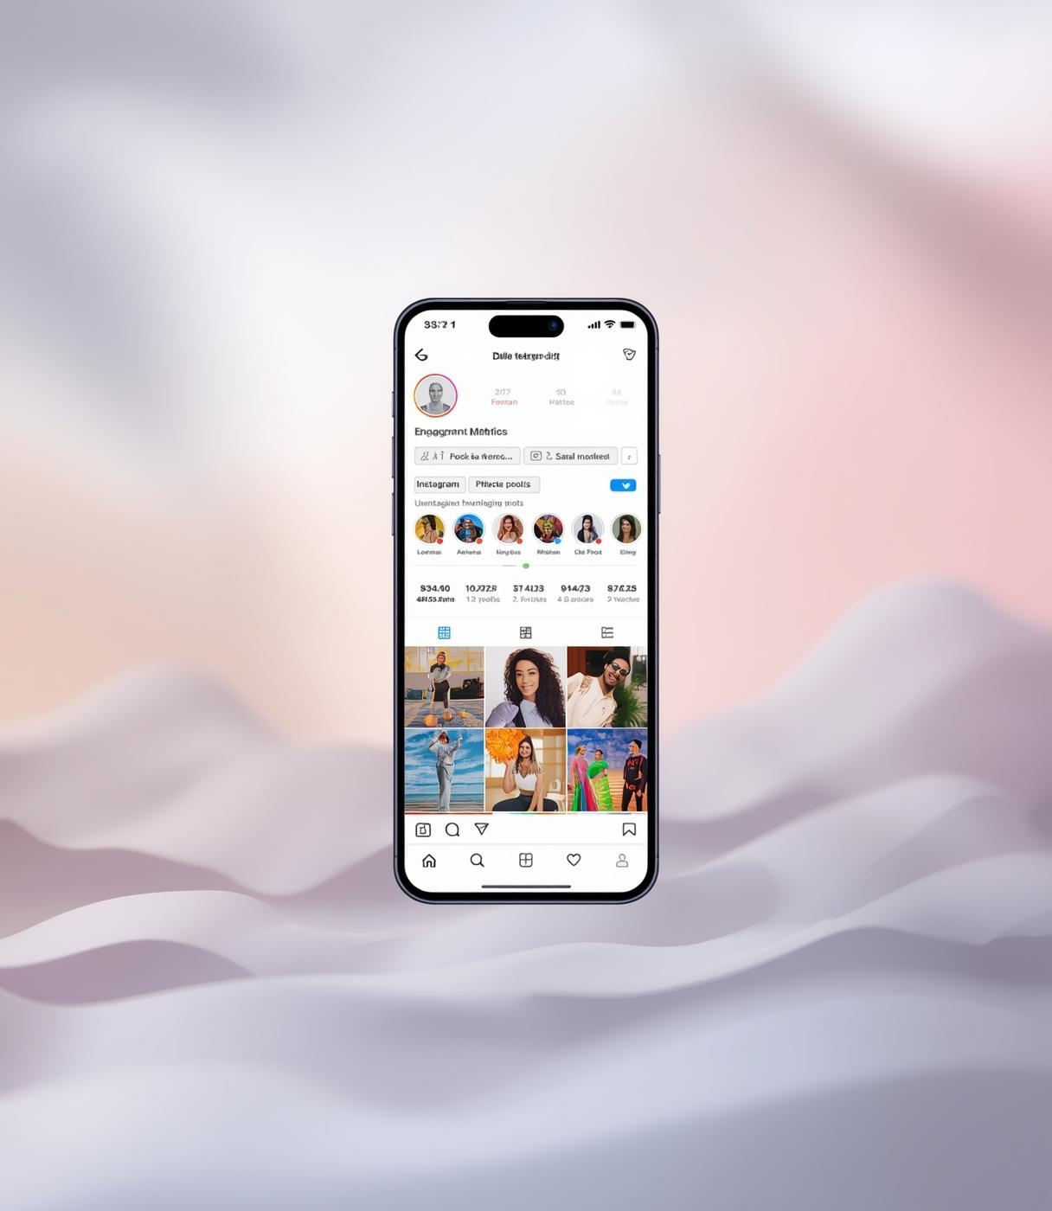
Instagram User Engagement & Growth Analysis
SQL-Based Marketing Insights
Tool Used: MySQL
PRESENTED BY
Sunny, Data Analyst
13-DEC-2025

Slide 2

Introduction
In today’s digital ecosystem, user engagement plays a critical role in driving platform growth, retention, and monetization.
This project focuses on analyzing user behavior and engagement data from a social media platform to uncover actionable insights that can support data-driven decision-making.
By leveraging SQL-based analysis, this study evaluates user activity, engagement patterns, content performance, and social interactions to identify high-value users, engagement opportunities, and optimization areas for marketing and platform strategy.

Slide 3
Problem Statement & Objectives
Problem Statement
You are hired as a Data Analyst at Meta to collaborate with the Marketing Team. The goal is to leverage Instagram’s user data to design targeted marketing strategies that increase user engagement, retention, and acquisition by extracting actionable insights from user behavior and engagement patterns.
Objectives
  Analyze user activity and engagement
  Identify loyal, inactive, and high-value users
  Evaluate content and hashtag performance
  Support data-driven marketing decisions

Slide 4
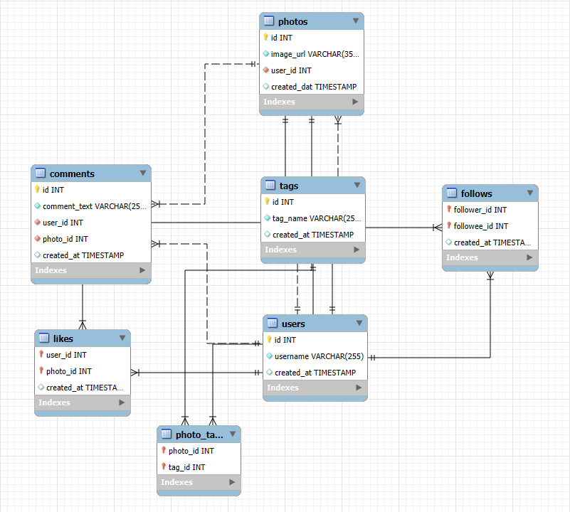
Data Overview
The dataset represents core Instagram user interactions and content activity.
Key Tables Used
  Users – User profiles & account creation
  Photos – Posts & upload timestamps
  Likes & Comments – Engagement signals
  Follows – Social relationships
  Tags & Photo_Tags – Hashtag analysis

Slide 5
Methodology
  Extracted and analyzed Instagram user data using SQL in MySQL.
  Cleaned and validated data to handle null values, duplicates, and integrity issues.
  Aggregated user activities such as posts, likes, comments, and follows to measure engagement.
  Calculated key metrics including activity levels, engagement rates, and follower counts.
  Segmented users based on engagement and activity behavior.
  Derived business insights and recommendations to support marketing and growth strategies.

Slide 6
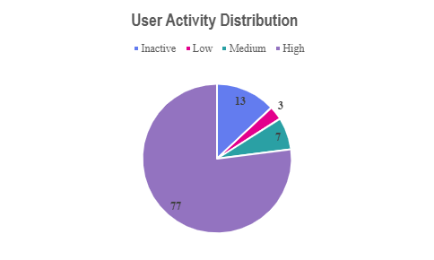
User Activity Distribution
Key Insights
  Majority of users are highly active
  Small inactive segment offers re-engagement opportunity
  Engagement is skewed toward power users
Opportunity: Target inactive & mid-level users
Recommendations
  Retain power users: Badges, early access, rewards
  Re-engage inactive users: Personalized nudges
  Grow mid-level users: Content & creator recommendations
  Monitor movement across segments regularly

Slide 7
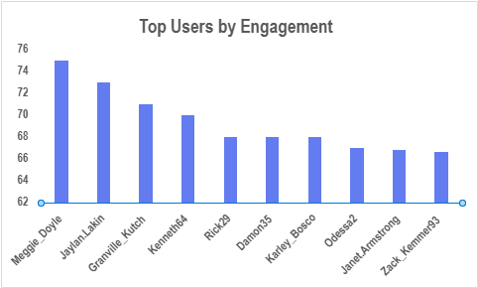
Top Users by Engagement
Key Insights
  Ranked by average engagement per post
  High engagement ≠ high posting volume
  Mix of:
  High-impact creators
  Consistent performers
Recommendations
  Prioritize top users for influencer campaigns
  Use high engagement-per-post creators for viral reach
  Long-term partnerships with consistent creators
  Validate engagement quality before scaling

Slide 8
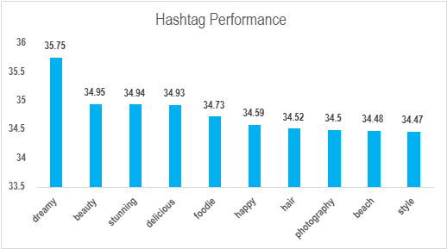
Hashtag Performance
Key Insights
  Top hashtags: #dreamy, #beauty, #stunning, #foodie
  High engagement with moderate usage = strong quality
  Average likes per post reflects true content impact
Recommendations
  Align ads with high-performing hashtag themes
  Focus on beauty, food, lifestyle content
  Build interest-based targeting using hashtags
  Track emerging hashtag trends regularly

Slide 9
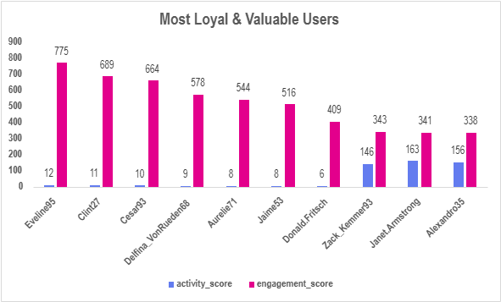
Most Loyal & Valuable Users
Key Insights
  Small user group drives disproportionate engagement
  Engagement driven by content quality, not frequency
  Strong micro-influencer potential
Recommendations
  Reward with creator badges & early features
  Enroll in ambassador programs
  Amplify their content for organic reach

Slide 10
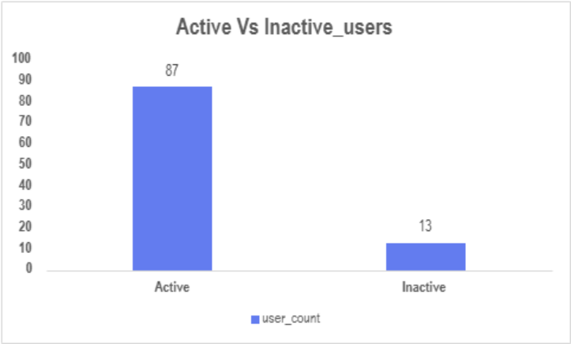
Inactive User Re-engagement
Key Insights
  ~13% users inactive
  High potential to boost engagement & retention
  Even small reactivation = large impact
Recommendations
  Personalized content recommendations
  Behavior-based notifications
  Welcome-back incentives
  Low-friction posting experience

Slide 11
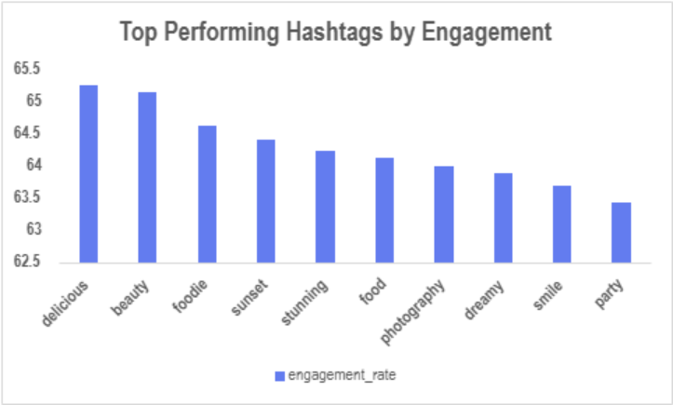
Content Strategy Using Hashtags
Key Insights
  Food, beauty & lifestyle hashtags show 63%+ engagement
  Visual & interest-based content performs best
Recommendations
  Use top hashtags in organic & paid campaigns
  Target users already engaging with these themes

Slide 12
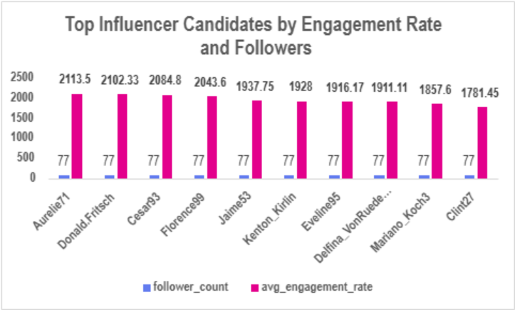
Influencer Marketing Candidates
Key Insights
  Engagement concentrated among few users
  Engagement quality > posting volume
  Hashtag-driven themes perform consistently
Recommendations
  Partner with high-engagement creators
  Run influencer pilot campaigns
  Track performance monthly

Slide 13
User Segmentation for Marketing
How Users Are Segmented
  Activity Level: Posts, likes, comments made
  Engagement Level: Likes & comments received
Key User Segments
  High Eng + Moderate Activity → Influencers
  High Eng + Low Activity → Creator incentives
  Low Eng + Low Activity → Discovery campaigns
  Inactive → Re-engagement
Why This Matters
  Enables precise targeting
  Improves engagement & retention
  Supports personalized marketing strategies

Slide 14
Strategic Recommendations Summary
  Retain High-Value Users: Reward highly engaged users with exclusive features, badges, and early access to strengthen loyalty.
  Leverage Influencers & Creators: Partner with users having high engagement rates to amplify reach and improve campaign performance.
  Re-Engage Inactive Users: Use personalized notifications, incentives, and content recommendations to revive participation.
  Optimize Content Strategy: Focus campaigns around high-performing themes (food, beauty, lifestyle) driven by hashtag insights.
  Data-Driven Marketing: Continuously monitor engagement metrics and refine targeting, creatives, and budget allocation.

Slide 15
Business Impact
  Increased User Engagement: Targeted strategies drive higher likes, comments, and content creation.
  Improved User Retention: Rewarding loyal users and re-engaging inactive users reduces churn.
  Stronger Marketing ROI: Influencer and hashtag-driven campaigns improve CTR, conversions, and cost efficiency.
  Faster Growth & Acquisition: High-engagement creators amplify organic reach and attract new users.
  Data-Driven Decision Making: Insights enable smarter content, campaign, and budget optimization.
Result: Sustainable engagement growth, better marketing efficiency, and long-term platform value.

Slide 16
Conclusion
  User engagement on the platform is driven by a small group of high-value and high-engagement users.
  Data analysis enabled clear user segmentation, helping identify influencers, loyal users, and inactive users.
  Hashtag and content insights highlight what resonates most with the audience.
  Targeted marketing, creator partnerships, and re-engagement strategies can significantly improve platform performance.
  A data-driven approach ensures scalable growth, stronger retention, and better marketing ROI.

Slide 17
Thank
You

