Slide 1
×2

Slide 2
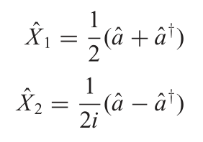
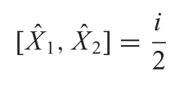

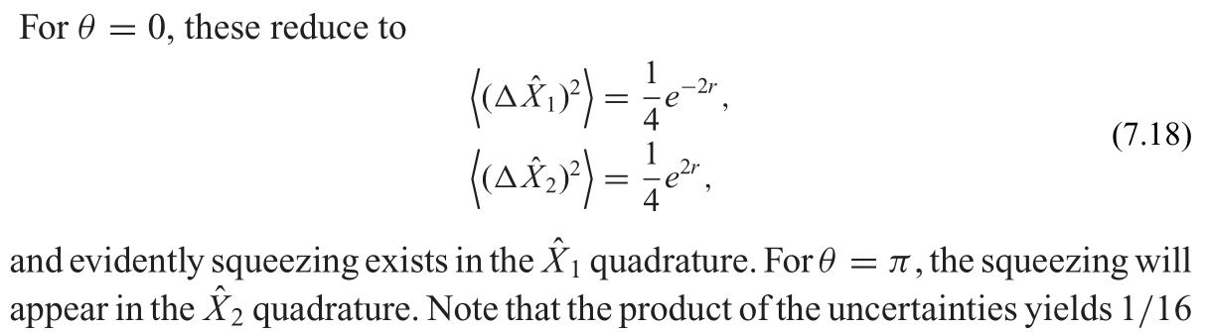
For two quadratures:
and squeezed operation:
then the variance of two quadratures will be:
Introductory quantum optics - Christopher Gerry, Peter Knight - Cambridge University Press (2004). p150-154

Slide 3
In our work, homodyne measurement act on the quadrature:
so I tend to think the squeezing parameter should be:
to minimize the variance of
then variances of two quadratures are:

