Slide 1

ONLINE REAL ESTATE MANAGEMENT SYSTEM
Presented By:
Aishwarya Shivaprakash
Venkata Naveen Kumar Kamatham
Sandhya Allu
S Vikram Raj

Slide 2

Description:
A Management system for Real Estate Agents to manage their list of customers, properties and other agent.
To keep track of no. of sale made via them.
This product maintains a record of their customers, property under them, and other agent who work with them.

Slide 3
PROBLEM STATEMENT:
Property masters is currently operating a manual estates management system for different departments

Slide 4
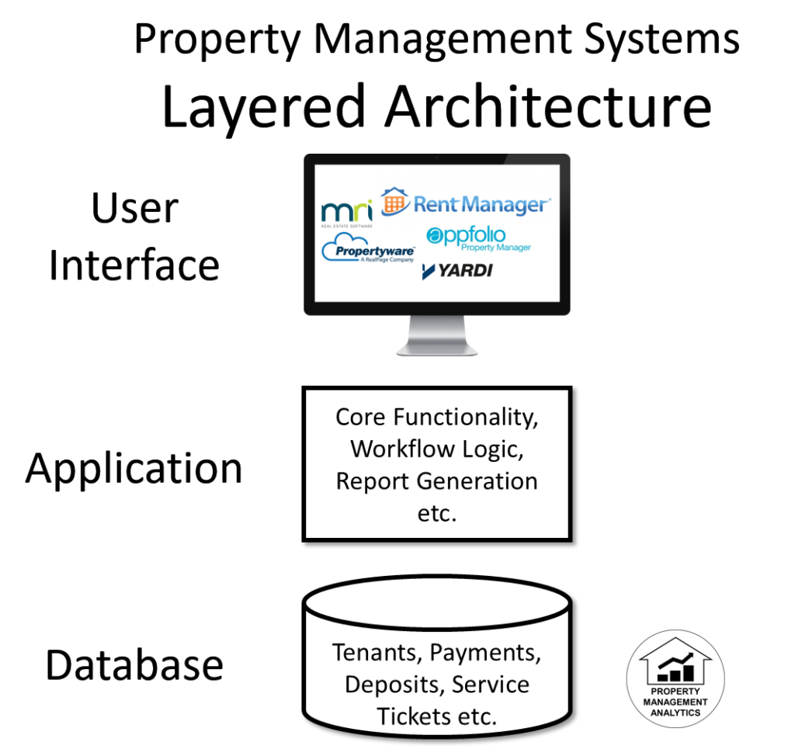

Slide 5
SOFTWARE REQUIREMENTS:
Windows 10
Languages – Java
Front end – HTML, CSS, JavaScript
Back end – MYSQL
Platform – J2EE
Web Servers – Tomcat Server

Slide 6

Hardware Requirements:
Processor – Core i3
SSD – 236GB
Memory – 12GB RAM
Screen

Slide 7

RESULT

Slide 8

Login Page:

Slide 9
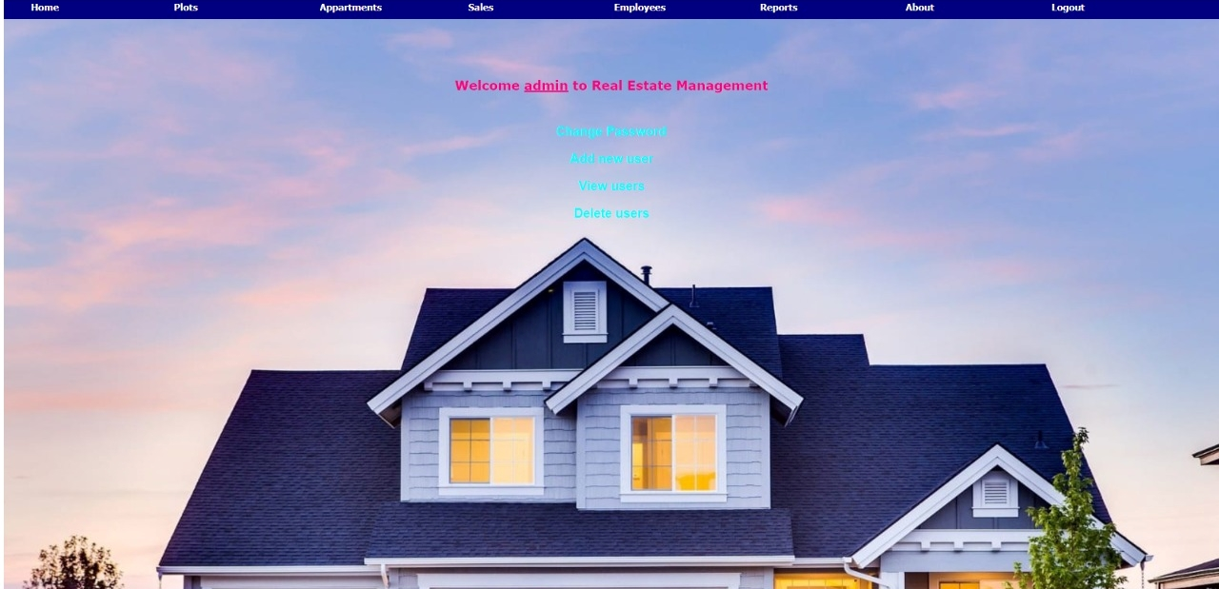
Admin Access:

Slide 10

User Access:

Slide 11

Logout Page:

Slide 12

THANK YOU

