Slide 1
AIR QUALITY INDEX PREDICTION
Course Title: Machine Learning and Pattern Recognition (B9DA109)
Lecturer Name: Mark Germaine
Assignment Title: Supervised Machine Learning – Regression
Group Members: Sunny Rao Karegam (20058107) Sandeep Kumar Kandagatla (20058796) Srikanth Kannamoni (20047954) Alphin Stivi John (20055263)

Slide 2
INTRODUCTION
What is AQI?
Air Quality Index (AQI) measures air pollution levels based on pollutants like PM2.5, PM10, NO₂, SO₂, CO, and O₃.
Ranges from 0 (Good) to 500 (Hazardous).
Why Predict AQI?
Early warnings for public health.
Helps governments & organizations manage pollution.
Understands environmental impacts on air quality.
Project Objective
Use Machine Learning to predict AQI based on environmental factors.
Compare models to find the best-performing approach.

Slide 3
DATASET OVERVIEW
Dataset: city_day.csv (29,531 records, 16 features)
Key Features:
Pollutants: PM2.5, PM10, NO2, NOx, CO, SO2, O3, Benzene, etc.
Date & City: Identifies the location and time of recording.
AQI (Target Variable): Measures air pollution levels.
AQI Bucket: Categorizes AQI (Good, Moderate, Poor, etc.).
AQI Ranges:
0-50 (Good), 51-100 (Satisfactory), 101-200 (Moderate) 201-300 (Poor),
301-400 (Very Poor), 401-500+ (Severe)

Slide 4
DATA PREPROCESSING
Handling Missing Values:
AQI is the target variable, so rows with missing AQI values were removed to ensure model accuracy.
For numerical features (e.g., PM2.5, PM10, NO2), missing values were filled using mean imputation, replacing them with the average of each column.
Feature Scaling:
Data was standardized using StandardScaler, which transforms features to have zero mean and unit variance.
Standardization helps models like Linear Regression and Neural Networks perform better by ensuring all features have a similar scale.

Slide 5
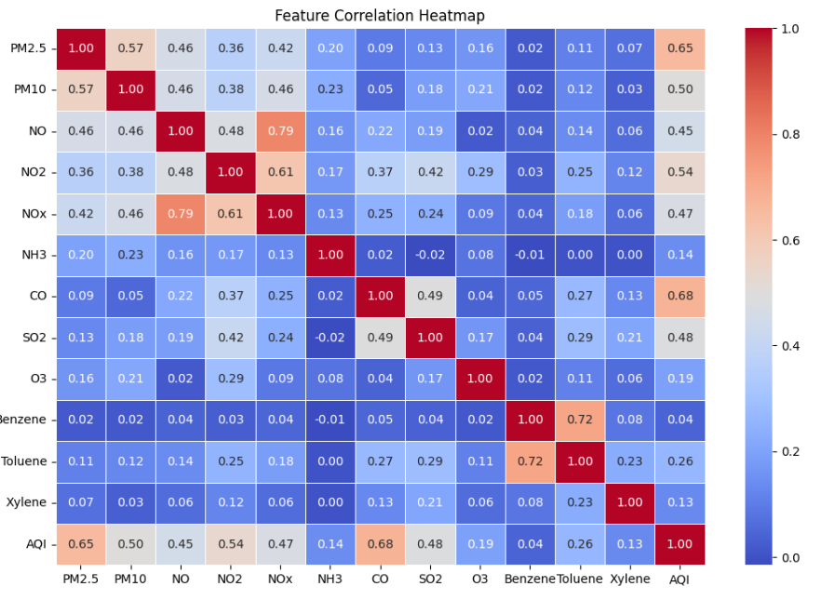
FEATURE CORRELATION HEATMAP
Purpose:
Visualizes the relationship between AQI and various pollutants.
Helps identify the most influential features for AQI prediction.
Key Insights:
PM2.5 (0.65) and CO (0.68) show a strong positive correlation with AQI, making them critical predictors.
PM10, NO2, and SO2 also contribute significantly to AQI fluctuations.
Weak correlation observed for gases like O3, Benzene, and Xylene, indicating lesser impact on AQI.

Slide 6
MODELS USED
Linear Regression
Predicts continuous values by identifying a direct relationship between input features and the target.
Simple and easy to interpret but struggles with capturing complex, non-linear patterns.
Random Forest Regressor
Uses multiple decision trees and combines their predictions to improve accuracy.
Handles non-linearity well, reduces overfitting, and is resilient to missing data.
XGBoost Regressor
A high-performance boosting algorithm that enhances weak models step by step.
Fast, scalable, and accurate, with built-in regularization to prevent overfitting.

Slide 7
TRAINING & EVALUATION
Training & Evaluation
Train-Test Split:
The dataset was divided into 80% for training and 20% for testing to evaluate model performance on unseen data.
Ensures the model learns patterns from the training set and generalizes well to new data.
Model Evaluation Metrics:
Mean Absolute Error (MAE):
Measures the average absolute difference between actual and predicted values.
Lower MAE indicates better model accuracy.

Slide 8
Root Mean Squared Error (RMSE):
Similar to MAE but penalizes larger errors more strongly.
Helps identify models that make large deviations in predictions.
Model | MAE | RMSE | R² Score
Linear Regression | 31.203327 | 59.108362 | 0.809197
Random Forest | 20.591788 | 40.480720 | 0.910508
XGBoost | 21.835663 | 42.384466 | 0.901893
R² Score (Coefficient of Determination):
Measures how well the model explains the variance in AQI.
R² value ranges from 0 to 1, where 1 indicates a perfect fit and 0 means no predictive power.

Slide 9
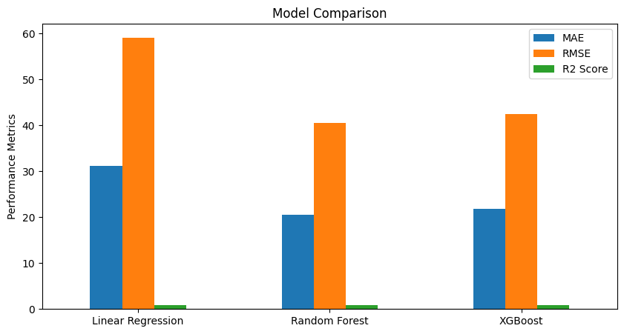
MODEL COMPARISION

Slide 10
WHY XGBOOST IS PREFERRED OVER RANDOM FOREST
Better Handling of Missing Data – XGBoost processes missing values natively, while Random Forest requires imputation.
Less Overfitting – Random Forest may overfit due to correlated pollutants, while XGBoost generalizes better.
Captures Complex Relationships – Boosting technique helps model AQI-pollutant interactions more effectively.
Higher Predictive Accuracy – XGBoost iteratively corrects errors, improving performance over decision trees.
Efficiency & Speed – Optimized for faster training and better scalability on large datasets (~29,000 rows).

Slide 11
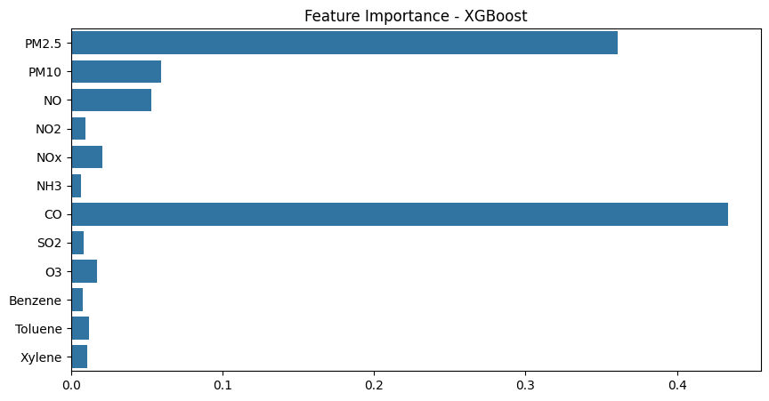
FEATURE IMPORTANCE - XGBOOST

Slide 12
HYPERPARAMETER TUNING
Why Hyperparameter Tuning?
Improves model performance by optimizing key parameters.
Prevents overfitting or underfitting by selecting the best configuration.
Tuning Process:
GridSearchCV was used to test different combinations of hyperparameters.
Cross-validation (cv=5) ensured robustness in parameter selection.
Hyperparameters Tuned:
n_estimators: [50, 100, 200] – Controls the number of boosting rounds.
learning_rate: [0.01, 0.1, 0.2] – Determines the step size at each iteration.
max_depth: [3, 5, 7] – Defines the complexity of trees in the model.

Slide 13
Best Parameters Found:
learning_rate = 0.2, max_depth = 5, n_estimators = 100
Final Model Training:
The optimized XGBoost model was trained with the best parameters.
Model performance improved significantly after tuning.
Performance of Optimized Model:
Mean Absolute Error (MAE): Reduced error in AQI predictions.
Root Mean Squared Error (RMSE): Lower values indicate fewer large prediction errors.
R² Score: Improved ability to explain AQI variance.
Model Saving:
The best model was saved using joblib for future AQI predictions.

Slide 14
MAKING PREDICTIONS FROM THE TRAINED MODEL
The trained XGBoost Regressor was used to predict AQI values for unseen test data.
A subset of scaled test features (first 5 samples) was selected for demonstration.
The model generated predicted AQI values, which were compared with actual values.
A line plot visualized the accuracy of predictions, showing close alignment with actual AQI.
The results confirmed that XGBoost effectively captures patterns in air quality data.

Slide 15
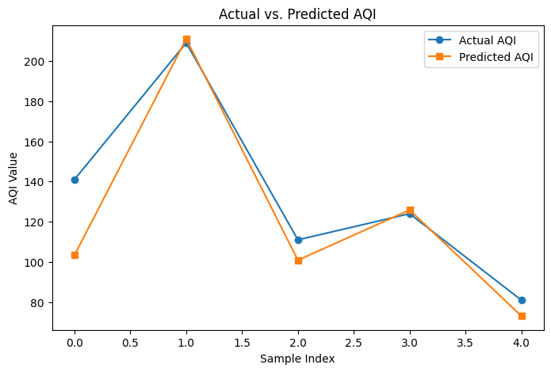
ACTUAL VS. PREDICTED AQI

Slide 16
CONCLUSION & FUTURE SCOPE
Successfully implemented machine learning models for AQI prediction.
XGBoost outperformed due to better handling of missing data and reduced overfitting.
Demonstrated the potential of AI in environmental monitoring and policy decision-making.
Future improvements include integrating deep learning models like LSTMs and CNNs.
Expanding the dataset with meteorological and real-time air quality data.
Developing AI-powered dashboards and mobile applications for real-time AQI tracking and alerts.

Slide 17
INDIVIDUAL CONTRIBUTION
Team Members | Contribution
Sunny Rao Karegam | Dataset Collection & Preprocessing
Sandeep Kumar Kandagatla | Feature Engineering & Model Implementation
Srikanth Kannamoni | Model Training, Evaluation & Optimization
Alphin Stivi John | Prediction, Analysis & Final Insights

Slide 18
THANK YOU

