Slide 1
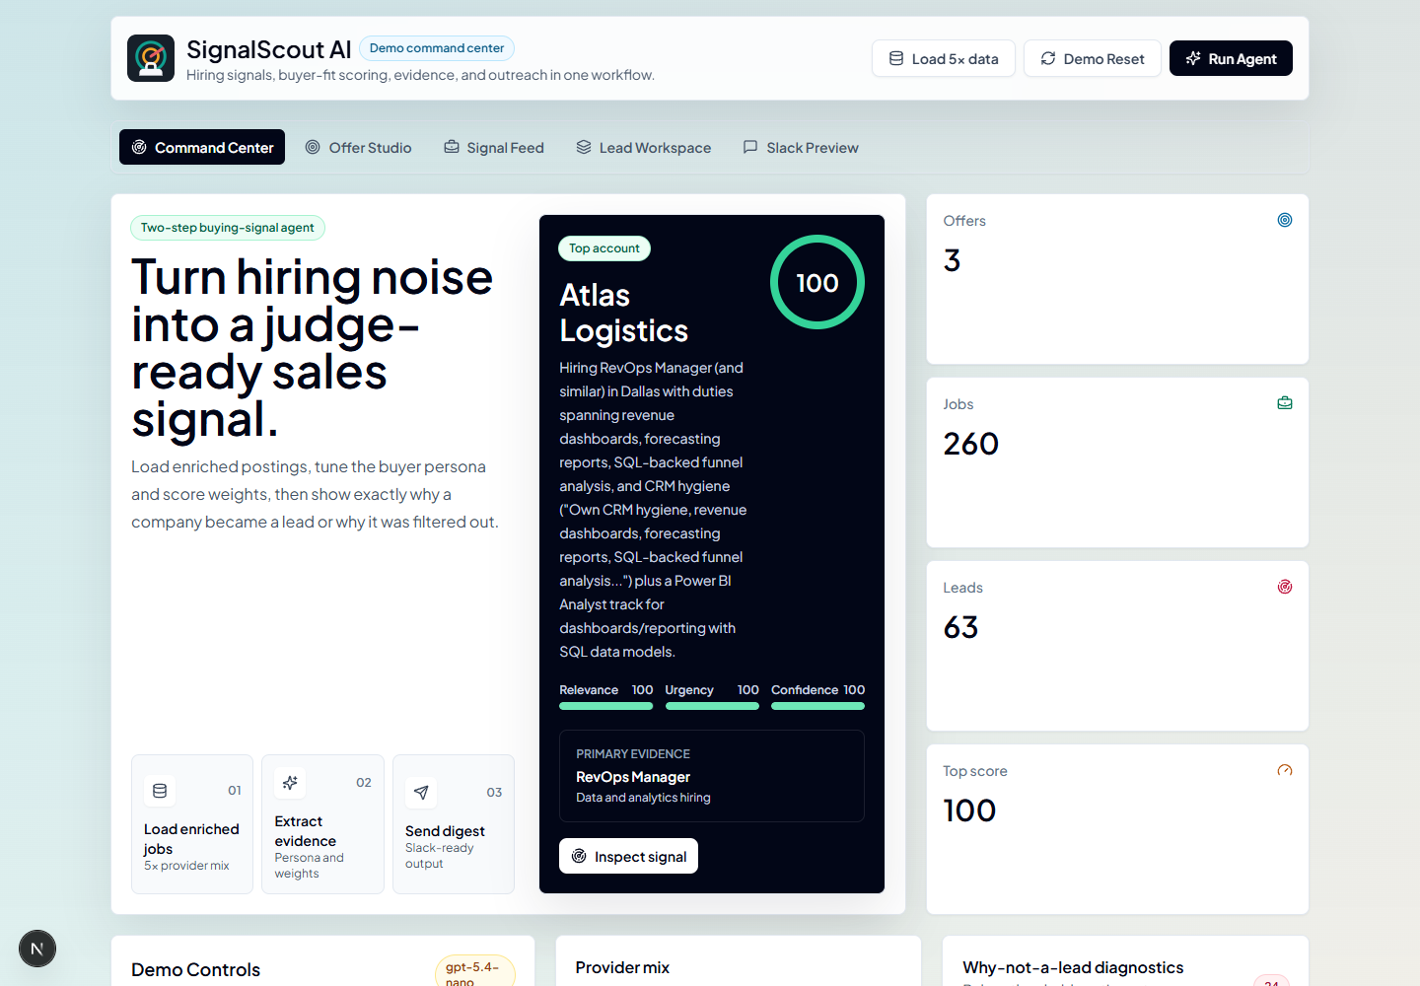
SignalScout AI
Marketable product
Turn job postings into B2B buying signals.
SignalScout connects public hiring behavior to ranked leads, evidence, outreach, and team handoff.
Live product is the proof object
Hackathon demo setup
01 / 08
Notes:
Timing: 30 to 40 seconds.
Open with the premise: companies quietly publish buying signals every day through the roles they are hiring for. SignalScout AI turns those public signals into evidence-backed sales priorities for service providers.
Set the demo expectation early: this is not a CRM replacement and not a lead list marketplace. It is a workflow that starts from job postings, finds business pain, ranks accounts, drafts outreach, and packages the result for the sales team.

Slide 2
PROBLEM
Outbound teams are late to the signal.
The issue is not finding more companies. It is knowing when a company has a credible reason to buy.
Static lead lists
Fresh hiring behavior
Who exists
Why now
Firmographics and old account lists
VS
Public evidence of active company change
Generic intent labels without evidence
Roles imply budget, bottlenecks, and projects
Timing often visible after demand peaks
Outreach can reference actual evidence
Buying intent is not just a list problem; it is a timing and evidence problem.
SignalScout uses hiring activity as the public trail that makes timing defensible.
Source: slide prep narrative
02 / 08
Notes:
Timing: 45 to 55 seconds.
Frame the common sales problem. Agencies and consultancies already know who they could sell to, but they often do not know who is changing right now or why this week is a good time to reach out.
Static lead lists age quickly. Generic intent data can be broad and expensive. Manual research is useful, but it is slow and usually stays trapped in a seller's notes. The opportunity is to convert a public, current behavior into a practical sales action.

Slide 3
INSIGHT
Hiring is a public trail of operational intent.
A job post is not proof of budget, but it is evidence of a business priority.
HIRING PATTERN
POSSIBLE BUYING SIGNAL
BEST-FIT SELLER
BI Analyst + Tableau Developer
Dashboard backlog or reporting initiative
Dashboard agency
Data Engineer + Analytics Engineer
Pipeline or metrics-layer buildout
Data consultancy
Cloud Engineer + SRE
Infrastructure modernization or reliability push
Cloud partner
Security Engineer + IAM role
Compliance, access, or risk readiness work
Security vendor
Automation Specialist + RevOps Manager
Process automation and GTM operations gap
AI automation shop
The bridge is role evidence to vendor need. SignalScout makes that bridge repeatable.
Slide setup: hiring patterns are interpreted as evidence, not guaranteed purchase intent
03 / 08
Notes:
Timing: 45 to 55 seconds.
Make the insight concrete. A job post is more than a recruiting artifact. The role, seniority, department, location, and repeated pattern often point to an operating gap.
For example, RevOps and BI roles suggest reporting pressure, pipeline visibility gaps, or dashboard backlog. Security roles can suggest compliance and access work. The product does not claim guaranteed purchase intent. It gives sellers a better reason to start a timely, specific conversation.

Slide 4
PRODUCT
SignalScout turns hiring behavior into sales action.
It is a workflow, not just a scraper: each stage creates an artifact the seller can use.
Job data
Hiring signal
Lead score
Outreach draft
Slack digest
Postings by company and source
Role pattern plus matched evidence
Relevance, urgency, and confidence
Grounded opening line and pain
Morning team handoff
OUTPUT: FEED
OUTPUT: REASON
OUTPUT: RANK
OUTPUT: EMAIL
OUTPUT: DIGEST
The seller sees why the company is ranked, not just that it is ranked.
That is what makes the workflow credible for a real sales team.
Workflow: job data to evidence-backed sales action
04 / 08
Notes:
Timing: 50 to 60 seconds.
Walk through the product system at a high level. SignalScout ingests job data, extracts the hiring signal, scores the lead, drafts the outreach, and sends a Slack digest.
Emphasize the artifacts at each stage. The output is not just a score. It is the evidence, the inferred pain, the ranked account, the opening line, and the team handoff. That is why the workflow is demoable and defensible.

Slide 5
FIRST USER
Built first for agencies and consultancies.
These teams sell expertise into companies that are already changing.
Data-dashboard
Cloud migration
Cybersecurity
AI automation
agencies
consultancies
vendors
providers
RevOps and BI roles signal reporting pain, dashboard backlog, and pipeline visibility needs.
Cloud engineers and SRE roles point to reliability, modernization, and platform operations projects.
Security, compliance, and IAM hiring can reveal access, risk readiness, and audit pressure before RFPs appear.
Automation and operations roles suggest process gaps that service providers can turn into specific outreach.
First wedge: service providers that need timely, specific reasons to start sales conversations.
Initial ICP from SLIDE_PREP.md
05 / 08
Notes:
Timing: 45 to 55 seconds.
Explain the first wedge. The product is built first for agencies, consultancies, and B2B service providers because they sell expertise into companies that are already changing.
Data-dashboard agencies, cloud migration firms, cybersecurity vendors, and AI automation providers all need a timely reason to start a conversation. SignalScout gives them a reason that is anchored in observable hiring behavior.

Slide 6
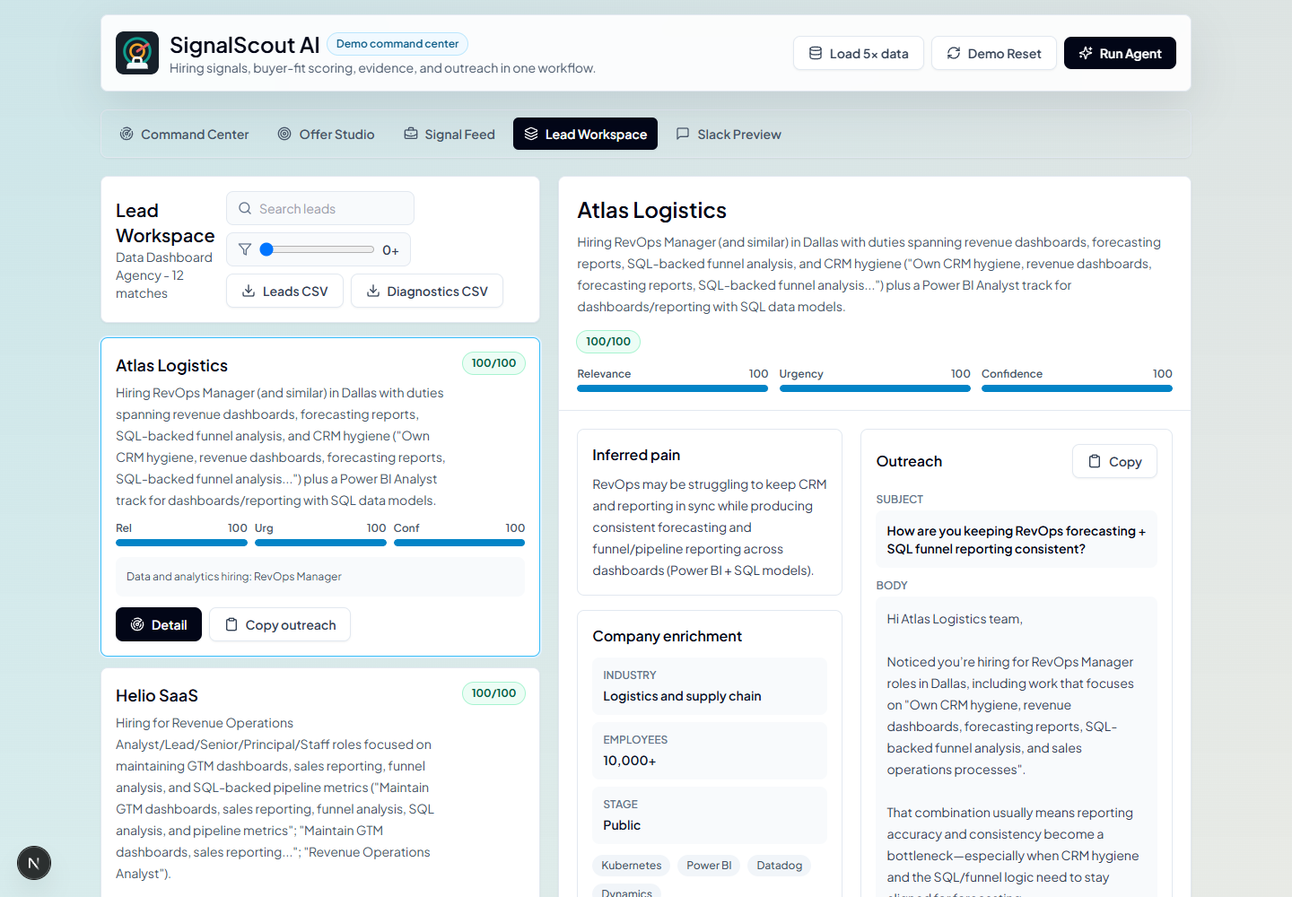
PRODUCT PROOF
SignalScout already completes the loop.
Live data becomes ranked sales action.
260 postings ingested
Seed postings become provider-style job signals.
Atlas Logistics ranks first
Score, evidence, and pain sit in one workspace.
Slack digest is ready
The seller moves from insight to team action.
A marketable workflow: ingest, rank, explain, draft, and hand off.
Fresh screenshot captured from the running local app
06 / 08
Notes:
Timing: 45 to 55 seconds.
Move from concept to product proof. SignalScout already shows the full loop: postings are ingested, leads are ranked, a top account is selected, evidence is displayed, outreach is drafted, and a Slack digest is ready.
Point to the screenshot as product evidence, not as a mockup. Keep this slide short because the next proof should happen inside the running product, not on the deck.

Slide 7
COMMERCIAL READY
Ready to sell into service teams.
The product packages a daily outbound workflow agencies can adopt without changing their CRM.
PRIMARY BUYER
Runs on public data
B2B agencies and consultancies
Job postings are observable, repeatable, and refreshed by the market itself.
Produces a daily priority list
The buyer receives ranked accounts with evidence instead of another raw lead table.
They already sell expertise. SignalScout tells them which accounts have timely evidence for a focused conversation.
Creates usable sales artifacts
Each lead comes with inferred pain, proof, and a grounded outreach draft.
Fits existing sales motion
Clear first wedge
Slack digest and export paths make the workflow easy to pilot with a small team.
SignalScout is not just a demo: it is a practical prospecting product with a clear buyer.
Commercial readiness before live demo
07 / 08
Notes:
Timing: 45 to 55 seconds.
Make the commercial case before switching to the live product. SignalScout is built for B2B agencies and consultancies that need a timely reason to reach accounts already showing operational change.
The product is marketable because it uses public data, creates a daily priority list, produces usable sales artifacts, and fits existing sales workflows through Slack and export paths.

Slide 8
SignalScout AI
LIVE WEBSITE DEMO
Now we run it live.
Data
Score
Watch public hiring signals become a sales-ready account.
Job data -> hiring signal -> lead score -> outreach draft -> Slack digest
Team
Evidence
The next 8 to 10 minutes are product, not slides.
Transition slide
08 / 08
Notes:
Timing: 20 to 30 seconds.
Transition cleanly. The slide section is complete. Now switch to the running website and prove the loop with the demo path: job data to hiring signal to lead score to outreach draft to Slack digest.
Do not add another explanation here. Start the live product walkthrough.

