Slide 1

WAM Quantization
Progress & Next Steps
Weekly Group Meeting
Fast-WAM baseline → action-sensitive weight VQ
NTU · College of Computing and Data Science
Weekly Group Meeting
7 October 2026
Notes:
这次汇报分三部分：先确认 Fast-WAM Optional-IDM 的起点和两篇论文的 LIBERO 结果；再看我们自己的 LIBERO-Plus 子集与 A4 诊断；最后说明 action-sensitive weight VQ 的下一步方案。所有论文截图与本地数据分别标注来源。后面的 VQ 架构和 codebook 几何示例是 proposal，不是已完成结果。

Slide 2
Baseline: Fast-WAM Optional-IDM
Stage 1 · Imagine future video
Stage 2 · Infer actions from frozen video
Observation
+ instruction
VideoDiT
video denoising
Frozen video
K / V context
First VQ target:
independent
ActionDiT
Hold the video branch in BF16 for the first pilot
Proprioception
+ action noise
ActionDiT
action denoising
Action chunk
Transfer after the Fast-WAM pilot: LingBot-VA → Cosmos-Policy
Architecture follows the current Optional-IDM implementation; first VQ pilot targets ActionDiT.
02
Notes:
先用 Fast-WAM 的独立 ActionDiT 做可控、范围小的 weight VQ pilot。当前 Optional-IDM 实现分两段：先 denoise video，然后将完整 denoised video 固定为条件，prefill video K/V，再 denoise action。图按当前实现绘制，不把论文的 first-frame-only 快速路径混入本地 Optional-IDM。第一轮 VQ 只改 ActionDiT，video branch 保留 BF16，并不等同于前面的现有四臂联合 Linear 量化配置。
之后推广到 LingBot-VA 和 Cosmos-Policy；共享 backbone 模型应称 action-targeted，不能假设仍是完全独立的 action-only 模块。
来源：Fast-WAM arXiv:2603.16666v2；本地 FastWAM/src/fastwam/models/wan22/fastwam_idm.py，Stage 1/2 inference implementation。

Slide 3

Fast-WAM on LIBERO: QuantWAMs
Paper-reported result · Table 1
SVDQuant W4A4: 73.7 ± 0.7% LIBERO Avg
QuantWAMs W4A4: 97.4 ± 0.2%
QuantWAMs · arXiv:2607.28405v1 · Table 1, p.7 · Original PDF pixels
03
Notes:
这是 QuantWAMs Table 1 原始截图，Fast-WAM 所在 panel。LIBERO 平均 success：FP16 97.6±0.2%，SVDQuant W4A4 73.7±0.7%，SVDQuant* 75.3±0.6%，Atom 76.2±0.7%，Atom* 82.1±0.5%，QuantWAMs 97.4±0.2%。星号行按论文用于匹配 mixed-precision budget，不能当成与另一篇完全相同的运行 recipe。论文报告 LIBERO 每个 protocol seed 2,000 episodes，3 seeds 合计 6,000；截图中的 ± 是论文报告值。Speedup 与 memory 是该论文的实验口径，不是本地结果。
来源：QuantWAMs: Calibrating at the Right Granularity for World Action Models, arXiv:2607.28405v1, Table 1, PDF physical p.7。https://arxiv.org/abs/2607.28405v1

Slide 4
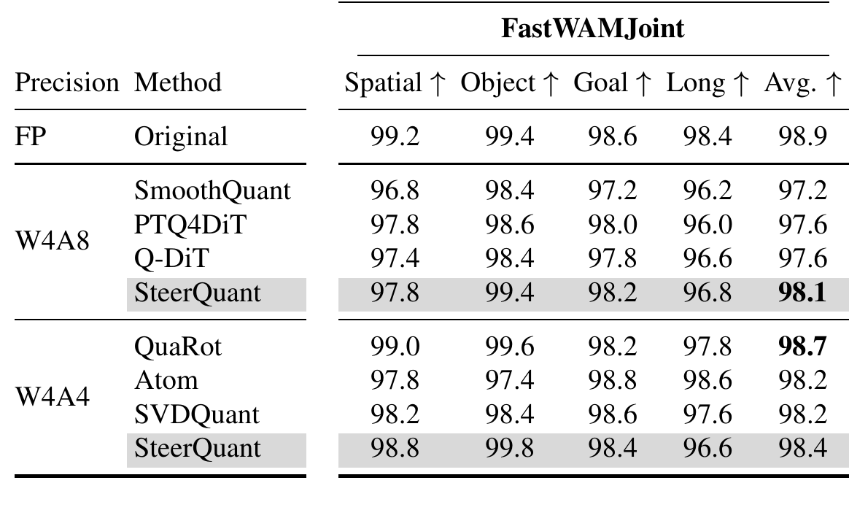
Fast-WAM on LIBERO: SteerQuant
Paper-reported result · FastWAMJoint panel of Table 1
SVDQuant W4A4: 98.2% here vs 73.7% in QuantWAMs
Check model variant, quantization scope and evaluation protocol.
SteerQuant · arXiv:2609.39056v1 · Table 1, p.7 · Same-page pixel zoom
04
Notes:
这是 SteerQuant Table 1 的 FastWAMJoint 部分，保留原 PDF pixels。为了可读性，zoom 从同一页拼接左侧 Precision/Method 与右侧 FastWAMJoint panel，没有改写数字。红圈标出 SVDQuant W4A4 的 Avg 98.2%。上一页 QuantWAMs 同名 baseline 是 73.7±0.7%，mean 相差 24.5 个百分点；Atom 也存在较大差异。现阶段把它作为 cross-paper protocol alignment 问题，不能仅凭两个表宣称论文或数据有误。需要先对齐模型变体 / checkpoint、量化范围、calibration、mixed precision 和 evaluation seeds。SteerQuant caption 报告 2,000 LIBERO rollouts。
来源：SteerQuant: Steering Quantization Error with Action-Guided Scaling in World-Action Models, arXiv:2609.39056v1, Table 1, PDF physical p.7。https://arxiv.org/abs/2609.39056v1

Slide 5
Our LIBERO-Plus pilot: observed subset
300 paired variants · Spatial only · 6 of 28 planned cells
Spatial dimension | BF16 | W4A8 | W4A4 | W4A4KV4
Background textures (n=50) | 44/50 (88%) | 45/50 (90%) | 0/50 (0%) | 0/50 (0%)
Camera viewpoints (n=50) | 26/50 (52%) | 26/50 (52%) | 0/50 (0%) | 0/50 (0%)
Language instructions (n=50) | 46/50 (92%) | 46/50 (92%) | 0/50 (0%) | 0/50 (0%)
Light conditions (n=50) | 47/50 (94%) | 48/50 (96%) | 0/50 (0%) | 0/50 (0%)
Objects layout (n=50) | 47/50 (94%) | 47/50 (94%) | 0/50 (0%) | 0/50 (0%)
Robot initial states (n=50) | 33/50 (66%) | 40/50 (80%) | 0/50 (0%) | 0/50 (0%)
Overall (n=300) | 243/300 (81%) | 252/300 (84%) | 0/300 (0%) | 0/300 (0%)
W4A8: +3 pp descriptively; both A4 arms: 0/300.
Local snapshot: 6 Oct 2026 · All completed shards · Joint Linear quantization · 22 cells have no results
05
Notes:
这是用户本地 frozen-checkpoint Fast-WAM Optional-IDM LIBERO-Plus 四臂闭环测量，不是 paper-reported 数值。预注册计划是 4 suites × 7 dimensions，每格 n=50，共 1,400 variants、5,600 arm episodes。最新 all-completed 聚合覆盖 78 个保留 shards、300 个 paired Spatial variants 和 1,200 个 arm episodes。总表分母每臂都是 300：BF16 243/300 (81%)，W4A8 252/300 (84%)，W4A4 与 W4A4KV4 各 0/300；两个 W4A4 臂的已完成 episode 都以 400-step control_step_timeout 结束。W4A8 对 BF16 的配对差为 +3.0 个百分点（19 个仅 W4A8 成功、10 个仅 BF16 成功）。逐维表只放有数据的 6 个 libero_spatial dimension，每格 n=50；其他 22 个 cell 在当前聚合中缺失，不要补成 0。12 个已取消 children（indices 78–89）从聚合排除。结论仅限该 observed subset，不说完整 Plus 或“所有 A4”均失败。W4A4KV4是 W4+A4+KV4 组合，没有 BF16KV4 arm，不能独立归因 KV4。
现有四臂使用相同 W4 G128 weight bank 与 dynamic per-row RTN A8/A4，量化614个Linear（video/action/proprio），不是前页拟议的 ActionDiT-only VQ。Text/VAE、norm、非Linear和attention运算保持BF16。没有完整benchmark结论，也没有正式部署latency。
本地来源：D:/Downloads/Final Year Project/experiment/idea-validation/fastwam-libero-plus-pilot/artifacts/25699421.pbs101/results/analysis.json

Slide 6
A4 diagnosis: error appears before rollout
300 reset-observation pairs
One-input native-path check
Median normalized motor RMSE · first 10 actions
Same input · 4 queries · no rollout steps
Comparison | RMSE
W4A8 vs BF16 | 0.0228
W4A4 vs BF16 | 0.3222
W4A4KV4 vs BF16 | 0.3217
KV4 addition vs W4A4 | 0.0387
Diagnostic measure | Value
W4A4 vs BF16 motor RMSE¹ | 0.2853
Native vs FP32 ref. RMSE² | 0.0407
INT4 GEMM calls | 6,436
Discrete gripper flips¹ | 0/10
The A4 recipe needs diagnosis; current controls do not isolate W-only or A-only effects.
¹ First 10 action positions. ² Full 32×7 chunk, all channels. Fixed-input fidelity; no timing claim.
06
Notes:
这页放两种不同分母、不同目的的 fixed-observation 证据，务必分成两个视觉区域。左侧是 all-completed 聚合中的 n=300 个 paired reset-observation 动作对比：动作块前 10 个 motor action 的 median normalized RMSE，W4A8 vs BF16 为 0.02283，W4A4 vs BF16 为 0.32219，W4A4KV4 vs BF16 为 0.32173，KV4 臂 vs W4A4 为 0.03870。该误差在闭环 rollout 之前已出现。右侧仅为 diagnose_a4 的一个 observation、四次 arm/reference 查询、0 个环境步，不计 episode：native W4A4 vs BF16 的前10 motor RMSE 为 0.2853；native 与独立 FP32 解量化参考在整个 32×7 action chunk 上 RMSE 为 0.04068；INT4 计数器增加 6,436。前10位置离散 gripper command 与 BF16 相同（0/10 flips），但连续 gripper RMSE 仍是 0.1322。诊断数组的 action位置 0–9 与10–31 motor RMSE是0.2853与0.2737；这里的 index 是 32-step action chunk 的位置，不是 10 个 diffusion denoising iterations；逐扩散步误差没有保存。W4A8与W4A4共用W4权重，分别切换A8/A4；没有W4-only或W16A4臂，所以不能把下降归结为activation或weight的单独效应。Kernel gate、native counter和FP32 reference只支持本诊断中存在真实执行且未见明显kernel实现异常，不能证明泛化精度。该 diagnose_a4 脚本标记 measure=False、timing_claim=none；其查询wall seconds不是native latency或deployment slowdown。
本地来源：D:/Downloads/Final Year Project/experiment/idea-validation/fastwam-libero-plus-pilot/artifacts/25699421.pbs101/results/analysis.json
本地来源：D:/Downloads/Final Year Project/experiment/idea-validation/fastwam-libero-plus-pilot/artifacts/25698767.pbs101/diagnostic/diagnose_a4.json

Slide 7
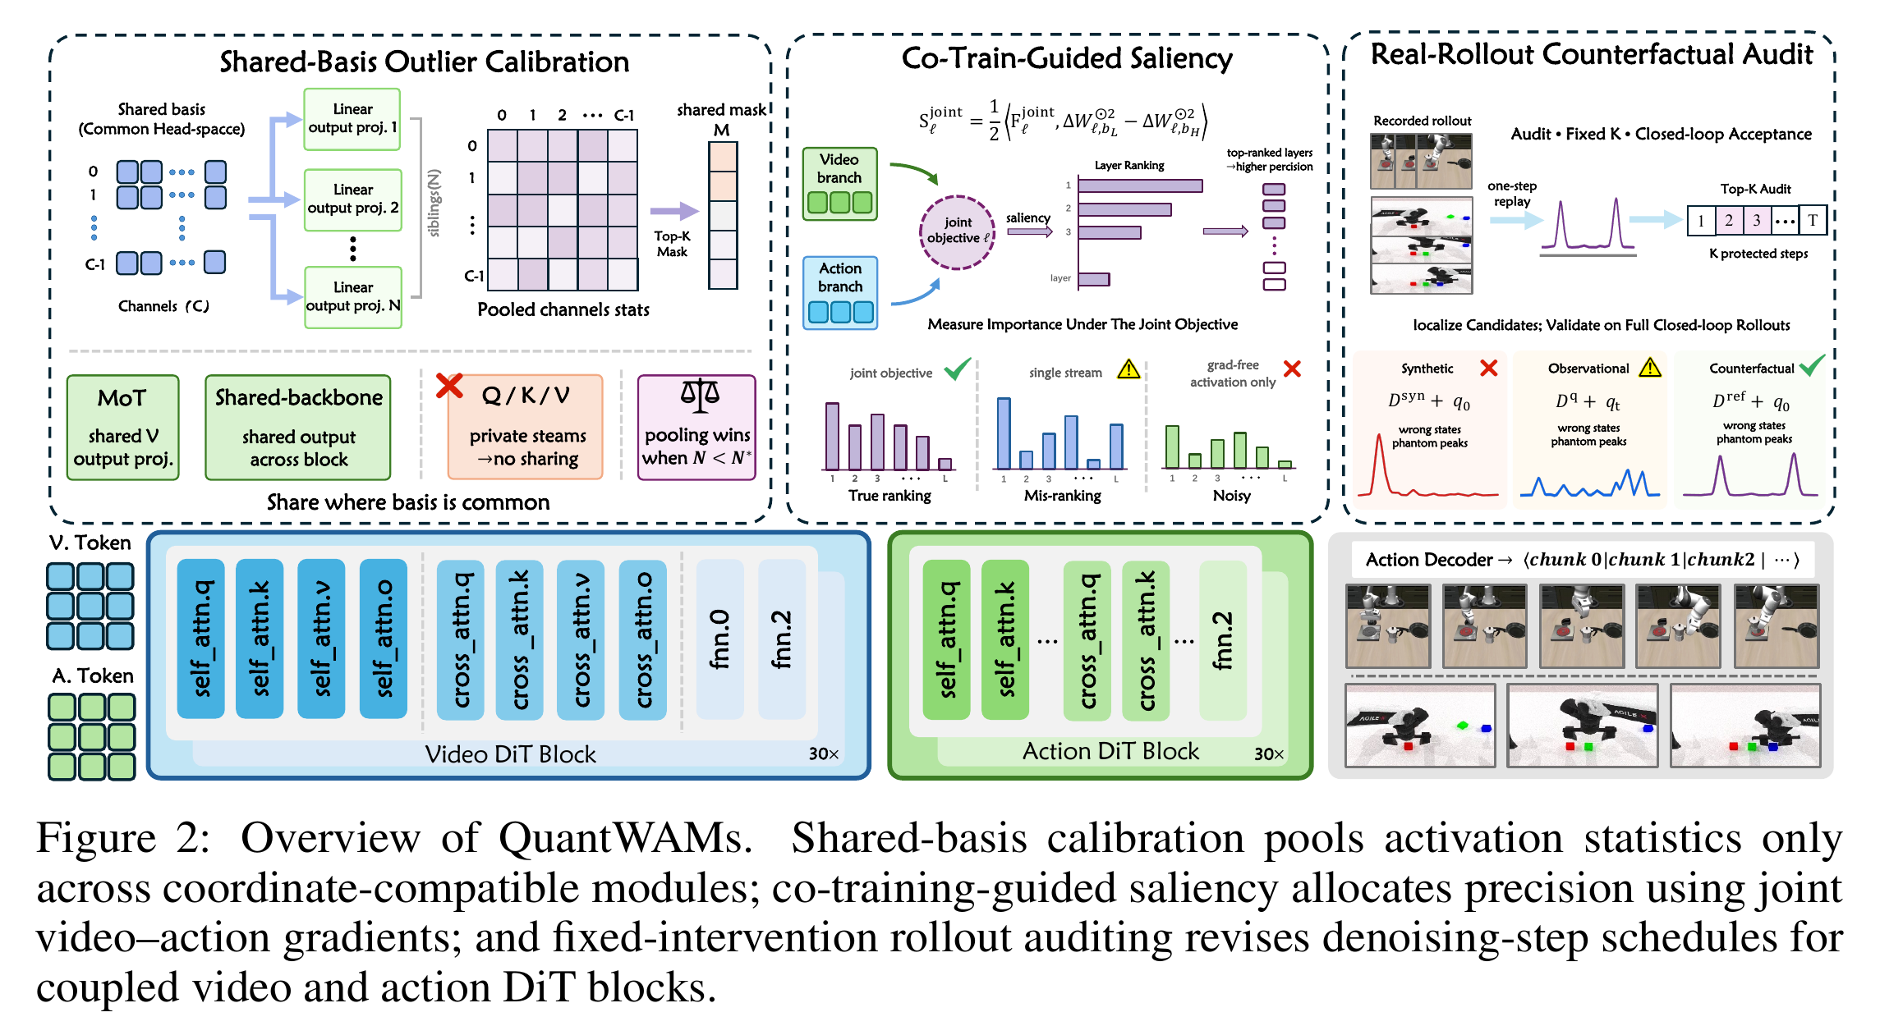
QuantWAMs: calibrate at the right granularity
Structure-aware calibration + joint saliency + rollout validation
QuantWAMs · arXiv:2607.28405v1 · Figure 2 · Figure crop from original PDF
07
Notes:
主要 figure 是 QuantWAMs Figure 2 原图。可按左中右说明：shared-basis calibration 只在 coordinate-compatible modules 合并activation statistics，不能随意把Q/K/V跨private streams合并；co-training-guided saliency 用joint video-action objective排序层，配置mixed precision；real-rollout counterfactual audit 用固定干预对denoising-step protection做closed-loop验证。启发是：量化误差的重要性要按系统结构与控制结果判断，不能只用activation amplitude。
来源：QuantWAMs, arXiv:2607.28405v1, Figure 2。https://arxiv.org/abs/2607.28405v1

Slide 8
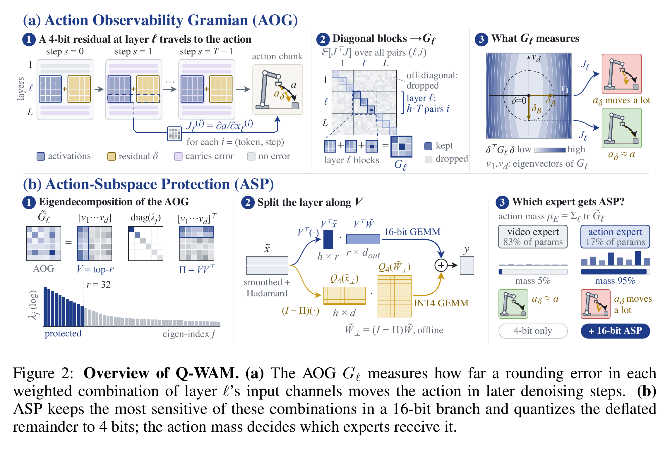
Q-WAM: protect action-sensitive subspaces
Measure action sensitivity; preserve the most influential directions.
Q-WAM · arXiv:2609.33269v1 · Figure 2 · Figure crop from original PDF
08
Notes:
Q-WAM Figure 2 原图。AOG（Action Observability Gramian）估计layer输入误差经过后续denoising传播到最终action的敏感方向；ASP把最敏感子空间留在16-bit branch，剩余部分4-bit。图中的95% action mass/17% action-expert parameters是论文对应设置下的统计，不是所有WAM通用常数。其benchmark主要是RoboTwin与real-world，不把这篇列成Fast-WAM LIBERO表的来源。
对于我们的VQ方案，action sensitivity已有先例，不能把“关注action敏感方向”单独视作novelty。下一步要验证敏感度是否能指导weight codebook，而不是机械复制一个高精度残差branch。
来源：Q-WAM: 4-Bit Quantization of World Action Models with Action-Subspace Protection, arXiv:2609.33269v1, Figure 2。https://arxiv.org/abs/2609.33269v1

Slide 9
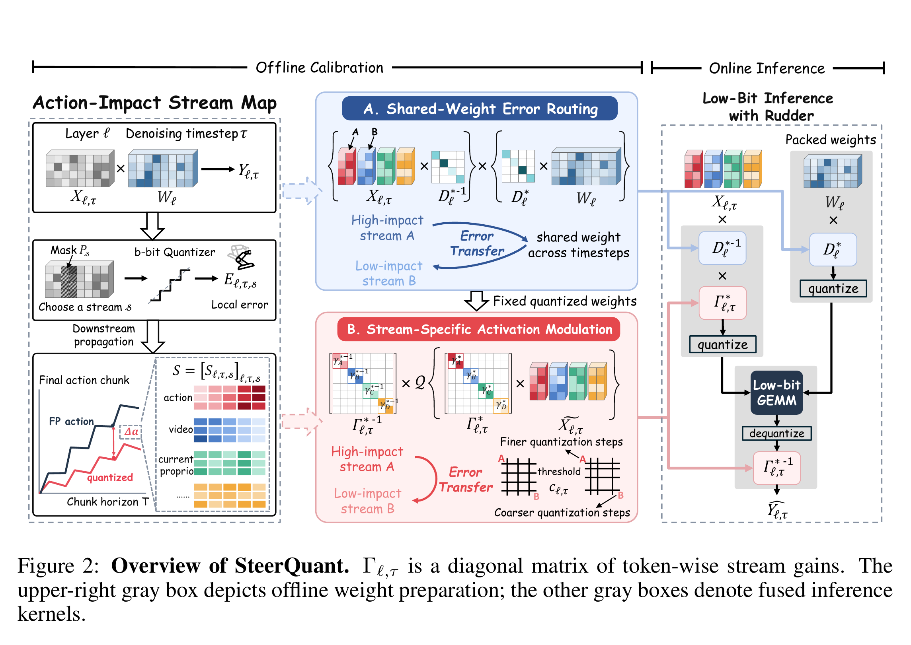
SteerQuant: route error away from actions
Action-impact calibration → error routing → fused low-bit inference
SteerQuant · arXiv:2609.39056v1 · Figure 2 · Figure crop from original PDF
09
Notes:
SteerQuant Figure 2 原图。先估计layer × denoising timestep × stream的action-impact map，再用shared-weight scaling与stream-specific activation modulation把量化误差转移到较低action-impact的stream。Online inference 的 Rudder 把 scaling、量化/反量化或output compensation与low-bit GEMM融合。它不是已实现的VQ lookup kernel，后续我们若做VQ需要设计codebook/index表示和lookup/decode/GEMM的路径。
来源：SteerQuant: Steering Quantization Error with Action-Guided Scaling in World-Action Models, arXiv:2609.39056v1, Figure 2。https://arxiv.org/abs/2609.39056v1

Slide 10
Next step: action-sensitive weight VQ
(a) Equivalent reparameterization
(b) Weight VQ
(c) Action inference
X
Scale + Hadamard
X̃ = XD⁻¹H
BF16 first
A8 / A4 later
Linear
Action
Aim: reduce activation outliers
Paired transform
W̃ = WDH
Sensitive codebook
C + vector indices
Reconstruct
Ŵ
W
Scale shift to the weight branch
Action sensitivity
M from calibration
Dashed path: offline calibration
Before quantization: X̃W̃ᵀ = XWᵀ when HHᵀ = I and D is invertible.
Proposed method · BF16 activations first; A8/A4 later · Outlier reduction must be measured
10
Notes:
这是待验证方案，不是实测结论。第一阶段先做weight VQ，activation维持BF16，使codebook效果可单独评估；之后再试A8/A4。SmoothQuant式D缩放与Hadamard H作用于同一个输入feature维度：若Y=XWᵀ，设X̃=XD⁻¹H、W̃=WDH，并满足D可逆、HHᵀ=I，则量化前X̃W̃ᵀ=XWᵀ。这个配对变换把缩放的负担转到weight branch，再用VQ处理变换后的weight groups。Hadamard只保证正交与norm保持，不能直接保证每个operator的outlier下降；需测activation tails、weight tails和operator placement。
Action sensitivity M从calibration估计，用于偏向保护敏感方向的codebook与assignment。必须和uniform/L2 codebook在相同bit/byte预算下比较，并记录closed-loop success，避免仅看weight reconstruction MSE。图中decode是概念路径，第一轮可先做fidelity验证；performance需要packed表示与native kernel。
来源：SmoothQuant https://proceedings.mlr.press/v202/xiao23c.html ; QuaRot https://papers.nips.cc/paper_files/paper/2024/hash/b5b939436789f76f08b9d0da5e81af7c-Abstract-Conference.html ; VPTQ https://aclanthology.org/2024.emnlp-main.467/ 。

Slide 11
Codebook geometry: prioritize sensitive directions
(a) A two-dimensional weight block
(b) Action-weighted distortion
Less sensitive
c₂ = (0, 0.6)
Action-weighted nearest
dₘ(v,c) = (v−c)ᵀM(v−c)
M = diag(9, 1) in this illustration
Sensitive direction
Euclidean distortion
c₁: 0.09 c₂: 0.36
w = (0, 0)
c₁ = (0.3, 0)
Euclidean nearest
Action-weighted distortion
c₁: 0.81 c₂: 0.36
Ellipse: equal action-weighted error
Lᵥq = Σⱼ (w̃ⱼ − c_zⱼ)ᵀ Mⱼ (w̃ⱼ − c_zⱼ)
Illustrative geometry, not measured data · M is an estimated PSD action-sensitivity metric
11
Notes:
这是人工构造的二维示意图，不是实验点或论文结果。权重block w=(0,0)，两个候选codewords：c₁=(0.3,0)、c₂=(0,0.6)。普通Euclidean distortion分别为0.09与0.36，会选择c₁。设action sensitivity metric M=diag(9,1)，action-weighted distortion分别为0.81与0.36，选择c₂。尽管c₂的Euclidean距离更远，它沿更不敏感方向引入误差。椭圆表示固定action-weighted error水平集；敏感方向容许更小偏差。
实际codebook需优化Σⱼ(w̃ⱼ−c_zj)ᵀMⱼ(w̃ⱼ−c_zj)。可用M≈E[JᵀJ]（J从变换后weight group到最终action的Jacobian，包含denoising），或低秩/梯度PSD proxy。逐组求和忽略cross-group terms，是local approximation。所有metric与codebook必须在同一transformed coordinates中定义。
第一轮消融：L2 VQ → +D/H → +action metric，固定storage预算与paired protocol。只有weight误差小不保证控制更好；需看action fidelity和paired closed-loop outcomes。

Slide 12
After VQ: cache, kernels and QAT
1 KV cache quantization
Test K/V precision after weight VQ; measure cache bytes and control fidelity.
2 Rudder-inspired VQ kernels
Fuse codebook lookup / decode with GEMM and scaling; test native end-to-end latency.
3 QAT, if GPU budget permits
Start with an ActionDiT pilot; direct WAM-control QAT remains a direction to investigate.
Order: weight-VQ fidelity → paired closed-loop evaluation → packed kernels → resource-dependent QAT
12
Notes:
先完成weight VQ的fidelity与closed-loop gate，再扩展：
1. KV cache quantization：把K/V视为persistent activation，量化对象与weight不同。先分开测试，避免沿用A4已经崩溃时的组合臂来归因KV4。验证cache error、packed bytes与控制结果。
2. Rudder-inspired VQ kernel：学习其融合思路，但重新设计codebook/index packed representation、lookup/decode、GEMM、scaling compensation以及模型集成。fake quant或离线压缩不等于native speedup；正式结论需paired native end-to-end latency与relevant fidelity。
3. QAT：resource-dependent extension。已核对的QuantWAMs、Q-WAM、SteerQuant都是PTQ。当前不宣称“全球没有人做WAM QAT”或已经证明novelty。若有GPU且PTQ诊断支持，先在Fast-WAM独立ActionDiT做小范围quantization-aware codebook/weight tuning，再推广到共享模型。需要训练预算和可复现的held-out control evaluation。
顺序：先数学变换和error mechanism → bounded fidelity pilot → paired closed-loop → packed/native performance。

