Slide 1

Latent + Action-Aware
WAM Quantization
Microscaling VQ, activation refinement & relational KL
Guo Yichen
College of Computing and Data Science (CCDS)
21 October 2026
Notes:
本次汇报顺序：已实现方法 → 所有有代表性的本地 LIBERO+ 闭环结果 → future intervention → 旧 loss 与闭环的差距 → Soft-bin + relational KL → potential contributions 与下一步。所有闭环数据来自已完成本地报告，截止 20 October 2026。

Slide 2
Latent + action-aware Microscaling VQ
Observation + language + proprioception
BF16 teacher · frozen
Video DiT
Future Zₜ
Action DiT
Actions aₜ
Shared
inputs
video K/V
Quantized WAM
Video DiT
VQ + A4
Own future Zₛ
Action DiT
VQ + A4
Actions aₛ
Latent loss
Action loss
MSE(first 10 × 6 motor actions) + ρc · NMSE(future latents)
614 target Linears; update codebooks + row gains. Latents exclude frame 0; motor loss excludes gripper.
2
Notes:
已实现的 Fast-WAM weight quantization 框架。Teacher 和 student 共享 observations、language、proprioception、sampler seeds。Student 通过自身生成的 future 构建 video K/V；不注入 teacher future 训练。所有 614 target Linear 覆盖 video/action/proprio 等目标模块。Weight calibration 更新 codebooks 和 row gains；indices、B32 exponents 和 transforms 固定。图为结构示意，tokens 数量不代表真实 tensor 大小。
Sources:
D:/Downloads/Final Year Project/experiment/idea-validation/fastwam-vq-c8-action-latent-plus/README.zh.md
D:/Downloads/Final Year Project/experiment/idea-validation/fastwam-vq-action-latent/README.zh.md
D:/Downloads/Final Year Project/Weekly Slides/2026-10-21_assets/method-imagegen-reference.png

Slide 3
Microscaling additive VQ weights
Transformed weight row
B32 = 8 vectors × d4
B32 = 8 vectors × d4
…
Codebook C₁
256 × 4 · BF16
e_g = round(log₂(block_RMS / r_row))
i₁ (8-bit)
× r_row × 2^(e_g)
+
Codebook C₂
256 × 4 · BF16
i₂ (8-bit)
BF16 row gain + B32 exponent
4 core bpw + 0.25 B32 bpw + codebooks / gains / transforms ≈ 4.27 bpw
Fixed indices + exponents; calibrate codebooks + row gains. VQ codewords remain BF16 values.
3
Notes:
每一 target Linear 共享两个 K=256,d=4 BF16 codebooks。每四个 scalar weight 使用两条 uint8 indices，core cost 为 16/4=4 bpw。每 output row 保留 BF16 RMS row gain r；沿 input dimension 每 32 个 weights 用一个 uint8 exponent，贡献 8/32=0.25 bpw。e_g=round(log2(block_RMS/r_row))，拟合中固定。有效预算含 codebooks、gains、tails 和 transforms，Fast-WAM row-scale≈4.020873，microscaling≈4.270878。Weight calibration 用 FP32 masters/STE 调整 BF16-stored books 与 row gains。
Sources:
D:/Downloads/Final Year Project/experiment/idea-validation/fastwam-vq-microscale/README.zh.md
D:/Downloads/Final Year Project/experiment/idea-validation/fastwam-vq-microscale/RESULTS.zh.md
D:/Downloads/Final Year Project/experiment/idea-validation/fastwam-vq-c8-action-latent-plus/README.zh.md

Slide 4
Per-channel scaling + activation clipping
Activation path
X
Smooth 0.5
+ H128
z
÷ D
v
Dynamic
signed A4
BF16
dense Linear
Weight path
Frozen VQ
representation
Decode Wq
BF16(Wq · D)
cache once
s_t = r_l · max |v_t| / 7
q = clamp(round(v / s_t), −7, 7)
Learn D per channel + r_l per Linear on C80; keep VQ weights fixed. BF16 KV; native VQ kernel pending.
4
Notes:
这是 per-input-channel scaling + per-Linear activation clipping，不是每 channel 一个 clipping threshold。D=2^log2_D 为每个 physical input channel 一个正的 continuous scale；r_l 为每 Linear 一个 ratio，跨 token/denoising steps 共享。先对 input 施加已冻结 Smooth0.5/H128，然后 v=z/D；每 token s=r_l max|v|/7，signed A4 q=clamp(round(v/s),-7,7)。decoded BF16 Wq 乘相同 D 后以 BF16 缓存。忽略 rounding 时 compensating Linear 恒等；已 quantized 情况下改变 error。C80 refinement 从 C8 rho1.5 开始，80 updates，只训 D/r_l，VQ 参数冻结。使用 coupled dynamic-absmax surrogate 和 STE。
Sources:
D:/Downloads/Final Year Project/experiment/idea-validation/fastwam-vq-per-channel-scaling-clipping/channel_banks.py
D:/Downloads/Final Year Project/experiment/idea-validation/fastwam-vq-c80-per-channel-plus/README.zh.md

Slide 5
Fast-WAM: LIBERO+ local baselines
Frozen paired cohort: 4 suites × 7 perturbations × 10 variants = 280 episodes / arm
Method | Eq. bpw | Spatial | Object | Goal | Long | Overall
BF16 | 16.00 | 56 | 55 | 51 | 54 | 216 (77.14%)
QuaRot adapted | ≈4.13† | 51 | 52 | 45 | 47 | 195 (69.64%)
SpinQuant adapted | ≈4.13† | 55 | 51 | 48 | 49 | 203 (72.50%)
Smooth + H128 Scalar | 4.14 | 53 | 52 | 47 | 48 | 200 (71.43%)
Row-scale VQ + A4 | 4.02 | 54 | 53 | 47 | 48 | 202 (72.14%)
B32 Micro VQ + A4 | 4.27 | 56 | 51 | 46 | 51 | 204 (72.86%)
Microscaling VQ: 204/280 vs local SpinQuant 203/280
Overall denominator: 280; suite cells: /70. Low-bit arms: W4A4. † bpw estimates exclude rotation/tail overhead.
5
Notes:
所有 rows 都来自本地完成的 frozen 280-variant cohort，不是 paper-reported numbers。每 suite 分母 70。QuaRot/SpinQuant 是针对 Fast-WAM 的本地 adaptation，不等同官方完整 recipe。Scalar 与 rotation baselines 实际采用 native packed S4 path，而 VQ 是 decode BF16；本表只比较 closed-loop success 与编码预算，不比较 latency。不同 arm calibration 覆盖和目标不同，不是单因素消融。Rotation bpw 的4.125是4bit code+BF16 scale/128 的估算，未把 rotations/tails 算入，因此加 dagger，避免误报为实测全 overhead payload。
Sources:
D:/Downloads/Final Year Project/experiment/idea-validation/fastwam-vq-plus/results/RESULTS.zh.md
D:/Downloads/Final Year Project/experiment/idea-validation/fastwam-rotation-baselines/protocol.json
D:/Downloads/Final Year Project/experiment/idea-validation/fastwam-smooth-scalar-plus/source_receipts/receipt.json

Slide 6
Fast-WAM: supervision and refinement
A+Z: action+latent · C8 weight calibration / C80 activation refinement
Method | Eq. bpw | Spatial | Object | Goal | Long | Overall
BF16 | 16.00 | 56 | 55 | 51 | 54 | 216 (77.14%)
B32 Micro VQ + A4 | 4.27 | 56 | 51 | 46 | 51 | 204 (72.86%)
C8 A+Z, ρ0.1 · 2 epochs | 4.27 | 50 | 54 | 48 | 49 | 201 (71.79%)
C8 A+Z, ρ1.5 · 1 epoch | 4.27 | 51 | 54 | 48 | 53 | 206 (73.57%)
C80 clip-only | 4.27 | 51 | 54 | 50 | 52 | 207 (73.93%)
C80 joint VQ + clip | 4.27 | 52 | 53 | 48 | 49 | 202 (72.14%)
C80 channel scales + clip | 4.28 | 54 | 56 | 46 | 47 | 203 (72.50%)
Best completed low-bit result here: clip-only 207/280 (73.93%)
Overall: /280; suite: /70. Target-weight bpw includes metadata; VQ uses decoded BF16 + fake A4.
6
Notes:
同一 frozen 280-episode cohort 的全部后续完成配置。C8表示weight calibration contexts；C80表示 activation-refinement contexts，不是 rollout 数。ρ0.1 完整2epochs/16updates，ρ1.5为1epoch/8updates；这是各自冻结配置，不是matched training budget消融。C80 clip-only207，joint202，per-channel203；joint per-channel虽有fixed-input结果尚未发现完成闭环，不能加入completed表。该cohort未有独立seed重复，不应对1—5个success小差异宣称稳定统计优势。
Sources:
D:/Downloads/Final Year Project/experiment/idea-validation/fastwam-vq-c8-action-latent-plus/results/RESULTS.zh.md
D:/Downloads/Final Year Project/experiment/idea-validation/fastwam-vq-c80-clip-joint-plus/RESULTS.zh.md
D:/Downloads/Final Year Project/experiment/idea-validation/fastwam-vq-c80-per-channel-plus/RESULTS.zh.md

Slide 7
Cosmos Policy: LIBERO+ transfer
Direct policy · C8 calibration · same 280 paired variants per arm
Method | Eq. bpw | Spatial | Object | Goal | Long | Overall
BF16 | 16.00 | 59 | 62 | 54 | 58 | 233 (83.21%)
SpinQuant adapted W4A4 | 4.13 | 54 | 61 | 46 | 60 | 221 (78.93%)
Action+latent Micro VQ | 4.29 | 57 | 62 | 49 | 58 | 226 (80.71%)
+5 successes vs SpinQuant; −7 vs BF16
VQ uses 3.92% more target-weight bits than SpinQuant.
Whole-DiT bpw: 5.45 vs 5.31; transferability of the current recipe is demonstrated.
Overall: /280; suite: /70. bpw covers target weights. Decoded BF16 / fake A4; native speedup remains untested.
7
Notes:
Cosmos-Predict2-2B direct policy，planning disabled。三臂840episodes全部完成，每臂280。5denoising steps、16action chunk并执行16steps；与Fast-WAM10/10和执行10steps不同，不能跨model数值比较来归因量化方法。C8共享observations但teacher由Cosmos自身产生。VQ学习codebooks/rowgains，目标为16×6motor MSE+future-image slots6/7 NMSE。SpinQuant200updates，VQ16updates且objectives不同，因此不是action/latent loss贡献的单因素消融。有效bpw均含编码开销；whole DiT bpw另计未量化参数。
Sources:
D:/Downloads/Final Year Project/experiment/idea-validation/cosmos-policy-c8-w4a4/RESULTS.zh.md
D:/Downloads/Final Year Project/experiment/idea-validation/cosmos-policy-c8-w4a4/retrieved/results/evaluation/summary.json

Slide 8
Does protecting the future help downstream actions?
Future donor
Parent / action-only / +latent
Fixed BF16 reader
video K/V → Action DiT
a
Future donor | First-10 motor RMSE ↓ | Vs action-only
Parent | 0.036145 | −12.36%
Action-only | 0.041243 | Reference
Action+latent | 0.035084 | −14.93%
Protecting future latents improves mean downstream motor fidelity
Earlier row-scale VQ family: 22 cases × 2 seeds; 13/22 improve. Fixed-input teacher fidelity; no closed-loop claim.
8
Notes:
干预冻结 downstream BF16 reader，包括 video prepare/prefill、action DiT/proprio 等，注入不同 donor 的 final future，重新构建 K/V。完整60contexts包括8cal、4selection×2seed、22test×2seed；表格是22test cases先平均2seeds的case mean。BF16 donor自重放误差0，Parent=0.036144691，Action-only=.041243219，Action+latent=.035083670。13/22first10改善，full32/late22各14/22。是已见cohort的fixed-input intervention，0 executed episodes，不是真实future accuracy或新泛化证据。
Sources:
D:/Downloads/Final Year Project/experiment/idea-validation/fastwam-vq-future-reader/retrieved/results/analysis_teacher/REPORT.zh.md

Slide 9
Future protection across readers
The mean gain transfers across readers
Fixed student reader | A-only future | A+latent future
Action-only | 0.058110 | 0.053481
Action+latent | 0.058677 | 0.052951
Most of the gain can be reproduced by reducing future error energy
Future donor · fixed BF16 reader | Future NMSE ↓ | Motor RMSE ↓
A: action-only | 0.093011 | 0.041243
C: A, NMSE matched to B | 0.071786 | 0.036074
B: action+latent | 0.071787 | 0.035084
B vs C improves 11/22 cases; no robust extra benefit at matched NMSE. This supports latent fidelity, not a unique mechanism.
9
Notes:
左表来自2×2cross-reader intervention，reader固定action-only或action+latent时替换future donor。这里reader不再是BF16。Action-only reader mean .058110442→.053481176，action+latent reader .058676505→.052951009。分别10/22、12/22cases改善，平均收益不等于每case收益。右表是另一个fixedBF16reader NMSE-matched control：C=T+alpha(A−T)，经有界BF16correction逐context匹配B的NMSE，alpha不使用action选值。B−C mean−.00099049但median+.000042169，11/22改善，leave-one-out可变正，full32/late22比C差。原均值收益约84%由总future误差幅度降低重现。不能宣称已确认特定semantic/spatial有害drift。
Sources:
D:/Downloads/Final Year Project/experiment/idea-validation/fastwam-vq-future-reader/retrieved/results/analysis_cross/REPORT.zh.md
D:/Downloads/Final Year Project/experiment/idea-validation/fastwam-vq-future-nmse-matched/RESULTS.zh.md

Slide 10
MSE fidelity and closed-loop success
Original objective: L = MSE_action + ρc · NMSE_future
c is frozen from initial calibration loss values; ρ = 1.5
C80 refinement | Motor RMSE ↓ | Latent NMSE ↓ | LIBERO+ success ↑
Clip-only | 0.043848 | 0.054848 | 207/280 · 73.93%
Joint VQ + clipping | 0.041847 | 0.048973 | 202/280 · 72.14%
Per-channel + clipping | 0.031641 | 0.055378 | 203/280 · 72.50%
−27.84% motor RMSE, but −4 closed-loop successes vs clip-only
Motivation: preserve the structure of action sequences and future latents,
then test whether the objective better tracks rollout failures.
10
Notes:
原训练loss是first10motor MSE+rho*c*futureNMSE，c=0.028303017887797623，rho1.5，lambda=.04245452683169643。RMSE仅用来报告，优化的是MSE。c依据初始化calibrationmean冻结，rho不是gradient ratio。Fixedinput来自40heldoutcases×2seeds，四suite等权。C80clip .0438484373/.0548481241，joint .0418468372/.0489733362，perchannel .031641466/.055377875；对应闭环207/202/203。Heldout metric和closedloop是不同测量而且访问状态分布不同。
Sources:
D:/Downloads/Final Year Project/experiment/idea-validation/fastwam-vq-per-channel-scaling-clipping/results/RESULTS.zh.md
D:/Downloads/Final Year Project/experiment/idea-validation/fastwam-vq-c80-clip-joint-plus/RESULTS.zh.md
D:/Downloads/Final Year Project/experiment/idea-validation/fastwam-vq-c80-per-channel-plus/RESULTS.zh.md

Slide 11
Soft-bin KL: preserve absolute values
Teacher xₜ
Shared frozen
channel normalization
16-bin distribution
Gaussian CDF mass
σ = 0.375
Student xₛ
z = (x − μ_c) / max(σ_c, 0.02)
15 interior edges: −3.5 … 3.5 + 2 tails
L_bin = mean over scalar positions KL(p_teacher || p_student)
Apply separately to first 10 × 6 motor values and future latent values.
Soft-bin keeps the absolute-value anchor when relation distances have blind spots.
11
Notes:
真实实现softbin_loss.py以Gaussian CDFdifference而不是centroidsoftmax生成每scalar16bin分布。z=(x−mu_c)/max(std_c,.02)，mu/std仅完整C80teacher计算并冻结。15interioredges[-3.5,3.5]等间距，sigma=.375，两个无限tail。每一对应scalar位置算KL(teacher||student)再平均，不是整条actiontrajectory先pool成histogram。Teacher detached。alpha_a=.01230247928,alpha_z=.31297895225，初始C80 MSE/KL和NMSE/KL配平，保留原rho*c。只训D/r_l，80updates，固定final80；books/gains/indices/exponents不变。
Sources:
D:/Downloads/Final Year Project/experiment/idea-validation/fastwam-vq-dual-kl/softbin_loss.py
D:/Downloads/Final Year Project/experiment/idea-validation/fastwam-vq-dual-kl/results/prepare/loss_scaling.json

Slide 12
Temporal / spatial relational KL
Action: ordered temporal windows
Latent: spatial + temporal graph
2 future times × 2 views × 7 × 7
196 tokens × 48 features
10 steps × 6 motor dimensions
time 1
time 2
[a₁,a₂,a₃] [a₂,a₃,a₄] …
8 ordered tokens × 18 features
Neighbors: all other windows
Self-pairs masked
8 spatial neighbors + same-position time edge
2×2 pool per view; no cross-camera edges
dᵢⱼ = mean (uᵢ − uⱼ)² p(j|i) = softmax(−dᵢⱼ / τ)
Match teacher → student neighbor distributions with KL; frozen teacher statistics and temperature.
12
Notes:
关系代码用每feature mean-squared pairwise distance，不是Gram matrix。Action标准化first10×6，经length3stride1 orderedwindows得到8×18tokens，全部非selfwindows相邻。Latentshape[1,48,3,14,28]去frame0，按widthsplit两camera各14×14，各自2×2avgpool到7×7，2times×2views×49=196token×48features。邻边是samecamera,sametime的8neighbors以及sameposition跨time。Boundary spatial节点少于8邻居。无跨cameraedge，无action-latent强制时间插值。Teacher概率detach，tau依据C80teacherpositiveedgedistancemedian冻结。Softbin检测关系对整体translation/signflip等的盲区。
Sources:
D:/Downloads/Final Year Project/experiment/idea-validation/fastwam-vq-relational-kl/relational_loss.py
D:/Downloads/Final Year Project/experiment/idea-validation/fastwam-vq-relational-kl/README.zh.md

Slide 13
The combined KL objective
L = α_a [ L_bin,a + β_a L_temporal,a ]
+ λ α_z [ L_bin,z + β_z L_spatiotemporal,z ]
Component | Definition / calibration rule
α_a, α_z | Initial C80 MSE / soft-bin KL; NMSE / soft-bin KL
λ = ρc | Original action–latent balance; ρ=1.5, λ≈0.04245
τ_a, τ_z | Median positive C80 teacher neighbor distance
β_a, β_z | 0.25 × soft-bin KL / relation KL under fixed teacher noise
Only student D and clipping ratios are updated.
All statistics and weights are frozen before training; teacher is detached.
13
Notes:
L=alpha_a*(action_KL+beta_a*action_temporal_KL)+rho*c*alpha_z*(latent_KL+beta_z*latent_spatiotemporal_KL)。Teacheronlycalibrationfitting：alpha用C80initMSE/KL与NMSE/KL；tau_a=.05844502896,tau_z=.42243281007；beta_a=.61968510916,beta_z=27.14823378066，通过预设standardizednoise std .1的0.25relativeweight配平。0.25并不意味着真实modelerror或gradient中占25%。D/r_l独立从C8rho1.5checkpoint初始化，各80updates，未用heldoutselectfinal80。Distance关系本身有translation/signflip/部分timereversal盲区，softbin绝对anchor补足，不能声称所有结构错误可识别。
Sources:
D:/Downloads/Final Year Project/experiment/idea-validation/fastwam-vq-relational-kl/results/prepare/summary.json
D:/Downloads/Final Year Project/experiment/idea-validation/fastwam-vq-relational-kl/protocol.json
D:/Downloads/Final Year Project/experiment/idea-validation/fastwam-vq-relational-kl/results/ANALYSIS.zh.md

Slide 14
KL refinement: current evidence
Same held-out 40 cases × 2 seeds · fixed final80 checkpoints
Refinement loss | Motor RMSE ↓ | Latent NMSE ↓ | Temporal KL ↓ | Latent relation KL ↓
MSE + NMSE (historical) | 0.031641 | 0.055378 | — | —
Soft-bin | 0.032330 | 0.053033 | 0.040418 | 0.006397
Soft-bin + relational | 0.031438 | 0.054296 | 0.034485 | 0.006147
Adding relations: temporal KL −14.68%, latent relation KL −3.91%
Motor RMSE −2.76%, while latent NMSE rises 2.38% vs soft-bin
Paired LIBERO+ evaluation is in progress; final success rates are pending.
14
Notes:
本表来自原40heldoutcase×2seeds，先seedcase平均再四suite等权。Softbinrelationaltrain各1trajectory、80updates，固定final80，不在heldout选ckpt。原MSEfinal80是历史同协议endpoint重放比较。Softbin.03232986/.053033005，relational.031438487/.054295895；temporal .040418109→.034484781；spatiotemporal .0063970953→.006147169；composite .0059133057→.0057434071。KL闭环评测在最近local快照431/560episode记录，未有completecriterion。进度不是success，pending不能替代最终rates。
Sources:
D:/Downloads/Final Year Project/experiment/idea-validation/fastwam-vq-relational-kl/results/ANALYSIS.zh.md
D:/Downloads/Final Year Project/experiment/idea-validation/fastwam-vq-relational-kl/results/aggregate/summary.json
D:/Downloads/Final Year Project/Weekly Slides/2026-10-21_assets/cosmos_loss.json

Slide 15
Potential contributions
01
Identify future-latent fidelity as a key quantization target
Evidence: fixed-reader interventions link latent preservation to mean action fidelity.
02
Develop latent + action relational distillation for WAMs
Aim: preserve value and structure, and better anticipate rollout error.
03
Build a VQ framework with competitive performance at similar bpw
Demonstrated on Fast-WAM and Cosmos Policy; “first” requires a prior-art audit.
04
Deliver native kernel acceleration for the VQ framework
Planned contribution · not implemented yet; no native speedup claimed.
15
Notes:
用户的四点contribution按证据强度润色：1当前fixedinputfutureintervention支持latentfidelity的重要性，但likelyvulnerable机制还待验证；2loss已实现，forecastrollouterror仍为researchgoal，当前没有证明predictiveassociation；3Fast-WAM+Cosmos框架/闭环已实现，similarbpw下cohortcurrentrecipecompetitive，但first需priorartcheck且不声称SOTA或统计显著；4nativekernel尚未实现。所有措辞作为proposedpapercontributions，不把目标写成completedclaim。

Slide 16
Next steps
01
Refine KL against closed-loop outcomes
Finish the paired run; inspect failure traces and improve loss balance.
02
Run controlled ablations
Soft-bin / temporal / spatial terms; action–latent balance; D versus clipping.
03
Expand models and benchmarks
Cosmos Policy on LIBERO / LIBERO+; LingBot-VA2 on RoboTwin 2.0.
04
Validate on a real robot and implement native acceleration
Measure task success and end-to-end latency; establish the actual deployment gain.
Hope to catch CVPR :)
16
Notes:
近期优先完成冻结checkpoint的pairedLIBERO+评测；loss优化需以闭环success与失败轨迹为目标，同时保留原cohortcontrols。候选消融：MSEvssoftbin、action-onlyvslatent-onlyvsboth、temporal-onlyvsspatial/temporal-latent、D/r的分离、C8/C80等校准规模，匹配bpw与预算。换baseline：CosmosPolicy on LIBERO/LIBERO+，LingBot-VA2 on RoboTwin2.0，均为planned未实现本轮不保证可行性/日期。真实robot需要确认hardware/tasks，报告success、rollout error与endtoendlatency。Kernel关注decode/transformprofiling、batchedtransform接线、nativeVQ执行与真实latency，不将compressedpayload当作VRAM。CVPR表达愿望无未查证deadline。

Slide 17
Questions and Discussion
Notes:
讨论重点：当前proxy与闭环目标之间的差距、KL结构设计的优先级、跨模型和真机验证范围，以及kernel工作量。

Slide 18
Appendix: protocol and bit-budget scope
Condition | Fast-WAM | Cosmos Policy
Closed-loop cohort | 4 × 7 × 10 = 280 variants / arm | Same 280-variant protocol
Sampler / chunk | 10 video + 10 action steps; execute 10/32 | 5 denoising steps; execute 16/16
Target weights | 614 Linear layers; 6.016B weights | 280 Linear layers; 1.762B weights
VQ encoding | d4, 2 × K256 BF16 books, B32 | Same encoding family
Execution | Decoded BF16; fake A4; BF16 KV | Decoded BF16; fake A4; BF16 KV
Equivalent bpw = encoded payload bytes × 8 / target weight count
Includes quantizer metadata where measured; excludes activations, KV and non-target model weights.
Encoded bpw is not runtime VRAM. Fast-WAM rotation baselines use a different native S4 path.
18
Notes:
FastWAM模型614targetLinears/6016317440weights。encodedbpw统一bytes*8/Ntarget。Scalar receipt包含transforms，VQ包含indices/books/gains/B32exps/transforms；perchannel另计FP32log2D。Rotation只有code+G128scaleestimate4.125，未有统一completepayload。Cosmos同target280Linear1761607680weights。两model不同steps/chunks因此不跨模型比较latency或success来声称量化方法优劣。闭环manifest280是固定subset，不是全LIBEROPlusbenchmark。
Sources:
D:/Downloads/Final Year Project/experiment/idea-validation/fastwam-vq-plus/results/RESULTS.zh.md
D:/Downloads/Final Year Project/experiment/idea-validation/fastwam-rotation-baselines/protocol.json
D:/Downloads/Final Year Project/experiment/idea-validation/fastwam-smooth-scalar-plus/source_receipts/receipt.json
D:/Downloads/Final Year Project/experiment/idea-validation/fastwam-vq-c80-per-channel-plus/RESULTS.zh.md
D:/Downloads/Final Year Project/experiment/idea-validation/cosmos-policy-c8-w4a4/RESULTS.zh.md

Slide 19
Appendix: C80 activation refinements
Configuration | Motor RMSE ↓ | Latent NMSE ↓ | Closed-loop successes
C8 ρ1.5 baseline | 0.044297 | 0.060877 | 206/280
Clip-only | 0.043848 | 0.054848 | 207/280
B32 scaling + clipping | 0.043987 | 0.054152 | Not evaluated
Joint VQ + clipping | 0.041847 | 0.048973 | 202/280
Per-channel + clipping | 0.031641 | 0.055378 | 203/280
Joint VQ + per-channel | 0.032668 | 0.048842 | Not evaluated
Per-channel scaling substantially improves motor fidelity.
Joint optimization and latent fidelity trade-offs still need closed-loop explanation.
19
Notes:
Fixedinputevidence：same40heldoutcases×2seed/equal4suites。Baseline.044296774/.060877371;clip.043848437/.054848124;b32.043986743/.054151555;joint.041846837/.048973336;perchannel.031641466/.055377875;jointperchannel.032668?.048842。Jointperchannel数字从周报四舍五入，完整源results。本表用于记录已实现的可训练参数组合，不给没有完成closedloop的row补成功率。
Sources:
D:/Downloads/Final Year Project/experiment/idea-validation/fastwam-vq-per-channel-scaling-clipping/results/RESULTS.zh.md
D:/Downloads/Final Year Project/experiment/idea-validation/fastwam-vq-joint-per-channel/results/RESULTS.zh.md
https://app.notion.com/p/3fd44c7da965815ead32f7858e8e98db

Slide 20
Appendix: execution cost and kernel work
Model / implementation | Warm full-query mean | Interpretation
Fast-WAM C80 clip / joint | 4.99 s / 4.96 s | Decoded BF16 + batched H128 + fake A4
Fast-WAM per-channel + clipping | 4.91 s | Cached BF16 compensated weights
Cosmos BF16 / SpinQuant / VQ | 0.594 / 1.057 / 10.042 s | VQ path still uses block-wise H128
Native VQ speedup is not implemented
Profile transform / decoding costs and connect batched transforms.
Develop the native VQ path; measure end-to-end latency and memory.
Different rollout trajectories yield different query counts; these means are not paired latency benchmarks.
20
Notes:
warmfullactionquerycost来自不同rolloutquery流，非fixedinputpairedbenchmark。FastWAMclip4.99sec/joint4.96/perchannel4.90508；CosmosBF16.59399,Spin1.05653,VQ10.04213。CosmosVQ在线blockH128path未接入batchedtransform，即使summary标签写batched也不能声称已生效。此页保持实现scope避免把编码4bpw当成nativeacceleration。
Sources:
D:/Downloads/Final Year Project/experiment/idea-validation/fastwam-vq-c80-clip-joint-plus/RESULTS.zh.md
D:/Downloads/Final Year Project/experiment/idea-validation/fastwam-vq-c80-per-channel-plus/RESULTS.zh.md
D:/Downloads/Final Year Project/experiment/idea-validation/cosmos-policy-c8-w4a4/RESULTS.zh.md

Slide 21
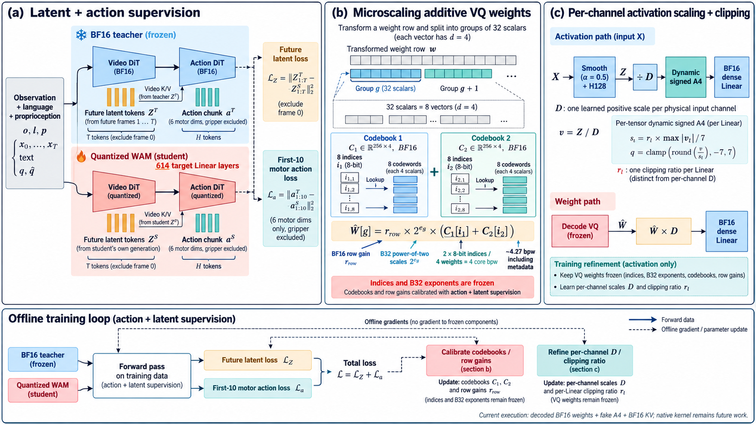
Appendix: ImageGen method design
Generated design reference; the method on slides 2–4 is rebuilt as editable PowerPoint objects.
21
Notes:
本页是用户要求的built-inimagegen学术图视觉设计参考，图内label仅作示意，不作为数值证据。正式方法描述以slides2—4和11—13的可编辑objects与源码为准。
Sources:
D:/Downloads/Final Year Project/Weekly Slides/2026-10-21_assets/method-imagegen-reference.png
D:/Downloads/Final Year Project/Weekly Slides/2026-10-21_assets/imagegen-prompts.txt

Slide 22
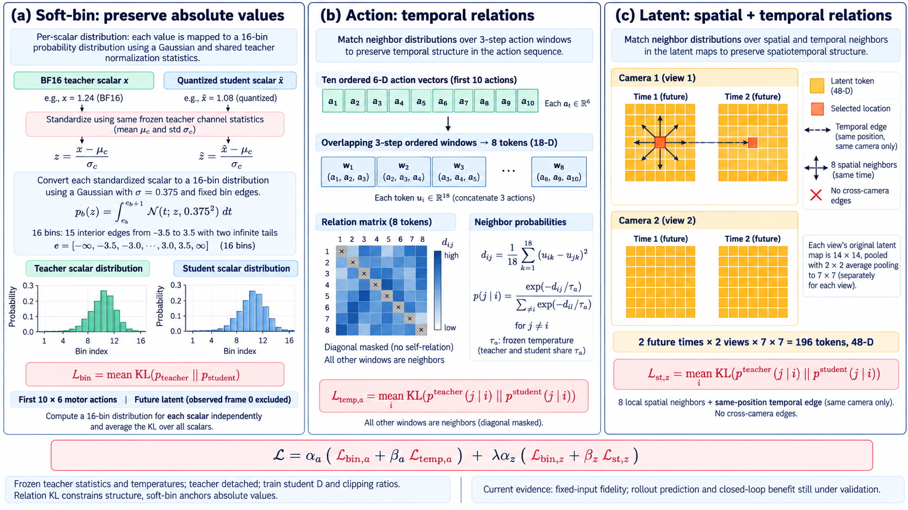
Appendix: ImageGen loss design
Generated design reference; editable loss definitions and diagrams are on slides 11–13.
22
Notes:
本页是用户要求的built-inimagegen学术图视觉设计参考，图内label仅作示意，不作为数值证据。正式方法描述以slides2—4和11—13的可编辑objects与源码为准。
Sources:
D:/Downloads/Final Year Project/Weekly Slides/2026-10-21_assets/loss-imagegen-reference.png
D:/Downloads/Final Year Project/Weekly Slides/2026-10-21_assets/imagegen-prompts.txt

