Slide 1


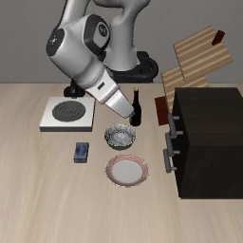
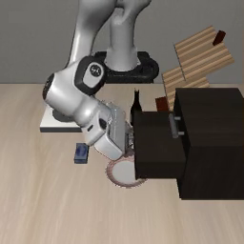
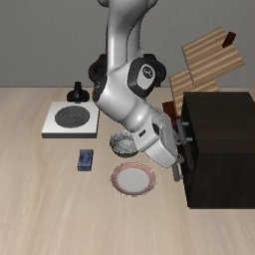
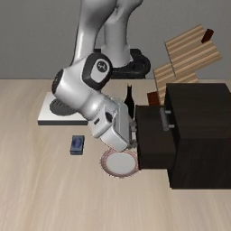
LAVQ
Forward / workflow
Reference
Metric / guidance
Table update
Frozen (fixed reference)
Calibrated lookup table (editable)
1
Reader metric
2
Future-aware bit allocation
3
Trellis-coded initialization
Full-precision
future z*
Action
Fixed total bit budget
Future-fidelity
gain / added bit
bₗ
Trellis (common code family)
π(a
*
| z
*
)
R*
Future-generating
groups
…
+1 bit
Wₗ
Shared table C
Ŵₗ
…
…
Δg₁ ↓
Rademacher probes
Δg = 0
groups
…
−1 bit
Δg₂ ↓
…
(Jacobian-vector backpropagation)
Other
layers
…
…
t₁
t₂
t₃
t₄
Reader-aware metric M
Codes cₗ
…
M = 𝔼[Jᵀ D J]
0
1
0
1
1
0
≈
…
+
∑
n
b
≤ B ∑
n
Mixed bit widths {b_{l}}
Low-rank + diagonal + identity
…
l
l
l
l
l
1
2
3
4
1–4 bits · one code family
Fixed codes
Shared tables
Initialize student
4
Shared-table calibration
Deployment
Full-precision WAM (teacher)
Frozen-reader consistency K
Codes + scales + calibrated tables
Calibration contexts (o, ℓ)
z*
a*
G*
R*
π(R*(z*))
0
1
0
1
…
“open the drawer”
…
z*
R*
C_{g} ← C + ΔC_{g}
Future error Z_{M}
π(R*(ẑ))
KL
Z_{M} =
δz^{T} M δz
Action error A
ẑ
L = A + λ_{M}Z_{M} + βK
Standard trellis decoder
||z*||²
Export
δz = ẑ − z*
K = KL(π(R*(z*)) || π(R*(ẑ)))
Quantized WAM (student)
Quantized WAM
ẑ
â
ẑ
â
Ĝ
R̂
…
Ĝ
…
R̂
Codes fixed
Shared by
role / bit width
Update shared tables
0
1
0
1
1
0
…
C_{g} = C + ΔC_{g}
Same bit budget
No extra storage
Notes:
Figure 2: LAVQ. Layout and content faithfully reconstructed from D:/Downloads/Final Year Project/CVPR2027/figures/figure2_lavq_method.png. All text, matrices, trellis, tensors, icons and lines are editable native PowerPoint objects. The only raster source is the user-provided D:/Downloads/Final Year Project/CVPR2027/figures/libero_sim_screenshot.png, reused as requested for the left context and right deployment illustrations. Repeated screenshot thumbnails are illustrative, not new experimental trajectory frames. Method content source: CVPR2027/sec/3_motivation.tex and sec/4_method.tex. The role of scales during calibration remains unspecified in the manuscript; the diagram fixes codes and highlights shared-table calibration.

