Slide 1
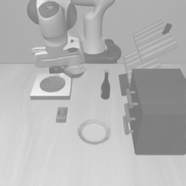

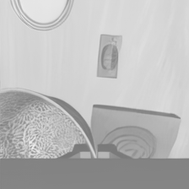

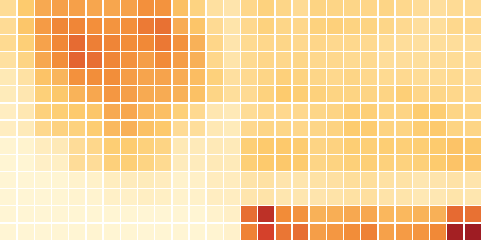
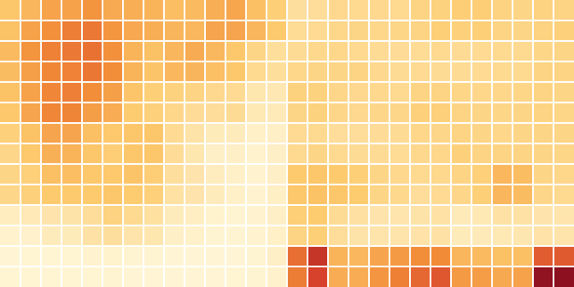
third-person view
wrist view
share
Across contexts
2%
1
0.5
0.86
0.19
stable in
location
not in
direction
0

