Slide 1
Data Simulation on Relation of Prenatal Phenylalanine Exposure to Infant and Childhood Cognitive Outcomes --Siyang Zeng
Simulate data according to the given statistics.
Analyze the variables.
Model the relation between prenatal exposure to phenylalanine (Phe) and measures of offspring intellectual development.
Estimate the developmental relations of maternal demographic, pregnancy-related, and prenatal variables on offspring intelligence.
Reference:
Widaman, K. & Azen, C. (2003). Relation of Prenatal Phenylalanine Exposure to Infant and Childhood Cognitive Outcomes: Results From the International Maternal PKU Collaborative Study. Pediatrics, 112(Supplement 4), 1537-1543. Retrieved from http://pediatrics.aappublications.org/content/112/Supplement_4/1537.

Slide 2
Method
Variable | N | Mean | SD | Minimum | Maximum
Mother’s age (y) | 412 | 24.1 | 4.1 | 16 | 36
Mother’s Verbal IQ | 376 | 85.6 | 12.7 | 22 | 129
Mother’s Performance IQ | 378 | 88.5 | 14.4 | 47 | 132
Mother’s Full-scale IQ | 379 | 85.9 | 13.7 | 40 | 130
Weight gain (lb) | 366 | 29.0 | 14.1 | −13 | 70
SD of Phe (μmol/L) | 408 | 165 | 90 | 6 | 468
Average Phe exposure (μmol/L) | 412 | 494 | 269 | 78 | 1698
Weeks’ gestation at term | 412 | 39.2 | 1.9 | 28.7 | 43.3
Birth length (cm) | 406 | 49.0 | 3.1 | 39.0 | 56.5
Birth weight (g) | 411 | 3068 | 562.8 | 1389 | 4886
Birth head circumference (cm) | 403 | 32.8 | 2.0 | 26.0 | 38.0
Bayley MDI at 1 y | 283 | 100.1 | 20.3 | 49 | 151
Bayley PDI at 1 y | 265 | 98.1 | 18.3 | 49 | 138
From the given summary statistics of each variable, determine its distribution.
Generate the summary statistics of the variables to see whether they match with what’s proposed.
Costruct linear regression model to predict interested variables from the others.
Bayley MDI ~ Average Phe exposure + prenatal variables
Bayley PDI ~ Average Phe exposure + prenatal variables
Birth weight ~ Average Phe exposure + prenatal variables

Slide 3
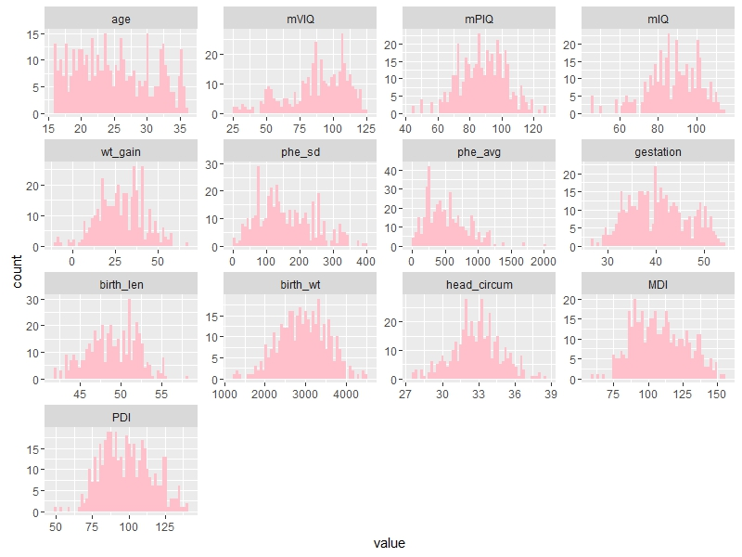
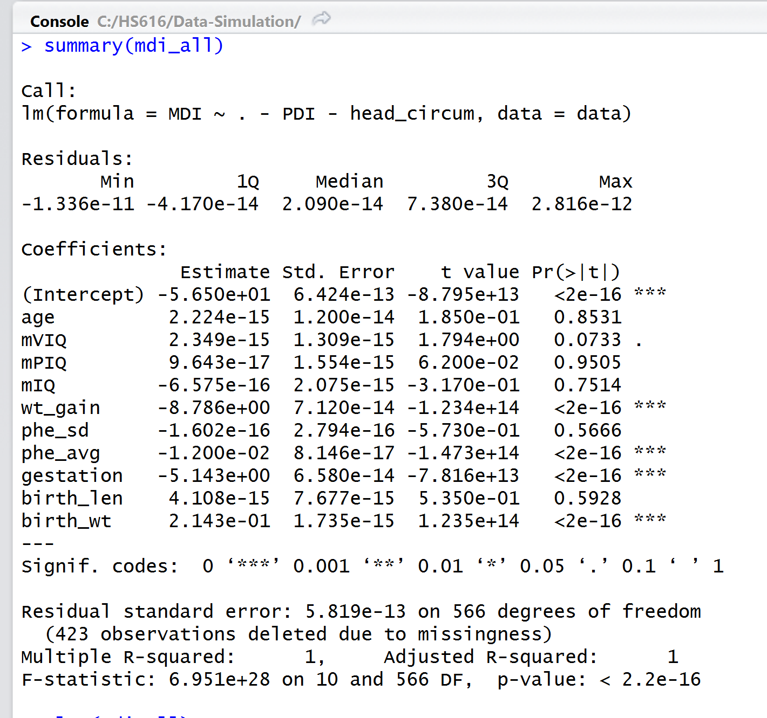
Results

Slide 4
Variable | N | Mean | SD | Minimum | Maximum
Mother’s age (y) | 412 | 24.1 | 4.1 | 16 | 36
Mother’s Verbal IQ | 376 | 85.6 | 12.7 | 22 | 129
Mother’s Performance IQ | 378 | 88.5 | 14.4 | 47 | 132
Mother’s Full-scale IQ | 379 | 85.9 | 13.7 | 40 | 130
Weight gain (lb) | 366 | 29.0 | 14.1 | −13 | 70
Variability (SD) of Phe (μmol/L) | 408 | 165 | 90 | 6 | 468
Average Phe exposure (μmol/L) | 412 | 494 | 269 | 78 | 1698
Gestation at term (weeks) | 412 | 39.2 | 1.9 | 28.7 | 43.3
Birth length (cm) | 406 | 49.0 | 3.1 | 39.0 | 56.5
Birth weight (g) | 411 | 3068 | 562.8 | 1389 | 4886
Birth head circumference (cm) | 403 | 32.8 | 2.0 | 26.0 | 38.0
Bayley MDI at 1 y | 283 | 100.1 | 20.3 | 49 | 151
Bayley PDI at 1 y | 265 | 98.1 | 18.3 | 49 | 138

