Slide 1
HKUST COMP 4981
Cheung Hau Yin Franklin
Hou Anthony Tian Rui
Liu Ngai Chiu
Sze Wang Cheong
EventLens
Event risk research for indices and equities
Testing whether prediction-market activity can improve event-driven volatility analysis.
01
02
03
Prediction-market probabilities
Historically informative wallets
Volatility and portfolio risk
Advised by Prof. Shuai Wang
EVENTLENS FINAL YEAR PROJECT PROPOSAL
01 / 08
Notes:
Opening. EventLens asks one focused research question: can prediction-market information improve the way we study risk around scheduled events? The project combines Polymarket prices, public wallet activity and conventional asset data. The goal is a reproducible research system, not a trading recommendation engine. Source: proposal abstract and Section 1.

Slide 2
MOTIVATION AND RESEARCH GAP
A probability signal for event risk
OBSERVED GAP
RESEARCH OPPORTUNITY
Asset markets show repricing, not the event probability itself
Prediction markets expose prices and participant histories
News, prices and volatility indicators reveal market reaction. They do not directly show a continuously updated probability for the underlying event.
Contract prices provide market-implied probabilities. Public settlement records make dated wallet behaviour observable for research.
69%
0.1%
CORE QUESTION
of users lost money in one recent Polymarket study
of users captured more than half of aggregate gains
Do wallet and event features improve out-of-sample volatility forecasts?
EVENTLENS FINAL YEAR PROJECT PROPOSAL
02 / 08
Notes:
Why this matters. Event risk often enters financial analysis indirectly. Prediction markets offer an explicit probability, while blockchain settlement records let us study whether some participants have persistent informational value. The cited concentration figures motivate the wallet analysis, but they do not prove predictability. EventLens must test that claim out of sample. Source: proposal Sections 1.1 and 1.3, citing Akey et al.

Slide 3
LOGICAL SYSTEM ARCHITECTURE
From on-chain activity to asset volatility research
MARKET STATE
WALLET ACTIVITY
FINANCIAL CONTEXT
Polymarket APIs
Polygon and Goldsky
ETF and event data
Event rules, contract prices, order books and resolution status
Fills, positions, transfers, redemptions and receipt checks
Adjusted returns, supported assets and Federal Reserve timing
↓
↓
↓
VERSIONED EVIDENCE LAYER
Normalise identifiers and timestamps, apply historical cut-offs, preserve provenance
↓
01
02
03
04
Wallet intelligence
›
Probability research
›
Event-to-asset mapping
›
Financial risk engine
Dated eligibility and informativeness scores
Raw and wallet-informed event probabilities
Reviewed links and matched historical windows
Volatility forecasts, scenarios, VaR and expected shortfall
RESEARCH OUTPUT
Does prediction-market information improve out-of-sample asset volatility forecasts?
EVENTLENS FINAL YEAR PROJECT PROPOSAL
03 / 08
Notes:
End-to-end flow. Polymarket provides event definitions and market probabilities. Polygon and Goldsky provide wallet-level activity, while financial feeds provide ETF returns and the Federal Reserve provides announcement timing. The evidence layer normalises and freezes these records at each historical cut-off. Wallet scores feed the probability model. Reviewed event-to-asset mappings then connect those probabilities to volatility forecasts and portfolio scenarios. Source: proposal Sections 2.1 and 2.2.

Slide 4
RESEARCH BOUNDARY
A narrow MVP keeps the test credible
VENUE
Polymarket on Polygon
SUCCESS CRITERION
Incremental predictive value against a fixed volatility baseline
EVENTS
Federal Reserve rate decisions
ASSETS
Major indices and ETFs
1, 5 and 20 trading days
Extensions wait for evidence
HORIZONS
Other event classes, individual equities, cross-platform data and entity clustering remain outside the first validation cycle.
WALLET MODEL
Address-level, past-only scoring
EVENTLENS FINAL YEAR PROJECT PROPOSAL
04 / 08
Notes:
Scope discipline. The MVP prioritises data feasibility and a valid experiment. It starts with Polymarket on Polygon, Federal Reserve decisions and index-tracking assets. The horizons match the proposal. Extensions only proceed if historical coverage and model stability support them. This prevents the team from broadening the sample informally after seeing early results. Source: proposal Section 1.2 and evaluation design.

Slide 5
PROBABILITY RESEARCH
Wallet evidence must earn its weight
01
02
03
04
Consolidate decisions
Score past informativeness
Shrink uncertain scores
Calibrate probability
Merge repeated fills into wallet-event decisions. Separate directional from balanced holdings.
Score prior resolved events using only evidence available at each forecast date.
Pull sparse histories toward the population average.
Add wallet flow and market-quality controls to a regularised logistic model.
MARKET ESTIMATE
EXPERIMENTAL ESTIMATE
PAST DATA ONLY
p raw
p adjusted
Provisional eligibility
YES bid/ask midpoint with spread, depth and timestamp.
Calibrated model with eligible-wallet flow.
At least 10 earlier resolved events across 3 announcement dates.
EVENTLENS FINAL YEAR PROJECT PROPOSAL
05 / 08
Notes:
We want to test whether wallet behaviour adds information beyond the market price. First, we combine repeated fills into one wallet-event decision and separate directional positions from balanced YES and NO holdings.
We score wallets using earlier resolved events and their historical informativeness. At every forecast date, we use only evidence that was already available. Sparse histories are pulled towards the average to avoid overconfidence.
Eligible wallet signals and market-quality controls then enter a logistic model. We keep the raw market probability and adjusted estimate separate so we can evaluate the wallet contribution.
The ten-event threshold is provisional. We will test alternatives, and if history is insufficient, we withhold the signal. The key question is whether historical wallet information improves probability estimates on unseen events.
Source: proposal Sections 2.1 and 2.2.

Slide 6
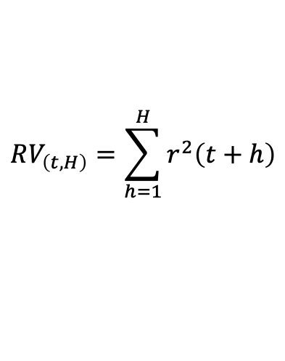
FORECASTING AND SCENARIOS
Volatility forecasting and portfolio scenarios
$$RV_{\left(t,H\right)}=\sum_{h=1}^{H}{r^{2}\left(t+h\right)}$$
PORTFOLIO SCENARIOS
Forecast target: realised variance • H = 1, 5 or 20 trading days
Weight YES and NO distributions
BASELINE
AUGMENTED
Recent-return regression
YES samples, weight p
Same model plus event features
Average squared daily return over the preceding 20 trading days.
NO samples, weight 1 − p
Add p_raw and the wallet adjustment p_adjusted − p_raw.
→ Portfolio loss distribution
Scenario return and volatility
Compare MSE and QLIKE on identical forecast dates and units.
Tail risk: 95% VaR and ES
Joint returns preserve cross-asset dependence.
Initial comparison • Other models remain candidates
EVENTLENS FINAL YEAR PROJECT PROPOSAL
06 / 08
Notes:
We use these probabilities in two related analyses. On the left, we test whether event information improves volatility forecasting. Our target is realized variance over one, five or twenty trading days.
The starting model uses recent squared returns. We keep that regression and add the raw event probability plus the wallet adjustment. Both versions use the same forecast dates and horizons. We compare MSE and QLIKE on unseen data to test whether the additional features help. More complex models remain candidates, but this provides a clear reference experiment.
On the right, a separate scenario engine weights YES and NO return samples by p and one minus p. It preserves relationships between assets and applies the portfolio weights. The resulting loss distribution gives scenario return, volatility and tail-risk measures.
Source: proposal Sections 2.1, 2.2 and 2.4.

Slide 7
SYSTEM DESIGN
Calculations remain separate from explanations
DATA
ANALYTICS
DELIVERY
Evidence layer
›
Research services
›
Dashboard and assistant
APIs, receipts, PostgreSQL, Parquet and versioned source records
Wallet scoring, probability calibration, forecasting and scenarios
Validated APIs, saved runs, evidence links and research reports
1
Event research agent
2
Analysis coordinator
3
Explanation agent
Retrieves evidence and proposes asset mappings for review.
Validates inputs and submits typed calculation requests.
Reads saved results and answers with source references.
The assistant cannot change wallet eligibility, fitted models or saved numerical results.
EVENTLENS FINAL YEAR PROJECT PROPOSAL
07 / 08
Notes:
Controlled AI. The architecture makes the numerical boundary explicit. Research services calculate probabilities and risk metrics. The assistant can retrieve evidence, request a validated run and explain saved outputs, but it cannot invent a number or alter model eligibility. Each answer refers back to run IDs and evidence IDs. Source: proposal Sections 2.1 and 2.2.

Slide 8
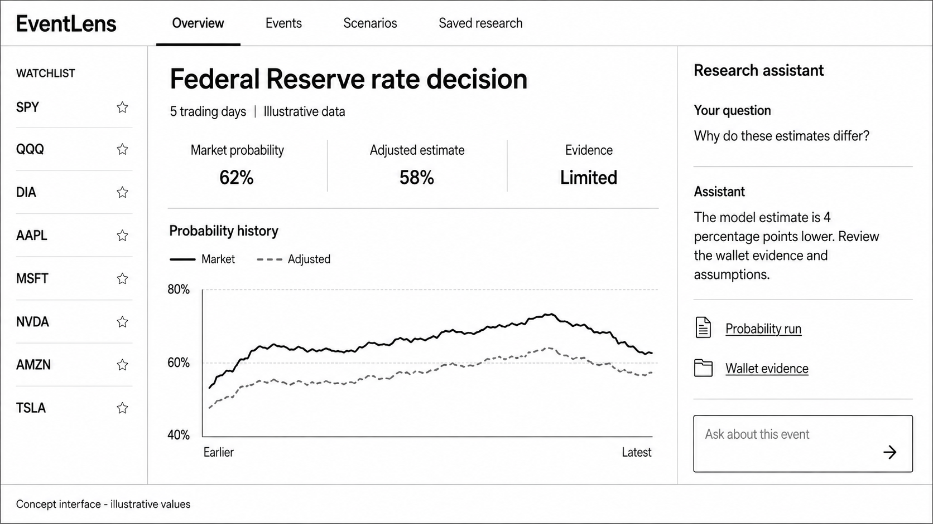
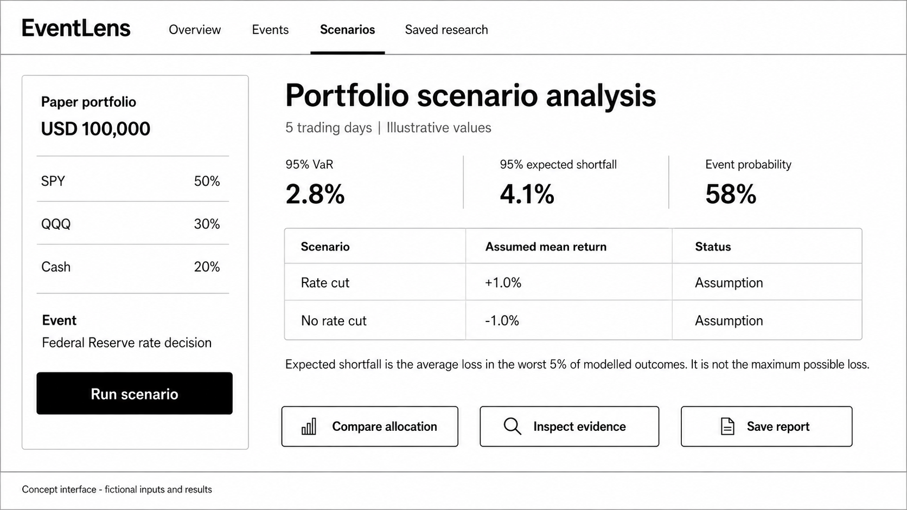
PRODUCT EXPERIENCE
Evidence and scenarios in one research journey
Overview
Compare market and wallet-informed probabilities with supporting evidence.
Scenarios
Connect a paper portfolio to VaR, expected shortfall and assumptions.
ILLUSTRATIVE CONCEPT SCREENS. VALUES SHOWN ARE NOT RESEARCH RESULTS.
EVENTLENS FINAL YEAR PROJECT PROPOSAL
08 / 08
Notes:
User journey. A user selects an asset or paper portfolio, chooses a horizon and reviews relevant events. The overview compares raw and adjusted probabilities and links to wallet evidence. The scenario view shows hypothetical risk metrics with assumptions. These are concept screens from the proposal, so every displayed value remains illustrative. Source: proposal Section 2.1 and Figures 5–6.

