Slide 1
HKUST COMP 4981
Cheung Hau Yin Franklin
Hou Anthony Tian Rui
Liu Ngai Chiu
Sze Wang Cheong
EventLens
Event risk research for indices and equities
Testing whether prediction-market activity can improve event-driven volatility analysis.
01
02
03
Prediction-market probabilities
Historically informative wallets
Volatility and portfolio risk
Advised by Prof. Shuai Wang
EVENTLENS FINAL YEAR PROJECT PROPOSAL
01 / 10
Notes:
Opening. EventLens asks one focused research question: can prediction-market information improve the way we study risk around scheduled events? The project combines Polymarket prices, public wallet activity and conventional asset data. The goal is a reproducible research system, not a trading recommendation engine. Source: proposal abstract and Section 1.

Slide 2
MOTIVATION AND RESEARCH GAP
A probability signal for event risk
OBSERVED GAP
RESEARCH OPPORTUNITY
Asset markets show repricing, not the event probability itself
Prediction markets expose prices and participant histories
News, prices and volatility indicators reveal market reaction. They do not directly show a continuously updated probability for the underlying event.
Contract prices provide market-implied probabilities. Public settlement records make dated wallet behaviour observable for research.
69%
0.1%
CORE QUESTION
of users lost money in one recent Polymarket study
of users captured more than half of aggregate gains
Do wallet and event features improve out-of-sample volatility forecasts?
EVENTLENS FINAL YEAR PROJECT PROPOSAL
02 / 10
Notes:
Why this matters. Event risk often enters financial analysis indirectly. Prediction markets offer an explicit probability, while blockchain settlement records let us study whether some participants have persistent informational value. The cited concentration figures motivate the wallet analysis, but they do not prove predictability. EventLens must test that claim out of sample. Source: proposal Sections 1.1 and 1.3, citing Akey et al.

Slide 3
RESEARCH BOUNDARY
A narrow MVP keeps the test credible
VENUE
Polymarket on Polygon
SUCCESS CRITERION
Incremental predictive value against a fixed volatility baseline
EVENTS
Federal Reserve rate decisions
ASSETS
Major indices and ETFs
1, 5 and 20 trading days
Extensions wait for evidence
HORIZONS
Other event classes, individual equities, cross-platform data and entity clustering remain outside the first validation cycle.
WALLET MODEL
Address-level, past-only scoring
EVENTLENS FINAL YEAR PROJECT PROPOSAL
03 / 10
Notes:
Scope discipline. The MVP prioritises data feasibility and a valid experiment. It starts with Polymarket on Polygon, Federal Reserve decisions and index-tracking assets. The horizons match the proposal. Extensions only proceed if historical coverage and model stability support them. This prevents the team from broadening the sample informally after seeing early results. Source: proposal Section 1.2 and evaluation design.

Slide 4
DATA AND PROVENANCE
Evidence becomes versioned research features
Polymarket APIs + Goldsky fills + Polygon receipts + ETF prices + Federal Reserve releases
STEP 01
STEP 02
STEP 03
STEP 04
STEP 05
Acquire
Reconcile
Freeze evidence
Derive features
Save runs
Event definitions, books, fills, receipts and asset histories.
Identifiers, timestamps, fills, transfers and market resolution.
Raw records, cut-offs, quality flags and source references.
Wallet decisions, probability signals and asset windows.
Model version, seed, inputs, outputs and evidence manifest.
Every forecast uses only information available at its historical cut-off.
EVENTLENS FINAL YEAR PROJECT PROPOSAL
04 / 10
Notes:
Point-in-time evidence. The system separates source collection from research features. Mutable metadata and incomplete order books receive explicit flags. Polygon receipts verify a sample of indexed settlement records. Most importantly, each historical forecast uses a frozen snapshot, which prevents later outcomes or newly successful wallets from leaking into earlier tests. Source: proposal Sections 2.1 and 2.2.

Slide 5
PROBABILITY RESEARCH
Wallet evidence must earn its weight
01
02
03
04
Consolidate decisions
Score past informativeness
Shrink uncertain scores
Calibrate probability
Separate directional exposure from balanced YES and NO holdings.
Use eventual outcomes, later price movement and breadth of history.
Pull sparse histories toward the population average.
Add wallet flow and market-quality controls to a regularised logistic model.
MARKET ESTIMATE
EXPERIMENTAL ESTIMATE
PROVISIONAL ELIGIBILITY
p raw
p adjusted
≥10 earlier resolved events
YES bid/ask midpoint with spread, depth and timestamp.
Calibrated model with eligible-wallet flow.
Across at least 3 announcement dates. Test 5 and 20 in sensitivity analysis.
EVENTLENS FINAL YEAR PROJECT PROPOSAL
05 / 10
Notes:
Wallet method. A smart-wallet label remains provisional and dated. Repeated fills become one wallet-event decision. The first eligibility rule requires at least ten earlier resolved events across three announcement dates, with sensitivity checks at five and twenty. If history is insufficient, the wallet signal is unavailable. Raw and adjusted probabilities stay visible separately so we can measure the wallet contribution. Source: proposal Section 2.1.

Slide 6
FORECASTING AND SCENARIOS
One controlled comparison, two research outputs
RVₜ,ₕ = Σ r²ₜ₊ₕ
PORTFOLIO SCENARIOS
H = 1, 5 and 20 trading days
Conditional YES and NO return distributions
BASELINE
AUGMENTED
Recent-return regression
Scenario return
Same model plus event features
Average squared daily return over the preceding 20 trading days.
Horizon volatility
Add p raw and the wallet adjustment p adjusted − p raw.
Loss probability
95% VaR
Compare MSE and QLIKE on identical forecast dates and units.
95% expected shortfall
Joint returns preserve cross-asset dependence.
EVENTLENS FINAL YEAR PROJECT PROPOSAL
06 / 10
Notes:
Forecast test. The forecast target is realised variance from daily returns. The baseline uses recent variation only. The augmented model keeps the same regression and adds the raw probability plus the wallet adjustment. That design isolates whether prediction-market features add value. A separate scenario engine combines conditional YES and NO return distributions to calculate hypothetical portfolio risk. Source: proposal Section 2.1.

Slide 7
SYSTEM DESIGN
Calculations remain separate from explanations
DATA
ANALYTICS
DELIVERY
Evidence layer
›
Research services
›
Dashboard and assistant
APIs, receipts, PostgreSQL, Parquet and versioned source records
Wallet scoring, probability calibration, forecasting and scenarios
Validated APIs, saved runs, evidence links and research reports
1
Event research agent
2
Analysis coordinator
3
Explanation agent
Retrieves evidence and proposes asset mappings for review.
Validates inputs and submits typed calculation requests.
Reads saved results and answers with source references.
The assistant cannot change wallet eligibility, fitted models or saved numerical results.
EVENTLENS FINAL YEAR PROJECT PROPOSAL
07 / 10
Notes:
Controlled AI. The architecture makes the numerical boundary explicit. Research services calculate probabilities and risk metrics. The assistant can retrieve evidence, request a validated run and explain saved outputs, but it cannot invent a number or alter model eligibility. Each answer refers back to run IDs and evidence IDs. Source: proposal Sections 2.1 and 2.2.

Slide 8
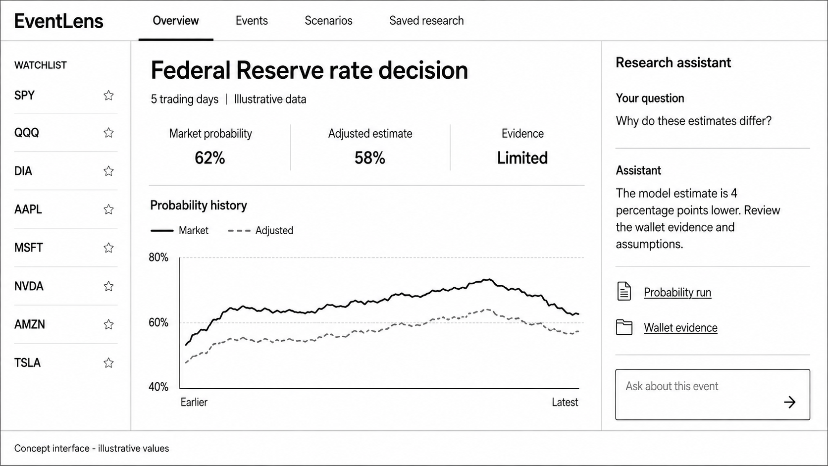
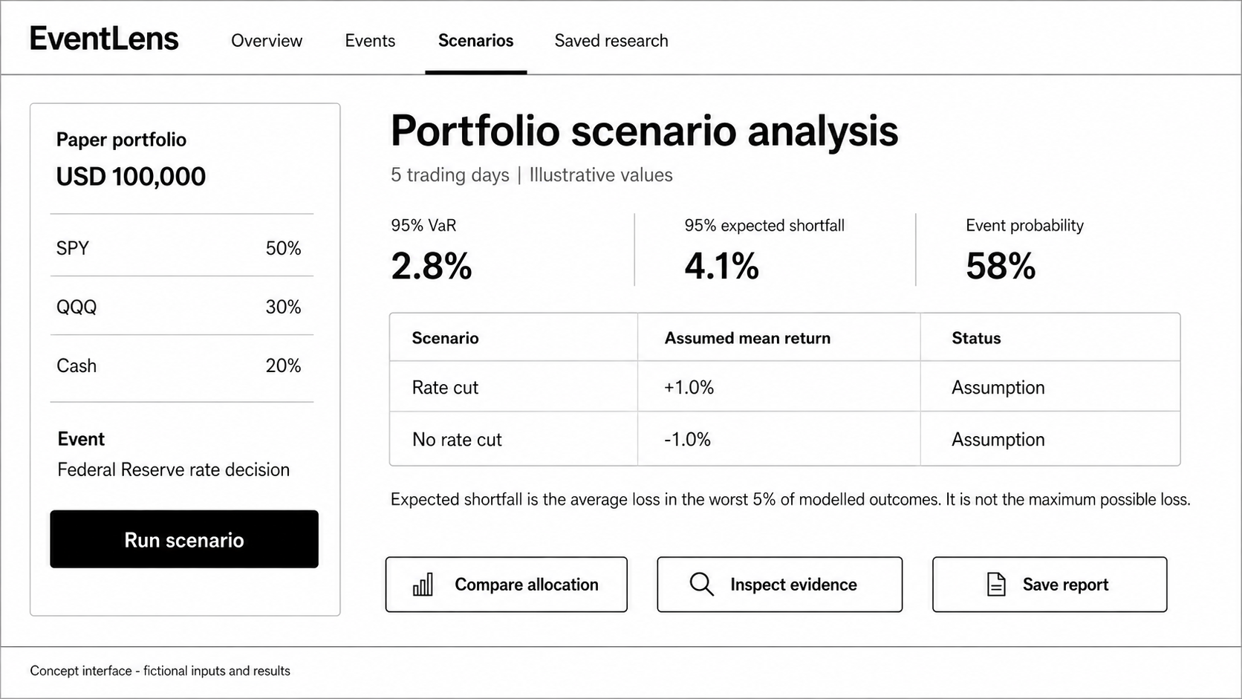
PRODUCT EXPERIENCE
Evidence and scenarios in one research journey
Overview
Compare market and wallet-informed probabilities with supporting evidence.
Scenarios
Connect a paper portfolio to VaR, expected shortfall and assumptions.
ILLUSTRATIVE CONCEPT SCREENS. VALUES SHOWN ARE NOT RESEARCH RESULTS.
EVENTLENS FINAL YEAR PROJECT PROPOSAL
08 / 10
Notes:
User journey. A user selects an asset or paper portfolio, chooses a horizon and reviews relevant events. The overview compares raw and adjusted probabilities and links to wallet evidence. The scenario view shows hypothetical risk metrics with assumptions. These are concept screens from the proposal, so every displayed value remains illustrative. Source: proposal Section 2.1 and Figures 5–6.

Slide 9
TESTING AND EVALUATION
A valid null result still counts
Objective | Comparison | Metric
Wallet identification | Score vs label-shuffled baseline | Brier score and accuracy
Adjusted probability | Raw price, liquidity, flow, wallet signal | Brier score and log loss
Volatility forecast | Baseline vs augmented model | MSE and QLIKE
Dashboard and assistant | User tasks and stored results | Completion, agreement, abstention
01
Chronological train, validation and test split
02
Contracts grouped by event and overlapping targets purged
03
Final test interval unopened until choices are fixed
04
Confidence intervals plus negative or null findings
Profitability is not a success criterion.
EVENTLENS FINAL YEAR PROJECT PROPOSAL
09 / 10
Notes:
Evaluation discipline. The main risk is lookahead leakage. Event contracts and snapshots stay together, overlapping targets are purged at split boundaries, and the final test interval stays closed until choices are fixed. Probability models use a baseline ladder. Volatility models compare identical dates and units. Given the small number of independent announcements, results include confidence intervals. Profitability is not a success criterion. Source: proposal Section 3.

Slide 10
24-WEEK DELIVERY PLAN
Feasibility comes first
W2
W7
W12
W18
W22
W24
Access and
scope decision
Versioned
dataset
Probability
comparison
Scenario
engine
Integrated
evaluation
Report and
demonstration
PROPOSED CONTRIBUTION
A controlled, evidence-linked test of whether prediction markets improve event-driven risk research.
Franklin Anthony Owen Sunny
EVENTLENS FINAL YEAR PROJECT PROPOSAL
10 / 10
Notes:
Close. The plan begins with a feasibility gate. By week 7 the team targets a versioned dataset. By week 12 it compares raw price, anonymous flow and wallet flow. Scenario calculations follow by week 18, integrated evaluation by week 22 and the final reproducibility package by week 24. If access or sample size fails, the team narrows coverage before optional work begins. Source: proposal Section 4.

