Slide 1
Homework Assignment #1:
Disk IO Performance under Sequential and Random Workloads by Using System Call, C Library and MMAP Interfaces

Slide 2
Outline
File I/O
C-library：fopen()、fread()、fwrite()、fclose()、fseek()
Homework Assignment #1_1
System call：open()、read()、write()、close()、lseek()
Homework Assignment #1_2
Memory-mapped file
Homework Assignment #1_3
Homework Assignment #1_4

Slide 3
File Input / Output
Process A
Read Operation
int main()
{
…
read(fd, buffer, 4096);
…
return 0;
}
User
mode
data
Page Cache
Kernel
mode
HDD
block

Slide 4
File Input / Output
Process A
Write Operation
int main()
{
…
write(fd, data, 4096);
…
close(fd);
return 0;
}
data
User
mode
page cache full
or
call close(fd)
Page Cache
Kernel
mode
HDD

Slide 5
Outline
File I/O
C-library：fopen()、fread()、fwrite()、fclose()、fseek()
Homework Assignment #1_1
System call：open()、read()、write()、close()、lseek()
Homework Assignment #1_2
Memory-mapped file
Homework Assignment #1_3
Homework Assignment #1_4

Slide 6
Standard C library
fopen()
#include <stdio.h>
FILE *fopen ( const char *filename, const char *mode );
EX: FILE *f1;
f1 = fopen ( “XXX.txt”, “w” );
mode:
“r” | read: Open file for input operations. The file must exist.
“w” | write: Create an empty file for output operations. If a file with the same name already exists, its contents are discarded and the file is treated as a new empty file.
“a” | append: Open file for output at the end of a file. Output operations always write data at the end of the file, expanding it. The file is created if it does not exist.
return value: Successful: the function returns a pointer to a FILE object. Otherwise: a null pointer is returned.

Slide 7
Standard C library(cont.)
fread()
#include <stdio.h>
size_t fread ( void * ptr, size_t size, size_t count, FILE * stream );
EX: fread ( buffer, sizeof(char), 4, f1 );
ptr: Pointer to a block of memory with a size of at least (size*count) bytes.
size: Size, in bytes, of each element to be read. size_t is an unsigned integral type.
count: Number of elements, each one with a size of size bytes.
stream: Pointer to a FILE object that specifies an input stream.
return value: The total number of elements successfully read is returned. If this number differs from the count parameter, the proper indicator is set, which can be checked with ferror and feof.

Slide 8
Standard C library(cont.)
fwrite()
#include <stdio.h>
size_t fwrite ( const void * ptr, size_t size, size_t count, FILE * stream );
EX: fwrite ( buffer, sizeof(char), 4, f1 );
ptr: Pointer to the array of elements to be written, converted to a const void*.
size: Size, in bytes, of each element to be written. size_t is an unsigned integral type.
count: Number of elements, each one with a size of size bytes.
stream: Pointer to a FILE object that specifies an output stream.
return value: The total number of elements successfully written is returned. If this number differs from the count parameter, a writing error prevented the function from completing. In this case, the error indicator (ferror) will be set for the stream.

Slide 9
Standard C library(cont.)
fclose()
#include <stdio.h>
int fclose ( FILE * stream );
EX: fclose (f1);
stream: Pointer to a FILE object that specifies the stream to be closed.
return value: If the stream is successfully closed, a zero value is returned. On failure, EOF is returned.

Slide 10
Standard C library(cont.)
fseek()
#include <stdio.h>
int fseek(FILE *stream, long int offset, int whence)
EX: fseek (f1,4096,SEEK_SET);
stream: Pointer to a FILE object that identifies the stream.
long: Number of bytes to offset from origin.
whence: Position used as reference for the offset. It is specified by one of the following constants defined in <cstdio> exclusively to be used as arguments for this function:
Constant | Reference position
SEEK_SET | Beginning of file
SEEK_CUR | Current position of the file pointer
SEEK_END | End of file *
return value: If successful, the function returns zero.
Otherwise, it returns non-zero value.
If a read or write error occurs, the error indicator (ferror) is set.

Slide 11
Homework Assignment #1_1(cont.)
fsync()
  fsync() transfers all modified in-core data of the file referred to by the file descriptor fd to the disk device so that all changed information can be retrieved even if the system crashes or is rebooted. This includes writing through or flushing a disk cache if present. The call blocks until the device reports that the transfer has completed.
#include <unistd.h>
int fsync(int fd);
The function fileno() examines the argument stream and returns its integer descriptor.
int fileno(FILE *stream);
Ex：fsync(fileno(fp))

Slide 12
Outline
File I/O
C-library：fopen()、fread()、fwrite()、fclose()、fseek()
Homework Assignment #1_1
System call：open()、read()、write()、close()、lseek()
Homework Assignment #1_2
Memory-mapped file
Homework Assignment #1_3
Homework Assignment #1_4

Slide 13
Homework Assignment #1_1
Write a C program that creates a 100MB file on your local disk and measures the execution time of five different operations using the C standard I/O library interface (e.g., fopen(), fread(), fwrite(), fseek(), and fclose().)
Implement each of the following operations as a separate function
  Sequential Read
  Sequential Write
  Random Read
  Random Buffered Write (Single Sync)
  Random Synchronous Write

Slide 14
Homework Assignment #1_1
Sequential Read
  Read the file sequentially from beginning to end.
  Read 4KB of data per operation.
  Continue until the entire 100MB file has been read.
Sequential Write
  Overwrite the file with 100MB of new data using sequential writes.
  Write 2KB of data per operation from beginning to end.
  After completing all writes, call fsync() to ensure that the data is flushed to disk.

Slide 15
Homework Assignment #1_1(cont.)
time()
  time() function is provided by time.h library.
  Calculates the current calender time and encodes it into time_t format.
#include<time.h>
time_t time(time_t *t);
ex. : time(NULL);

Slide 16
Homework Assignment #1_1(cont.)
rand()
  rand() function is provided by stdlib.h library.
  Returns a pseudo-random number in the range of 0 to RAND_MAX.
#include<stdlib.h>
int rand(void);
ex. : rand();

Slide 17
Homework Assignment #1_1(cont.)
srand()
  srand() function is provided by stdlib.h library.
  This function seeds the random number generator used by the function rand().
#include<stdlib.h>
void srand(unsigned int seed);
ex. : srand(time(NULL));

Slide 18
Homework Assignment #1_1
Random Offset Generation
  Use rand() to generate a random block index.
  Initialize the random seed once using: srand(time(NULL));
  Ensure the selected offset is 4KB-aligned.
  The offset must be within the 100MB file range.
Hint
  Call srand() in main().
  Before each random write or read, call (rand()%block numbers)*block size.

Slide 19
Homework Assignment #1_1
Random Read
  Repeat the following operation 50,000 times:
    Select a 4KB-aligned offset uniformly at random within the file.
    Seek to the selected offset.
    Read 4KB of data from that position.
Random Buffered Write (Single Sync)
  Repeat the following operation 50,000 times:
    Select a 4KB-aligned offset uniformly at random within the file.
    Seek to the selected offset.
    Write 2KB of data at that position.

Slide 20
Homework Assignment #1_1
Random Synchronous Write
  Repeat the following operation 50,000 times:
    Select a 4KB-aligned offset uniformly at random within the file.
    Seek to the selected offset.
    Write 2KB of data at that position.
    Call fsync() after each write.
The execution time of each workload must be measured independently.
  Use gettimeofday() (or a similar high-resolution timing function).
  The timing interval should include only the workload execution.
  Exclude file creation time from the measurement.
  Report the total elapsed time for each workload.

Slide 21
Homework Assignment #1_1(cont.)
gettimeofday()
  Get the time as well as a timezone.
#include <sys/time.h>
int gettimeofday (struct timeval *tv, struct timezone *tz );
struct timeval {
time_t tv_sec; /* seconds */
suseconds_t tv_usec; /* microseconds */
};
struct timezone {
int tz_minuteswest; /* minutes west of Greenwich */
int tz_dsttime; /* type of DST correction */
};

Slide 22
Homework Assignment #1_1(cont.)
EX:
  int main()
  {
  struct timeval start;
  struct timeval end;
  unsigned long diff;
  gettimeofday(&start,NULL);
  delay(10);
  gettimeofday(&end,NULL);
  diff = 1000000 * (end.tv_sec-start.tv_sec)+ end.tv_usec-start.tv_usec;
  printf("the difference is %ld (us)\n”, diff);
  return 0;
  }

Slide 23
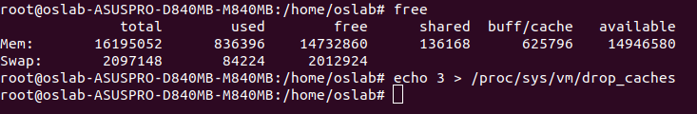
Homework Assignment #1_1(cont.)
If you want to take a look at the total available as well as used memory in the system. You can use free command.
To clean the Linux buffer/cache, you can use echo 3 > /proc/sys/vm/drop_caches command. Notice that, you should run it in root mode.
Ex:

Slide 24
Outline
File I/O
C-library：fopen()、fread()、fwrite()、fclose()、fseek()
Homework Assignment #1_1
System call：open()、read()、write()、close()、lseek()
Homework Assignment #1_2
Memory-mapped file
Homework Assignment #1_3
Homework Assignment #1_4

Slide 25
Linux system call interface
open()
#include <sys/types.h>
#include <sys/stat.h>
#include <fcntl.h>
int open ( const char *filename, int flags );
Int open ( const char *filename, int flags, mode_t mode );
EX: f1 = open ( "hello.txt", O_WRONLY | O_TRUNC );
flags:
O_RDONLY | Read only.
O_WRONLY | Write only.
O_RDWR | Read and write.
O_CREAT | Create file if it doesn’t exist.
O_TRUNC | If the file already exists and the open mode allows writing (i.e., is O_RDWR or O_WRONLY) it will be truncated to length 0.
return value: Return the file descriptor, or -1 is returned and errno is set appropriately.

Slide 26
Linux system call interface(cont.)
read()
#include<unistd.h>
ssize_t read(int fd, void *buf, size_t count);
EX: read(f1, buffer, 4);
fd: The file descriptor of where to read the input.
buf: A character array where the read content will be stored.
count: The number of bytes to read before truncating the data. If the data to be read is smaller than nbytes, all data is saved in the buffer.
return value: Upon successful completion, it shall return a non-negative integer indicating the number of bytes actually read. Otherwise, the functions shall return -1 and set errno to indicate the error.

Slide 27
Linux system call interface(cont.)
write()
#include<unistd.h>
ssize_t write(int fd, const void *buf, size_t count);
EX: write(f1, buffer, 4);
fd: The file descriptor of where to write the input.
buf: A pointer to a buffer of at least nbytes bytes, which will be written to the file.
count: The number of bytes to write. If smaller than the provided buffer, the output is truncated.
return value: On success, the number of bytes written is returned. On error, -1 is returned, and errno is set to indicate the cause of the error.

Slide 28
Linux system call interface(cont.)
close()
#include<unistd.h>
int close(int fd);
EX: close(f1);
fd: The file descriptor to be closed.
return value: returns zero on success. On error, -1 is returned, and errno is set appropriately.

Slide 29
Linux system call interface(cont.)
lseek()
#include <sys/types.h>
#include<unistd.h>
off_t lseek(int fd, off_t offset, int whence);
EX: write(f1, 4096, SEEK_SET);
fd: The file descriptor of where to change offset.
offset: Number of bytes to offset from origin.
whence: Position used as reference for the offset.
return value: Upon successful completion, lseek() returns the resulting offset location as measured in bytes from the beginning of the file. On error, the value (off_t) -1 is returned and errno is set to indicate the error.

Slide 30
Outline
File I/O
C-library：fopen()、fread()、fwrite()、fclose()、fseek()
Homework Assignment #1_1
System call：open()、read()、write()、close()、lseek()
Homework Assignment #1_2
Memory-mapped file
Homework Assignment #1_3
Homework Assignment #1_4

Slide 31
Homework Assignment #1_2
Write a C program that creates a 100MB file on your local disk and measures the execution time of five different operations using the system call I/O interface(e.g., open() ,read(), write(), lseek(), ande close()).
Implement each of the following operations as a separate function
  Sequential Read
  Sequential Write
  Random Read
  Random Buffered Write (Single Sync)
  Random Synchronous Write

Slide 32
Homework Assignment #1_2
Sequential Read
  Read the file sequentially from beginning to end.
  Read 4KB of data per operation.
  Continue until the entire 100MB file has been read.
Sequential Write
  Overwrite the file with 100MB of new data using sequential writes.
  Write 2KB of data per operation from beginning to end.
  After completing all writes, call fsync() to ensure that the data is flushed to disk.

Slide 33
Homework Assignment #1_2
Random Read
  Repeat the following operation 50,000 times:
    Select a 4KB-aligned offset uniformly at random within the file.
    Seek to the selected offset using lseek().
    Read 4KB of data from that position.
Random Buffered Write (Single Sync)
  Repeat the following operation 50,000 times:
    Select a 4KB-aligned offset uniformly at random within the file.
    Seek to the selected offset using lseek().
    Write 2KB of data at that position.
  After all writes have been completed, call fsync() once.

Slide 34
Homework Assignment #1_2
Random Synchronous Write
  Repeat the following operation 50,000 times:
    Select a 4KB-aligned offset uniformly at random within the file.
    Seek to the selected offset using lseek().
    Write 2KB of data at that position.
    Call fsync() after each write.
The execution time of each workload must be measured independently.
  Use gettimeofday() (or a similar high-resolution timing function).
  The timing interval should include only the workload execution.
  Exclude file creation time from the measurement.
  Report the total elapsed time for each workload.

Slide 35
Outline
File I/O
C-library：fopen()、fread()、fwrite()、fclose()、fseek()
Homework Assignment #1_1
System call：open()、read()、write()、close()、lseek()
Homework Assignment #1_2
Memory-mapped file
Homework Assignment #1_3
Homework Assignment #1_4

Slide 36
Memory-mapped file
Consider a sequential read of a file on disk using the standard system calls open(), read(), and write(). Each file access requires a system call and disk access.
③ copy
user space
user buffer
①
request
kernel space
kernel buffer
read file
②
storage
disk
Read system call

Slide 37
Memory-mapped file(cont.)
We can use the virtual memory techniques to treat file I/O as routine memory accesses. This approach, known as memory mapping a file, allows a part of the virtual address space to be logically associated with the file.
user space
user buffer
①
kernel buffer
kernel space
directly access
②
storage
disk
memory-mapped read

Slide 38
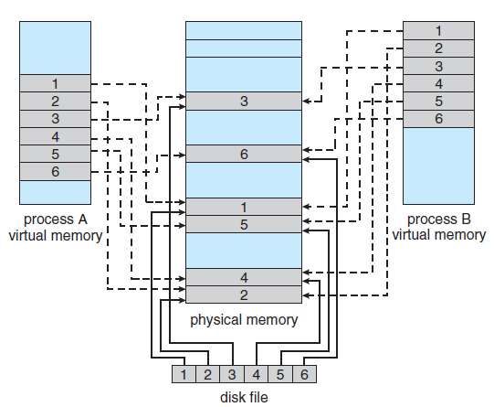
Memory-mapped file(cont.)

Slide 39
Memory-mapped file(cont.)
mmap()
#include <sys/mman.h>
void *mmap(void *addr, size_t length, int prot, int flags, int fd, off_t offset);
EX: char *map_f1;
map_f1 = mmap(NULL, filesize, PROT_READ, MAP_SHARED, f1, 0);
addr、length、fd、offset: The pages starting at addr and continuing for at most length bytes to be mapped from the object described by fd, starting at byte offset offset.
prot:
PROT_EXEC | Pages may be executed.
PROT_READ | Pages may be read.
PROT_WRITE | Pages may be written.
PROT_NONE | Pages may not be accessed.

Slide 40
Memory-mapped file(cont.)
mmap()
flags:
MAP_SHARED | Share this mapping with all other processes that map this object. Storing to the region is equivalent to writing to the file. The file may not actually be updated until msync(2) or munmap(2) are called.
MAP_PRIVATE | Create a private copy-on-write mapping. Stores to the region do not affect the original file. It is unspecified whether changes made to the file after the mmap() call are visible in the mapped region.
return value: On success, mmap() returns a pointer to the mapped area. On error, the value MAP_FAILED (that is, (void *) -1) is returned, and errno is set appropriately.

Slide 41
Memory-mapped file(cont.)
munmap()
#include <sys/mman.h>
int munmap(void *addr, size_t length);
EX: munmap(map_f1, filesize);
addr、length: The function remove any mappings for those entire pages containing any part of the address space of the process starting at addr and continuing for len bytes.
return value: Upon successful completion, it shall return 0; otherwise, it shall return -1 and set errno to indicate the error.

Slide 42
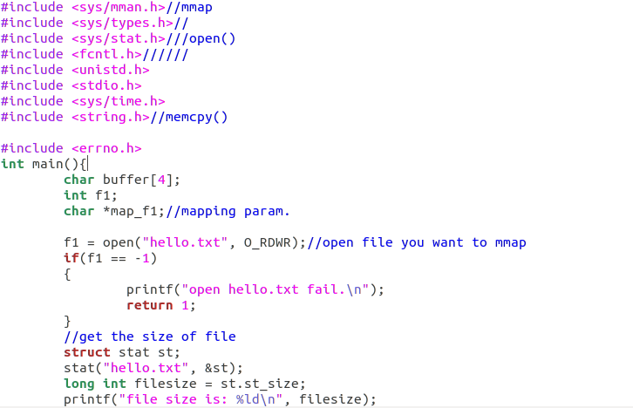
Memory-mapped file(cont.)
Example program

Slide 43
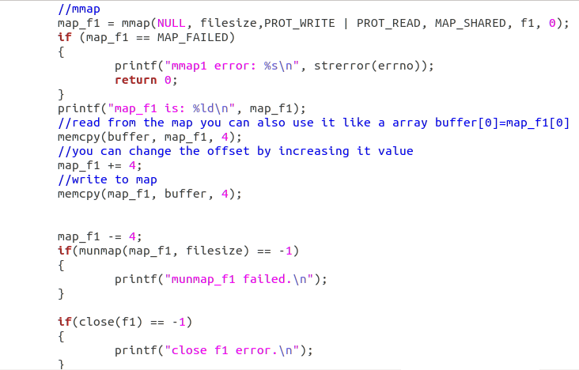
Memory-mapped file(cont.)
Example program

Slide 44
Outline
File I/O
C-library：fopen()、fread()、fwrite()、fclose()、fseek()
Homework Assignment #1_1
System call：open()、read()、write()、close()、lseek()
Homework Assignment #1_2
Memory-mapped file
Homework Assignment #1_3
Homework Assignment #1_4

Slide 45
Homework Assignment #1_3
Write a C program that creates a 100MB file on your local disk and measures the execution time of five different operations using the memory-mapped I/O interface.
Implement each of the following operations as a separate function
  Sequential Read
  Sequential Write
  Random Read
  Random Buffered Write (Single Sync)
  Random Synchronous Write

Slide 46
Homework Assignment #1_3
Sequential Read
  Read the file sequentially from beginning to end.
  Read 4KB of data per operation.
  Continue until the entire 100MB file has been read.
Sequential Write
  Overwrite the file with 100MB of new data using sequential writes.
  Write 2KB of data per operation from beginning to end.
  After completing all writes, call fsync() to ensure that the data is flushed to disk.

Slide 47
Homework Assignment #1_3
Random Read
  Repeat the following operation 50,000 times:
    Select a 4KB-aligned offset uniformly at random within the file.
    Access the selected offset via the memory-mapped region.
    Read 4KB of data from that position.
Random Buffered Write (Single Sync)
  Repeat the following operation 50,000 times:
    Select a 4KB-aligned offset uniformly at random within the file.
    Access the selected offset via the memory-mapped region.
    Write 2KB of data at that position.
  After all writes have been completed, call fsync() once.

Slide 48
Homework Assignment #1_3
Random Synchronous Write
  Repeat the following operation 50,000 times:
    Select a 4KB-aligned offset uniformly at random within the file.
    Access the selected offset via the memory-mapped region.
    Write 2KB of data at that position.
    Call fsync() after each write.
The execution time of each workload must be measured independently.
  Use gettimeofday() (or a similar high-resolution timing function).
  The timing interval should include only the workload execution.
  Exclude file creation time from the measurement.
  Report the total elapsed time for each workload.

Slide 49
Outline
File I/O
C-library：fopen()、fread()、fwrite()、fclose()、fseek()
Homework Assignment #1_1
System call：open()、read()、write()、close()、lseek()
Homework Assignment #1_2
Memory-mapped file
Homework Assignment #1_3
Homework Assignment #1_4

Slide 50
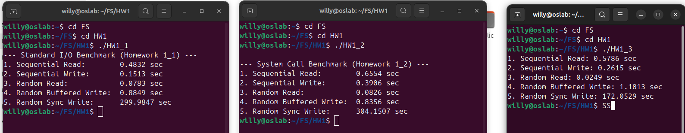
Homework Assignment #1_4
Analyze and compare the performance results obtained from Homework #1_1, #1_2, and #1_3.
Provide a detailed explanation of the observed differences among the three I/O interfaces.
Experimental Requirement
The page cache must be cleared after each program run to ensure fair and consistent measurements.

Slide 51
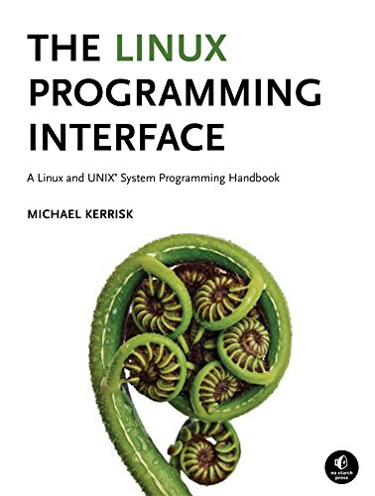
Reference
The Linux Programming Interface: A Linux and UNIX System Programming Handbook.

Slide 52
Turn in
Deadline
2026/4/1 23:30:00
Upload to i-learning
File name
  HW1_ID.zip (e.g. HW1_7113056017.zip)
    HW111.c、HW112.c、 HW113.c
    Report file (Word format)

Slide 53
TA
Name: 陳立崴
Email: g114056113@smail.nchu.edu.tw
  Title format: HW1 - [your name]
Lab: OSNET(1001A)

