Slide 1
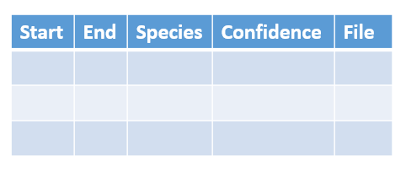
Filter confidence based on the result of the first chapter
2021 breeding
JPRF audio files
BirdNET
Initial table before filtering
“Correct” positive detections
Add a column identifying the first detection for unique (day, species, site)
Calibrate the time with the civil twilight time
Add columns to show the month, day, time
Summarize the first singing time for each (day, species, site)
Plot: First detection versus Day (averaged across sites)
Compare the ranking of the target species
Day (60) | Species (2) | Site (2) | First detection (mins after twilight)
Day 1 | A | 1 | --
Day 1 | B | 1 | --
Day 1 | A | 2 | --
Day 1 | B | 2 | --
Day 2 | A | 1 | --
Day 2 | B | 1 | --
Extract the OSFL, calculate the detection density across days
Extract the OSFL, calculate the coexistence of other flycatcher, richness

