Slide 1
Fitting Parameters that Characterize a Frequency-dependent Beam Model
Xinze Guo
UC Berkeley
sunnyguo@berkeley.edu

Slide 2
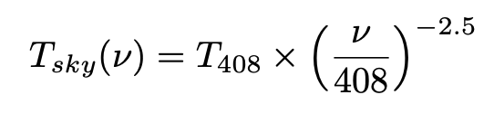
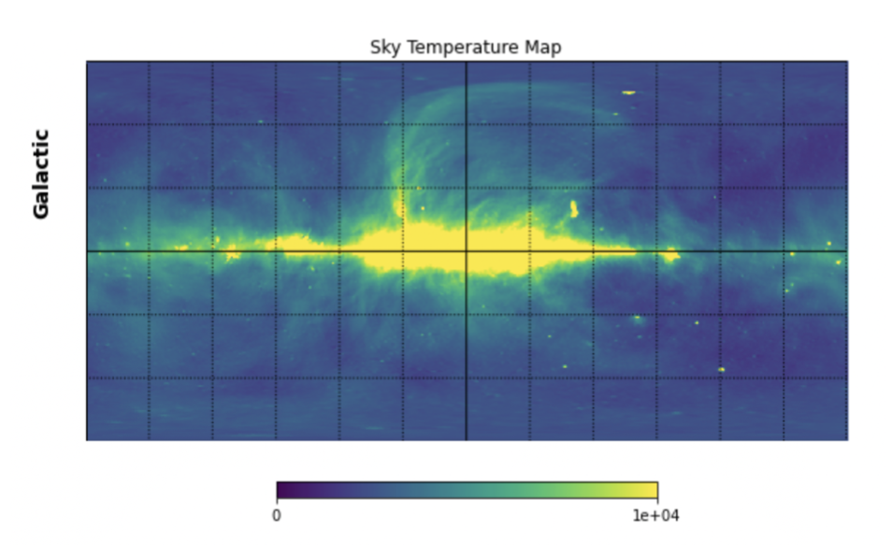
Sky Model
The Haslam map is used to create a simple but realistic sky model
scaled from 408 MHz to 10 - 100 MHz
Reduce resolution
3,145,728 pixels (Nside = 512)
786,432 pixels (Nside = 256)
pixelfunc.ud_grade

Slide 3


Beam Model
A function of Galactic longitude (l), Galactic latitude (b), and the width (σ_{G}) according to this Gaussian formula:
A₀ = 5, l₀ = 0, b₀ = 0, frequency is in MHz
m = 0.3 and n = 7.5
At 10 MHz, σ_{G} = 10.5; At 50 MHz, σ_{G} = 22.5; At 100 MHz, σ_{G} = 37.5

Slide 4
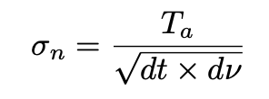
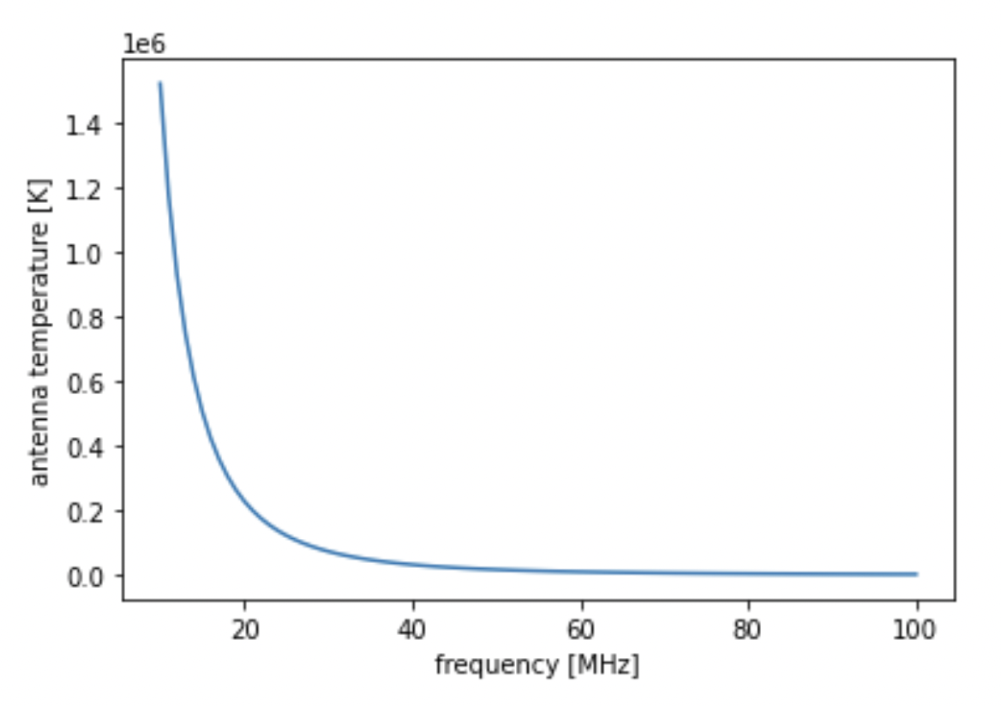
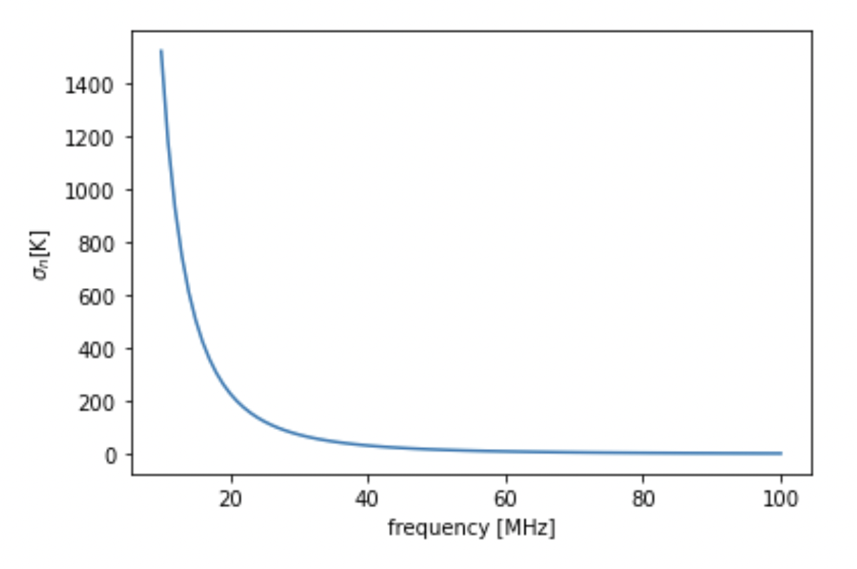
Spectrum and Noise
dt = 1 s and dν = 1 MHz.
Radiometer Equation

Slide 5
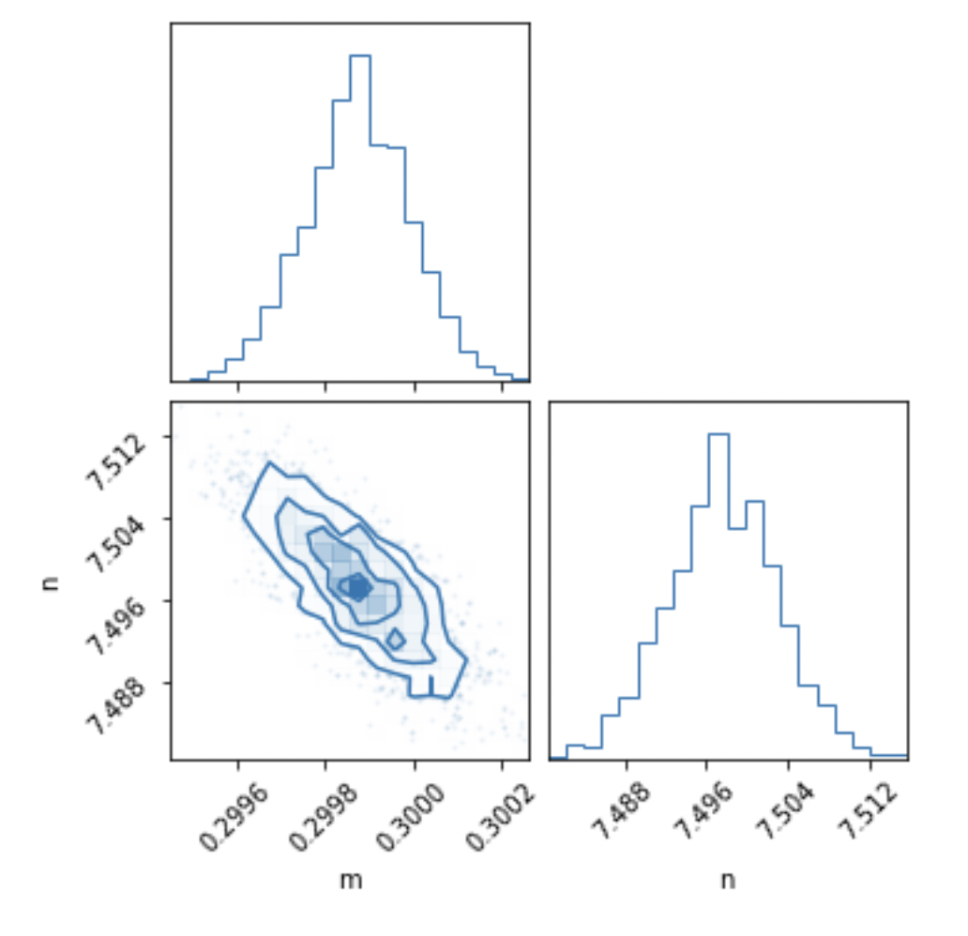
pocoMC Result
m = 0.2999 ± 0.0001
n = 7.4976 ± 0.0053 (1σ)
Log-likelihood = -44.65 for fitting
Log-likelihood = -44.65 for true value
Log Bayesian Evidence = -61.48

Slide 6
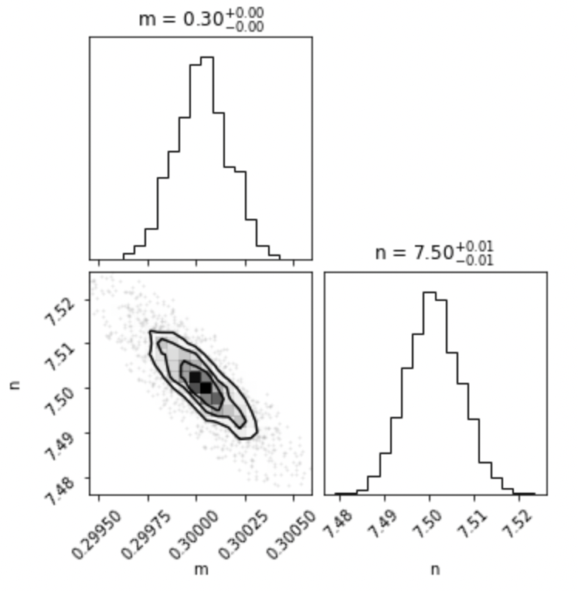
UltraNest Results
m = 0.30003 ± 0.00014
n = 7.5010 ± 0.0060 (1σ)
Log-likelihood = -37.94 for fitting
Log-likelihood = -38.14 for true value
Log Bayesian Evidence = -52.522 ± 0.213

Slide 7
Thank you!

