Slide 1
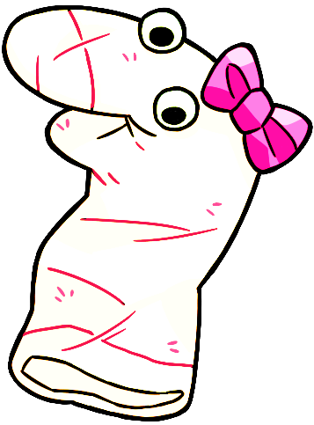
Thanks for helping Maggie!

Slide 2
She learned a lot from you!

