Slide 1
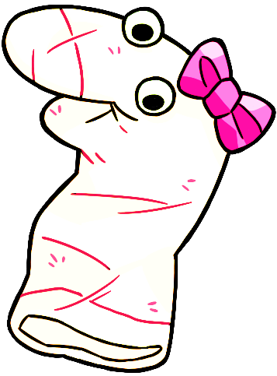
This is Maggie!

Slide 2
Let’s say hi to Maggie!

Slide 3
OK let’s practice giving answers by pressing a button on the screen.

Slide 4
For this, Maggie will ask a question and you will answer “Yes” or “No”.

Slide 5
If you think the answer is “Yes” then press this button.

Slide 6

If you think the answer is “No” then press this button.

Slide 7
OK let’s help Maggie!

Slide 8
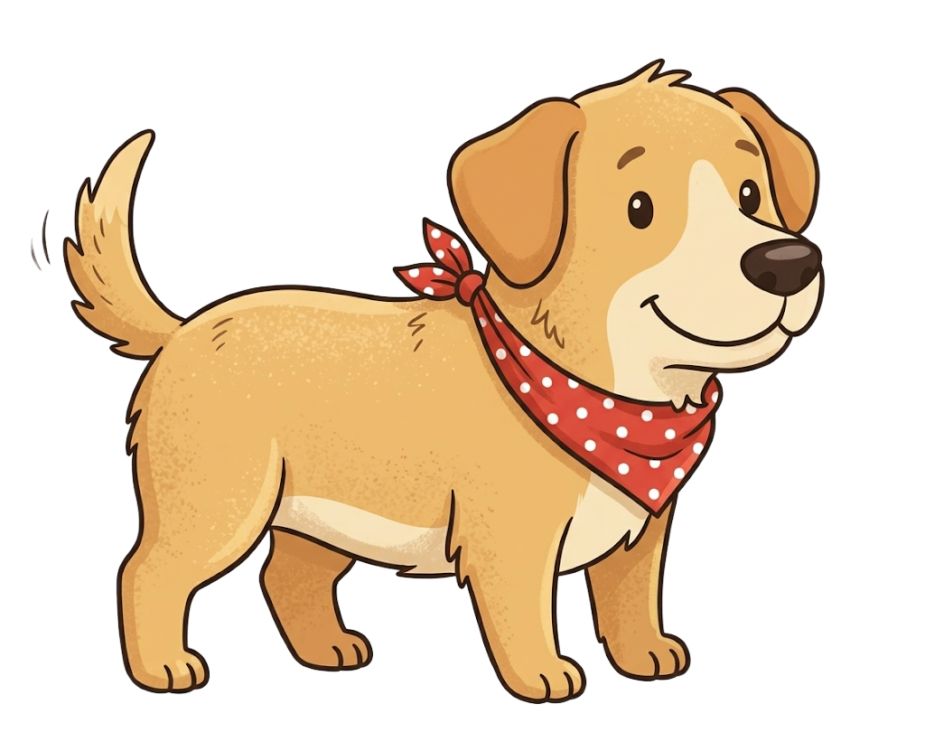
Maggie sees this.

Slide 9
Maggie says, “This is a dog”.

Slide 10
Do you think this is a dog?

Slide 11
Response options
Yes
No

