Slide 1
Data Visualization with Tableau

Slide 2
Tableau Data Type 数据类型
Number (decimal)
Number (whole)
Date & Time
Date
String
Boolean
Geographic Values

Slide 3
Tableau Data Field 字段类型
Dimensions & Measures | Continuous & Discrete | Example
Dimensions 维度 | Discrete 离散
Dimensions 维度 | Continuous 连续
Measures 度量 | Discrete 离散
Measures 度量 | Continuous 连续
Only with Date dimensions

Slide 4
Dimensions & Measures
Dimensions cannot be aggregated 维度不能进行聚合
Measures can be aggregated 度量能进行聚合

Slide 5
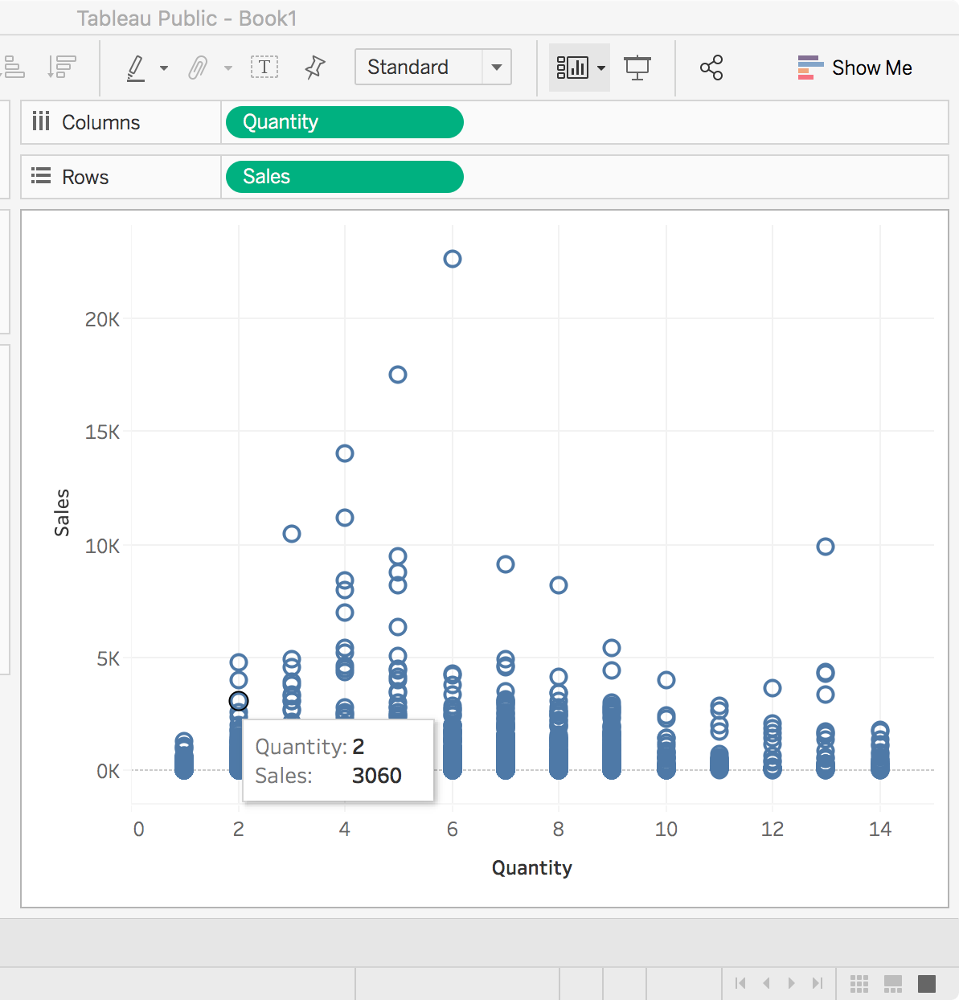
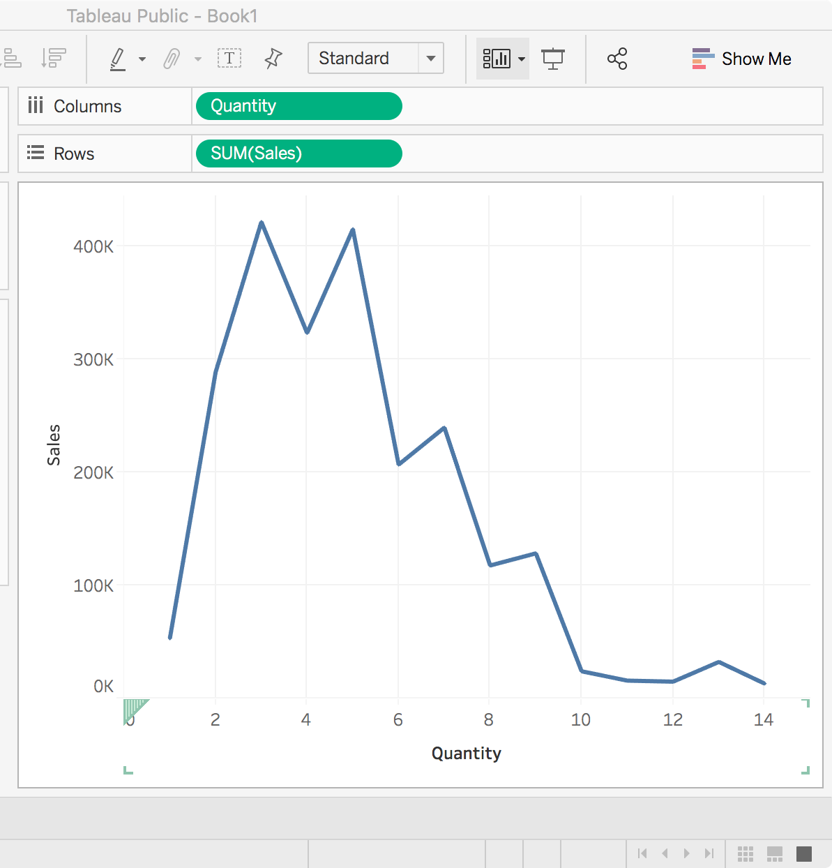
Dimensions & Measures

Slide 6
Dimensions & Measures
Dimensions CANNOT be aggregated
Measures CAN be aggregated

Slide 7
Continuous & Discrete
Continuous fields produce axes 连续字段生成轴
Discrete fields create headers 离散字段创建标题

Slide 8
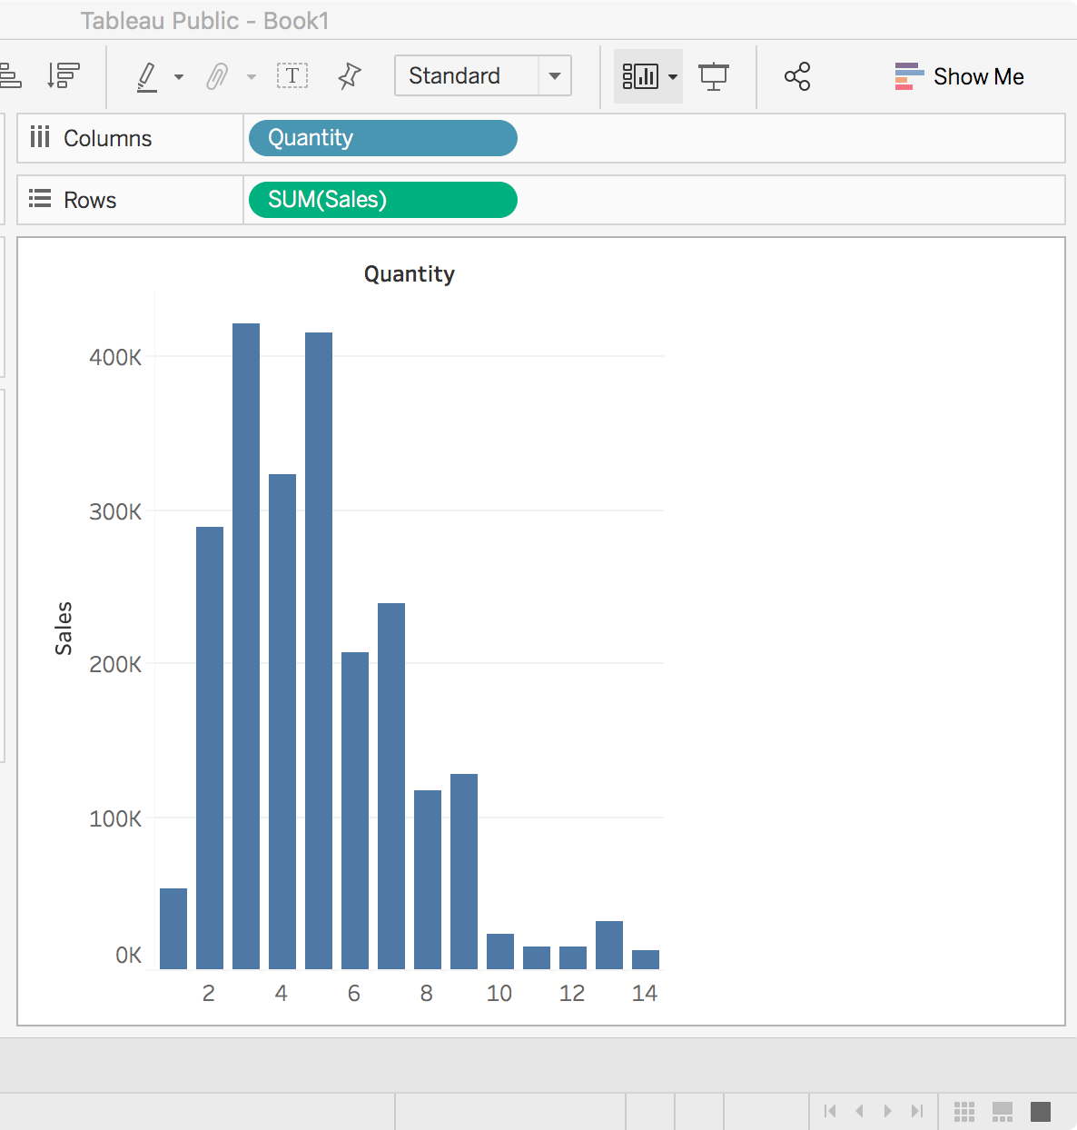
Continuous & Discrete

Slide 9
Continuous & Discrete
Continuous fields produce AXES
Discrete fields create HEADERS

Slide 10
Tableau Data Field 字段类型 Quiz 1
Variable | Dimensions 维度 or Measures 度量 | Continuous 连续 or Discrete离散
Quantity | ? | ?
Sales | ? | ?

Slide 11
Tableau Data Field 字段类型 Quiz 1
Variable | Dimensions 维度 or Measures 度量 | Continuous 连续 or Discrete离散
Quantity | Dimensions 维度 | Continuous 连续
Sales | Dimensions 维度 | Continuous 连续

Slide 12
Tableau Data Field 字段类型 Quiz 2
Variable | Dimensions 维度 or Measures 度量 | Continuous 连续 or Discrete离散
Quantity | ? | ?
SUM(Sales) | ? | ?

Slide 13
Tableau Data Field 字段类型 Quiz 2
Variable | Dimensions 维度 or Measures 度量 | Continuous 连续 or Discrete离散
Quantity | Dimensions 维度 | Continuous 连续
SUM(Sales) | Measures 度量 | Continuous 连续

Slide 14
Tableau Data Field 字段类型 Quiz 3
Variable | Dimensions 维度 or Measures 度量 | Continuous 连续 or Discrete离散
Quantity | ? | ?
SUM(Sales) | ? | ?

Slide 15
Tableau Data Field 字段类型 Quiz 3
Variable | Dimensions 维度 or Measures 度量 | Continuous 连续 or Discrete离散
Quantity | Dimensions 维度 | Discrete 离散
SUM(Sales) | Measures 度量 | Continuous 连续

Slide 16
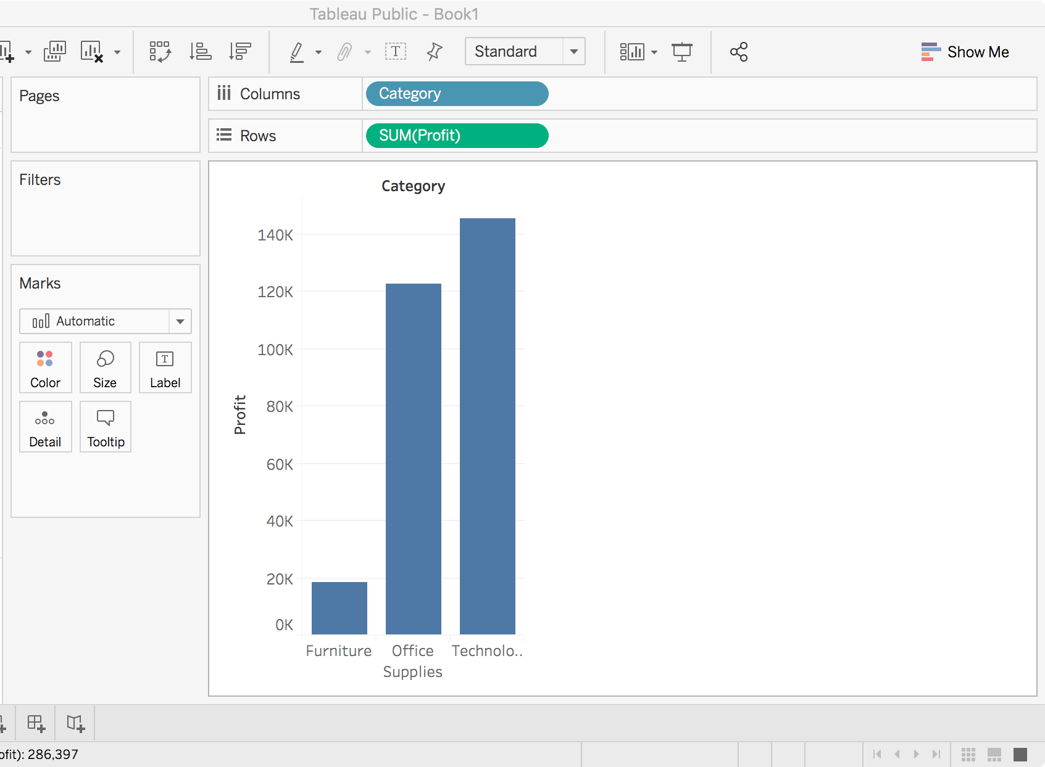
Basic Chart Types—Bar Chart 条形图
Discrete Dimension 离散维度
Continuous Measure 连续度量

Slide 17
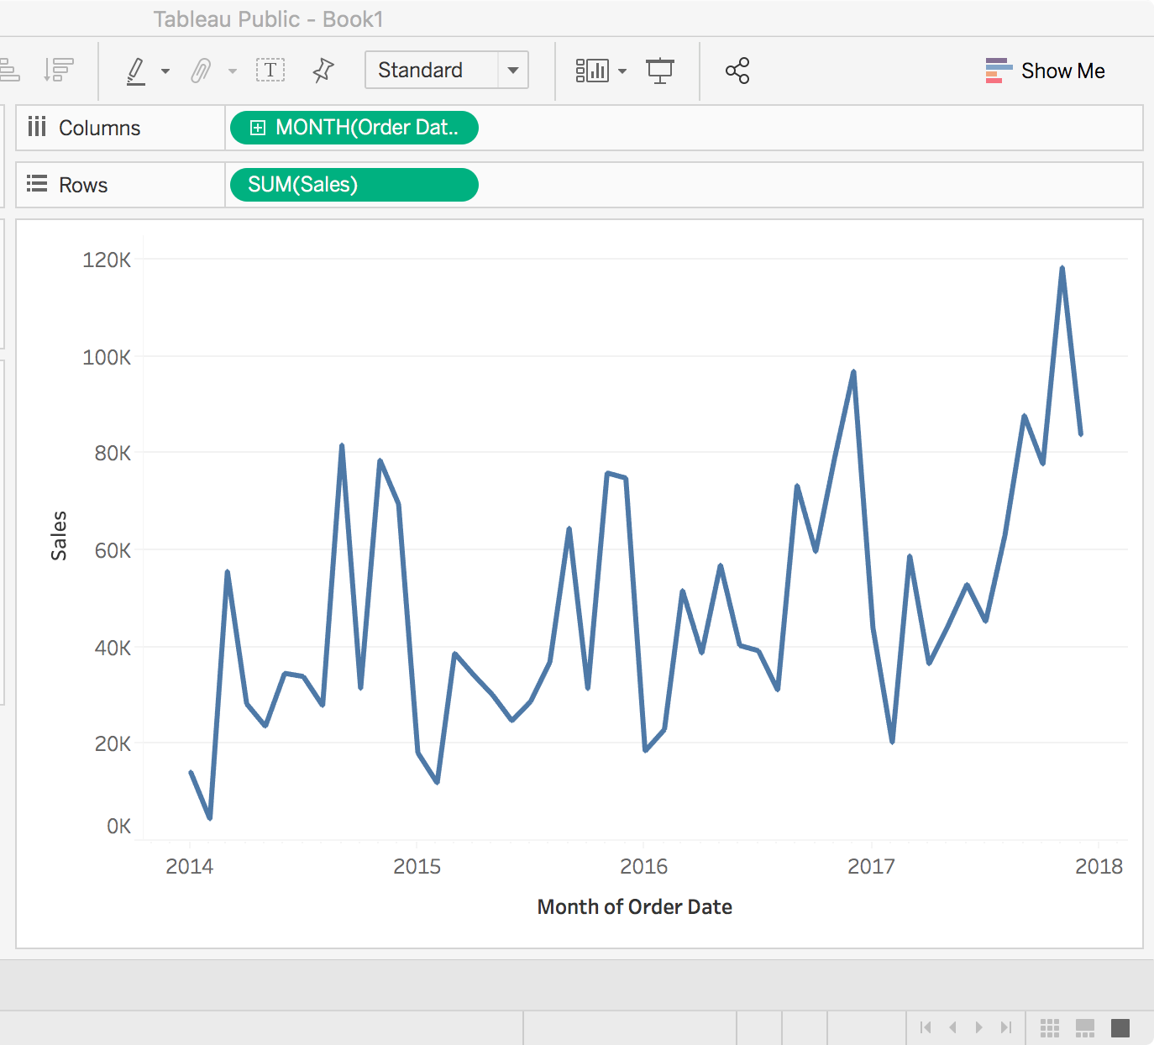
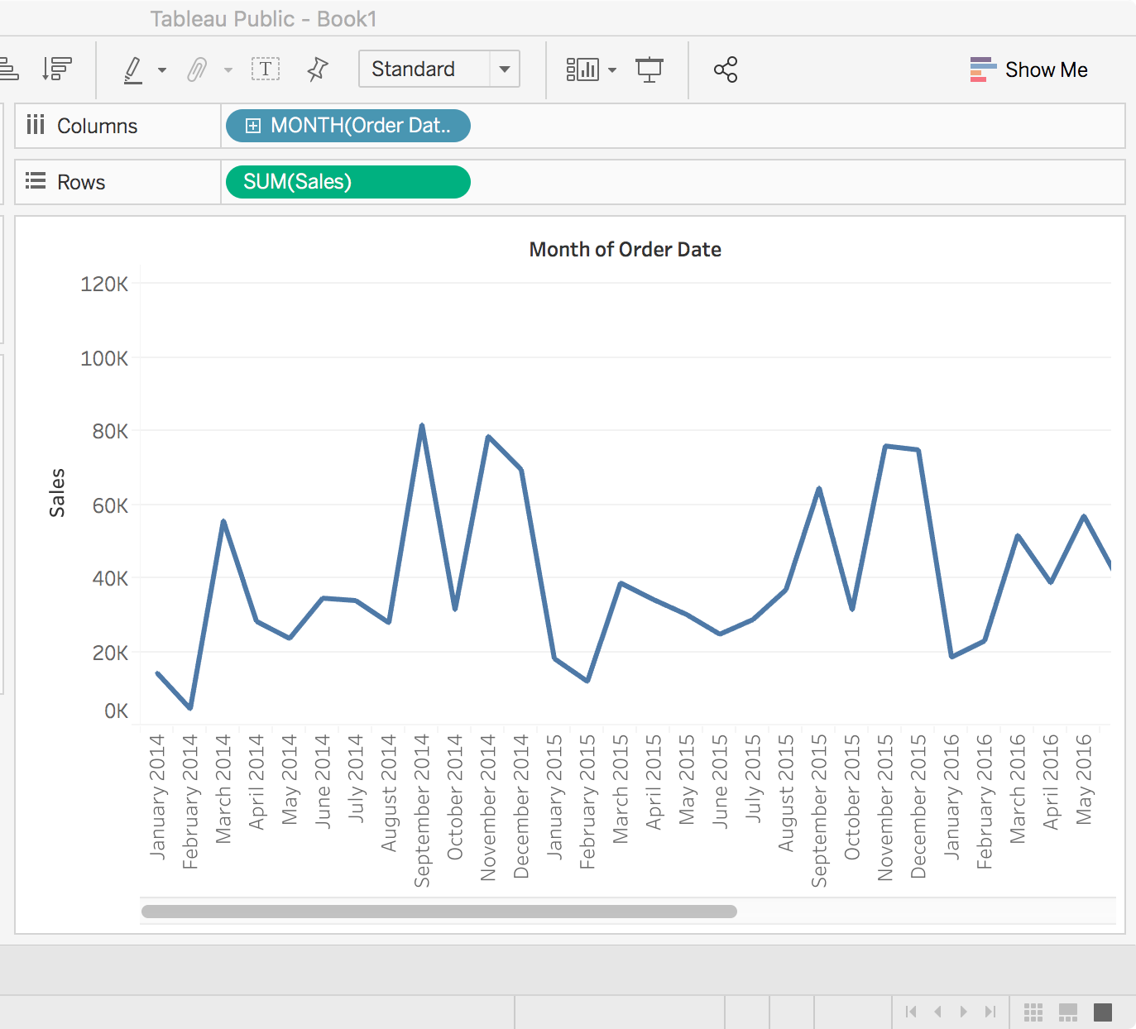
Basic Chart Types—Line Chart 折线图
Continuous Date 连续日期
Discrete Date 离散日期
Continuous Measure 连续度量
Continuous Measure 连续度量

Slide 18
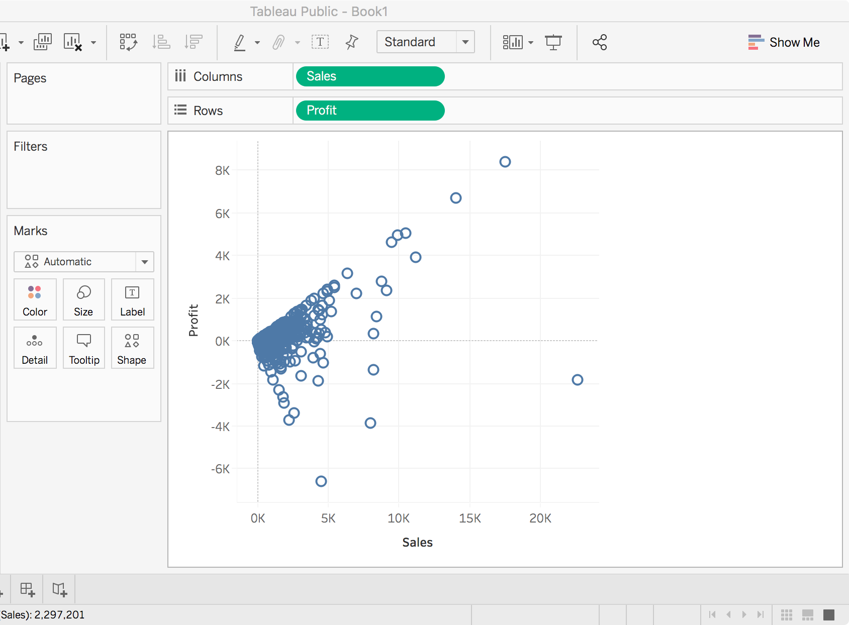
Basic Chart Types—Scatter Plot 散点图
Continuous Measure 连续度量
Continuous Measure 连续度量

Slide 19
Dimensionality of Data Visualization
Chart Dimensions
Bar Chart
Line Chart
Scatter Chart
Other Visual Encodings
Color
Size
Shape
Small Multiples 小图组

Slide 20
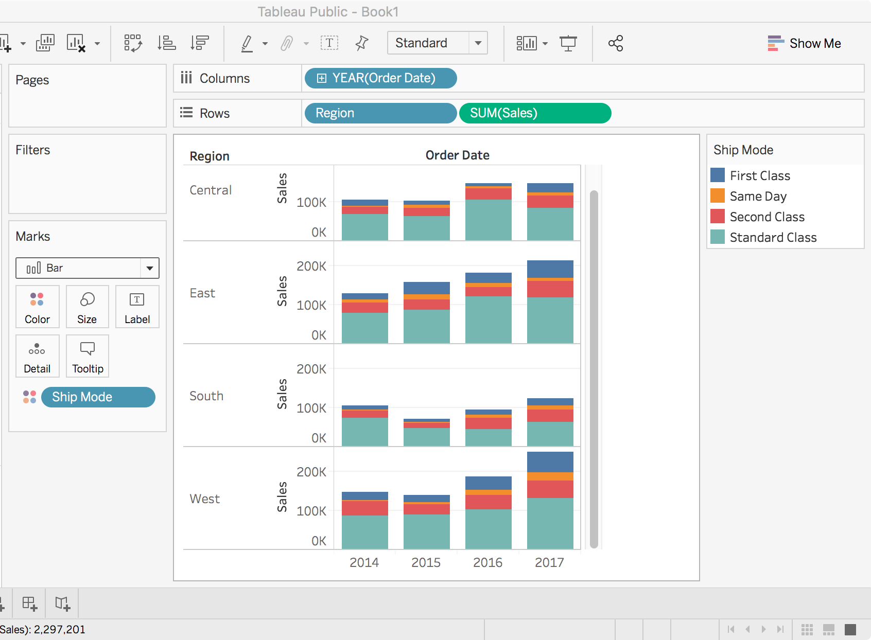
Dimensionality of Data Visualization
Chart Dimensions
Bar Chart
Line Chart
Scatter Chart
Other Visual Encodings
Color
Size
Shape
Small Multiples
Discrete 离散

Slide 21
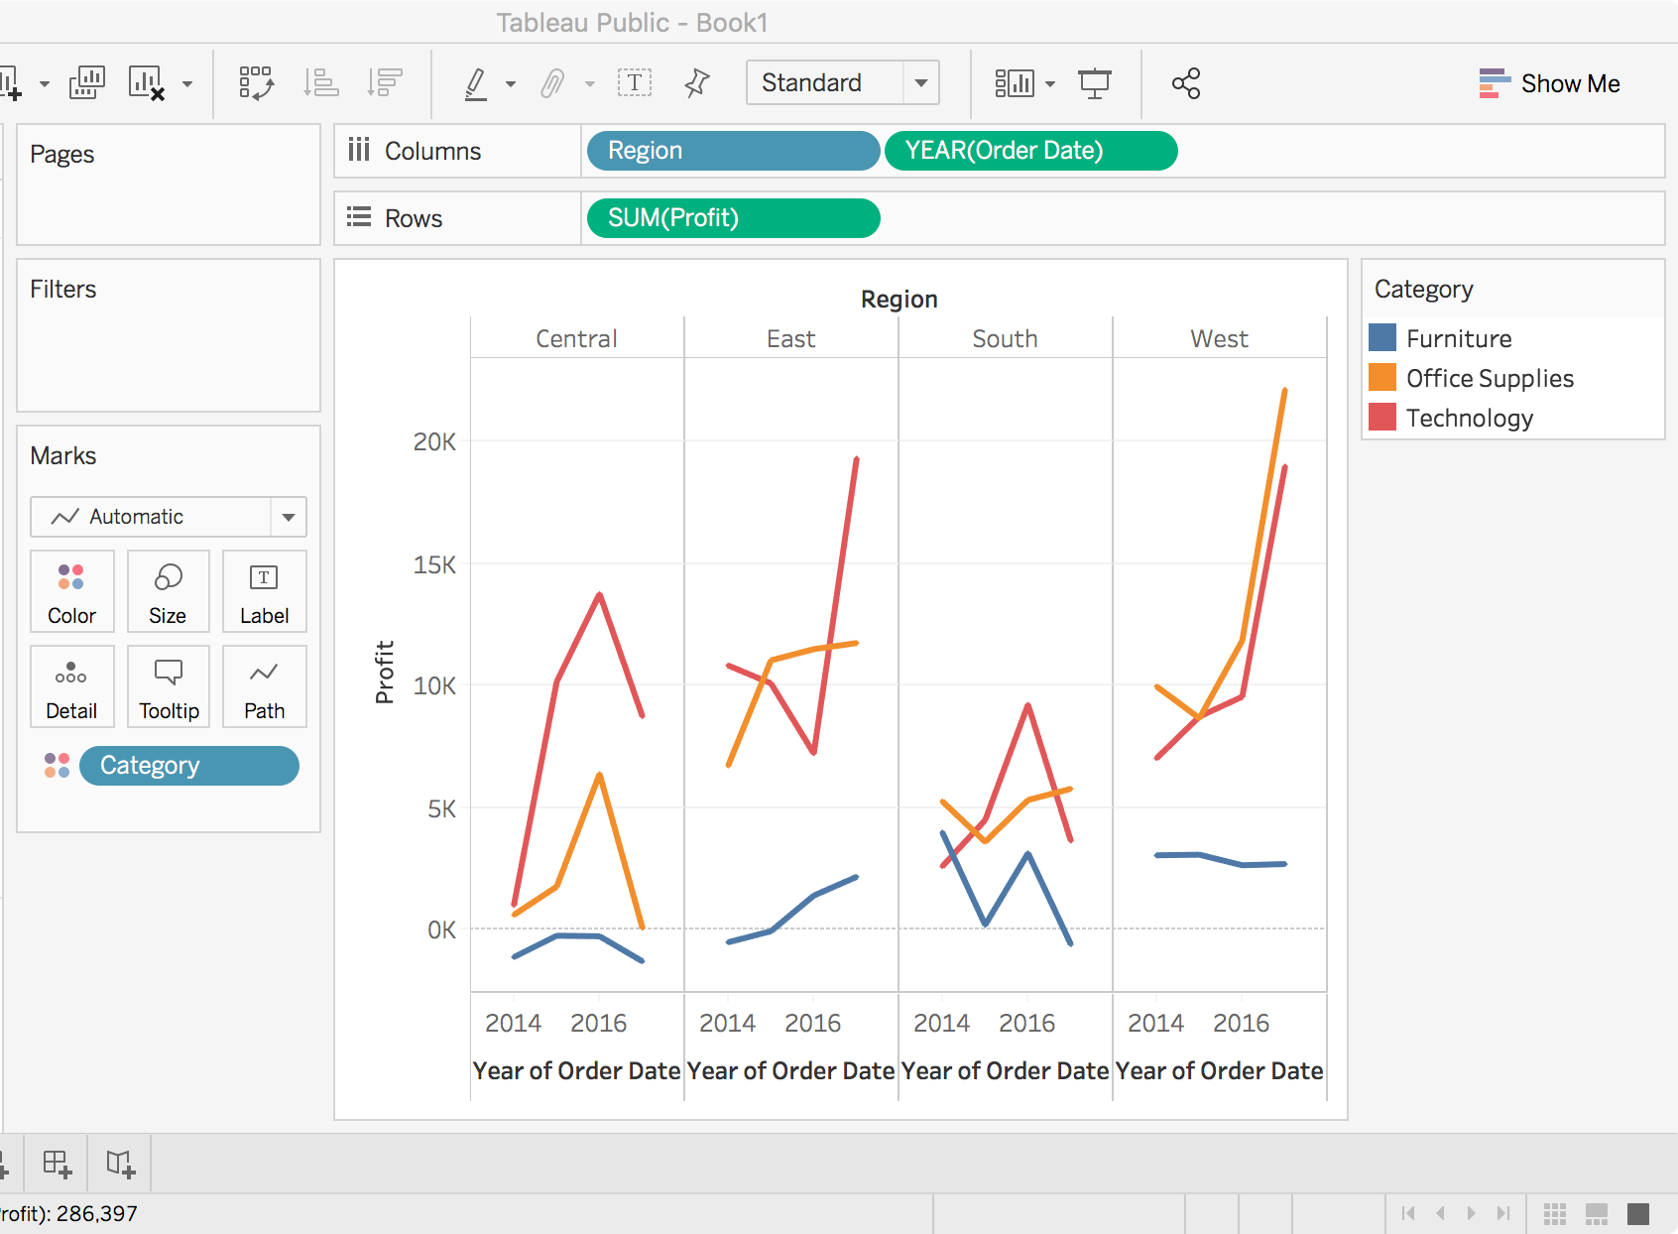
Dimensionality of Data Visualization
Chart Dimensions
Bar Chart
Line Chart
Scatter Chart
Other Visual Encodings
Color
Size
Shape
Small Multiples
Discrete 离散

Slide 22
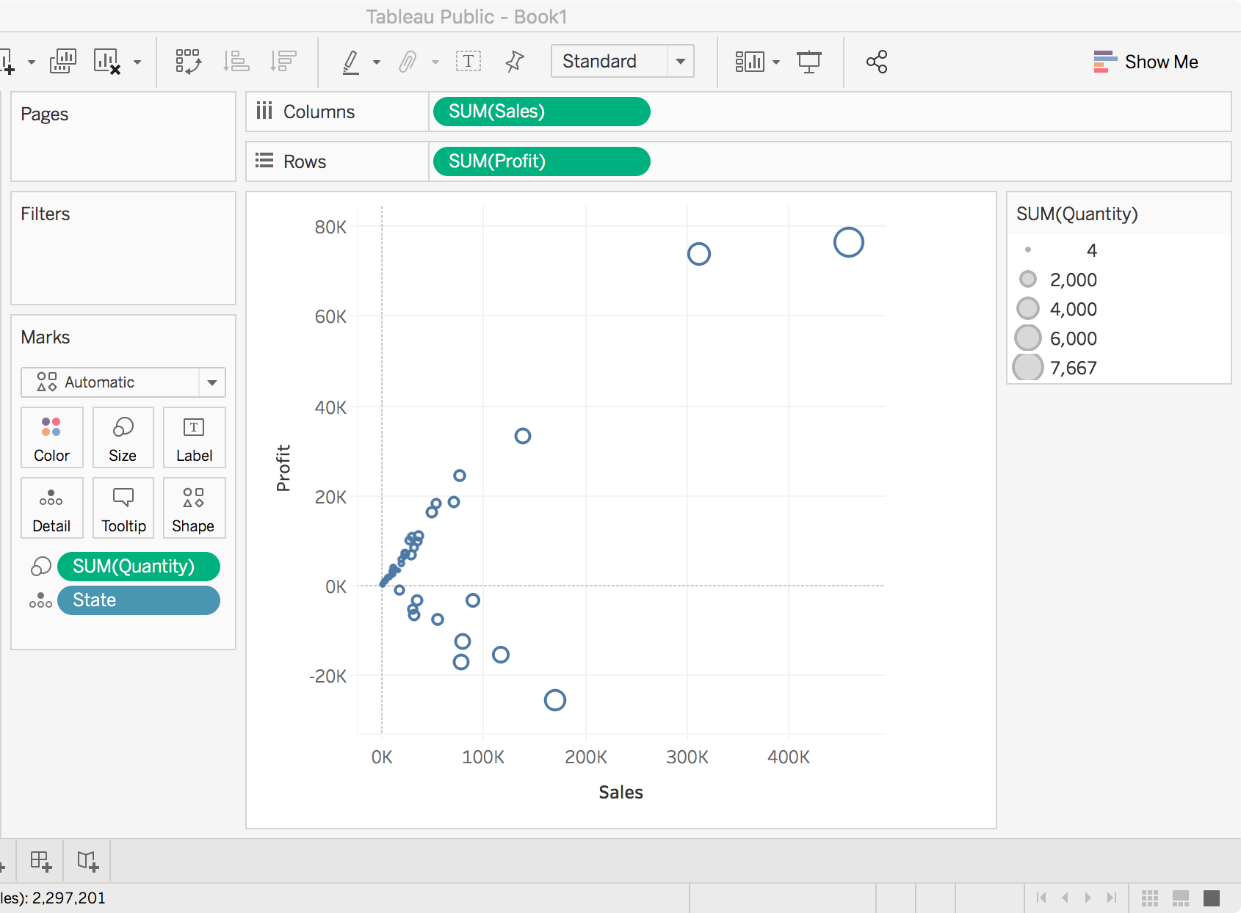
Dimensionality of Data Visualization
Chart Dimensions
Bar Chart
Line Chart
Scatter Chart
Other Visual Encodings
Color
Size
Shape
Small Multiples
Continuous 连续

Slide 23
Data Visualization Resources
Which chart of graph is right for you?
https://www.tableau.com/sites/default/files/media/which_chart_v6_final_0.pdf
Python Graph Gallery
http://www.python-graph-gallery.com/
D3.js
https://d3js.org/
The Data Visualisation Catalogue
https://datavizcatalogue.com/ZH/

