Slide 1
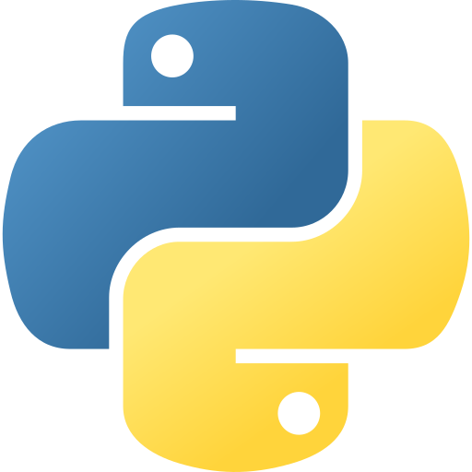

Why python is important?
By Sunny Kumar

Slide 2
Why python is important?
The Programming Language Shaping Our Digital Future
Discover why Python has become one of the most influential and widely-used programming languages in the world

Slide 3
What is Python?
A High-Level, Interpreted Programming Language
Created in the year 1991 by Guido Van Rossum in Netherlands
Python is very easily understandable.
Free to use and modify
Simplicity and readability comes first.

Slide 4
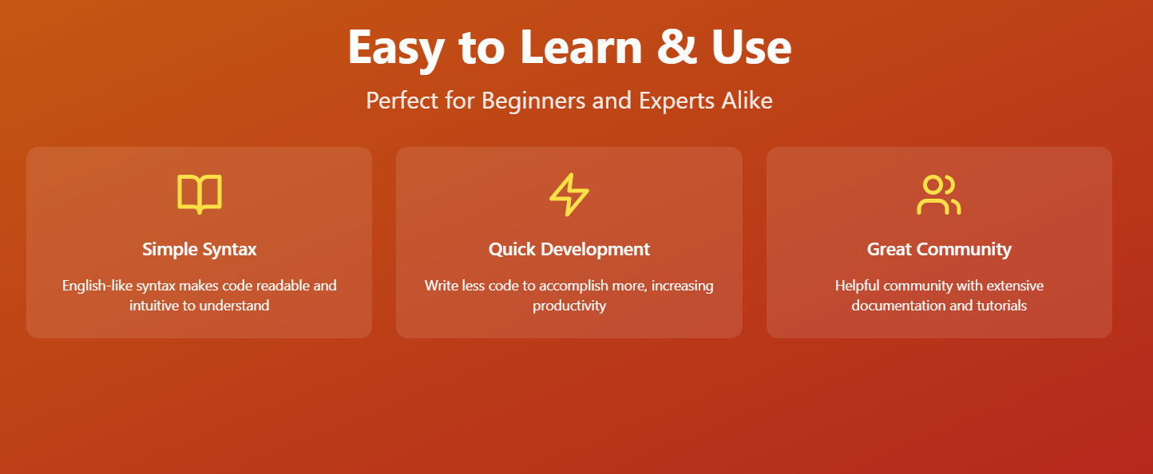

Slide 5
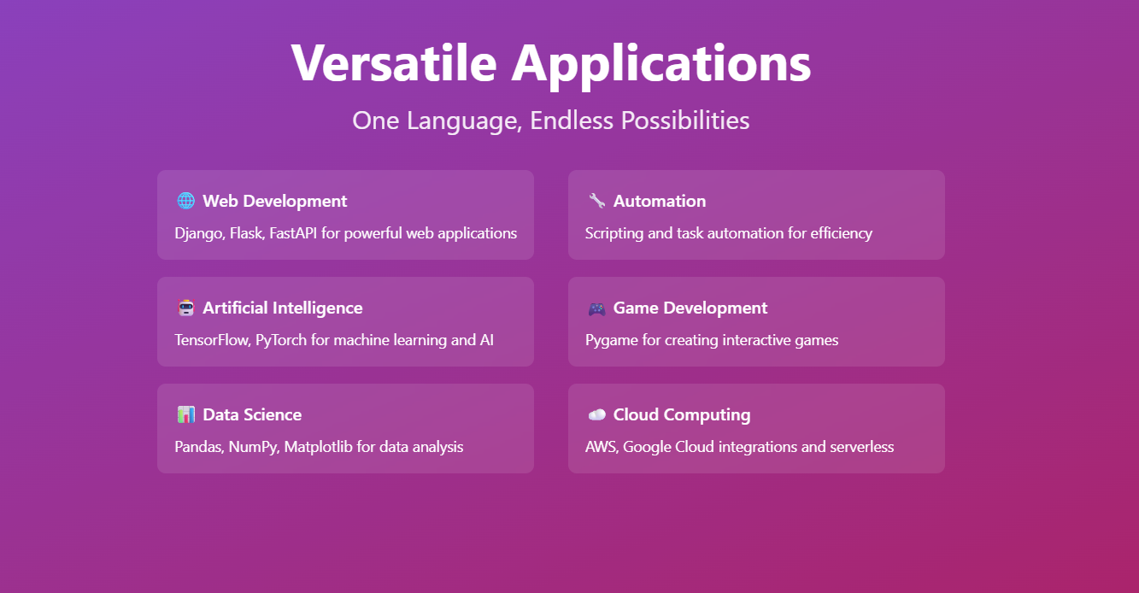

Slide 6
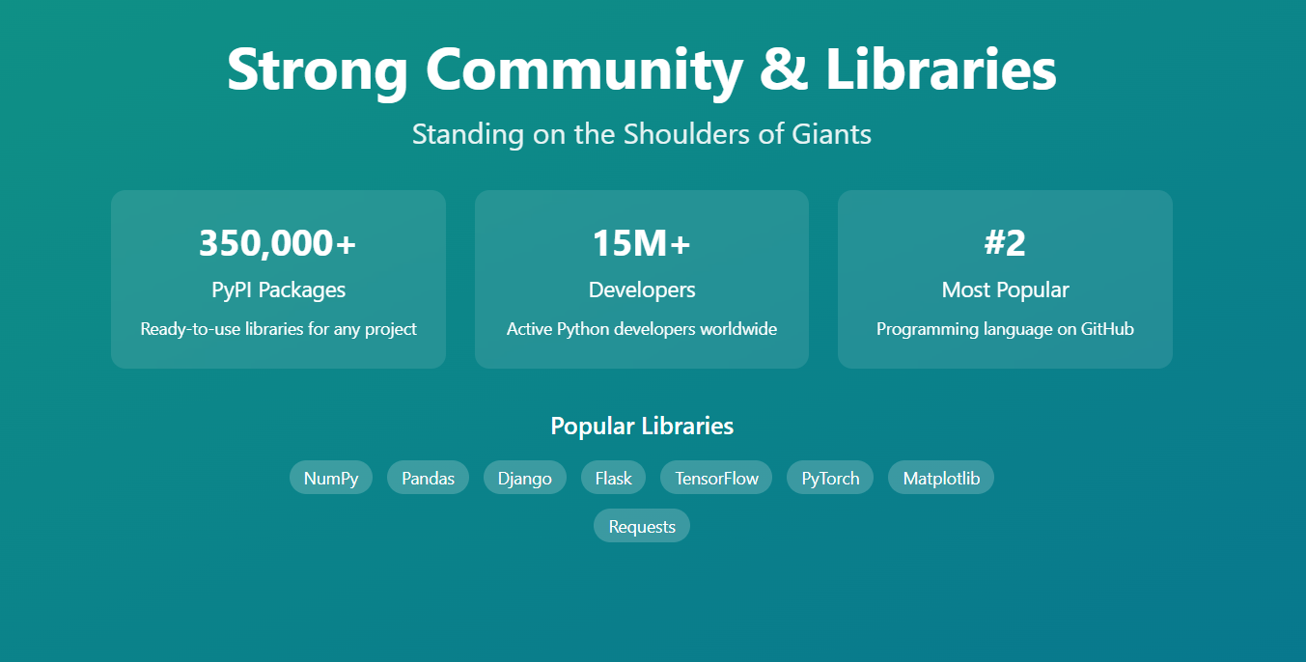

Slide 7
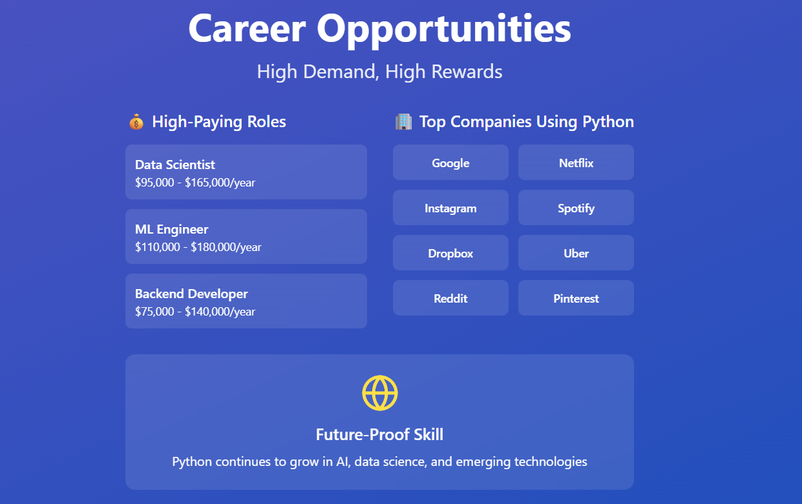

Slide 8
Thank You

