Slide 1






Slide 2
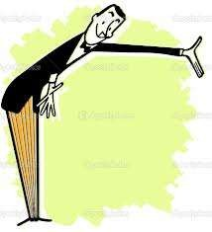

INTRODUCTION
Leadership is the one of the most important function of
management.
Leading involves directing, influencing & motivating employees to perform

Slide 3
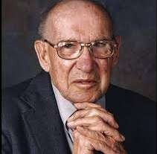






DEFINITION :
According to Peter
Drucker, “ Leadership is shifting of own vision to higher sights,the raising of man’s performance to higher standards,the building of man’s personality beyond its normal limitations.”

Slide 4


WHO IS A LEADER......?
One that leads or guides.
One who is in charge or in command of others.
One who heads a political party or organization.
One who has influence or power, especially of a political nature.

Slide 5
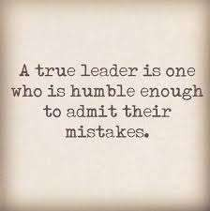
CHARACTERS OF LEADERSHIP
Empathy
Consistancy
Honesty
Direction
Communication
Needs support from all
Assume obligation

Slide 6

DIFFERENCE BETWEEN
MANAGER & LEADER
MANAGER
Oversees the current process well
Must achieve balance
Thinks execution
Comfortable with control
Problems are just that &
need resolusion ASAP
Procedure is King
Instructs as to technique & process
Impersonal,remote
LEADER
Wants to create the future
Needs to make change
Thinks ideal
Welcomes risks
Sees problems as opportunities is patient
Substance thumps the King
Your best college professor
High emotional intelligence

Slide 7

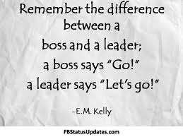
IMPORTANCE OF LEADERSHIP
Initiates action
Motivation
Providing guidance
Creating confidence
Co-ordination
Effective planning
Inspiration & motivation

Slide 8


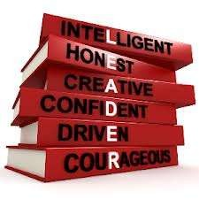
ROLE OF A LEADER
A Leader’s role is always to ensure his/her team achieves the task in hand,but an effective leader will also ensure they meet more subtle requirement....... :- like

Slide 9
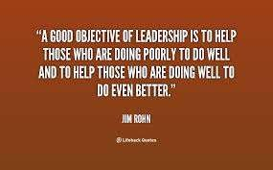
Strong focus
Integrity
Good engagement with others
Looking at the bigger picture
Resourcefulness
Organisational Clout
Effective communication

Slide 10

Managerial Leadership influences the organisation in the following ways:
Leading affects Morale
Leading is key to effective Communication
Leading effectively contributes more to the bottom line

Slide 11







