Slide 1
INTERNATIONAL CONFERENCE
On Intelligent Computing and Communication Techniques 28th-29th June 2024
JNU, New Delhi
BLOCKCHAIN BASED TWITTER DAPP
[Paper ID : 1007]
AUTHORS
ROHIT, VIKAS PATEL, RATNESH SINGH, SUNNY RAJBHAR

Slide 2
Table of Content:
Introduction
Objectives
Use Case
Architecture of the proposed system
Implementation: Algorithm
Observation
Graph for comparison between traditional platform and platform using blockchain
Conclusion
Future Work
References

Slide 3
Introduction:
Reward Based Funding:
It is a type of crowdfunding[3][4] in which
Group of individuals contribute to campaign
Contributors receive rewards in exchange
Rewards can include
Early access to product
Exclusive merchandise
Funding platform without Blockchain:
With the help of platform
Creator create the campaign
Individuals browse and contribute to campaign
Challenges with funding platform without Blockchain:
High platform fee
Trust issues
Lack of transparency
High international transaction time

Slide 4
Objectives:
Using blockchain and IPFS(Interplanetary File System) technology we can
Reduce fees
Enable global access
Ensure trust and transparency
Enhance security of transactions
Implement tokenization for rewards [5][6]

Slide 5
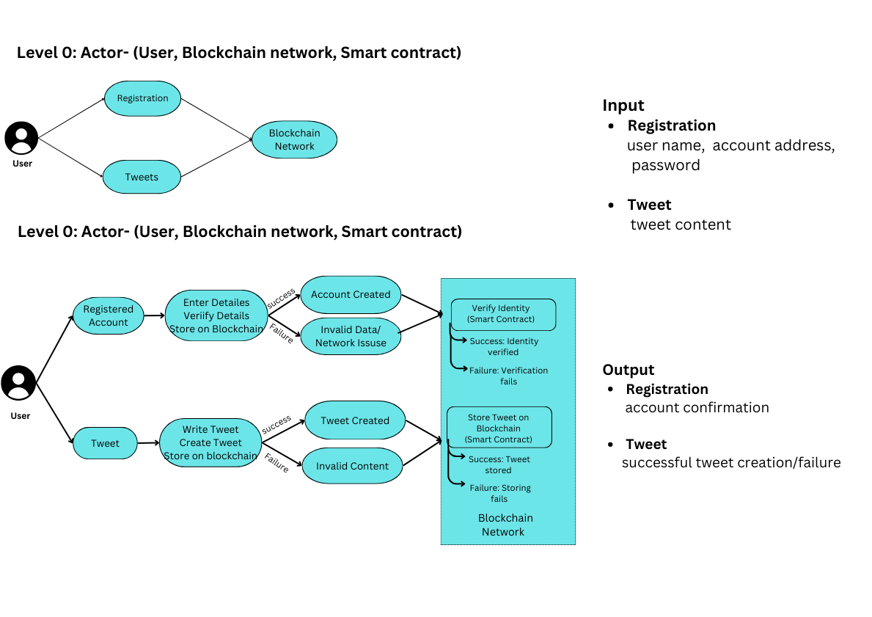
Use Case:

Slide 6
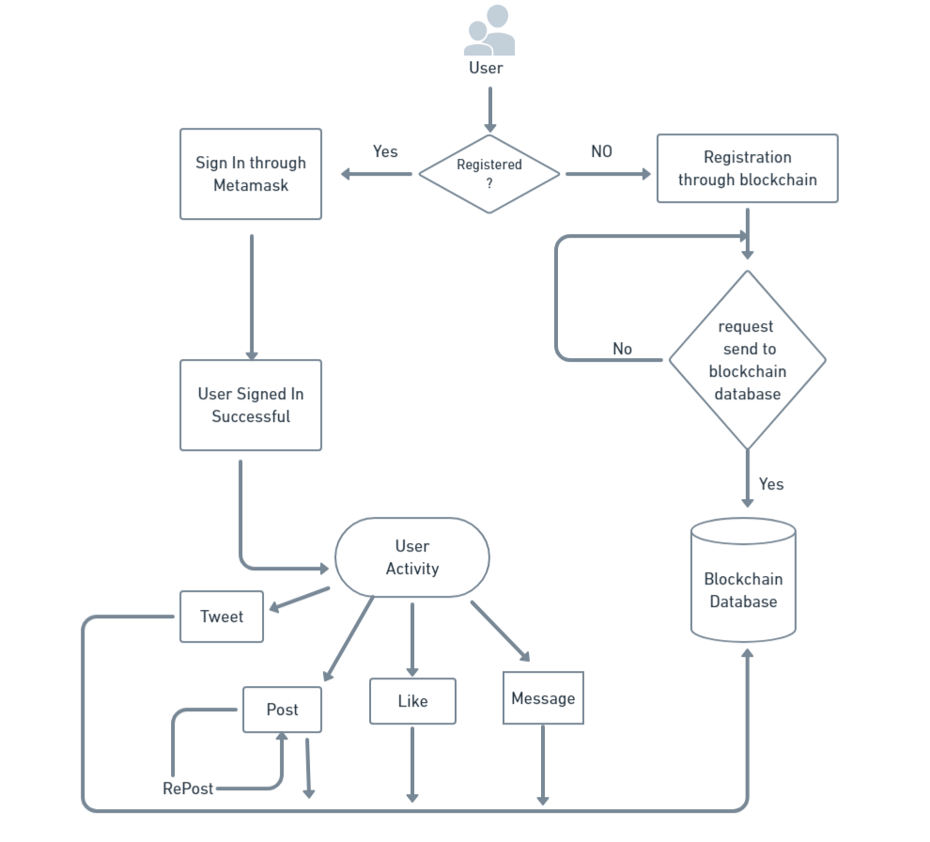
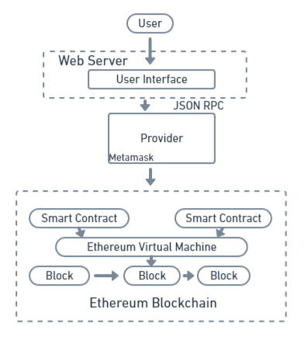
Architecture of the proposed system:

Slide 7
Implementation : Algorithm
Algorithm 1: User Registration and Authentication
Input: Username, Password
Output: Success or failure of the User Registration and Authentication
1: if isUserDetailsValid(username, password) then
2: deployUserContract(username, password) [7]
3: storeUserCredentialsOnBlockchain(username, password)
4: return "Registration successful"
5: else
6: return "Registration failed"
7: end if

Slide 8
Implementation : Algorithm
Algorithm 2: Algorithm for contribution in campaign
Input: User address, tweet content
Output: Success or failure message
1. Initialize tweetCreated as false
2. Validate userAddress: If invalid, return "Invalid user address“
3. Validate content: If empty or exceeds limit, return "Invalid tweet content“
4. Create tweet transaction
5. If successful, set tweetCreated to true and return "Tweet created successfully“
6. Else return "Failed to create tweet"

Slide 10


Observation:
The formula for change in percentage for improvement is given as:
$Global Payment=\left(\frac{y−x}{x}\right)∗100$ …….(1)
$Fees =\left(\frac{y−x}{x}\right)∗100$……..(2)
where x represents time taken by international bank transfer for one transaction and y represents time taken for transaction through blockchain.
where x represents fees charged by traditional platforms and y represents fees charged through platform using blockchain charge as a gas fee for transaction.
Aspect | Centralized Twitter | Decentralized Twitter
Architecture | Centralized Architecture | Peer-to-peer(P2P) or Decentralized Architecture
Data Storage | Stored on Centralized Servers | Decentralized Data Storage across Multiple Nodes
Data Control | Platform provide retains control and ownership over user data and content | Users have more control over their data and content

Slide 11
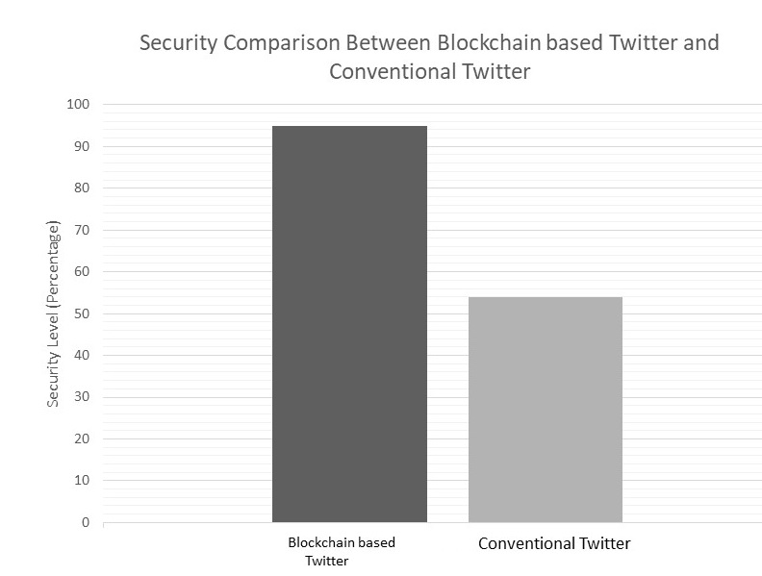
Graph for comparison between the Blockchain based Twitter and Conventional Twitter:

Slide 12
Conclusion:
Proposes a crowdfunding platform using Blockchain and IPFS technology
Increases platform effectiveness
Platform cost is reduced
Achieves higher levels of trust and transparency
Utilizes Smart Contracts for secure and automated processes

Slide 13
Improve scalability 11 / 11
Future Work:
Incorporate side chains to reduce the load on the main chain
Expand payment options beyond MetaMask
Improve the scalability

Slide 14
Improve scalability 11 / 11
References:
Page, J., 2024, How Long Does It Take to Transfer Ethereum, https://cryptohead.io/how-long-does-it-take-to-transfer-ethereum/
Keating, R., 2023, How long do international bank transfers take, https://rb.gy/as7q7k
Smith, T., 2023, Crowdfunding: What it is, how it works, and popular websites, https://shorturl.at/gtA23
Jules, 2019, https://www.easyship.com/blog/types-of-crowdfunding
Oza, K. & Naik, P., 2024, https://shorturl.at/dnsvE
Abrol, A., 2023, https://www.blockchain-council.org/blockchain/what-is-tokenization/
Weston, G., 2023, https://101blockchains.com/deploy-smart-contract/
Rohit Singh, N. Shukla, R. & Singh, A., 2024, Feature Enhancement of Micro-service based Cab Booking System using Blockchain, ICCMST

Slide 15
THANK YOU

