Slide 1
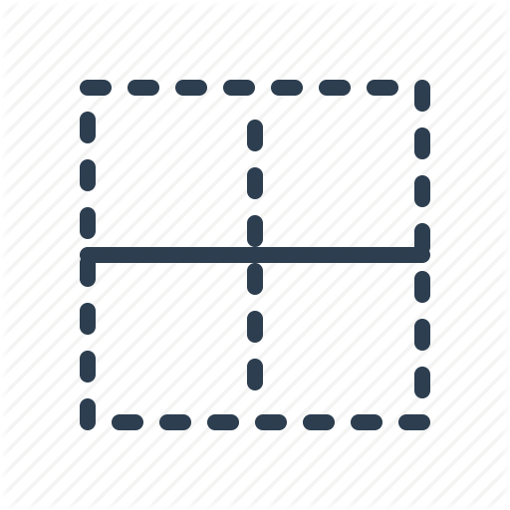


Paolo Monella
Encoding Pre-modern Writing Systems
Sunoikisis Digital Classics,
Summer 2022 programme
May 12, 2022

Slide 2

ERC PAGES (AdG 2019 n° 882588)
This project has received funding from the European Research Council (ERC) under the European Union's Horizon 2020 research and innovation programme (grant agreement No 882588)

Slide 3
Outline

Slide 4
Outline
Interoperability
of digital scholarly editions (DSEs)
based on diplomatic transcriptions
  The issue
  Current solutions
  Interoperability through modelling
Orlandi’s table of sign
Graphemes/allographs

Slide 5
Outline
Interoperability
of digital scholarly editions (DSEs)
based on diplomatic transcriptions
  The issue
  Current solutions
  Interoperability through modelling
Orlandi’s table of sign
Graphemes/allographs
Can allographs have a distinctive value?
Open issues

Slide 6
Interoperability: the issue

Slide 7
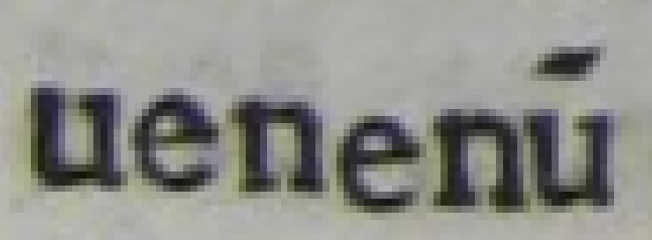
Interoperability: the issue

Slide 8
Interoperability: the issue
uenenū

Slide 9
Interoperability: the issue
uenenū
Diplomatic
Manual or HTR
  Visualization
  Processing

Slide 10
Interoperability: the issue
uenenū

Slide 11
Interoperability: the issue
uenenū
uenenum

Slide 12
Interoperability: the issue
Processing
    Search
    Collation
    NLP (lemma, PoS etc.)
    Statistics (dist. reading)
uenenū
uenenum

Slide 13
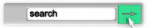
Interoperability: the issue
Processing
    Search
    Collation
    NLP (lemma, PoS etc.)
    Statistics (dist. reading)
uenenū
uenenum
venenum

Slide 14

Interoperability: the issue
Processing
    Search
    Collation
    NLP (lemma, PoS etc.)
    Statistics (dist. reading)
uenenū
uenenum

Slide 15
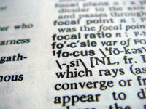
Interoperability: the issue
Processing
    Search
    Collation
    NLP (lemma, PoS etc.)
    Statistics (dist. reading)
uenenū
uenenum

Slide 16

Interoperability: the issue
Processing
    Search
    Collation
    NLP (lemma, PoS etc.)
    Statistics (dist. reading)
uenenū
uenenum

Slide 17
Interoperability: the issue
My focus: European Medieval handwriting
  ...and early print (imitating handwriting)

Slide 18
Interoperability: current solutions

Slide 19
Unicode (TEI’s recommendation)
Solution for new digital texts
Not enough for pre-modern writing systems
  Allographs
    ſ (U+017F) / s (U+0073; ASCII 115)
    Have I told the computer that they correspond to each other (variants of grapheme <s>)?

Slide 20
Unicode (TEI’s recommendation)
Solution for new digital texts
Not enough for pre-modern writing systems
  Allographs
    ſ (U+017F) / s (U+0073; ASCII 115)
    Have I told the computer that they correspond to each other (variants of grapheme <s>)?
  Ligatures
    & (U+0026; ASCII 38)
    Have I encoded that it is equivalent to “e + t” in that MS?
  Grapheme set
    u (U+0075; ASCII 117)
    Have I encoded whether it “covers” (or not) <u> and <v>?

Slide 21
Manual normalized transcription
uenenū
Diplomatic
Visualization
Processing

Slide 22
Manual normalized transcription
Normalized
Processing
    Search
    Indexing
    Collation
    NLP (lemma, PoS etc.)
    Statistics (distant reading)...
venenum
uenenū
Diplomatic
Visualization
Processing

Slide 23
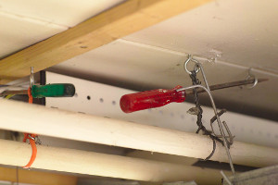
Project-specific pre-processing
Collation: pre-processing to normalize the text
  Or instruct collation software to ignore some discrepancies
Same with search/indexing/NLP/statistics software
Disposable home-made solutions
  …for a shared issue

Slide 24
Interoperability through modelling

Slide 25
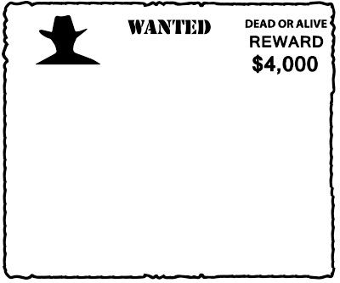
Interoperability through modelling
Documenting project-specific modelling (transcription) and normalization practices
  What am I transcribing (graphemes/allographs)? How?
  What corresponds to what (ſ/s)?
Documentation
  In English prose (specifications for other programmers)
  Formal (software code, tables)

Slide 26
Interoperability through modelling
Documenting project-specific modelling (transcription) and normalization practices
  What am I transcribing (graphemes/allographs)? How?
  What corresponds to what (ſ/s)?
Documentation
  In English prose (specifications for other programmers)
  Formal (software code, tables)
Example ahead!

Slide 27
Orlandi’s table of signs

Slide 28
Orlandi’s table of signs
OCR/HTR
(witness A)
Manual (selective)
transcription
(witness B)

Slide 29
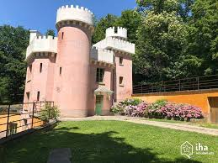
Orlandi’s table of signs
Allographic
transcription
Vnder τhis Casτle
under this caſtle
OCR/HTR
(witness A)
Manual (selective)
transcription
(witness B)

Slide 30
Orlandi’s table of signs
Allographic
transcription
Vnder τhis Casτle
under this caſtle
OCR/HTR
(witness A)
Manual (selective)
transcription
(witness B)

Slide 31
Orlandi’s table of signs
Unicode
characters
Allographic
transcription
Vnder τhis Casτle
under this caſtle
OCR/HTR
(witness A)
Manual (selective)
transcription
(witness B)

Slide 32
Orlandi’s table of signs
Allographic
transcription
Vnder τhis Casτle
under this caſtle
OCR/HTR
(witness A)
Manual (selective)
transcription
(witness B)

Slide 33
Orlandi’s table of signs
Allographic
transcription
Vnder τhis Casτle
under this caſtle
OCR/HTR
(witness A)
Manual (selective)
transcription
(witness B)

Slide 34
Orlandi’s table of signs
Allographic
transcription
Vnder τhis Casτle
under this caſtle
OCR/HTR
(witness A)
Manual (selective)
transcription
(witness B)

Slide 35
Orlandi’s table of signs
Allographic
transcription
Vnder τhis Casτle
under this caſtle
OCR/HTR
(witness A)
Manual (selective)
transcription
(witness B)

Slide 36
Orlandi’s table of signs
Gr Allogr
s: s
t: τ | Ɛ | √
u: u | V
Gr Allogr
s: s | ſ
t: t
u: u
Allographic
transcription
Vnder τhis Casτle
under this caſtle
OCR/HTR
(witness A)
Manual (selective)
transcription
(witness B)

Slide 37
Orlandi’s table of signs
Graphematic
layer
unter dem schloss
unter dem schloss
Not hard-coded in the
project-specific
normalization
practice/software
But documented
and formalized
Gr Allogr
s: s
t: τ | Ɛ | √
u: u | V
Gr Allogr
s: s | ſ
t: t
u: u
Allographic
transcription
Vnder τhis Casτle
under this caſtle
OCR/HTR
(witness A)
Manual (selective)
transcription
(witness B)

Slide 38
Orlandi’s table of signs
(More) interoperability
Graphematic
layer
Processing
  Search
  Indexing
  Collation
  NLP (lemma, PoS etc.)
  Statistics (dist. reading)
unter dem schloss
unter dem schloss
Gr Allogr
s: s
t: τ | Ɛ | √
u: u | V
Gr Allogr
s: s | ſ
t: t
u: u
Allographic
transcription
Vnder τhis Casτle
under this caſtle
Visualization
Processing
OCR/HTR
(witness A)
Manual (selective)
transcription
(witness B)

Slide 39
Interoperability through modelling
Documenting project-specific modelling (transcription) and normalization practices
  What am I transcribing (graphemes/allographs)? How?
  What corresponds to what (ſ/s)?
Documentation
  In English prose (specifications for other programmers)
  Formal (software code, tables)

Slide 40
Interoperability through modelling
Scholarly discussion on modelling
  What is a grapheme? What is an allograph?
Shared models
  Grassroot approach, from discussion
Reusable software libraries

Slide 41
Graphemes/allographs

Slide 42
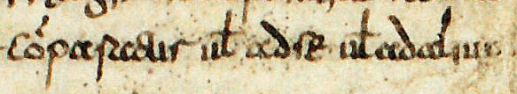
Graphemes/allographs: the commutation test
System
Comparatur vel ad se vel ad alium
He is compared to himself or to another
<s>
<t>
Text
cỏparaƐur uł adſe uładalium
<x>
<y>
<z>

Slide 43
Graphemes/allographs: the commutation test
System
System
<s>
«τ»
<t>
Text
cỏparaƐur uł adſe uładalium
«√»
<x>
<y>
<z>

Slide 44
Graphemes/allographs: the commutation test
<s>
«τ»
<t>
cỏparaƐur uł adſe uładalium
«√»
<x>
Substitution:
→ No change
in “denotative meaning”
<y>
Commutation:
→ Change
in “denotative meaning”
<z>

Slide 45
Graphemes/allographs: the commutation test
Allographs
Graphemes
<s>
«τ»
<t>
cỏparaƐur uł adſe uładalium
«√»
<x>
Substitution:
→ No change
in “denotative meaning”
<y>
Commutation:
→ Change
in “denotative meaning”
<z>

Slide 46
Graphemes/allographs: the commutation test
Gr Allogr
t: τ | Ɛ | √
u: u | v
z: z
Allographs
Graphemes
<s>
«τ»
<t>
cỏparaƐur uł adſe uładalium
«√»
<x>
Substitution:
→ No change
in “denotative meaning”
<y>
Commutation:
→ Change
in “denotative meaning”
<z>

Slide 47
Graphemes / allographs: what to transcribe?
Whatever our project needs!
  Based on its scientific interests
  (...and on time / money)
But: declaring what we are transcribing
  Based on a formal distinction, e.g., between graphemes / allographs
  Documenting it
    English prose
    Formal (software, tables...)

Slide 48
Good practices

Slide 49
Good practices
See section Seminar readings on GitHub
  Human-readable tables of signs
  Machine-readable tables of signs

Slide 50
Exercise

Slide 51
Exercise
See section Exercise on GitHub

Slide 52
Can allographs have a distinctive value?

Slide 53
Allographs
τ
τ
τ
τ
τ
Ɛ
Ɛ
√
√
√
√

Slide 54
Allographs
τ
τ
τ
τ
1. «τ»
τ
Ɛ
Ɛ
2. «Ɛ»
√
√
√
3.«√»
√

Slide 55
Capitals: allographs or graphemes?
Cool (CA) is a cool town Geographical name
Smith is a good smith Proper name
ODD files are odd files Acronym
OK for contemporary
Western writing systems
Not for classical/medieval
handwriting (see later)

Slide 56
Capitals: allographs or graphemes?
Cool (CA) is a cool town Geographical name
Smith is a good smith Proper name
ODD files are odd files Acronym
R. Mordenti
F. Neuber
P. Monella
Grapheme
<D>
Archi-grapheme D
Alphabeme
D
Allograph
«d»
Allograph
«D»
Grapheme
<d>
Grapheme
<D>
Grapheme
<d>
Grapheme
<D>

Slide 57
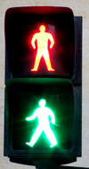
Sentence segmentation: distinctive value for meaning of the whole text
I go because I have to. Stay here!
I go because I have to stay here!
Capitals

Slide 58
Sentence segmentation: distinctive value for meaning of the whole text
I go because I have to. Stay here!
I go because I have to stay here!
Punctuation
Capitals

Slide 59

Word segmentation: distinctive value for meaning of the whole text
σαῦρος, ſucceſs, daſs (daß)

Slide 60
Word segmentation: distinctive value for meaning of the whole text
σαῦρος, ſucceſs, daſs (daß)
Paulus suſtinet me (Paolo holds me up)
Paulus ſus tinet me (Paolo the pig holds me)
Positional
allograph

Slide 61
Word segmentation: distinctive value for meaning of the whole text
σαῦρος, ſucceſs, daſs (daß)
Paulus suſtinet me (Paolo holds me up)
Paulus ſus tinet me (Paolo the pig holds me)
Positional
allograph
Space

Slide 62
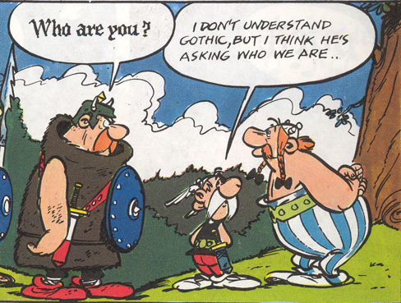
Connotators

Slide 63
Connotators

Slide 64
Connotators
𝖜𝖍𝖔
≠
who
Connotator
“Gothic”
(marked)
Pertinence
Connotator
“Gaul”
(not marked)

Slide 65
Connotators
Connotators, pertinent for the writer
I really like it Emphasis
the Evangelist wrote Respect

Slide 66




(Non-)pertinent allographs: positional variants
Ligatures
Non-pertinent for the writer
Connotators, pertinent
for (some) readers
  editors, paleographers, codicologists, historians studying a MS / book
  (Beneventan vs Caroline script, print font, ſ / s)
Allographs
«τ»
«Ɛ»
«√»

Slide 67
Distinctive value (pertinence) of allographs?
Graphemes change denotative meaning
  fame vs name
  Hjelmslev: denotative semiotics
Allographs can have other forms of distinctive value (pertinence)
  For the writer
    𝖜𝖍𝖔 vs who
    Hjelmslev: connotative semiotics
  For the reader (digital editor)
    Digital editors can set their own pertinence (transcription) criteria
      based on their scientific interests
      E.g.: fraktur font → political connotation in WW1

Slide 68
Open issues

Slide 69
Open issues
Allographic words
  Spelling (wife / wyffe)

Slide 70
Open issues
Allographic words
  Spelling (wife / wyffe)
  Abbreviations (ūter / unter)

Slide 71
Open issues
Allographic words
  Spelling (wife / wyffe)
  Abbreviations (ūter / unter)
Graphematic
ūter dem schloss
unter dem schloss
Allographic
ūter dem ſchloſs
unter dem ſchloſs

Slide 72
Open issues
Allographic words
  Spelling (wife / wyffe)
  Abbreviations (ūter / unter)
Linguistic
(normalized)
[unter]
[unter]
Graphematic
ūter dem schloss
unter dem schloss
Allographic
ūter dem ſchloſs
unter dem ſchloſs

Slide 73
Open issues
Allographic words
  Spelling (wife / wyffe)
  Abbreviations (ūter / unter)
Interoperability
Processing
  Search
  Collation
  NLP (lemma, PoS etc.)
  Statistics (dist. reading)
Linguistic
(normalized)
[unter]
[unter]
Graphematic
ūter dem schloss
unter dem schloss
Allographic
ūter dem ſchloſs
unter dem ſchloſs

Slide 74
Outline

Slide 75
Outline
Interoperability
of digital scholarly editions (DSEs)
based on diplomatic transcriptions
  The issue
  Current solutions
  Interoperability through modelling
Orlandi’s table of sign
Graphemes/allographs

Slide 76
Outline
Interoperability
of digital scholarly editions (DSEs)
based on diplomatic transcriptions
  The issue
  Current solutions
  Interoperability through modelling
Orlandi’s table of sign
Graphemes/allographs
Can allographs have a distinctive value?
Open issues

