Slide 1
Shell Bootcamp 2024 3 Reflections for Week 3
Sunidhi Singh
Date : 13-Sep-2024

Slide 2

About Me
A phrase that represents my motto in life is Dream big, work hard, stay focused

Slide 3

My learnings from this week!

Slide 4
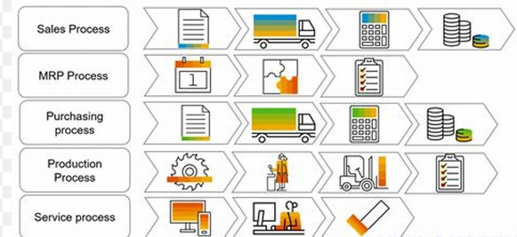
Learning 1 | My takeaways
Business process is a collection of linked tasks which find their end in the delivery of a service or product to a client , set of activities and tasks that once completed will complete an organizational goal. They include Marketing and Sales, Supply Chain Management, Accounting and Finance and Human Resources. Marketing and Sales comprise of marketing of a product, taking sales orders, customer relationship management, sales forecasting and advertising, Supply Chain Management comprises of Purchasing good and raw materials, receiving good and raw materials, transportation and logistic, scheduling product runs and manufacturing goods, Accounting and Finance comprises Financial Accounting of payments from customers to suppliers, cost allocation and control, Planning and Budgeting and Cash-flow management and Human Resources comprises Recruiting and Hiring, Training , Payroll, Benefits and Government Compliance.

Slide 5
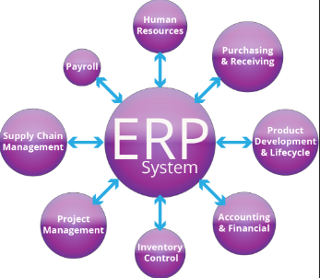
Learning 2 | My takeaways
What is ERP?
ERP system integrates all functions across a company to a single computer system that can serve all those functions specific needs. ERP supports business through optimizing, maintaining and tracking business functions. From product planning , parts purchasing , inventory control. Evolution and History of ERP: 1960s – Systems just for inventory control, 1970s – MRP (Material Requirement Planning),1980s – MRP 2 (Manufacture Resource Planning),Mid 1990s – ERP, 2000 – Web Architectures Emerge and the Game Changes,2010 – Cloud Computing threatens to storm ERP

Slide 6
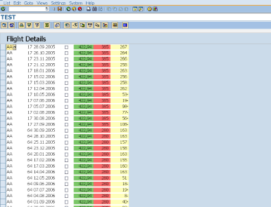
Learning 3 | My takeaways
ABAP isn’t case sensitive but ABAP is space sensitive
Role of an ABAPer in real time : R – Reports, I – Interfaces,C – Conversions,E – Enhancement,F – Forms,W – Work Flow . In SAP ABAP each task is called one object ,Report – based on the given input we will fetch data from database and display in a predefined format. Types of Reports include:
Classical Reports – to display entire information in a single list
Interactive Reports – to display summarized info in the basic list and detailed info in further lists
ALV Reports (ABAP LIST VIEWER) – used to display data with additional features i.e Borders , Colors etc.

Slide 7

Relevance of learnings for my organization

Slide 8
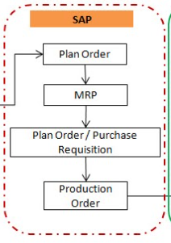
Learning 1 | Relevance for Shell
How I feel Shell implements this learning (in your own words)
Shell integrates efficient workflows across departments using advanced systems for CRM, logistics, financial management, and HR.
How I feel Shell benefits from this learning (in your own words)
These processes enhance efficiency, customer satisfaction, cost savings, decision-making, and compliance.

Slide 9
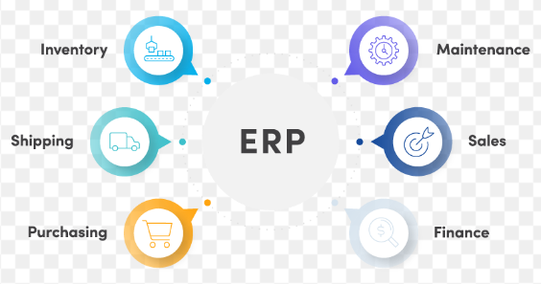
Learning 2 | Relevance for Shell
How I feel Shell implements this learning (in your own words)
Shell likely uses an ERP system to integrate and optimize all business functions, from product planning to inventory control, ensuring seamless operations across departments.
How I feel Shell benefits from this learning (in your own words)-
By using ERP, Shell can achieve higher efficiency, better resource management, and improved decision-making, leading to cost savings and enhanced competitiveness.

Slide 10
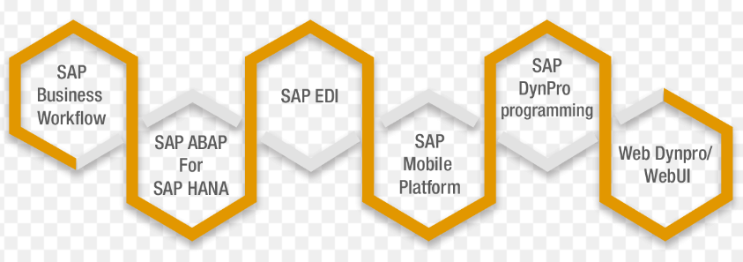
Learning 3 | Relevance for Shell
How I feel Shell implements this learning (in your own words)
Shell likely employs ABAP to develop and manage various SAP modules, ensuring efficient data handling and reporting through customized reports, interfaces, and workflows.
How I feel Shell benefits from this learning (in your own words) –
Using ABAP, Shell can streamline operations, enhance data accuracy, and improve decision-making processes, leading to better resource management and operational efficiency.

Slide 11

Challenges in implementing learning

Slide 12
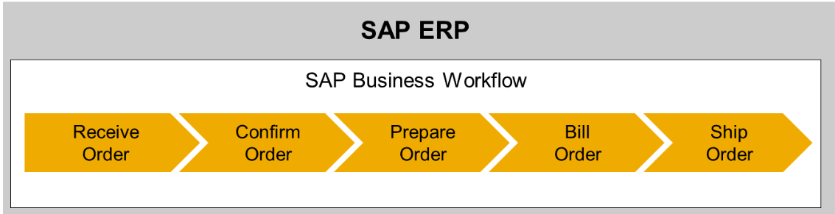
Challenge faced while implementing Learning 1
Practical Application: Applying theoretical knowledge to real-world scenarios can be challenging without hands-on experience.
2. Integration Understanding: Grasping how different processes interconnect and impact each other requires a deep understanding of the entire business ecosystem.

Slide 13
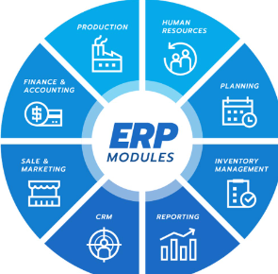
Challenge faced while implementing Learning 2
Complexity of Concepts: Understanding the intricate details of ERP systems, including their integration and optimization capabilities, can be overwhelming.
2. Plan to Overcome: To overcome ERP implementation challenges, we can develop a clear plan, engage stakeholders, and invest in comprehensive training. Ensure data accuracy, customize the system, and provide ongoing support.
Ta

Slide 14
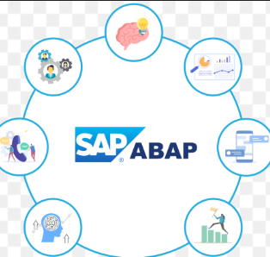
Challenge faced while implementing Learning 3
Implementing ABAP concepts also involves addressing performance issues, especially with complex ALV reports that include additional features like borders and colors. Seamless integration of ABAP enhancements with existing systems and workflows requires meticulous planning and testing. Additionally, ongoing maintenance and updates to ABAP objects to keep up with evolving business needs and SAP updates can be demanding. Providing adequate user training to ensure effective utilization of new reports and workflows is also crucial.

Slide 15

Action Plan

Slide 16
My Action Plan for this Week
Actions
Timeline
Status
Revising Concepts learnt and doing hands on
Coming 2 weeks
started

Slide 17

Learning is also Fun!

Slide 18
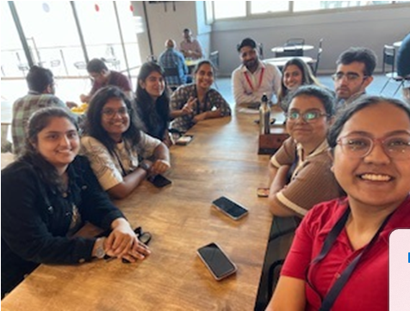
Learning is also Fun!
Please share how ”Your” learning was fun this week
The sessions were very interactive where we learned about real world implementation of the study material. JAMs were regularly conducted along with assessments that made us feel comfortable with the topic as it was new to all of us.

Slide 19

Summary
Business processes are collections of linked tasks aimed at delivering a service or product to a client, encompassing areas like Marketing and Sales, Supply Chain Management, Accounting and Finance, and Human Resources. ERP systems integrate all company functions into a single system to optimize and track business functions, evolving from inventory control in the 1960s to cloud-based solutions in the 2010s. ABAP, a programming language used in SAP, is not case-sensitive but is space-sensitive. ABAPers handle tasks such as creating Reports, Interfaces, Conversions, Enhancements, Forms, and Workflows, with report types including Classical, Interactive, and ALV reports.

Slide 20
Thank You

