Slide 1
Shell Bootcamp 2024 3 Reflections for Week 1
Sunidhi Singh
Date : 30-Aug-2024

Slide 2

About Me
A phrase that represents my motto in life is Dream big, work hard, stay focused

Slide 3

My learnings from this week!

Slide 4
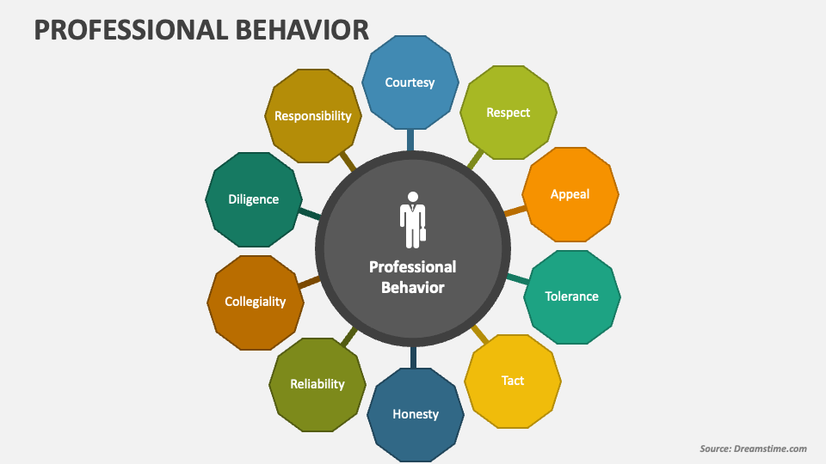
Learning 1 | My takeaways
Please share (in your own words) details of the learning.
Key learning – Professional Behaviour encompasses Integrity, Self awareness , Professional Qualities, Managing Complexity and New world imperatives.
Key takeaway – mindset is how you see the world around you. And your attitude is how you interact with the world according to how you see things
A growth mindset in the energy sector encourages professionals to view challenges as opportunities for innovation. This mindset drives the exploration of new technologies, such as renewable energy, and the adoption of sustainable practices.

Slide 5
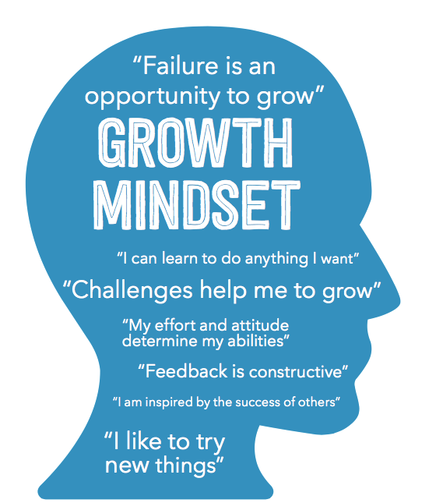
Learning 2 | My takeaways
Please share (in your own words) details of the learning.
Key learning – Neuroplasticity was taken up and discussion ensued regarding Fixed Mindset and Growth Mindset.
Key takeaway – Fixed Mindset believes putting forth effort is worthless while Growth Mindset believes mistakes are an essential part of learning
In a growth-minded energy sector, innovation is seen as a process of trial and error. This perspective allows for more experimentation, leading to breakthroughs in energy efficiency, sustainability, and resource management.

Slide 6
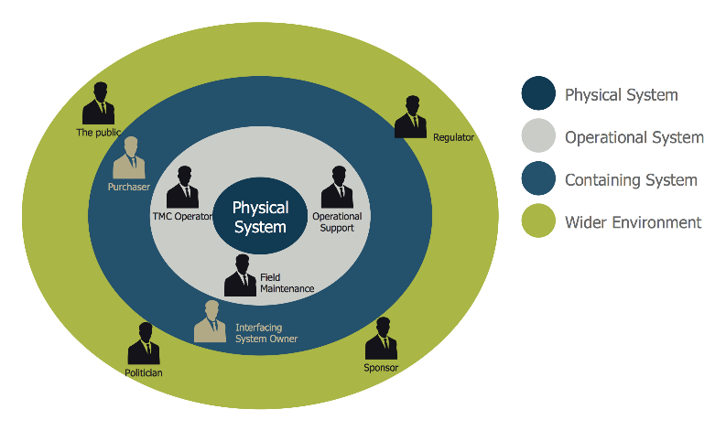
Learning 3 | My takeaways
Please share (in your own words) details of the learning.
Key learning – Stakeholder management was discussed starting with identification of all internal and external stakeholders, planning stakeholder management , engaging and controlling the stakeholders.
Key takeaway – This leads to Enhanced Project alignment , improved risk management and better resource allocation
In the energy sector, this leads to smoother project execution, greater support, and a higher likelihood of success, especially in complex and high-impact energy projects like renewable energy installations or infrastructure upgrades.

Slide 7
Learning 4 | My takeaways
Introduction to Business Analysis – According to IIBA – it’s the practice of enabling
change in an organisational context.
Definition of Business – an organisation which provides products or services to satisfy
the customers need with the objective of making profit.
Definition of Analysis
- Systematic Examination
SDLC Model -Planning (BA involved)
-Define Requirement
-Design and Prototyping
-Software Development
-Testing
-Deployment
-Operations and Maintenance
Requirement Analysis
It is the process of defining user expectations for a new software being built or modified.
Functional Requirement – Describe what the product does , its mandatory,
Non Functional Requirement – Describes how the product works , its non mandatory
Don’t assume ,ask was the key learning after we performed the team activity of modelling
a paper airplane
Gathering , analysis , implementing and testing
Requirement Elicitation

Slide 8
Learning 4 | My takeaways
It is the practice of researching and discovering the requirement of a system from users,
customers and other stakeholders. The practice is also sometimes referred to as
“requirement gathering”
The top elicitation techniques are
Brainstorming
Document analysis
Requirement Modelling
2. Class Based
3. Data Based
The top management techniques are:
Work Breakdown Structure
Gantt Charts
Critical Path Method
Waterfall Model
Kanban
Scrum
Work Breakdown structure is the cornerstone of effective project planning, execution, controlling , monitoring and reporting
Phase based structures
Deliverable based structures
Responsibility based structures
Requirement traceability
ensures each business need is tied to an actual requirement and that each requirement is tied to a deliverable

Slide 9
Learning 4 | My takeaways
Waterfall Model
Requirements
Design
Development
Testing
Deployment
Maintenance
Plan-Build-Test-Launch
Disadvantages
Cant go back
Customer sees product at launch not before that
No demo involved
Advantage
Simplicity , easy to understand
Good for small requirements
Works well when quality is more important than cost or schedule

Slide 10
Learning 4 | My takeaways
When to use Waterfall Model?
Requirements are very well known
Product definition is stable
Technology is understood
New version of an existing product
Porting and existing product to a new platform
Some Agile Methods
Adaptive Software Development
Feature Driven Development
Scrum
Extreme Programming
Kanban
Benefits of Scrum
Adaptability
Continuous Improvement
Sustainable Pace
Motivation
Faster Problem Resolution
Customer Centric
High Velocity
Efficient Development Process

Slide 11
Learning 4 | My takeaways
Scrum Events
Sprint – is a period of two weeks during which a given goal gets accomplished
Sprint Planning – what can be delivered within a sprint and what work will we needed to deliver it.
Daily Scrum – is a daily meeting that the development team uses to review progress toward the sprint goal
Sprint review – is held at the end of each sprint to review the achievements within that sprint and adapt product backlog if needed.
Sprint retrospective – during the retrospective , the scrum team inspects itself and creates a plan for improvements
Product Backlog for Planning- Project Planning is based on a Product Backlog which contains functions and technology enhancements
Two meeting are held –
One to decide features for the next sprint
Th other to plan out the work
Scrum Queues
-Scrum uses lightweight queue-based management and work breakdown mechanisms

Slide 12
Learning 4 | My takeaways
In case of Waterfall model , starting stage is less risky
The sprint
-Sprint – basic unit of development in Scrum
-Sprint duration – one week to one month
-”Time Boxed” effort of a constant length
Setting up Azure Devops

Slide 13
Learning 5 | My takeaways
Epic – Story – Task – SubTask
Epic is simply a story but is considered so large that it needs to be broken down into multiple
Stories.
Story- is essentially a requirement that is in a low enough detail that it can be estimated
Task – Developers , testers may break the story down further into tasks to allow them to estimate ,
Develop and test it.
Sub Task – Division of a parent issue(task) into chunks of work that can be assigned and tracked individually
Business functionality
Spike
Spike is the name for a time boxed user story or Task that is created in order to research a question or resolve a problem
Activity done for Enabler story
Story Pointing
Story points are units of measurement used to determine how much effort is required to complete
Any other piece of work

Slide 14
Learning 5 | My takeaways
The team assigns story points based on the work’s complexity, amount and uncertainty
The definition of Ready defines the ready state. In simple terms , a user story needs to meet some criteria
Before it can be picked up for a sprint.
Scrum Board
Its also called a sprint board, visual representation of work to be done in a single sprint.
Agile workflow
Agile product roadmap
Time Estimation
Logging Work
Why Kanban board
Why use Fibonacci numbers?
Fibonacci numbers get farther apart as the numbers get bigger making estimation easier
Burn up charts vs Burndown charts
Velocity Charts

Slide 15

Relevance of learnings for my organization

Slide 16
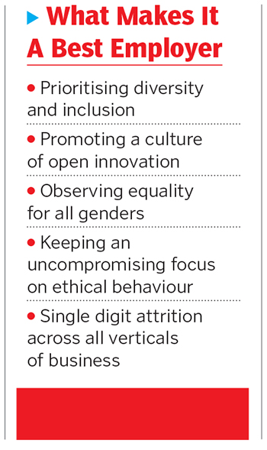
Learning 1 | Relevance for Shell
How I feel Shell implements this learning (in your own words)
Shell implements professionalism by propagating its core values of Honesty , Integrity and Respect among its employees.
How I feel Shell benefits from this learning (in your own words)
Shell benefits by earning the name of a reputed and trustworthy brand, stronger stakeholder relationships , employee morale and retention , resilience in crisis and Long-Term Sustainability.

Slide 17
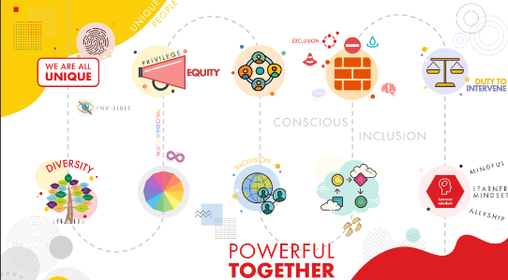
Learning 2 | Relevance for Shell
How I feel Shell implements this learning (in your own words)
Shell implements a Growth Mindset by encouraging its employees to participate in diverse community networks , few of them are SBO women network, LGBT network , enAble network and Young Shell India. Shell also organizes conferences to enable innovation and exchange of new ideas.
How I feel Shell benefits from this learning (in your own words)- Shell creates an environment where employees feel empowered to share ideas, take risks, and experiment. This leads to greater innovation, helping Shell stay ahead in the competitive energy sector.

Slide 18

Learning 3 | Relevance for Shell
How I feel Shell implements this learning (in your own words)
Shell implements this through its motto of “Powering Progress” that includes , generating Shareholder value, achieving net zero emissions,powering lives and respecting nature.
By aligning stakeholder management with these goals, Shell ensures that all stakeholders are engaged and managed effectively
How I feel Shell benefits from this learning (in your own words) - By mastering stakeholder management, Shell benefits from more streamlined project execution and greater support from stakeholders. This leads to fewer disruptions, better risk management, and more efficient use of resources.

Slide 19

Challenges in implementing learning

Slide 20

Challenge faced while implementing Learning 1
Maintaining Transparent Communication: Ensuring transparency in communication with all stakeholders can be difficult, especially in sensitive or high-stakes projects. There may be challenges in delivering consistent and clear messages.
Plan to Overcome: Implement structured communication plans and use multiple channels to disseminate information. Regular updates and feedback mechanisms can help maintain transparency and build trust.

Slide 21

Challenge faced while implementing Learning 2
Resistance to Change: Encouraging a shift from a fixed mindset to a growth mindset can be challenging, especially if individuals are accustomed to traditional ways of thinking and working. There may be resistance to embracing new approaches and accepting that mistakes are part of the learning process.
Plan to Overcome: Promote awareness and education about the benefits of a growth mindset. Provide training and workshops that emphasize the value of learning from mistakes and encourage a culture of experimentation and continuous improvement.
Ta

Slide 22
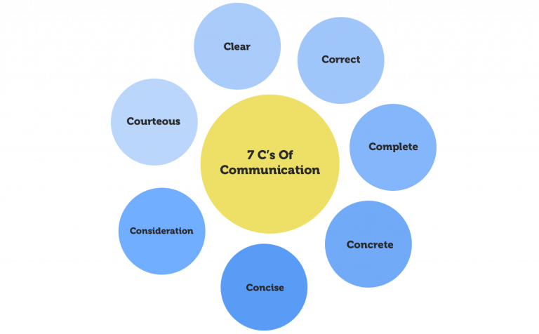
Challenge faced while implementing Learning 3
Engaging Stakeholders Effectively: Engaging stakeholders in a meaningful way can be challenging, especially if there are conflicting interests or if stakeholders are not responsive.
Plan to Overcome: Develop clear communication strategies and tailor engagement approaches to different stakeholder groups. Establish regular touchpoints and feedback mechanisms to address concerns and build strong relationships.

Slide 23

Action Plan

Slide 24
My Action Plan for this Week
Actions
Timeline
Status
1.Attend networking events, workshops, and webinars focused on professional networking. Joining industry-specific groups and communities to expand my network.
2. Select and read books focused on improving communication skills. Implement techniques and strategies from these books in your daily interactions.
1.Participate in at least one networking event per month and engage in relevant online communities weekly.
2. Choose and start reading a book within the first week, aiming to complete it and start applying the concepts within the following month.
1.Research and identify upcoming networking events and online communities to join.
2. Identify and acquire a book on effective communication; begin reading.

Slide 25

Learning is also Fun!

Slide 26
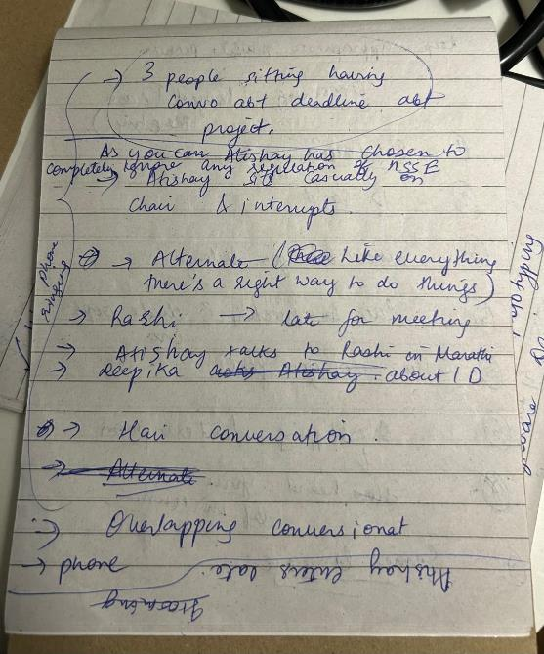
Learning is also Fun!
Please share how ”Your” learning was fun this week
We had a role play on professionalism and grooming. Our group simulated a team meeting where members broke code of conduct and created distractions in the meeting which was commented on and corrected in alternate situations and a case study where we had to identify stakeholder in Neha’s life.

Slide 27

Summary
Transitioning from college to a corporate environment involves adopting a growth mindset, which fosters adaptability and continuous learning, as opposed to a fixed mindset that views abilities as static. Effective stakeholder management is crucial in the corporate world, ensuring successful project outcomes through careful identification, engagement, and control of stakeholders. Grooming plays a key role in making positive first impressions and maintaining professional credibility. Additionally, embodying professional qualities such as reliability and effective communication is essential for building trust and succeeding in a corporate setting. Together, these elements support a smooth transition from academic life to a professional career.
The upcoming week engages us with technical aspects of the training
The upcoming week will also commence with team activities and the trust and communication along with adaptability and respect taught to us in the Sift Skills session will ensure smooth completion of projects.

Slide 28
Thank You

