Slide 1
Shell Bootcamp 2024 3 Reflections for Week 2
Sunidhi Singh
Date : 06-Sep-2024

Slide 2

About Me
A phrase that represents my motto in life is Dream big, work hard, stay focused

Slide 3

My learnings from this week!

Slide 4
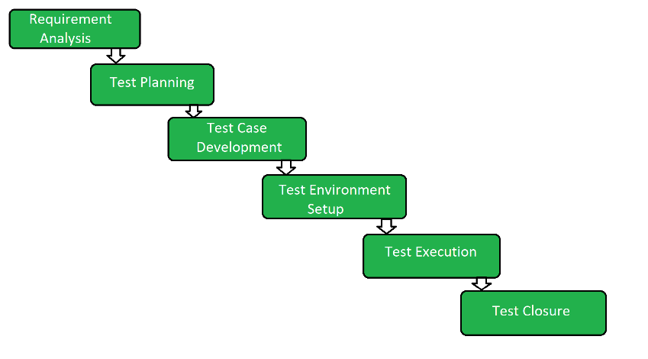
Learning 1 | My takeaways
Key learning- Software is a collection of instructions that enable the user to interact with a computer , or perform tasks and is developed with the help of SDLC.
Key takeaway- Software Testing is an activity that helps in identifying bugs in a software system under development, in order to provide a defect-free and reliable solution to the customer.
Testing is not a stand-alone activity, it has to adapt to the development model chosen for the project.

Slide 5
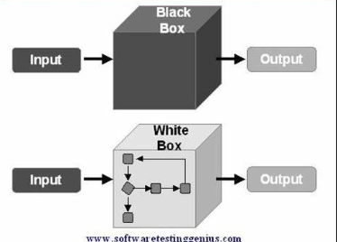
Learning 2 | My takeaways
Please share (in your own words) details of the learning.
Key learning – which test cases to automate and which test cases not to automate
Key takeaway – Repeated, tedious and difficult to perform, time consuming and high risk(Business Critical) tasks are the ones that need to be automated while changing requirement, ad-hoc and usability tasks are the ones that need not be automated.
Blackbox testing focuses on software’s external attributes and behavior while white box testing focuses on knowledge of internal data structures and architecture at the level of source code.

Slide 6
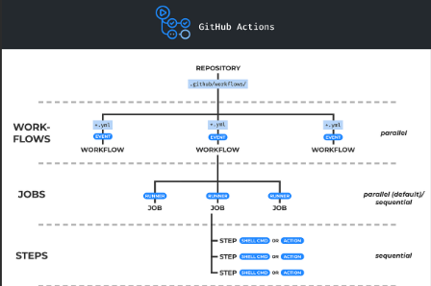
Learning 3 | My takeaways
Please share (in your own words) details of the learning.
Key learning – Github Actions automates different workflows including CI/CD pipelines, hosts VMs on multiple operating systems, and provides pre written CI templates.
Key takeaway – We can configure a GitHub Actions workflow to be triggered when an event occurs in our repository, such as a pull request being opened or an issue being created.
Components of GitHub Actions are workflows, events, jobs, actions and runners. GitHub Actions uses YAML syntax to define the workflow and each workflow is stored as a separate YAML file in our repository.

Slide 7

Relevance of learnings for my organization

Slide 8
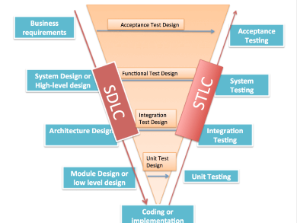
Learning 1 | Relevance for Shell
1. How I feel Shell implements this learning:
Shell uses the SDLC to create efficient software, ensuring high quality by following structured phases and adapting testing to the development model.
2. How I feel Shell benefits from this learning:
Shell delivers reliable software, enhancing customer satisfaction and its reputation. This approach also strengthens stakeholder relationships, boosts employee morale, and supports long-term sustainability.

Slide 9
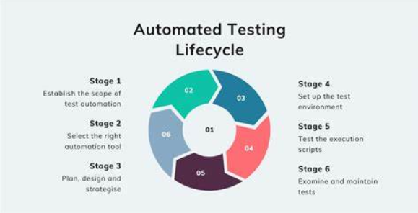
Learning 2 | Relevance for Shell
1. How I feel Shell implements this learning: Shell likely automates test cases that are repetitive, tedious, time-consuming, and high-risk to ensure efficiency and reliability. They avoid automating tasks with changing requirements, ad-hoc scenarios, and usability testing. By using both blackbox and whitebox testing, Shell ensures comprehensive coverage of both external behavior and internal structures of their software.
2. How I feel Shell benefits from this learning:Shell benefits by improving testing efficiency and accuracy, reducing manual effort, and minimizing risks in critical areas. This approach ensures high-quality software delivery, enhances customer satisfaction, and maintains Shell's reputation for reliability and professionalism.

Slide 10
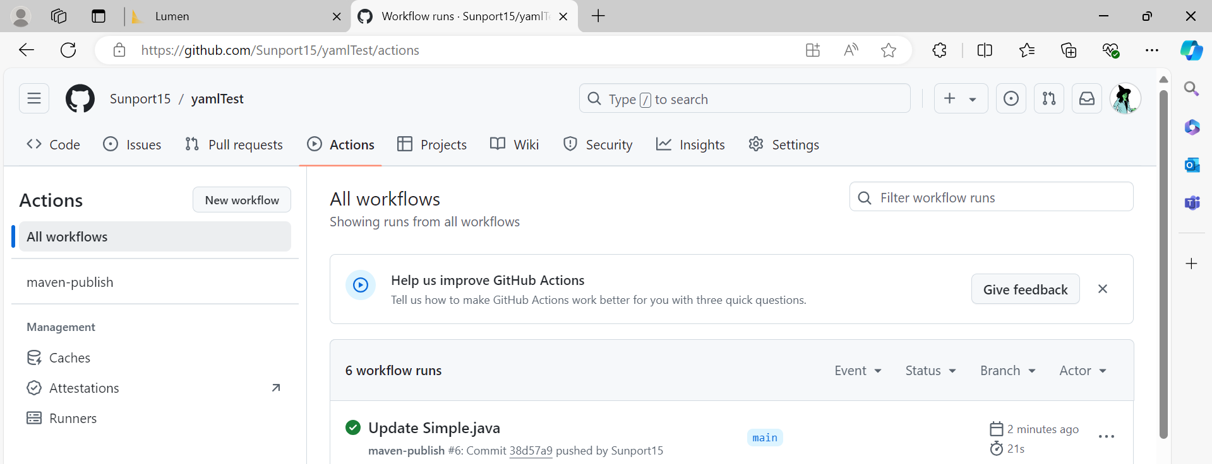
Learning 3 | Relevance for Shell
How I feel Shell implements this learning:
Shell uses GitHub Actions to automate workflows like CI/CD pipelines, triggering them on repository events. They use YAML files to define these workflows.
2. How I feel Shell benefits from this learning:
Shell benefits by automating tasks, speeding up development, and ensuring reliable CI/CD processes, which improves software quality and operational efficiency.

Slide 11

Action Plan

Slide 12
My Action Plan for this Week
Actions
Timeline
Status
Action Plan is to learn about automated testing like testrigor , explore selenium, learn how to create a docker image while implementing workflows using GitHub Actions
Explore all the learnings for a week
Still persuing

Slide 13

Learning is also Fun!

Slide 14
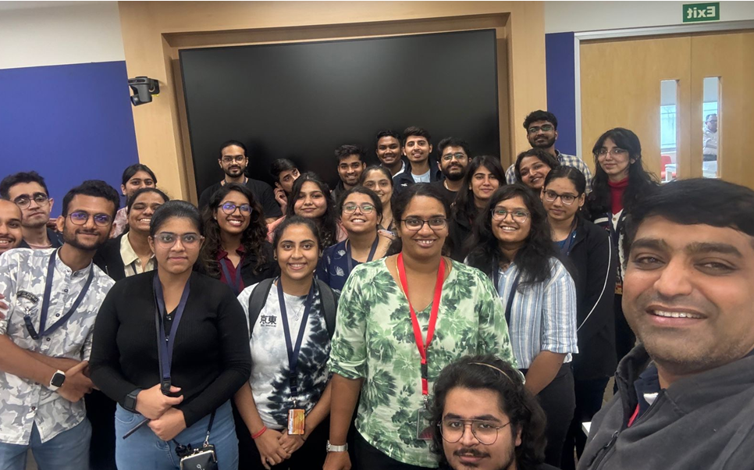
Learning is also Fun!
Please share how ”Your” learning was fun this week
Learning was interspersed with fun games and activities and videos that helped us understand more effectively

Slide 15

Summary
1. Software Development and Testing:
- Key Learning: Software is developed using the Software Development Life Cycle (SDLC), which includes phases like planning, designing, building, testing, and maintenance.
- Key Takeaway: Software testing identifies bugs to ensure a defect-free and reliable solution. Testing should adapt to the chosen development model.
2. Test Automation:
- Key Learning: It's important to decide which test cases to automate.
- Key Takeaway: Automate repetitive, tedious, time-consuming, and high-risk tasks. Avoid automating tasks with changing requirements, ad-hoc scenarios, and usability testing. Blackbox testing focuses on external attributes, while whitebox testing focuses on internal structures.
3. GitHub Actions:
- Key Learning: GitHub Actions automates workflows, including CI/CD pipelines, and supports multiple operating systems. It uses YAML syntax to define workflows.
- Key Takeaway: Workflows can be triggered by repository events like pull requests or issue creation. Components include workflows, events, jobs, actions, and runners.

Slide 16
Thank You

