Slide 1
生成对抗网络
2018.11.13

Slide 2



Slide 3

目标函数

Slide 4




Slide 5
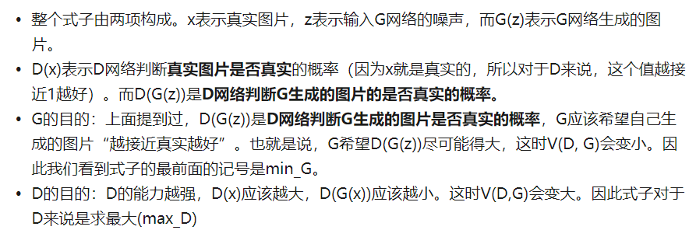

Slide 6
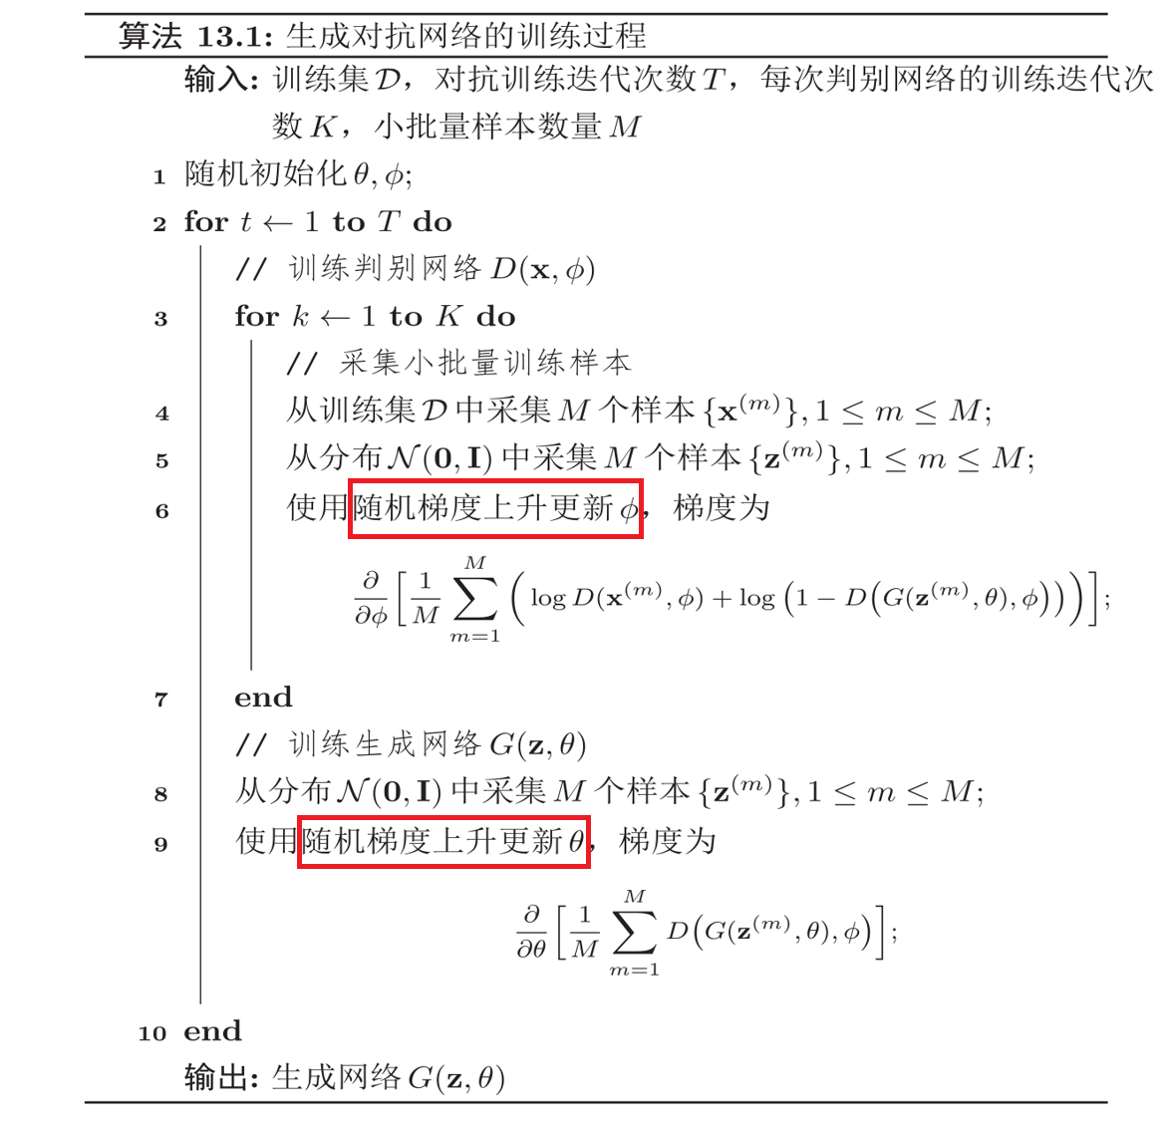

Slide 7


Slide 8
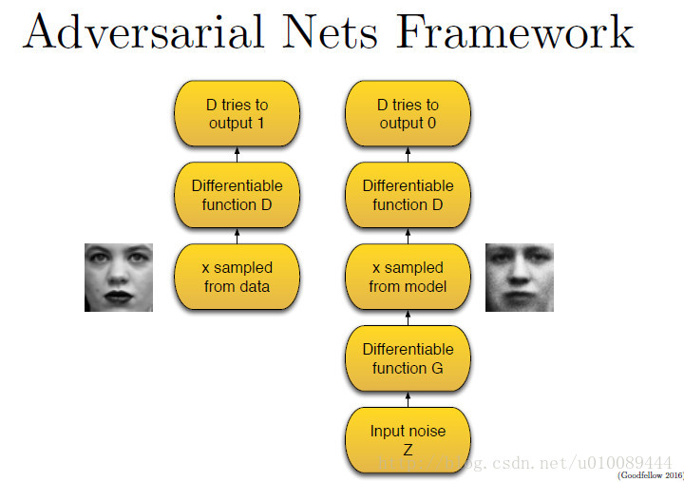


Slide 9



Slide 10
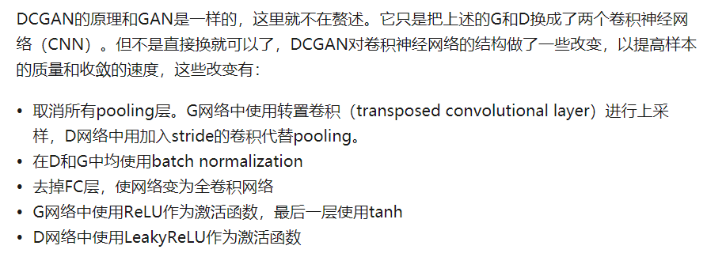

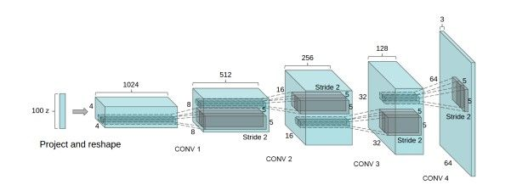
Deep Convolutional Generative Adversarial Networks

Slide 11
GAN网络汇总
https://github.com/zhangqianhui/AdversarialNetsPapers

