Slide 1
1. Introduction
Yong Peng
2022/02/15

Slide 2




What is Pattern Recognition?
Pattern Recognition is a field in machine learning
Pattern recognition (psychology), identification of faces, objects, words, melodies, etc.
http://en.wikipedia.org/wiki/Pattern_recognition_(disambiguation)
In machine learning, pattern recognition is the assignment of a label to a given input value.
http://en.wikipedia.org/wiki/Pattern_recognition
PRML：automatic discovery of regularities in data … and with the use of these regularities to take actions such as classifying the data into different categories

Slide 3

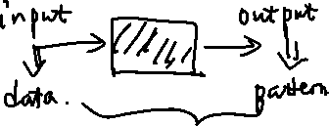

Features in Pattern Recognition
Input: data
Data, input value, …
Output: Pattern
Faces, objects, words, melodies, (classification) label, categories, regularity, …
Covert the input to output
Completed by computer systems (automatic, algorithm, assignment, …)
is usually a hard but funny process (discovery)

Slide 4
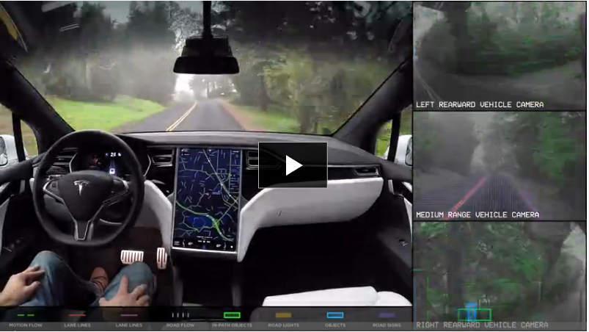
PR Examples
Autopilot:
Video resources: https://www.tesla.cn/models
Homepage of Autopilot: https://www.tesla.cn/autopilot?redirect=no
Input?
Output?
What are the difficulties?

Slide 5

PR Examples
Kinect
Video sources: http://v.youku.com/v_show/id_XMTgxNDk0ODc2.html
Kinect homepage: https://dev.windows.com/zh-cn/kinect
Input?
Output?
What are the difficulties?

Slide 6

PR Examples
Siri
Video resources: http://v.youku.com/v_show/id_XMzM1Mjc1MTgw.html
Siri products homepage: http://www.apple.com/cn/ios/siri/
Input?
Output?
What are the difficulties?

Slide 7
From data to pattern
Sensors
Cameras, microphones
Digital Information
text、images、audios、videos、3-D data clouds、…
Pattern
Object detection and recognition, action recognition, gesture recognition, audio to text, …
Applications
Make decision、plan、processing、…

Slide 8
example: gender recognition (feature)
Which data are appropriate for gender recognition?
Appearance?
Throat knot（喉结）？
Height?
Weight?
Voice?
Action? …
Feature: the data we extracted (learned) from the raw input data
Why we need to select, extract or learn features?

Slide 9
example: gender recognition (evaluation)
How to know whether the results of PR is good or not so good?
Evaluation
The usual way is to compare the outputs of PR systems (prediction) with the ground-truth.
Where is the ground-truth from?
Female: chromosome XX = X(from her mother) + X(from her father)
Male: chromosome XY=X(from his mother) + Y(from his father)
How to conduct comparison between prediction and the ground-truth?
To be discussed later

Slide 10
gender recognition (transformation)
How to construct a PR system to transform the inputs to outputs?
Widely used methods: machine learning
Learning from experience
Training set: the data collected
Model: the regularity obtained from the training set
Prediction (testing): the output of pattern recognition, using the learned regularity on new instances to get the prediction of these instances
Testing set: the data used to evaluate the regularity
Question: Are there requirements to training and testing sets?
i.i.d.t and no intersection between them

Slide 11
Example: gender recognition (applications)
What are the function of the outputs of PR algorithms?
The pattern recognition algorithms are usually integrated into larger systems.
iOnRoad, Siri, Kinect, …
How good should a pattern recognition system be?
It depends on the larger systems.
Usually should get the balance between the required functions and the cost of development.

Slide 12
The pipeline of PR
This is the typical pipeline of pattern recognition.
Sometimes, we need multiple revisions
Feedback
Which step is the most important?
Feature extraction
What’s the role of deep learning?
In my opinion, …..
Data Acquisition
Feature Extraction
Model Learning
Evaluation
Deployment

Slide 13
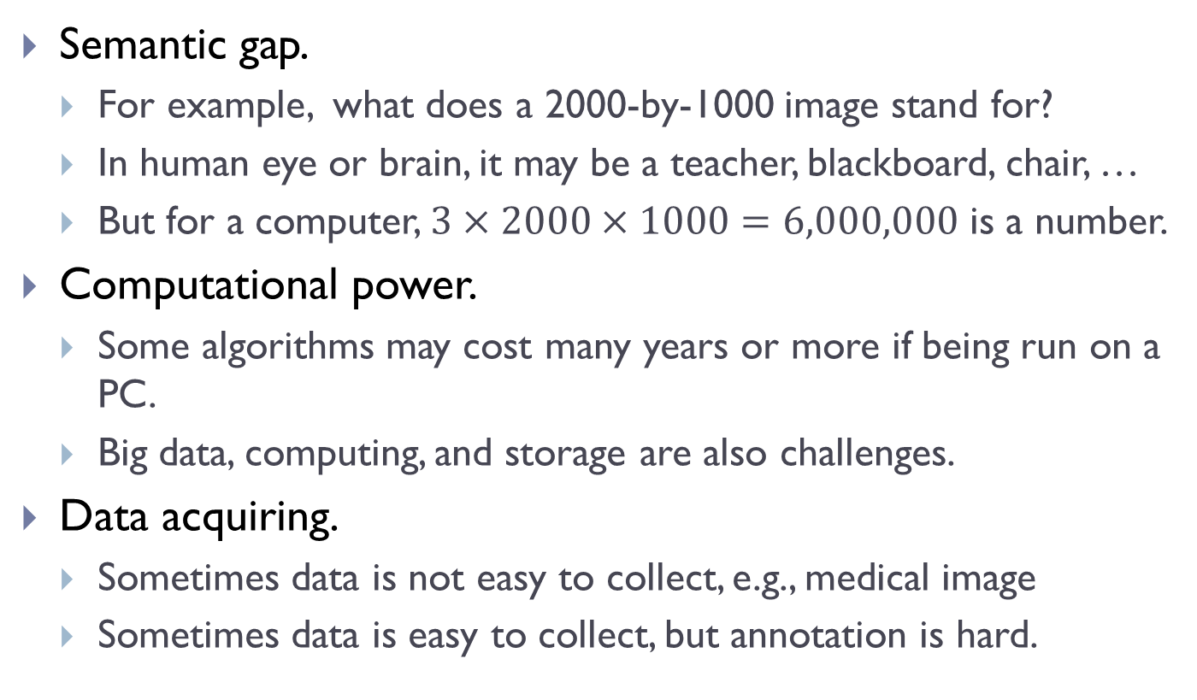
The difficulties in Pattern Recognition
Semantic gap.
For example, what does a 2000-by-1000 image stand for?
In human eye or brain, it may be a teacher, blackboard, chair, …
But for a computer, $3×2000×1000=6,000,000$ is a number.
Computational power.
Some algorithms may cost many years or more if being run on a PC.
Big data, computing, and storage are also challenges.
Data acquiring.
Sometimes data is not easy to collect, e.g., medical image
Sometimes data is easy to collect, but annotation is hard.

Slide 14

For example
ImageNet

Slide 15
Importance of each step in PR
Feature extraction
Can you determine the gender if given the age of one people?
Can you determine the gender if given the chromosome information?
Data acquisition
Consider the case of image-based gender recognition, but you are given the training set with only images of man.
Or images in training set have both man and woman, but all images are annotated with female.
Machine learning
There are many theoretical problems which are important for guiding the real applications.

Slide 16
Relations to other fields
Pattern recognition vs. machine learning
Machine learning plays important roles in pattern recognition
However, pattern recognition has more “systematic” properties such as data acquisition, feature extraction, …
The main difference is ‘data’ or “feature”
In deep learning, the boundary between them is not so clear
End-to-end models,…. Input: raw data, output: the prediction

Slide 17
Relations to other fields
Pattern recognition vs. computer vision
There are many overlaps between PR and CV in both researches and applications
Recognition is also an important task in computer vision
The input of pattern recognition systems is mainly from visual information
Pattern recognition contains many tasks out of the scope of vision
Audio, text, radar,…
Computer vision also has some tasks unrelated to recognition
Image super-resolution, 3D reconstruction, …

Slide 18
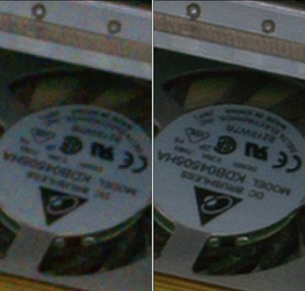
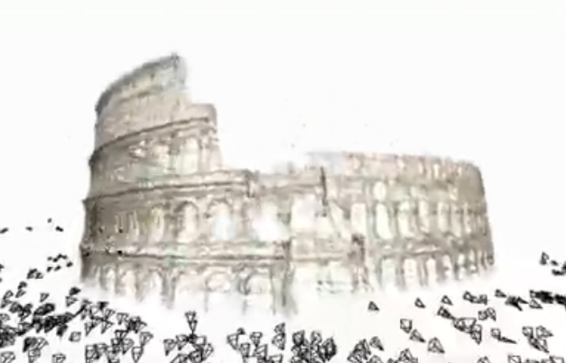
Examples
Image super-resolution and 3-D reconstruction

Slide 19
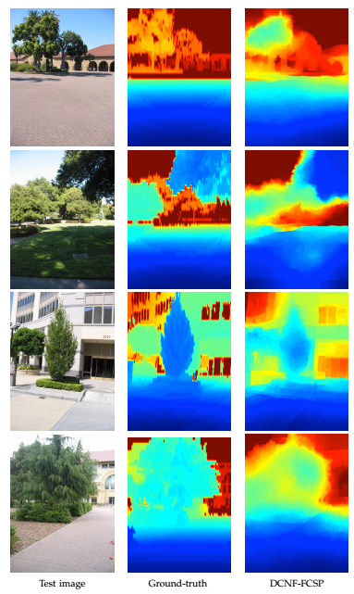
Examples
Depth estimation using deep learning from single image
Learning Depth from Single Monocular Images Using Deep Convolutional Neural Fields
http://arxiv.org/abs/1502.07411

Slide 20
Relations to other fields
Pattern recognition vs. multimedia
May both related to multimedia inputs
Multimedia puts more emphasis on the “systems”
Multimedia research does not over-emphasize the function of individual module and it pays more attention to the success of the whole system
Multimedia research focuses more on the complementary information of multimedia than pattern recognition research

Slide 21
Advanced reading materials
Advances in pattern recognition and related areas can be found by the following journal & conference papers
Machine learning: JMLR, ICML, NIPS,…
Computer Vision: TPAMI, IJCV, CVPR, ICCV, ECCV, …
Multimedia: ACM Multimedia, TMM, …
Useful resources:
Computer vision, image processing: OpenCV
Matlab: many toolboxes available
Deep learning package: Pytorch, Keras, MXNet, …

Slide 22
Q & A
Thanks
Next week
We will introduce some mathematics involved in AI and pattern recognition.
Linear algebra / matrix computation
Probability
Optimization

