Slide 1
K-means Clustering
Yong Peng

Slide 2
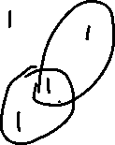
Clustering
Sometimes the data form clusters, where samples within a cluster are similar to each other, and samples in different clusters are dissimilar:
Such a distribution is multimodal, since it has multiple modes, or regions of high probability mass.
Grouping data points into clusters, with no observed labels, is called clustering. It is an unsupervised learning technique.
E.g. clustering machine learning papers based on topic (deep learning, Bayesian models, etc.)
But topics are never observed (unsupervised).

Slide 3
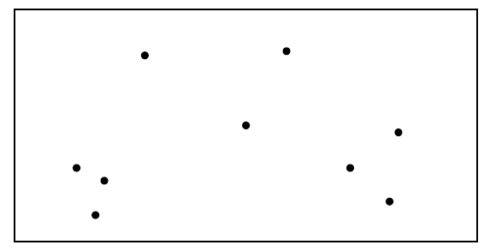
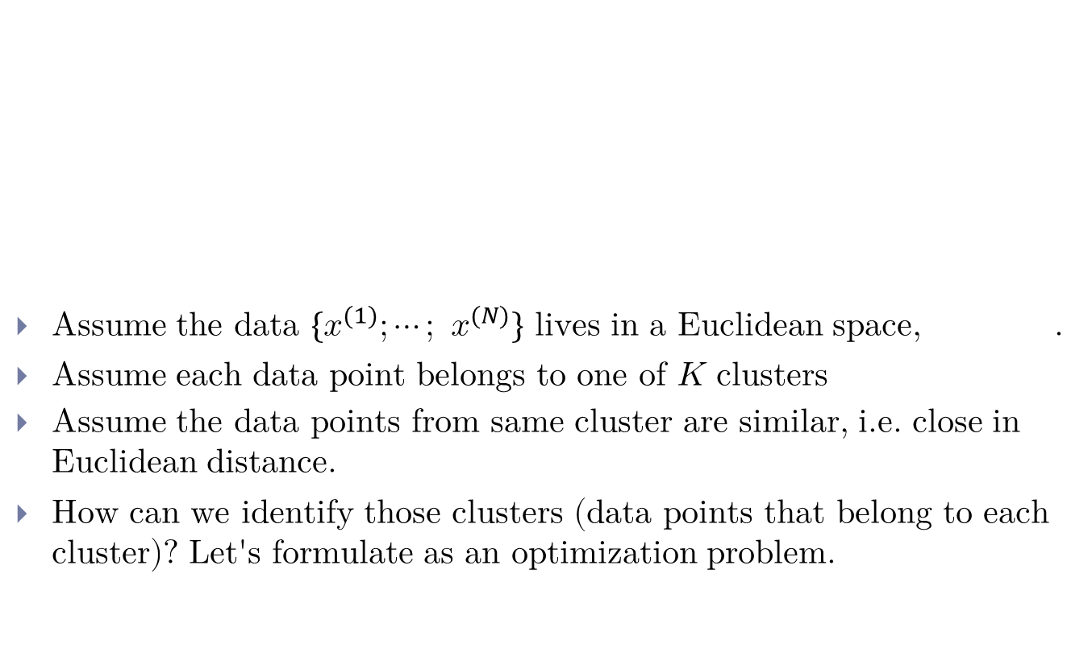
Clustering problem
Assume the data $\{x^{(1)};⋯; x^{(N)}\}$ lives in a Euclidean space, .
Assume each data point belongs to one of $K$ clusters
Assume the data points from same cluster are similar, i.e. close in Euclidean distance.
How can we identify those clusters (data points that belong to each cluster)? Let's formulate as an optimization problem.

Slide 4
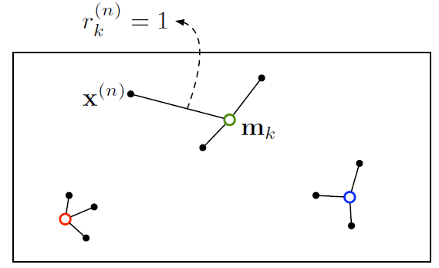
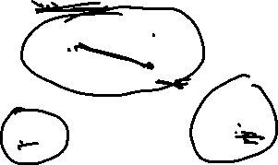
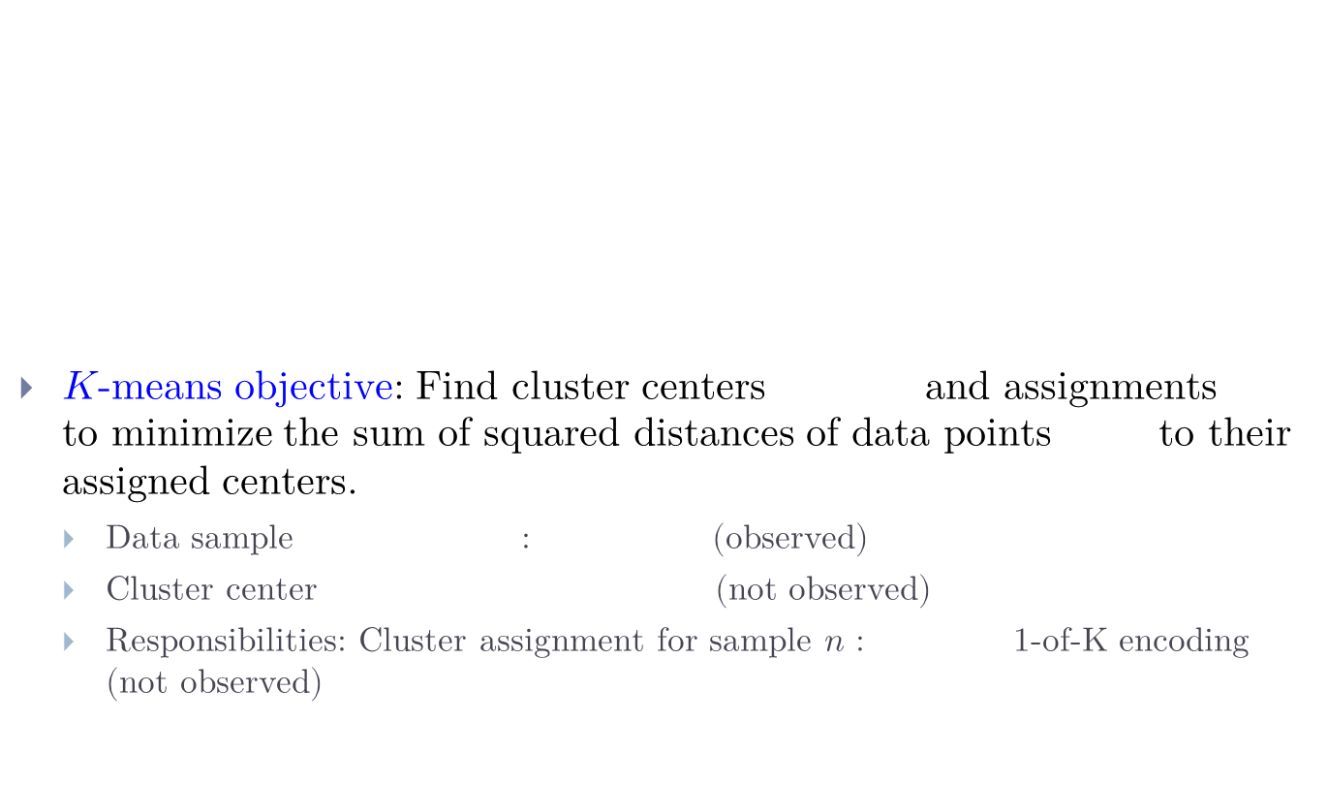

K-means Objective
$K$-means objective: Find cluster centers and assignments to minimize the sum of squared distances of data points to their assigned centers.
Data sample : (observed)
Cluster center (not observed)
Responsibilities: Cluster assignment for sample $n$ : 1-of-K encoding (not observed)

Slide 5
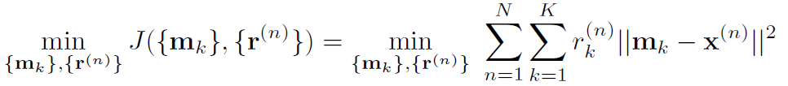


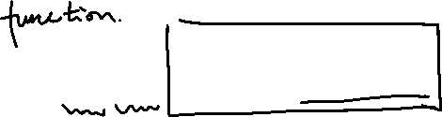



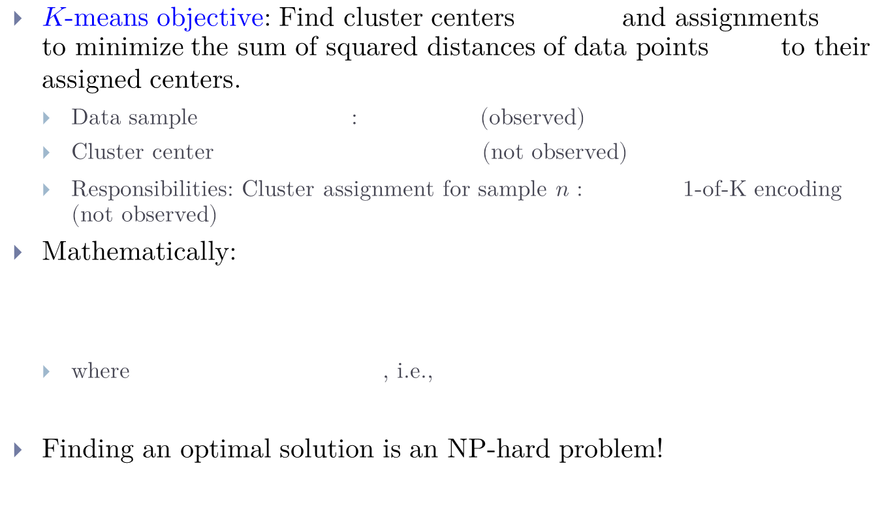

K-means Objective
$K$-means objective: Find cluster centers and assignments to minimize the sum of squared distances of data points to their assigned centers.
Data sample : (observed)
Cluster center (not observed)
Responsibilities: Cluster assignment for sample $n$ : 1-of-K encoding (not observed)
Mathematically:
where , i.e.,
Finding an optimal solution is an NP-hard problem!

Slide 6
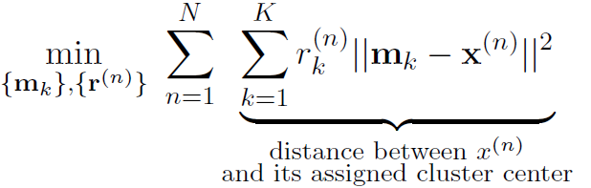



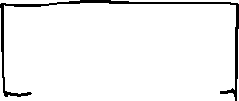

K-means Objective
Optimization problem:
Since , i.e.,
inner sum is over $K$ items but only one of them is non-zero
E.g., say sample is assigned to cluster $k$=3, then

Slide 7
How to optimize?: Alternating Minimization
Optimization problem:
Problem is hard when minimizing jointly over the parameters and
But note that if we fix one and minimize over the other, then it becomes easy.
Doesn’t guarantee the same solution!

Slide 8

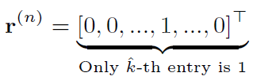



How to optimize?: Alternating Minimization
Optimization problem:
Note:
If we fix the centers then we can easily find the optimal assignments for each sample $n$
Assign each point to the cluster with the nearest center
E.g., if is assigned to cluster

Slide 9
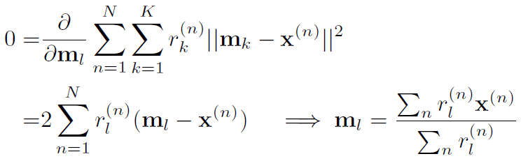

Alternating Minimization
Likewise, if we fix the assignments then can easily find optimal centers
Set each cluster's center to the average of its assigned data points:
For $l=1,2,⋯,K$
Let's alternate between minimizing with respect to and
This is called alternating minimization

Slide 10
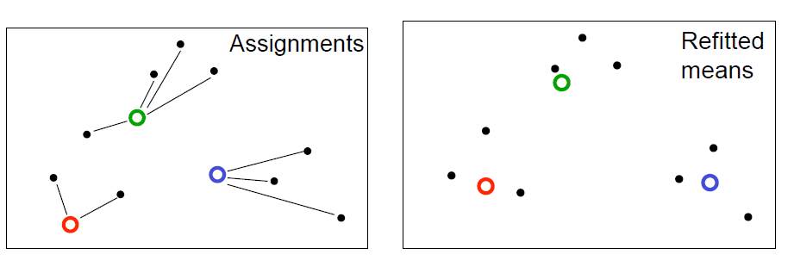
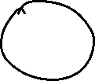


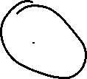
K-means Algorithm
High level overview of algorithm:
Initialization: randomly initialize cluster centers
The algorithm iteratively alternates between two steps:
Assignment step: Assign each data point to the closest cluster
Refitting step: Move each cluster center to the mean of the data assigned to it

Slide 11
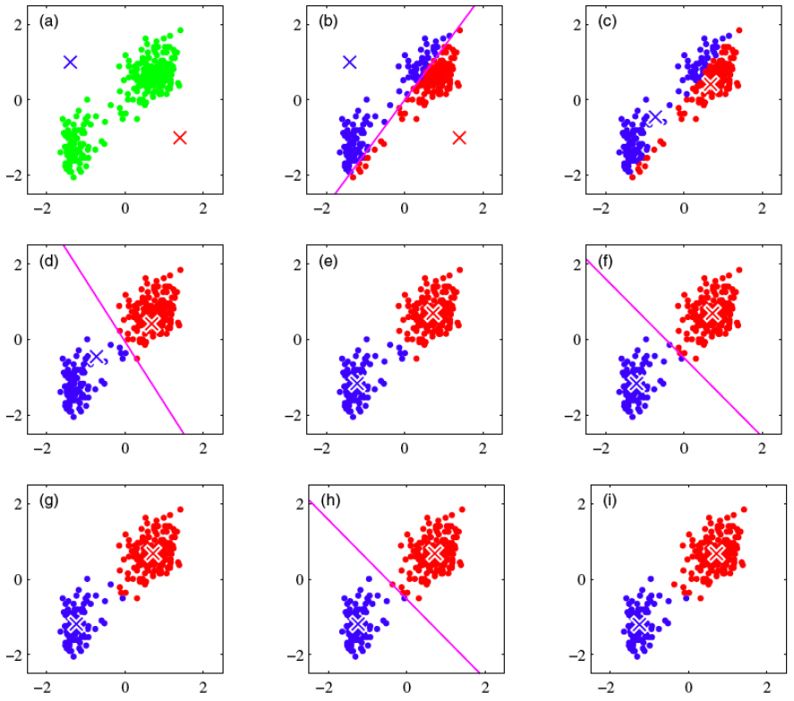

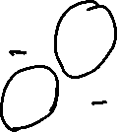
K-means Algorithm
Simple demo: http://syskall.com/kmeans.js/

Slide 12

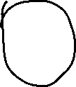
The K-means Algorithm
Initialization: Set $K$ cluster means to random values
Repeat until convergence (until assignments do not change):
Assignment: Optimize w.r.t. :
and Responsibilities (1-hot or 1-of-$K$ encoding)
Refitting: Optimize w.r.t. : Each center is set to mean of data assigned to it

Slide 13
K-means for Vector Quantization
Given image, construct “dataset” of pixels represented by their RGB pixel intensities
Run k-means, replace each pixel by its cluster center

Slide 14
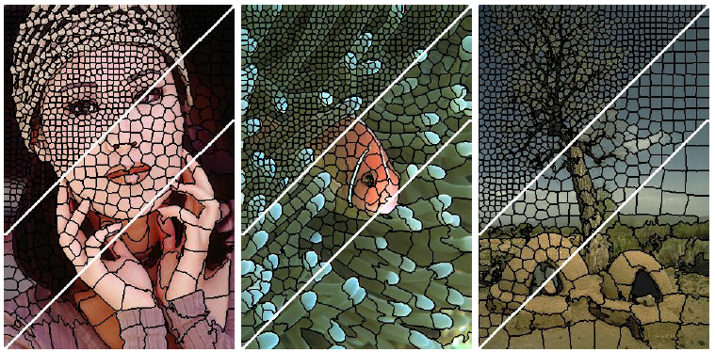
K-means for Image Segmentation
Given image, construct “dataset” of pixels, represented by their RGB pixel intensities and grid locations
Run k-means (with some modifications) to get super-pixels

Slide 15
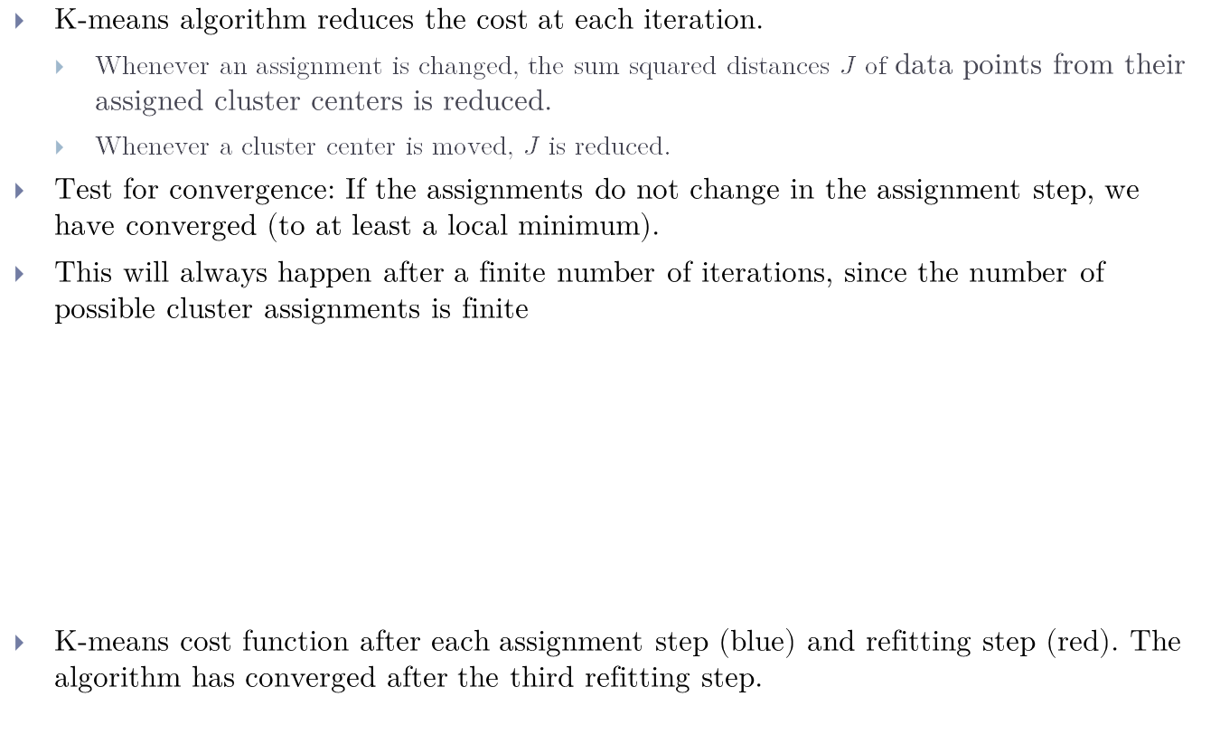
Why K-means Converges
K-means algorithm reduces the cost at each iteration.
Whenever an assignment is changed, the sum squared distances $J$ of data points from their assigned cluster centers is reduced.
Whenever a cluster center is moved, $J$ is reduced.
Test for convergence: If the assignments do not change in the assignment step, we have converged (to at least a local minimum).
This will always happen after a finite number of iterations, since the number of possible cluster assignments is finite
K-means cost function after each assignment step (blue) and refitting step (red). The algorithm has converged after the third refitting step.

Slide 16
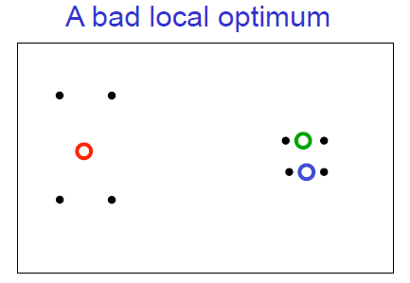

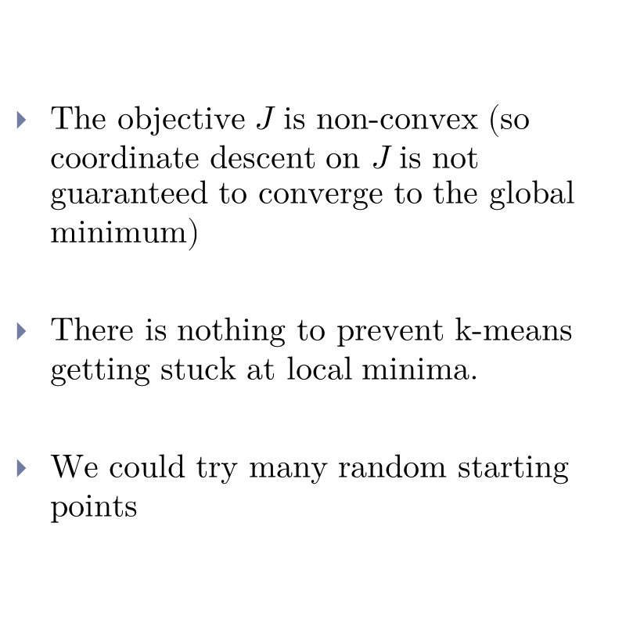
Local Minima
The objective $J$ is non-convex (so coordinate descent on $J$ is not guaranteed to converge to the global minimum)
There is nothing to prevent k-means getting stuck at local minima.
We could try many random starting points

Slide 17
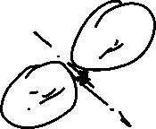
Soft K-means
Instead of making hard assignments of data points to clusters, we can make soft assignments. One cluster may have a responsibility of 0.7 for a datapoint and another may have a responsibility of 0.3.
Allows a cluster to use more information about the data in the refitting step.
How do we decide on the soft assignments?
We already saw this in multi-class classification:
1-of-K encoding vs softmax assignments

Slide 18
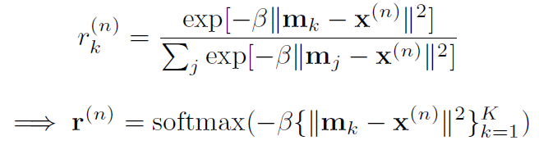
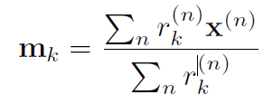

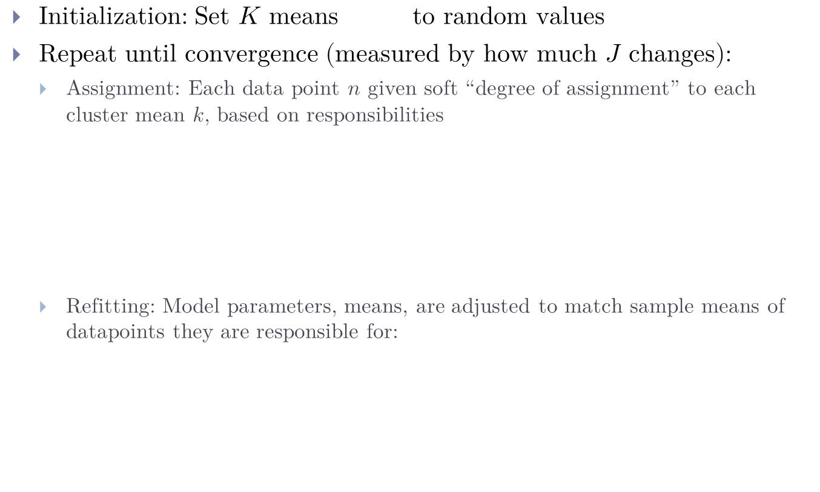
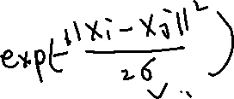

Soft K-means Algorithm
Initialization: Set $K$ means to random values
Repeat until convergence (measured by how much $J$ changes):
Assignment: Each data point $n$ given soft “degree of assignment” to each cluster mean $k$, based on responsibilities
Refitting: Model parameters, means, are adjusted to match sample means of datapoints they are responsible for:

Slide 19
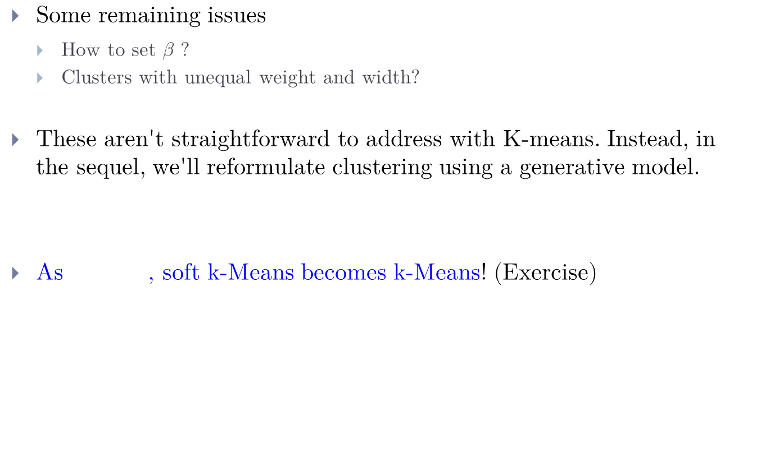
Questions about Soft K-means
Some remaining issues
How to set $β$ ?
Clusters with unequal weight and width?
These aren't straightforward to address with K-means. Instead, in the sequel, we'll reformulate clustering using a generative model.
As , soft k-Means becomes k-Means! (Exercise)

