Slide 1
4-Evaluation
Yong Peng
2021/03/24

Slide 2
Refined framework
Machine Learning
Domain unrelated feature transformation and feature extraction
Normalization, PCA, FLD, …
Different learning models to different properties of data
SVM, Decision Tree, imbalanced learning, HMM, DTW, graphical model, deep learning, pLSA, …
Categories of machine learning models
Linear & nonlinear (kernel-based, neural nets-based)
Different evaluation criteria to different problems
Data Acquisition
Feature Extraction
Model Learning
Evaluation
Deployment

Slide 3
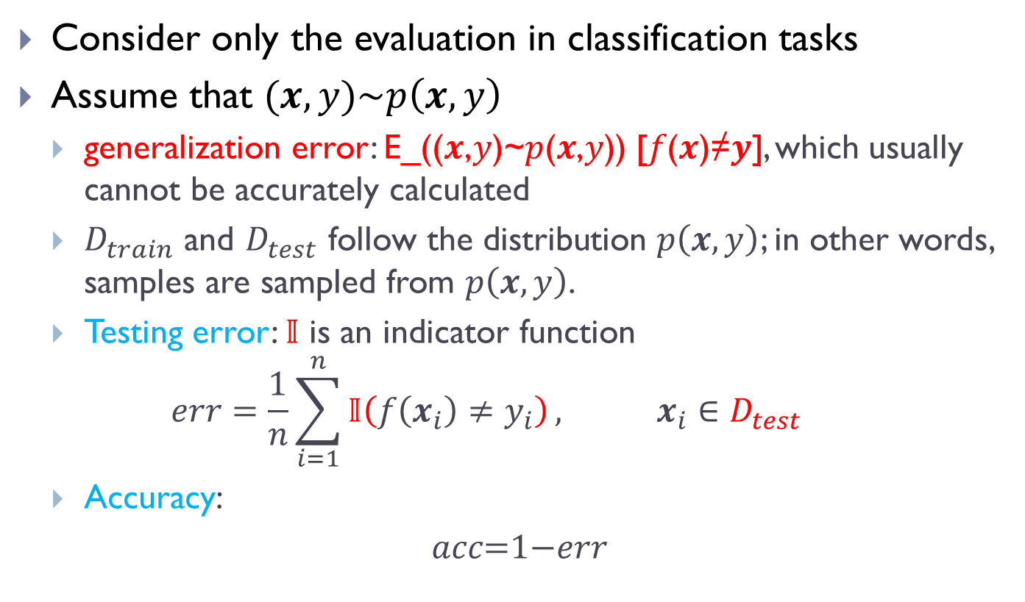
Evaluation criterion
Consider only the evaluation in classification tasks
Assume that $(x,y)\sim p\left(x,y\right)$
generalization error: E_((𝒙,𝑦)~𝑝(𝒙,𝑦)) [𝑓(𝒙)≠𝒚], which usually cannot be accurately calculated
$D_{train}$ and $D_{test}$ follow the distribution $p\left(x,y\right)$; in other words, samples are sampled from $p\left(x,y\right)$.
Testing error: $𝕀$ is an indicator function
$$err=\frac{1}{n}\sum_{i=1}^{n}{𝕀\left(f\left(x_{i}\right)≠y_{i}\right)}, x_{i}∈D_{test}$$
Accuracy:
𝑎𝑐𝑐=1−𝑒𝑟𝑟

Slide 4
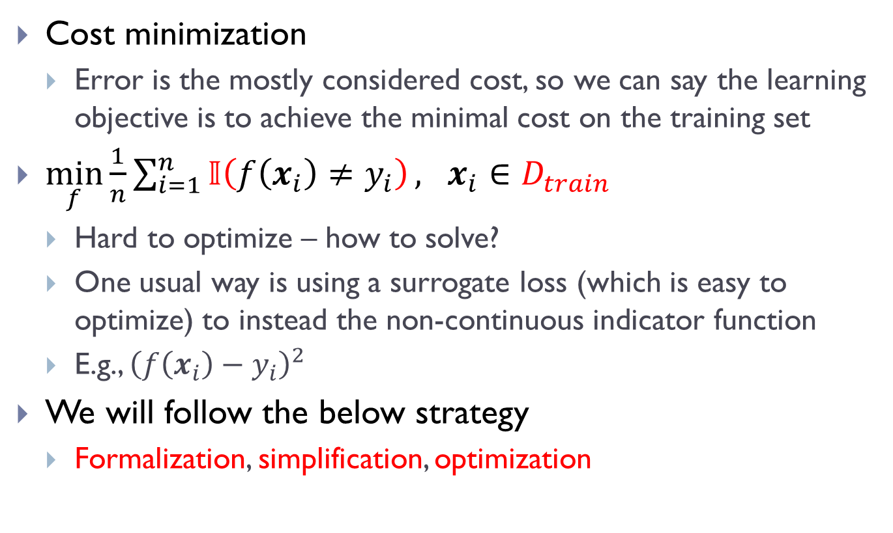
A usual learning framework
Cost minimization
Error is the mostly considered cost, so we can say the learning objective is to achieve the minimal cost on the training set
$\min_{f}\frac{1}{n}\sum_{i=1}^{n}{𝕀\left(f\left(x_{i}\right)≠y_{i}\right)}, x_{i}∈D_{train}$
Hard to optimize – how to solve?
One usual way is using a surrogate loss (which is easy to optimize) to instead the non-continuous indicator function
E.g., ${\left(f\left(x_{i}\right)−y_{i}\right)}^{2}$
We will follow the below strategy
Formalization, simplification, optimization

Slide 5
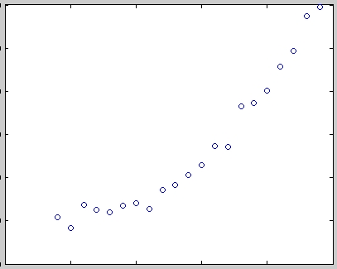
Overfitting & underfitting
Taking the regression task for example
These are the original samples
load census
newpop = pop + 10*randn(size(pop));
plot(cdate,newpop,'o’);
Task: how to fit these data points?

Slide 6
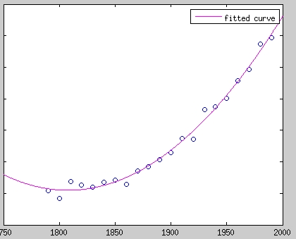
Overfitting & underfitting
First try: Fitted with 2nd order polynomial
[c2, gof2] = fit(cdate,newpop,'poly2');
plot(c2,'m')
plot(cdate,newpop,'o');
The mode complexity matches the the complexity of data
Best performance

Slide 7
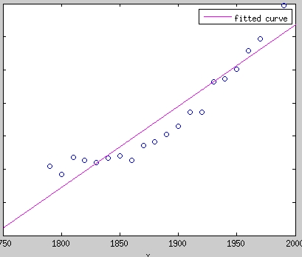
Overfitting & underfitting
Second try: Fitted by a polynomial with degree 1
[c3, gof3] = fit(cdate,newpop,'poly1');
plot(c3,'m')
plot(cdate,newpop,'o');
The model complexity is less than the complexity of data
underfitting

Slide 8
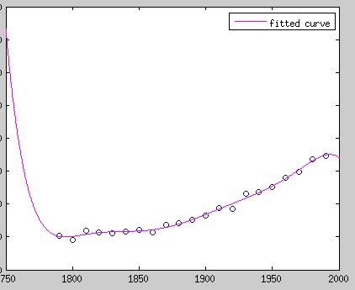
Overfitting & underfitting
Third try: Fitted by a polynomial with degree 7
[c4, gof4] = fit(cdate,newpop,'poly7');
plot(c4,'m')
The model complexity is greater than that of data
Overfitting

Slide 9
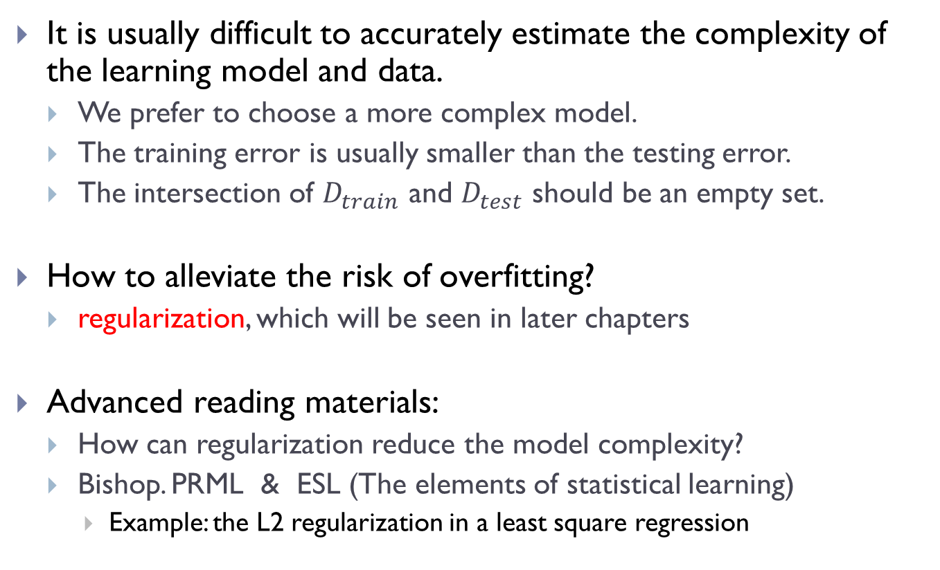
Regularization
It is usually difficult to accurately estimate the complexity of the learning model and data.
We prefer to choose a more complex model.
The training error is usually smaller than the testing error.
The intersection of $D_{train}$ and $D_{test}$ should be an empty set.
How to alleviate the risk of overfitting?
regularization, which will be seen in later chapters
Advanced reading materials:
How can regularization reduce the model complexity?
Bishop. PRML & ESL (The elements of statistical learning)
Example: the L2 regularization in a least square regression

Slide 10

If having no test set
For example, if the available samples are limited (medical images)
How to perform evaluation?
Cross validation, whose basic procedure is shown below
1. partition the training set into $N$ folds;
2. for 𝑖=1:𝑁
Using $D_{i}$ as testing set;
Using the remaining $N−1$ folds as training set;
Learning a classifier $f_{i}$ using the training set and learning algorithm;
Calculate the error rate of $f_{i}$ on $D_{i}$, denoted as $err_{i}$;
3. obtain the cross validation error rate $\frac{1}{N}\sum_{i=1}^{N}{err_{i}}$
This is widely called the $N$-fold cross validation ($N$=5 or 10 usually)

Slide 11
Imbalance of data or cost
For example, in binary classification task, the positive class often happens to be the minority class (defective parts) and the negative class often happens to be the majority class (qualified class).
Positive and negative in physical examination
The ratio of different genders
The cost of misclassifying samples in one class is much greater than the cost of misclassifying samples in the other class
Imbalance learning / Cost-sensitive learning
It is meaningless to use the accuracy as evaluation criterion
Advanced reading material:
http://cs.nju.edu.cn/zhouzh/zhouzh.files/publication/publication.htm

Slide 12
Criteria in imbalance learning
TP, TN, FP, FN: samples in respective four cases
TOTAL= TP+TN+FP+FN
The total number of positive examples: P=TP+FN
The total number of negative examples: N=FP+TN
False positive rate: FPR = FP / N
False negative rate: FNR = FN / P
True positive rate: TPR = TP / P
Accuracy：ACC = (TP+TN) / TOTAL
 | Prediction: positive | Prediction: negative
Truth label: positive | True positive | False negative
Truth label: negative | False positive | True negative

Slide 13
Criteria in imbalance learning
AUC-ROC (Area Under the ROC Curve)
ROC – Receiver operating characteristic
X-axis: FPR
Y-axis: TPR
Properties of AUC
Value is the area;
Monotonous;
What does the diagonal mean?
Notes:
The diagonal means a classifier with random outputs(predictions).

Slide 14
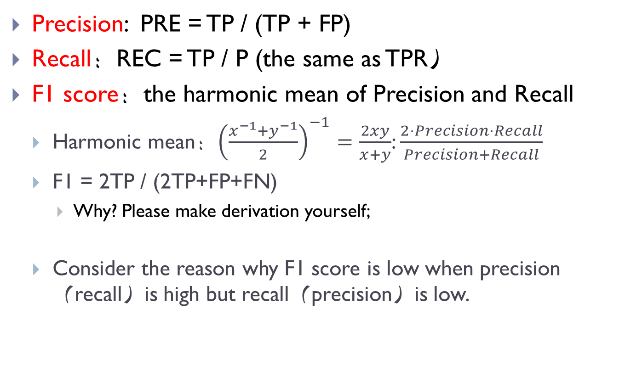
Criteria in imbalance learning
Precision: PRE = TP / (TP + FP)
Recall：REC = TP / P (the same as TPR）
F1 score：the harmonic mean of Precision and Recall
Harmonic mean：${\left(\frac{x^{−1}+y^{−1}}{2}\right)}^{−1}=\frac{2xy}{x+y}$: $\frac{2⋅Precision⋅Recall}{Precision+Recall}$
F1 = 2TP / (2TP+FP+FN)
Why? Please make derivation yourself;
Consider the reason why F1 score is low when precision（recall）is high but recall（precision）is low.

Slide 15
Criteria in imbalance learning
AUC-PR (Area Under the Precision-Recall Curve)
X-axis: Recall
Y-axis: Precision
The value is the area.
Non-monotonous
The AUC-PR measure is more discriminating than AUC-ROC.
Advanced reading material
Jesse Davis, Mark Goadrich. The relationship between Precision-recall and ROC curves. ICML2006.

Slide 16
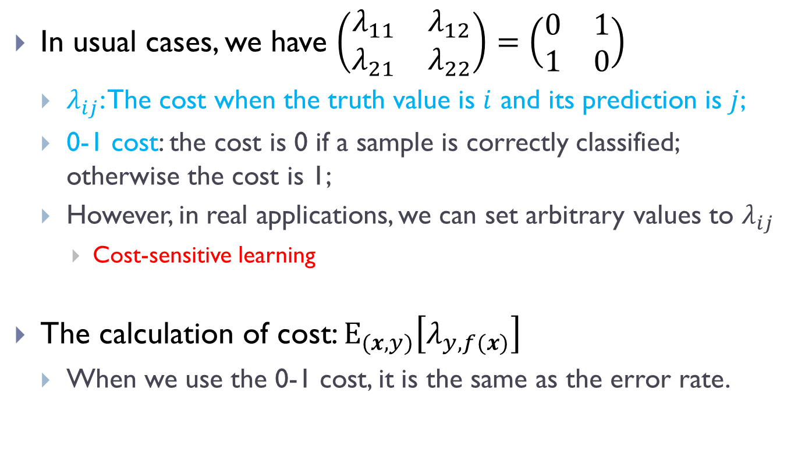
Cost matrix
In usual cases, we have $\left(\begin{matrix}λ_{11} & λ_{12} \\ λ_{21} & λ_{22}\end{matrix}\right)=\left(\begin{matrix}0 & 1 \\ 1 & 0\end{matrix}\right)$
$λ_{ij}$: The cost when the truth value is $i$ and its prediction is $j$;
0-1 cost: the cost is 0 if a sample is correctly classified; otherwise the cost is 1;
However, in real applications, we can set arbitrary values to $λ_{ij}$
Cost-sensitive learning
The calculation of cost: $E_{(x,y)}\left[λ_{y,f(x)}\right]$
When we use the 0-1 cost, it is the same as the error rate.

Slide 17
Ground truth
In most cases, they are manually annotated.
Or even there is no determined answer by human being
Incorrect annotation is widely happened due to the fatigue and other reasons.
Time-consuming and expensive
The form of truth labels
Classification: categorical values
Regression: real numbers
Structured output: for example, the participle result of a sentence, “一个/句子/的/分词/结果”
….

Slide 18
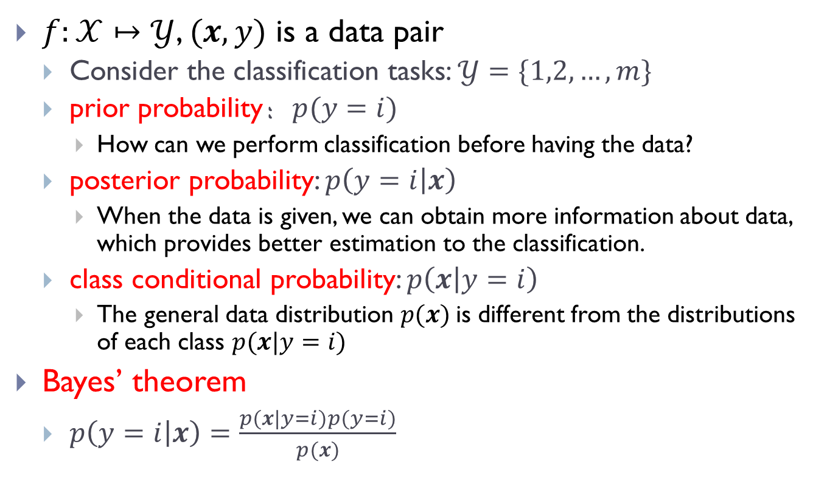
Can we reach 100% accuracy?
$f:𝒳↦𝒴$, $(x,y)$ is a data pair
Consider the classification tasks: $𝒴=\{1,2,…,m\}$
prior probability：$p(y=i)$
How can we perform classification before having the data?
posterior probability: $p\left(y=i | x\right)$
When the data is given, we can obtain more information about data, which provides better estimation to the classification.
class conditional probability: $p\left(x | y=i\right)$
The general data distribution $p(x)$is different from the distributions of each class $p(x|y=i)$
Bayes’ theorem
$p\left(y=i | x\right)=\frac{p(x|y=i)p(y=i)}{p(x)}$

Slide 19
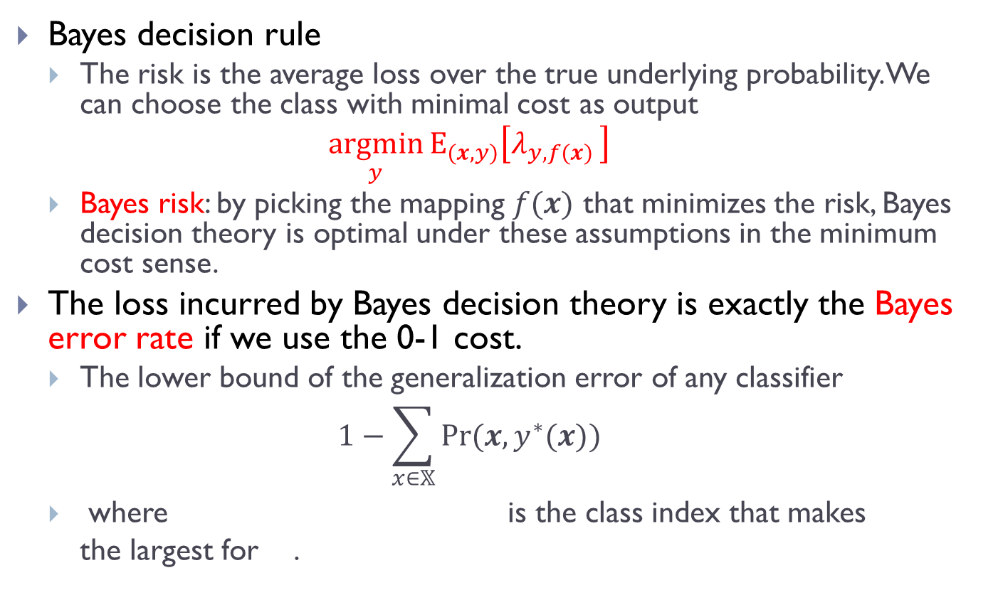
Can we reach 100% accuracy?
Bayes decision rule
The risk is the average loss over the true underlying probability. We can choose the class with minimal cost as output
$$\underset{y}{argmin}{E_{(x,y)}\left[λ_{y,f(x) }\right]}$$
Bayes risk: by picking the mapping $f(x)$ that minimizes the risk, Bayes decision theory is optimal under these assumptions in the minimum cost sense.
The loss incurred by Bayes decision theory is exactly the Bayes error rate if we use the 0-1 cost.
The lower bound of the generalization error of any classifier
$$1−\sum_{x∈𝕏}{Pr⁡(x,y^{∗}(x))}$$
where is the class index that makes the largest for .

Slide 20
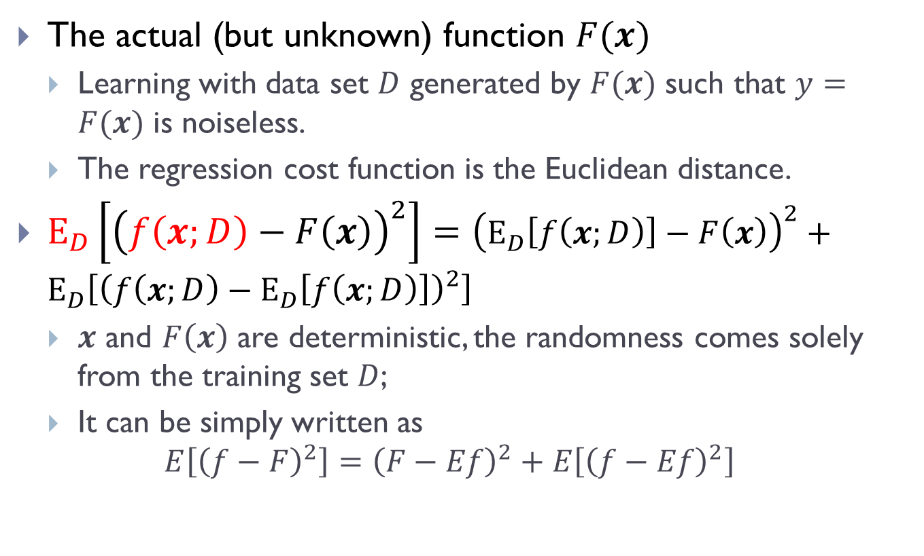
Where is the error from?
The actual (but unknown) function $F(x)$
Learning with data set $D$ generated by $F(x)$ such that $y=F(x)$ is noiseless.
The regression cost function is the Euclidean distance.
$E_{D}\left[{\left(f\left(x;D\right)−F\left(x\right)\right)}^{2}\right]={\left(E_{D}\left[f\left(x;D\right)\right]−F\left(x\right)\right)}^{2}+E_{D}\left[{\left(f\left(x;D\right)−E_{D}\left[f\left(x;D\right)\right]\right)}^{2}\right]$
$x$ and $F\left(x\right)$ are deterministic, the randomness comes solely from the training set $D$;
It can be simply written as
$$E\left[{\left(f−F\right)}^{2}\right]={\left(F−Ef\right)}^{2}+E\left[{\left(f−Ef\right)}^{2}\right]$$

Slide 21
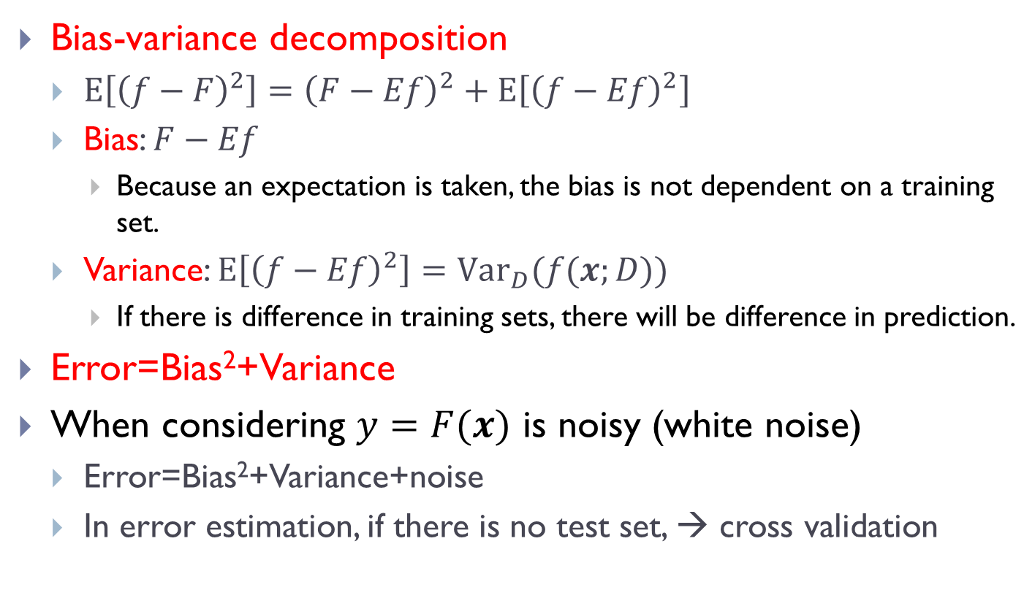
Bias-variance decomposition
Bias-variance decomposition
$E\left[{\left(f−F\right)}^{2}\right]={\left(F−Ef\right)}^{2}+E\left[{\left(f−Ef\right)}^{2}\right]$
Bias: $F−Ef$
Because an expectation is taken, the bias is not dependent on a training set.
Variance: $E\left[{\left(f−Ef\right)}^{2}\right]=Var_{D}(f(x;D))$
If there is difference in training sets, there will be difference in prediction.
Error=Bias²+Variance
When considering $y=F(x)$ is noisy (white noise)
Error=Bias²+Variance+noise
In error estimation, if there is no test set, → cross validation

Slide 22
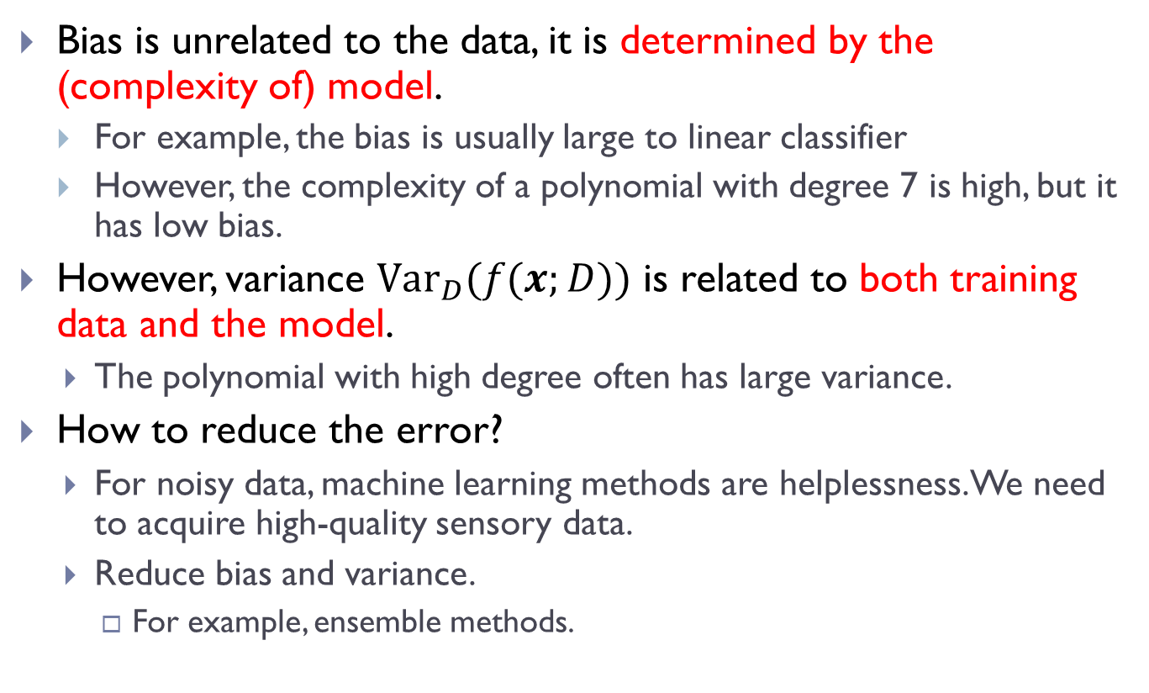
Understanding to the decomposition
Bias is unrelated to the data, it is determined by the (complexity of) model.
For example, the bias is usually large to linear classifier
However, the complexity of a polynomial with degree 7 is high, but it has low bias.
However, variance $Var_{D}(f(x;D))$ is related to both training data and the model.
The polynomial with high degree often has large variance.
How to reduce the error?
For noisy data, machine learning methods are helplessness. We need to acquire high-quality sensory data.
Reduce bias and variance.
For example, ensemble methods.

Slide 23
Statistical test
It can determine whether we have confidence on the evaluation results.
Self-learning section 5 ‘confidence in the evaluation results’ in this chapter.
The objective is to understand the underlying idea of statistical test.
Key points:
How to understand the confidence.
How to perform t-test?

