Slide 1

5-Principal Component Analysis
Yong Peng
2021/03/20

Slide 2
domain independent feature extraction
In the following weeks, we will cover
Principal Component Analysis (PCA)
Feature normalization
Fisher Linear Discriminant Analysis (FLD, or LDA)
This week, we come to
Principal Component Analysis (PCA)

Slide 3


Objective
Understand the meaning, objective and application scope of PCA;
Can use PCA to deal with real applications;
Understand the underlying explanations to PCA
Advanced objectives:
Understand the derivation to PCA
Reading extra materials on PCA….

Slide 4
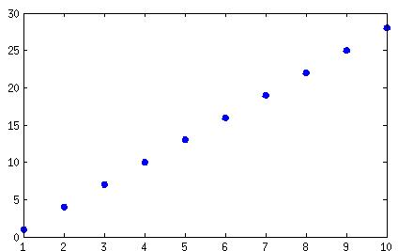
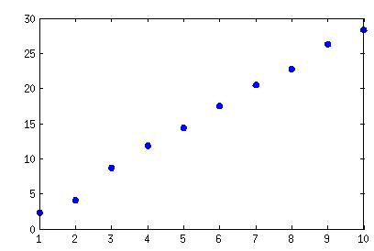
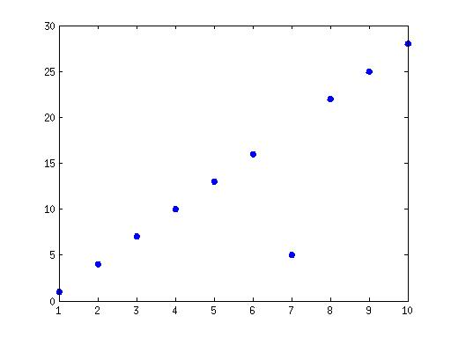
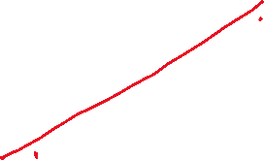


PCA basis
How many dimensions does your data have?
Notes:
1. x = 1:10;
y = 3*x-2;
plot(x,y,'*','LineWidth',3)
2. y = 3*x - 2;
y = y + rand(size(y))*2;
plot(x,y,'*','LineWidth',3)
3。 y = 3*x - 2;
y(7) = 5;
plot(x,y,'*','LineWidth',3)

Slide 5


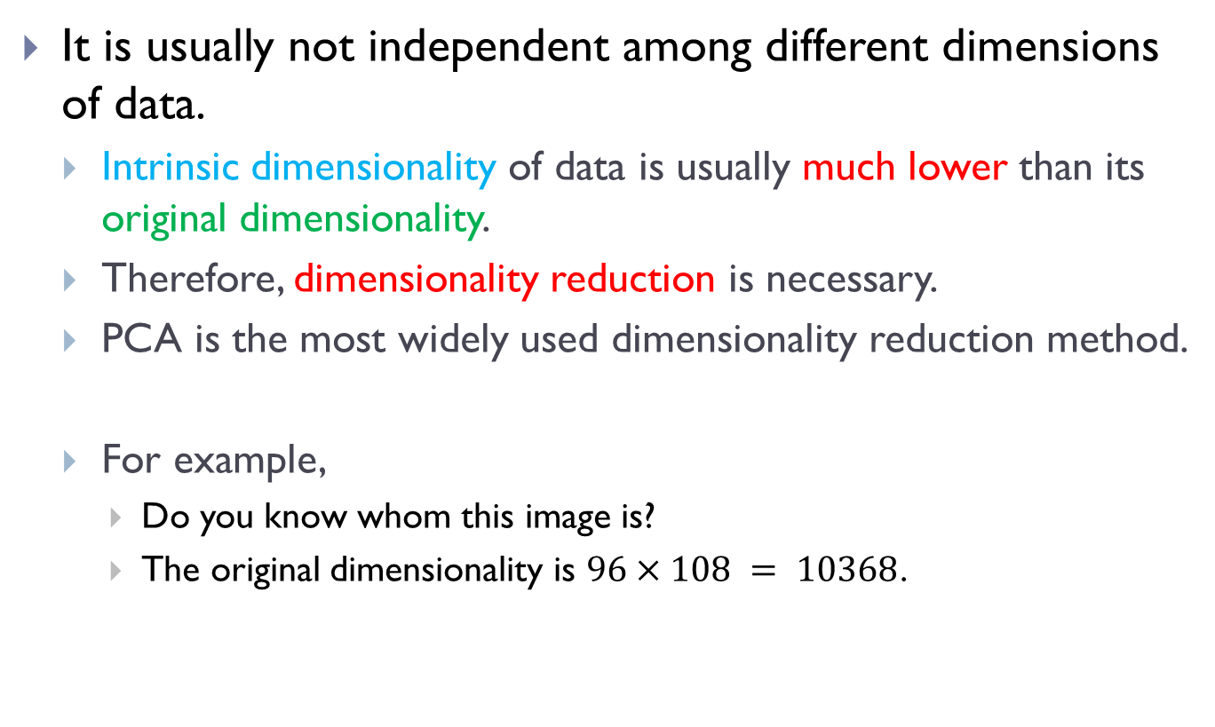



Data properties
It is usually not independent among different dimensions of data.
Intrinsic dimensionality of data is usually much lower than its original dimensionality.
Therefore, dimensionality reduction is necessary.
PCA is the most widely used dimensionality reduction method.
For example,
Do you know whom this image is?
The original dimensionality is $96×108 = 10368$.
Notes:
To recognize the identity of a person from one face image, we usually need a high-resolution face image; however, the intrinsic dimensionality of a face image is much less.

Slide 6

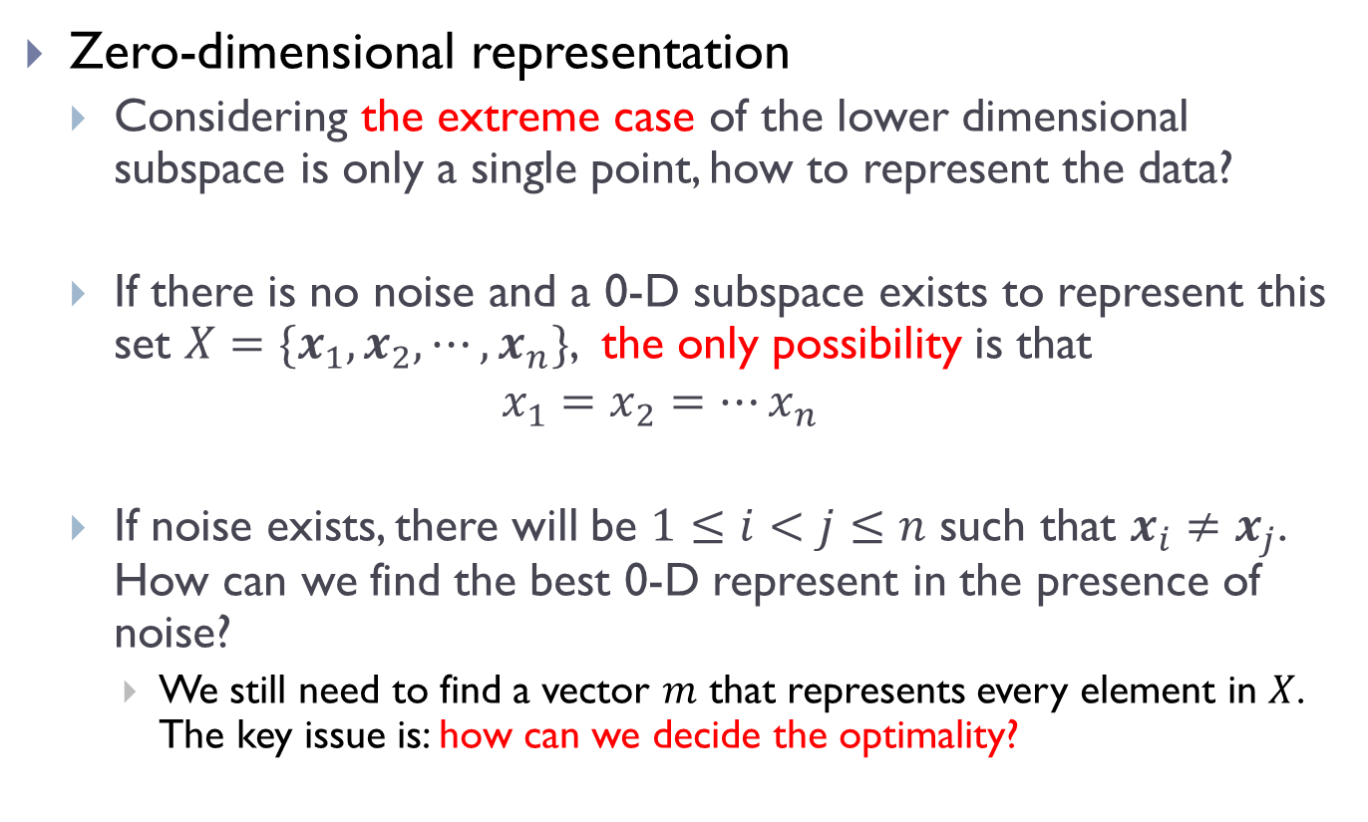

Starting point: 0-D representation
Zero-dimensional representation
Considering the extreme case of the lower dimensional subspace is only a single point, how to represent the data?
If there is no noise and a 0-D subspace exists to represent this set $X=\{x_{1},x_{2},⋯,x_{n}\}$, the only possibility is that
$$x_{1}=x_{2}=⋯x_{n}$$
If noise exists, there will be $1≤i<j≤n$ such that $x_{i}≠x_{j}$. How can we find the best 0-D represent in the presence of noise?
We still need to find a vector $m$ that represents every element in $X$. The key issue is: how can we decide the optimality?

Slide 7



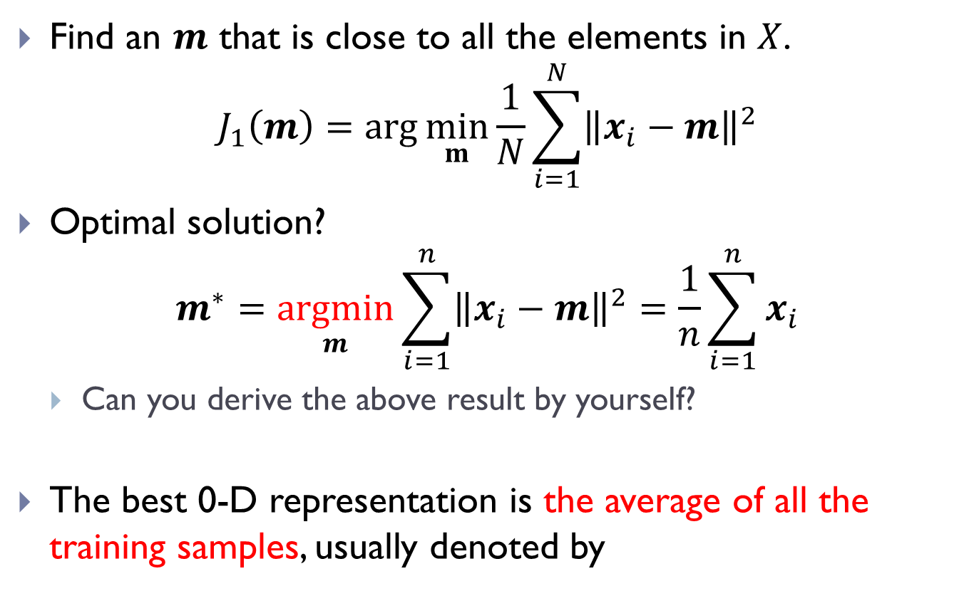


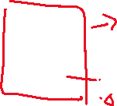
The idea-formalization-optimization approach
Find an $m$ that is close to all the elements in $X$.
$$J_{1}\left(m\right)=\arg{\min_{m}{\frac{1}{N}}}\sum_{i=1}^{N}{{\left\|x_{i}−m\right\|}^{2}}$$
Optimal solution?
$$m^{∗}=\underset{m}{argmin}{\sum_{i=1}^{n}{{\left\|x_{i}−m\right\|}^{2}}}=\frac{1}{n}\sum_{i=1}^{n}{x_{i}}$$
Can you derive the above result by yourself?
The best 0-D representation is the average of all the training samples, usually denoted by

Slide 8
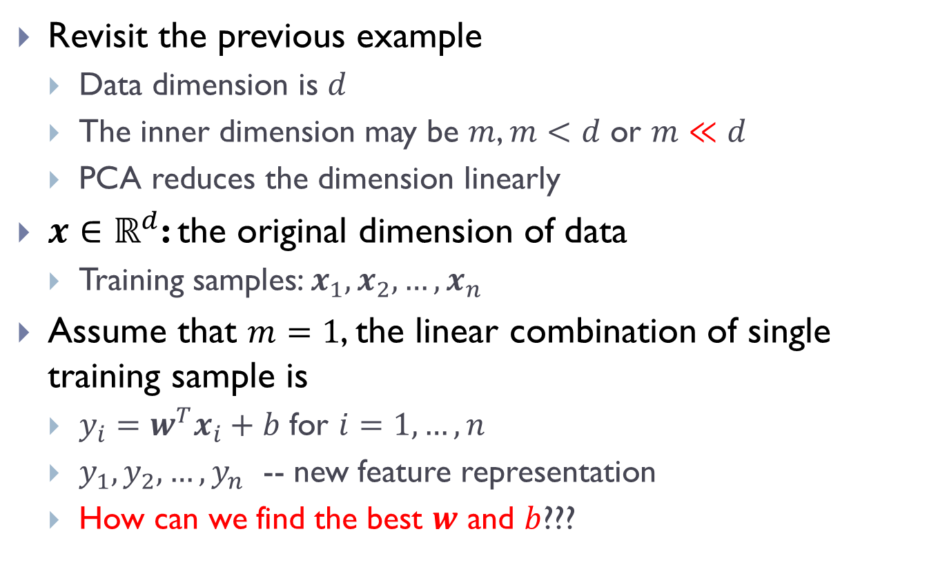


PCA to one-dimensional subspace
Revisit the previous example
Data dimension is $d$
The inner dimension may be $m$, $m<d$ or $m≪d$
PCA reduces the dimension linearly
$x∈ℝ^{d}$: the original dimension of data
Training samples: $x_{1},x_{2},…,x_{n}$
Assume that $m=1$, the linear combination of single training sample is
$y_{i}=w^{T}x_{i}+b$ for $i=1,…,n$
$y_{1},y_{2},…,y_{n}$ -- new feature representation
How can we find the best $w$ and $b$???

Slide 9
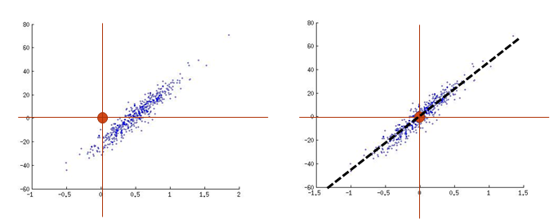


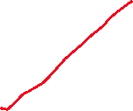


Idea
Which direction to choose? Why ?
Which direction is optimal?
1. size=500;
x=randn(size,2)*[0.1 0.3;0.3 16]+repmat([0.5 2],size,1);
scatter(x(:,1),x(:,2),3)
2. x = x - repmat(mean(x),length(x(:,1)),1);
scatter(x(:,1),x(:,2),3)
If see any Matlab error, clear the ‘size’ variable

Slide 10
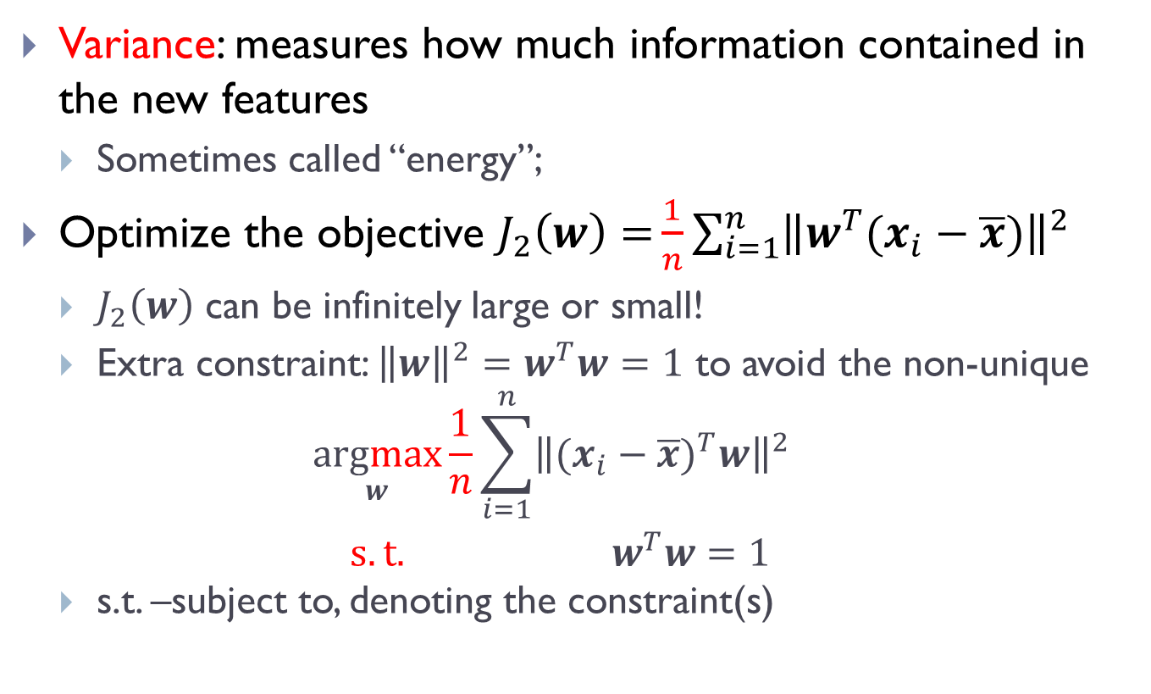
Formalization: maximize the variance
Variance: measures how much information contained in the new features
Sometimes called “energy”;
Optimize the objective $J_{2}\left(w\right)={\frac{1}{n}\sum_{i=1}^{n}{{\left\|w^{T}(x_{i}−\overline{x})\right\|}^{2}}}$
$J_{2}\left(w\right)$ can be infinitely large or small!
Extra constraint: ${\left\|w\right\|}^{2}=w^{T}w=1$ to avoid the non-unique
$$\begin{matrix}\underset{w}{argmax}{\frac{1}{n}\sum_{i=1}^{n}{{\left\|{(x_{i}−\overline{x})}^{T}w\right\|}^{2}}} \\ s.t. { w}^{T}w=1\end{matrix}$$
s.t. –subject to, denoting the constraint(s)

Slide 11

Simplification: simplify the transformation
${\left\|{(x_{i}−\overline{x})}^{T}w\right\|}^{2}={\left({(x_{i}−\overline{x})}^{T}w\right)}^{T}\left({(x_{i}−\overline{x})}^{T}w\right)=w^{T}{\left(x_{i}−\overline{x}\right)\left(x_{i}−\overline{x}\right)}^{T}w$
$\frac{1}{n}\sum_{i=1}^{n}{{\left\|{(x_{i}−\overline{x})}^{T}w\right\|}^{2}}=w^{T}\sum_{i=1}^{n}{\frac{1}{n}{\left(x_{i}−\overline{x}\right)\left(x_{i}−\overline{x}\right)}^{T}}w=w^{T}Cov(x)w$

Slide 12
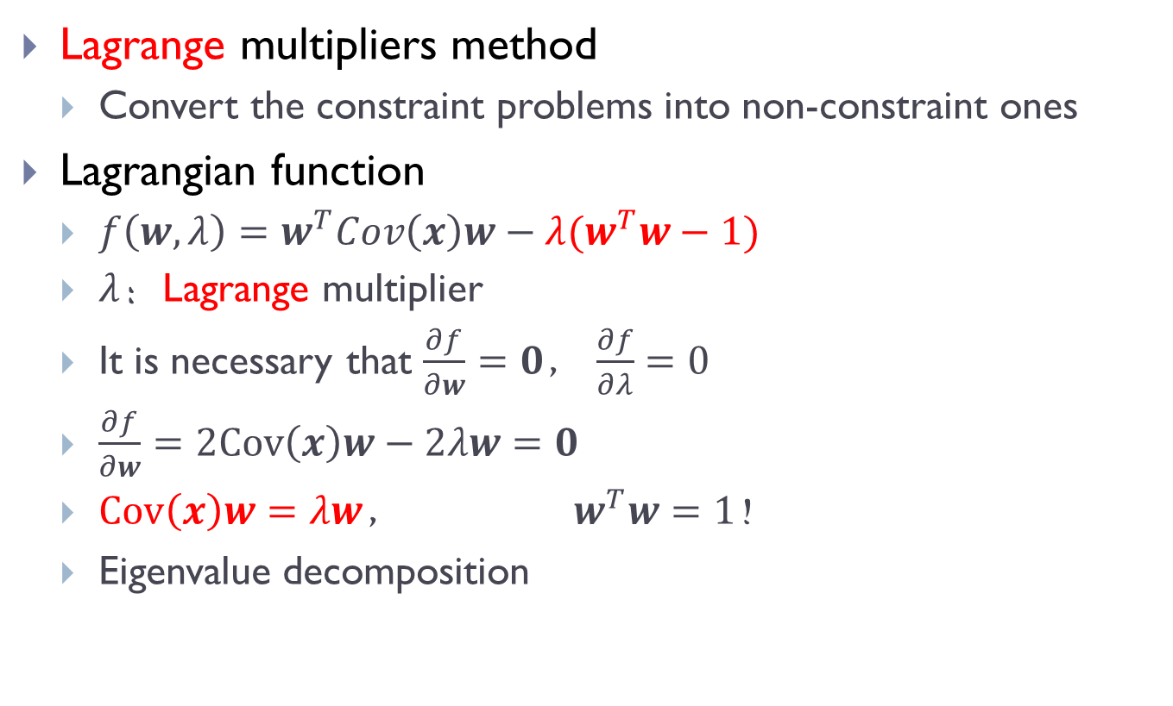
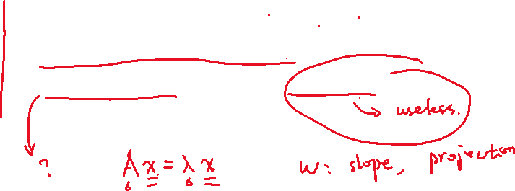
Optimization
Lagrange multipliers method
Convert the constraint problems into non-constraint ones
Lagrangian function
$f\left(w,λ\right)=w^{T}Cov\left(x\right)w−λ(w^{T}w−1)$
$λ$：Lagrange multiplier
It is necessary that $\frac{∂f}{∂w}=0$， $\frac{∂f}{∂λ}=0$
$\frac{∂f}{∂w}=2Cov\left(x\right)w−2λw=0$
$Cov\left(x\right)w=λw$， ${ w}^{T}w=1$！
Eigenvalue decomposition

Slide 13
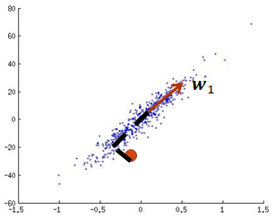
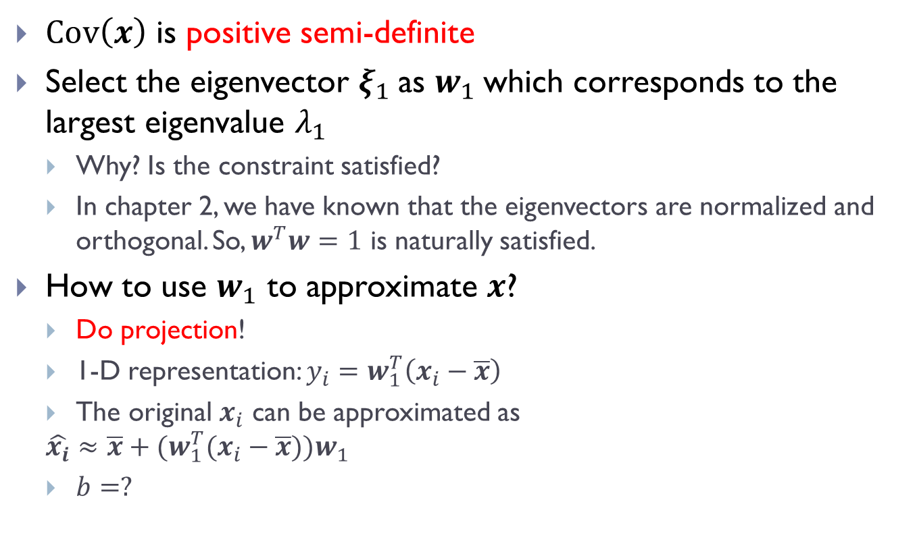
How to select the eigenvectors?
$Cov\left(x\right)$ is positive semi-definite
Select the eigenvector $ξ_{1}$as $w_{1}$which corresponds to the largest eigenvalue $λ_{1}$
Why? Is the constraint satisfied?
In chapter 2, we have known that the eigenvectors are normalized and orthogonal. So, $w^{T}w=1$ is naturally satisfied.
How to use $w_{1}$ to approximate $x$?
Do projection!
1-D representation: $y_{i}=w_{1}^{T}\left(x_{i}−\overline{x}\right)$
The original $x_{i}$ can be approximated as
$$\hat{x_{i}}≈\overline{x}+{(w}_{1}^{T}(x_{i}−\overline{x}))w_{1}$$
$b=?$

Slide 14
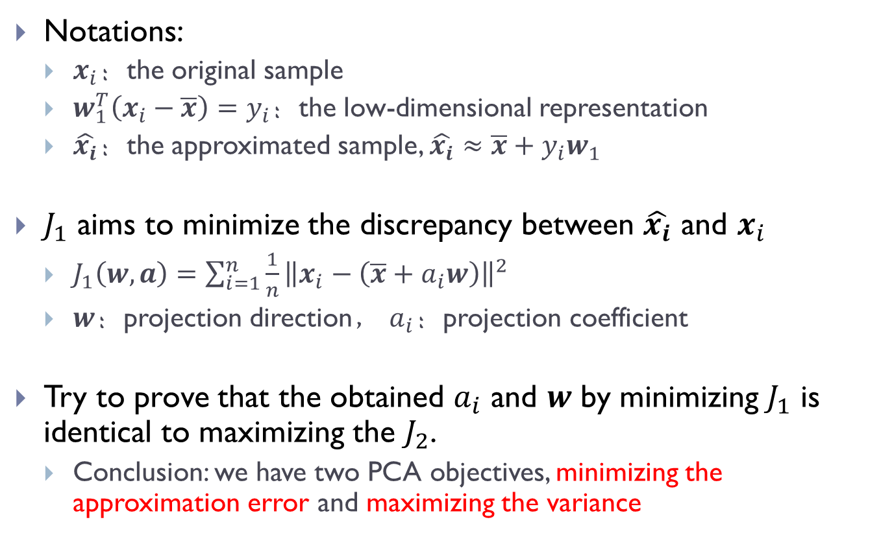

The equivalence between $J_{1}$ and $J_{2}$
Notations:
$x_{i}$：the original sample
$w_{1}^{T}\left(x_{i}−\overline{x}\right)=y_{i}$：the low-dimensional representation
$\hat{x_{i}}$：the approximated sample, $\hat{x_{i}}≈\overline{x}+y_{i}w_{1}$
$J_{1}$ aims to minimize the discrepancy between $\hat{x_{i}}$ and $x_{i}$
$J_{1}\left(w,a\right)=\sum_{i=1}^{n}{\frac{1}{n}{\left\|x_{i}−\left(\overline{x}+a_{i}w\right)\right\|}^{2}}$
$w$：projection direction， $a_{i}$：projection coefficient
Try to prove that the obtained $a_{i}$ and $w$ by minimizing $J_{1}$ is identical to maximizing the $J_{2}$.
Conclusion: we have two PCA objectives, minimizing the approximation error and maximizing the variance

Slide 15
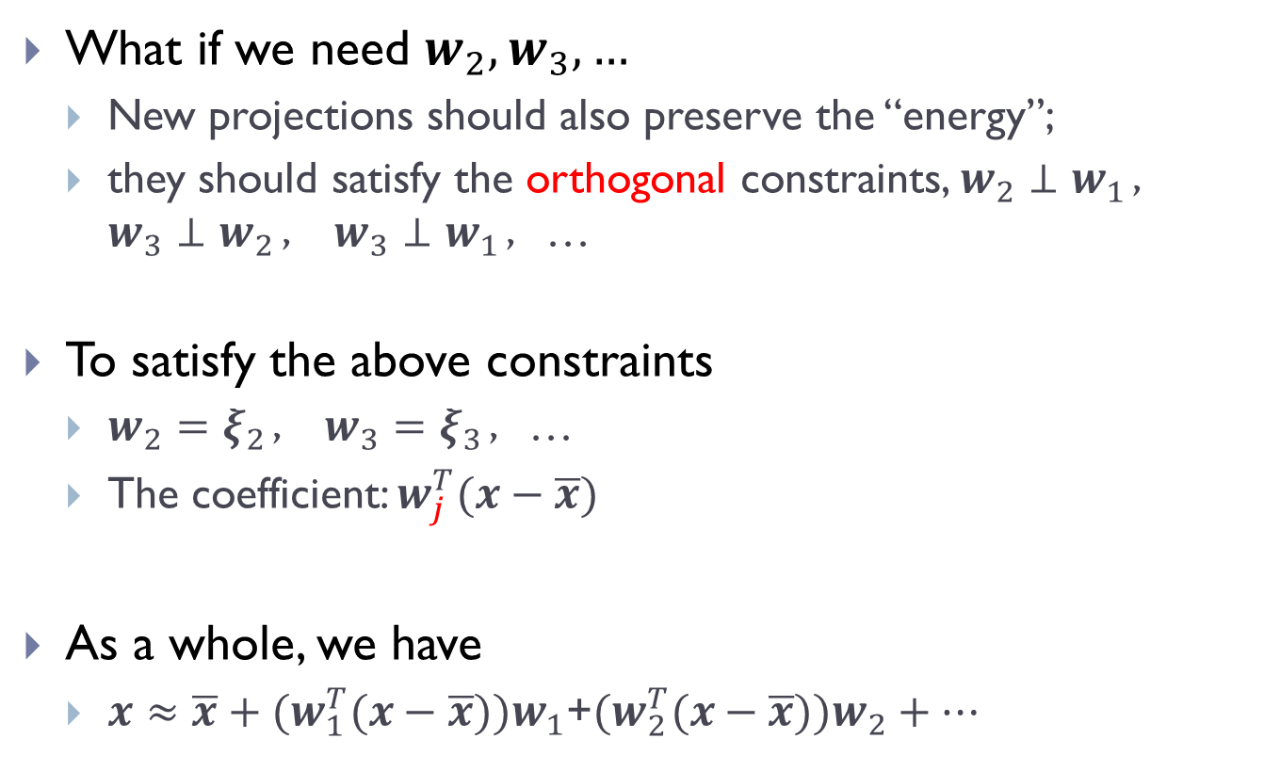

More projection directions
What if we need $w_{2},w_{3},…$
New projections should also preserve the “energy”;
they should satisfy the orthogonal constraints, $w_{2}⊥w_{1}$， $w_{3}⊥w_{2}$， $w_{3}⊥w_{1}$，…
To satisfy the above constraints
$w_{2}=ξ_{2}$， $w_{3}=ξ_{3}$，…
The coefficient: $w_{j}^{T}(x−\overline{x})$
As a whole, we have
$x≈\overline{x}+{(w}_{1}^{T}(x−\overline{x}))w_{1}$+${(w}_{2}^{T}(x−\overline{x}))w_{2}+⋯$

Slide 16
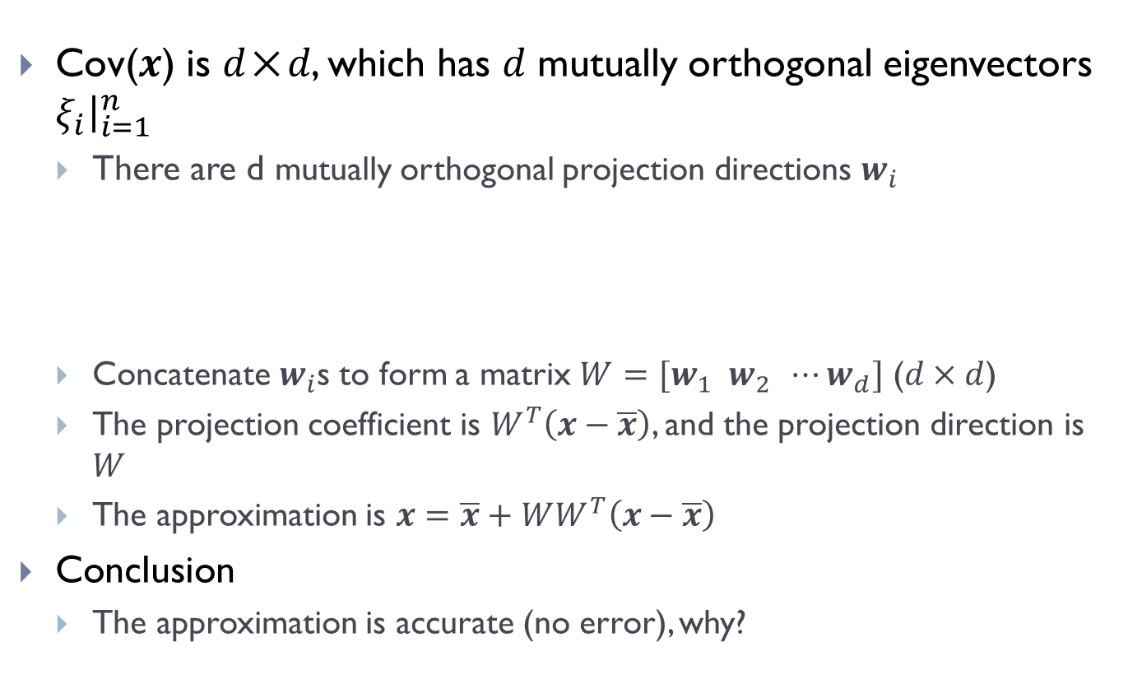

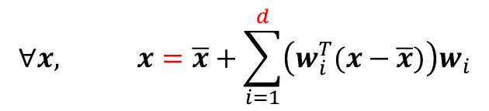
The relation between the approximated and original samples
Cov(𝒙) is 𝑑×𝑑, which has 𝑑 mutually orthogonal eigenvectors $ξ_{i}{\left.​\right|}_{i=1}^{n}$
There are d mutually orthogonal projection directions $w_{i}$
Concatenate $w_{i}$s to form a matrix $W=[w_{1} w_{2} ⋯w_{d}]$ ($d×d$)
The projection coefficient is $W^{T}\left(x−\overline{x}\right)$, and the projection direction is 𝑊
The approximation is $x=\overline{x}+WW^{T}\left(x−\overline{x}\right)$
Conclusion
The approximation is accurate (no error), why?
$$∀x, x=\overline{x}+\sum_{i=1}^{d}{\left(w_{i}^{T}(x−\overline{x})\right)w_{i}}$$

Slide 17
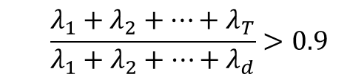
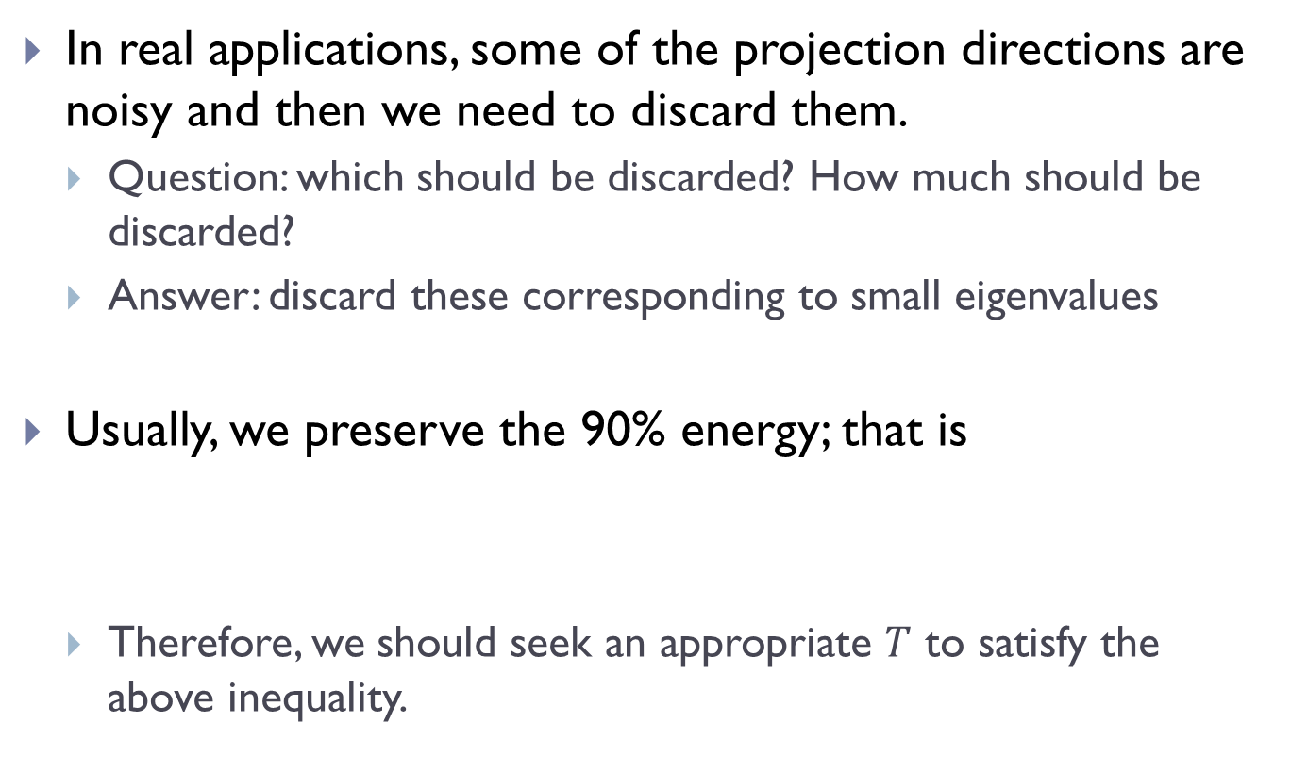

Dimensionality reduction
In real applications, some of the projection directions are noisy and then we need to discard them.
Question: which should be discarded? How much should be discarded?
Answer: discard these corresponding to small eigenvalues
Usually, we preserve the 90% energy; that is
Therefore, we should seek an appropriate $T$ to satisfy the above inequality.
$$\frac{λ_{1}+λ_{2}+⋯+λ_{T}}{λ_{1}+λ_{2}+⋯+λ_{d}}>0.9$$

Slide 18

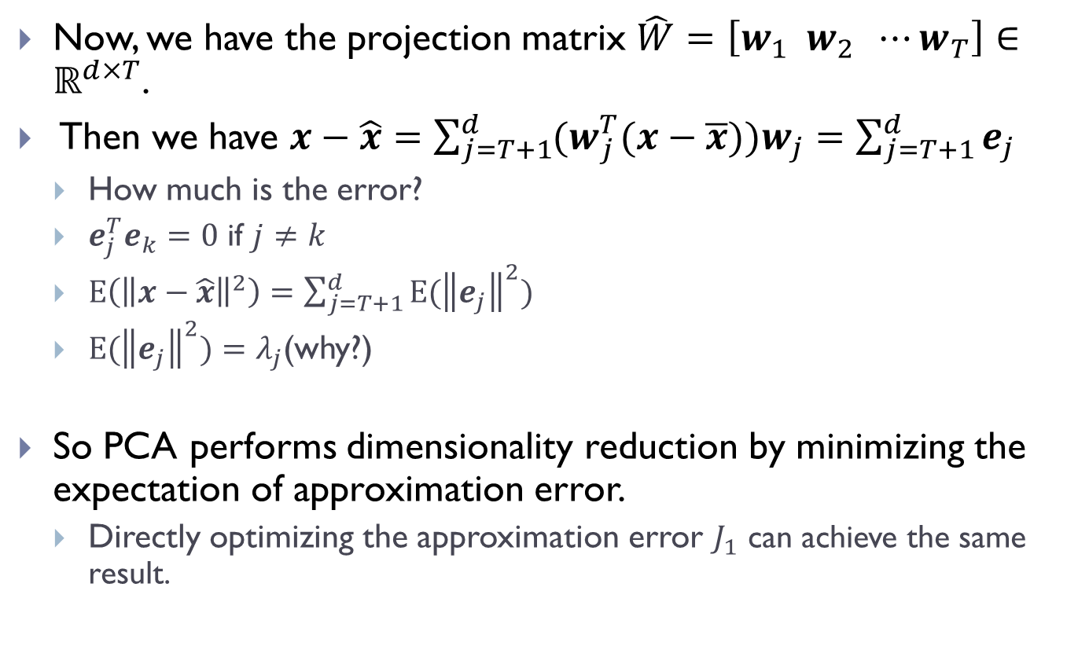

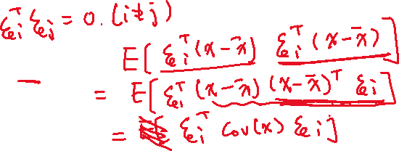




Loss in DR
Now, we have the projection matrix $\hat{W}=\left[w_{1} w_{2} ⋯w_{T}\right]∈ℝ^{d×T}$.
Then we have $x−\hat{x}=\sum_{j=T+1}^{d}{{(w}_{j}^{T}(x−\overline{x}))w_{j}}=\sum_{j=T+1}^{d}{e_{j}}$
How much is the error?
$e_{j}^{T}e_{k}=0$ if $j≠k$
$E\left({\left\|x−\hat{x}\right\|}^{2}\right)=\sum_{j=T+1}^{d}{{E(\left\|e_{j}\right\|}^{2})}$
${E(\left\|e_{j}\right\|}^{2})=λ_{j}$(why?)
So PCA performs dimensionality reduction by minimizing the expectation of approximation error.
Directly optimizing the approximation error $J_{1}$ can achieve the same result.

Slide 19




Summary: PCA procedure
Training samples: $x_{1},x_{2},…,x_{n}$
Calculate the $\overline{x}$ and $Cov\left(x\right)$
Calculate the eigenvalues and eigenvectors of $Cov\left(x\right)$
Matlab, R, octave
Determine $T$ according the eigenvalues
Determine the projection matrix $\hat{W}$
For any data $x$, the new representation obtained by PCA is $y={\hat{W}}^{T}(x−\overline{x})$
its reconstruction (approximation) is $x≈\hat{x}=\overline{x}+\hat{W}y$

Slide 20
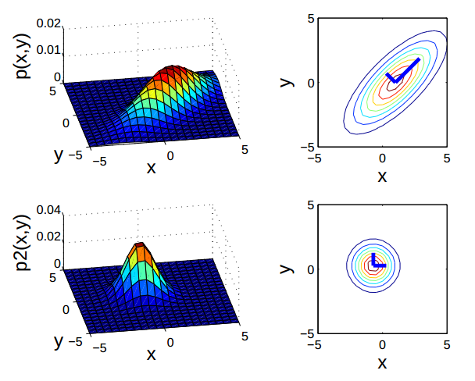
PCA for Gaussion data
PDF & equiprobability curve
Two 2-D Gaussion distributions with different covariance matrices

Slide 21
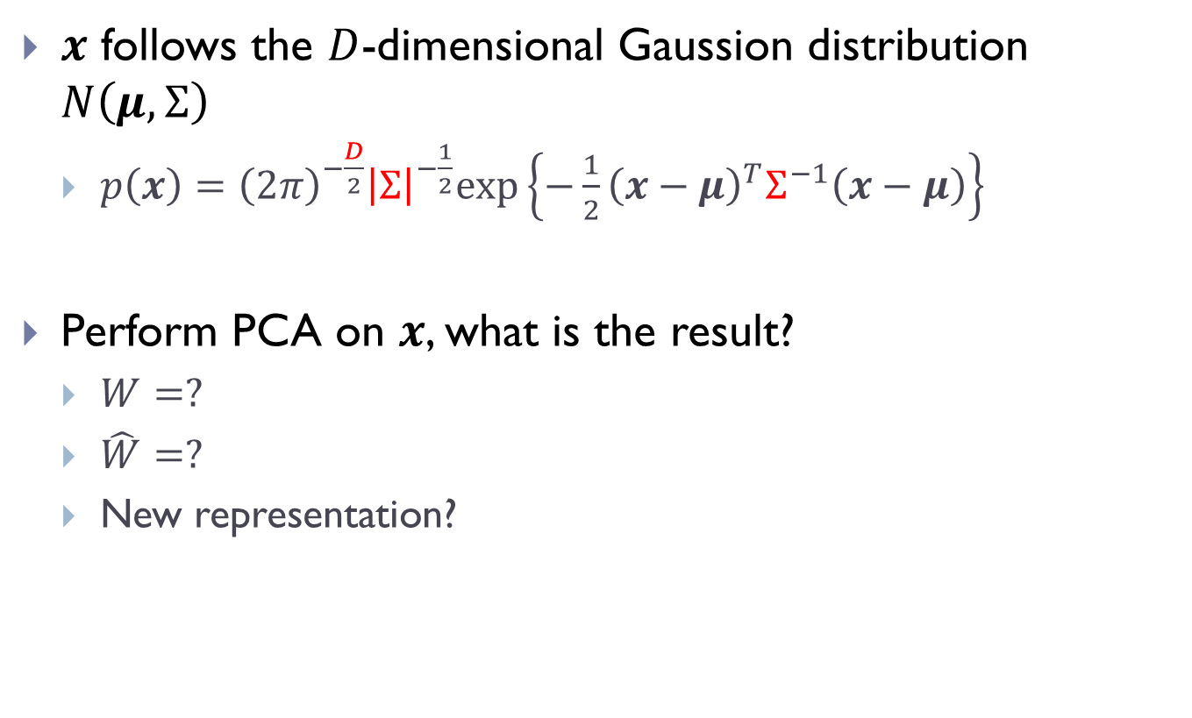
PCA vs. Gaussion
$x$ follows the $D$-dimensional Gaussion distribution $N\left(μ,Σ\right)$
$p\left(x\right)={\left(2π\right)}^{−\frac{D}{2}}{\left|Σ\right|}^{−\frac{1}{2}}exp⁡\left\{−\frac{1}{2}{\left(x−μ\right)}^{T}Σ^{−1}\left(x−μ\right)\right\}$
Perform PCA on $x$, what is the result?
$W=?$
$\hat{W}=?$
New representation?

Slide 22

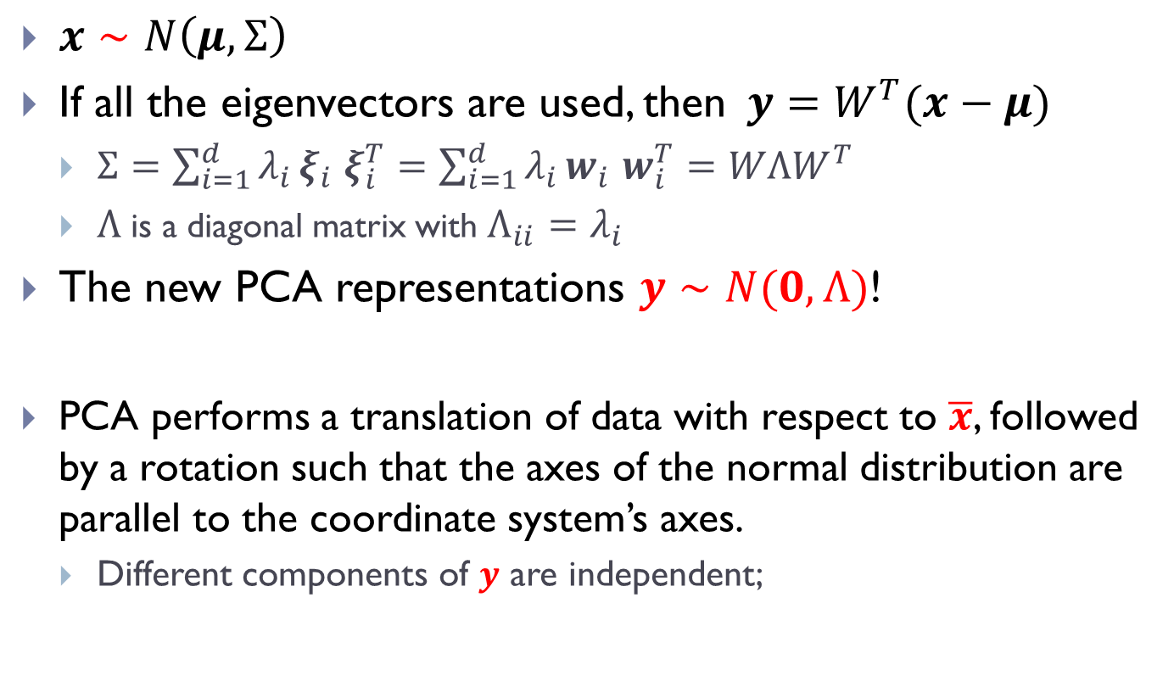
PCA vs. Gaussion
$x∼N\left(μ,Σ\right)$
If all the eigenvectors are used, then$y=W^{T}(x−μ)$
$Σ=\sum_{i=1}^{d}{λ_{i}}ξ_{i}$ $ξ_{i}^{T}=\sum_{i=1}^{d}{λ_{i}}w_{i}$ $w_{i}^{T}=WΛW^{T}$
$Λ$ is a diagonal matrix with $Λ_{ii}=λ_{i}$
The new PCA representations $y∼N(0,Λ)$!
PCA performs a translation of data with respect to $\overline{x}$, followed by a rotation such that the axes of the normal distribution are parallel to the coordinate system’s axes.
Different components of $y$ are independent;

Slide 23
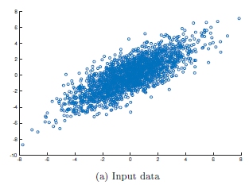
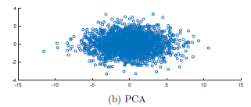
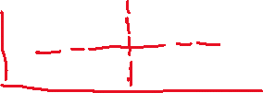
PCA vs. Gaussion
Graphical illustration
x=randn(2000,2)*[2 1;1 2]
New representation after PCA transformation, whose covariance matrix is diagonal (uncorrelated == independent in Gaussian distribution).

Slide 24
The merits of PCA
It can reduce the data volume
Reduce the computing burden, shorten the time in training, testing and recognition
Save the storage space (which is important to big data)
May remove the noise in data (resulting in improved recognition accuracy)
If data follows Gaussian distribution,
Dimensions of the new representation are uncorrelated (or equivalently, independent)
Beneficial to pattern recognition

Slide 25
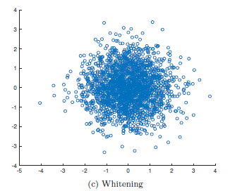


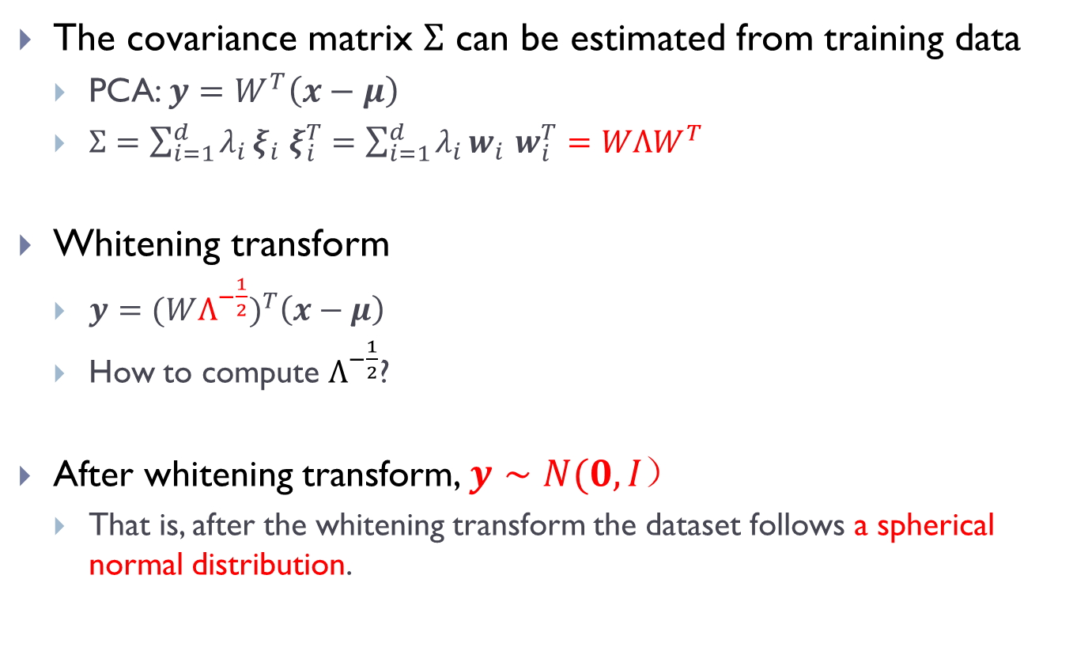




Whitening
The covariance matrix $Σ$ can be estimated from training data
PCA: $y=W^{T}\left(x−μ\right)$
$Σ=\sum_{i=1}^{d}{λ_{i}}ξ_{i}$ $ξ_{i}^{T}=\sum_{i=1}^{d}{λ_{i}}w_{i}$ $w_{i}^{T}=WΛW^{T}$
Whitening transform
$y={(WΛ^{−\frac{1}{2}})}^{T}\left(x−μ\right)$
How to compute $Λ^{−\frac{1}{2}}$?
After whitening transform, $y∼N(0, I）$
That is, after the whitening transform the dataset follows a spherical normal distribution.

Slide 26
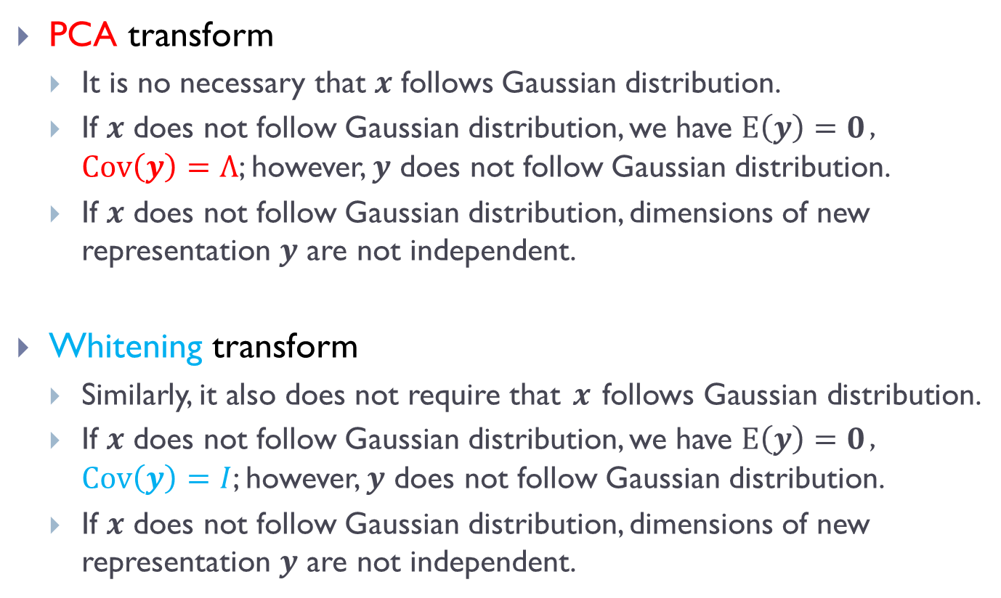
On Gaussian assumption
PCA transform
It is no necessary that $x$ follows Gaussian distribution.
If $x$ does not follow Gaussian distribution, we have $E\left(y\right)=0$，$Cov\left(y\right)=Λ$; however, $y$ does not follow Gaussian distribution.
If $x$ does not follow Gaussian distribution, dimensions of new representation $y$ are not independent.
Whitening transform
Similarly, it also does not require that $x$ follows Gaussian distribution.
If $x$ does not follow Gaussian distribution, we have $E\left(y\right)=0$，$Cov\left(y\right)=I$; however, $y$ does not follow Gaussian distribution.
If $x$ does not follow Gaussian distribution, dimensions of new representation $y$ are not independent.

Slide 27
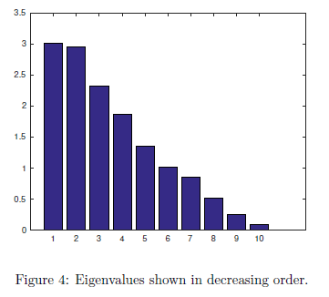
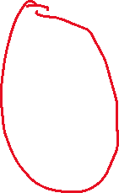
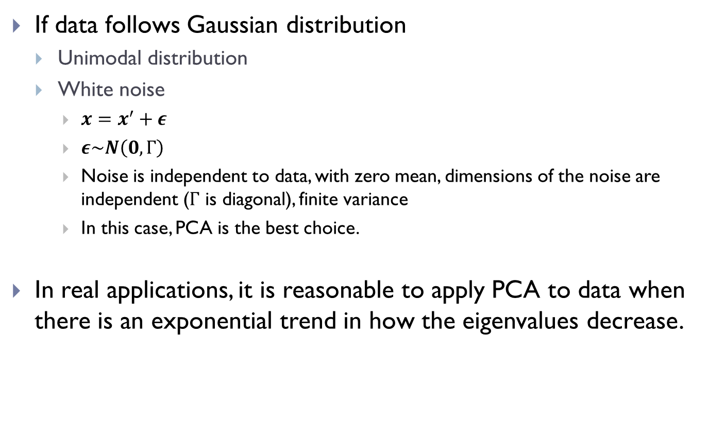

Can I use PCA?
If data follows Gaussian distribution
Unimodal distribution
White noise
$x=x^{′}+ε$
$ε\sim N\left(0,Γ\right)$
Noise is independent to data, with zero mean, dimensions of the noise are independent ($Γ$ is diagonal), finite variance
In this case, PCA is the best choice.
In real applications, it is reasonable to apply PCA to data when there is an exponential trend in how the eigenvalues decrease.

Slide 28
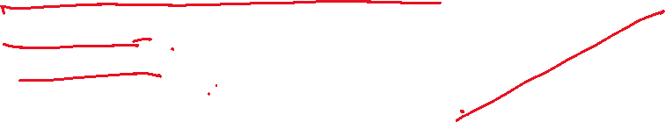

Can PCA deal with outliers?
Outliers can cause serious trouble for PCA.
Eigenvalues (825, 0)
Projection direction (3,1)
Eigenvalues (837.13, 0.42)
Projection direction (3.03, 1)
Eigenvalues (858.97, 16.43)
Projection direction (3.43, 1)

Slide 29
Thanks.
Further reading
Related sections in PRML
Lagrange multipliers method: Convex Optimization by Boyd and Vandenberghe, http://www.stanford.edu/~boyd/cvxbook/

