Slide 1



Fisher's linear discriminant
Yong Peng
2021/04/15

Slide 2
Objective
Basic objectives
Can use FLD, and master its derivation
Can apply both PCA and FLD to face recognition tasks
Advanced objectives
Can apply FLD to real cases (for postgraduates and partial undergraduates)
Read materials to understand some FLD variants

Slide 3



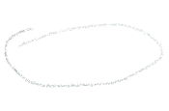

Why we need FLD?
Theoretically, PCA performs the best to unimodal distributed data
PCA is for data representation, but is uncorrelated to classification
In classification task, different classes should distribute differently; that is, 𝑝(𝒙│𝑦=𝑖) cannot be the same.
For example, for a binary classification task, if the whole data set follows the Gaussian distribution, and two classes also follow the Gaussian distribution, there is no way to make distinction
How to extract feature is optimal for classification?
FLD is the optimal feature extraction method under certain assumptions.
which takes the label information into consideration

Slide 4




Idea: motivation of FLD
FLD vs. PCA
Bad linear feature (PCA)
Good linear feature (FLD)
n1 = 200;
n2 = 200;
rot = [1 2; 2 4.5];
data1 = randn (n1 ,2) * rot ;
data2 = randn (n2 ,2) * rot + repmat ([0 5],n2 ,1);
Notes:
n1 = 200;
n2 = 200;
rot = [1 2; 2 4.5];
data1 = randn (n1 ,2) * rot ;
data2 = randn (n2 ,2) * rot + repmat ([0 5],n2 ,1);

Slide 5



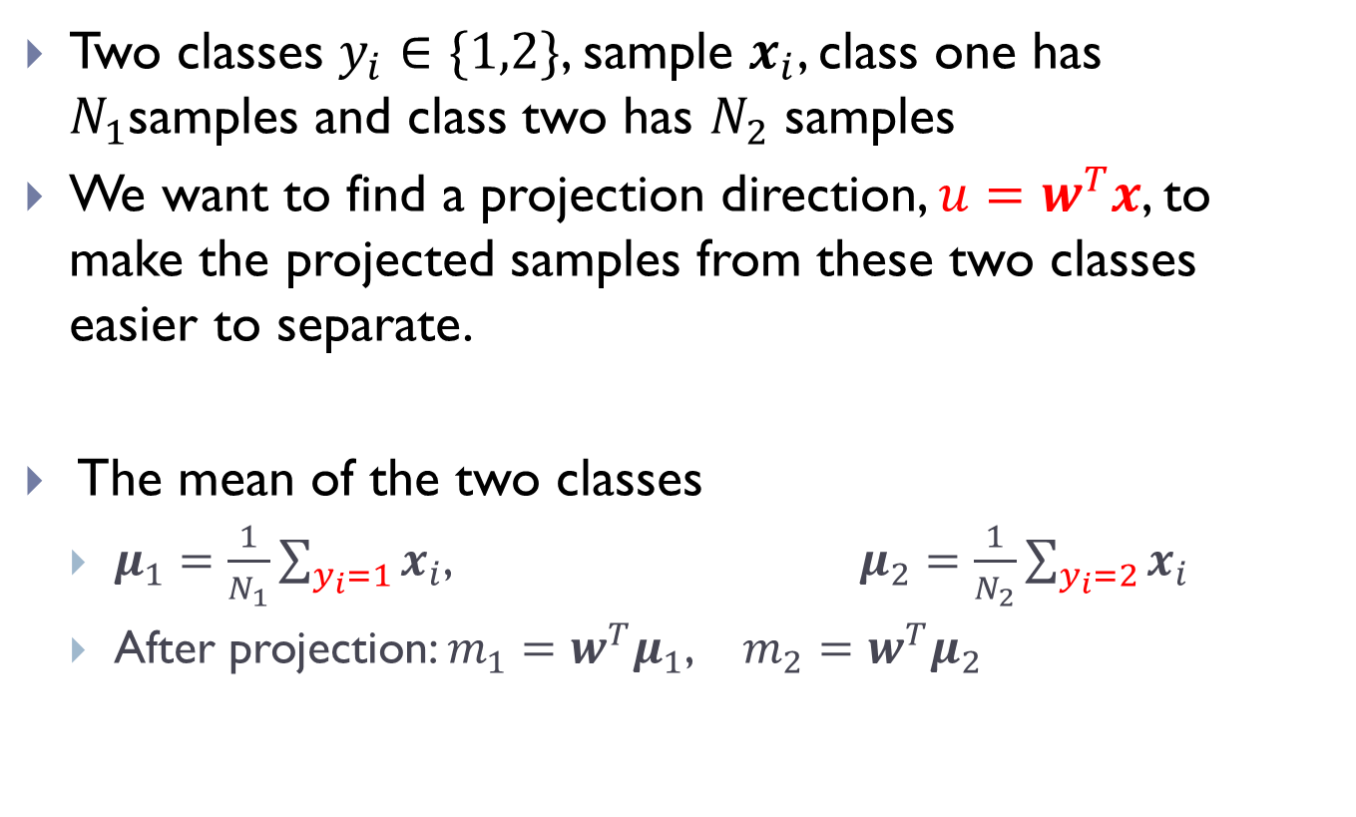

Formalize
Two classes $y_{i}∈\{1,2\}$, sample $x_{i}$, class one has $N_{1}$samples and class two has $N_{2}$ samples
We want to find a projection direction, $u=w^{T}x$, to make the projected samples from these two classes easier to separate.
The mean of the two classes
$μ_{1}=\frac{1}{N_{1}}\sum_{y_{i}=1}{x_{i}}$, $μ_{2}=\frac{1}{N_{2}}\sum_{y_{i}=2}{x_{i}}$
After projection: $m_{1}=w^{T}μ_{1}$, $m_{2}=w^{T}μ_{2}$

Slide 6
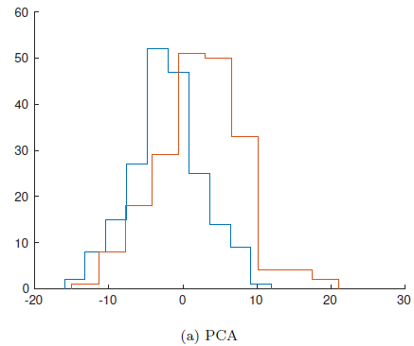
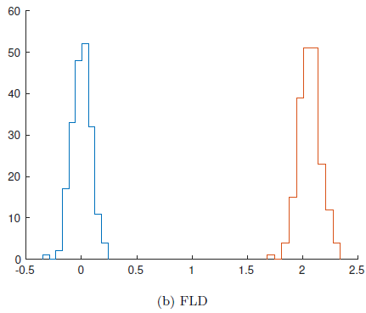
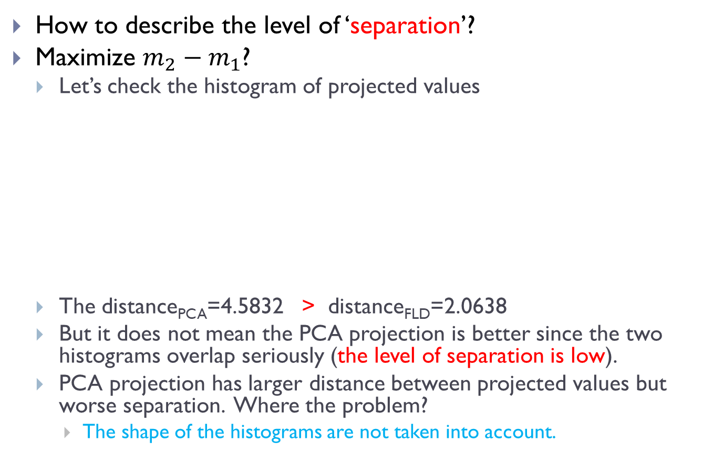


Objective: Fisher’s Criterion
How to describe the level of ‘separation’?
Maximize $m_{2}−m_{1}$?
Let’s check the histogram of projected values
The distance_{PCA}=4.5832 > distance_{FLD}=2.0638
But it does not mean the PCA projection is better since the two histograms overlap seriously (the level of separation is low).
PCA projection has larger distance between projected values but worse separation. Where the problem?
The shape of the histograms are not taken into account.

Slide 7
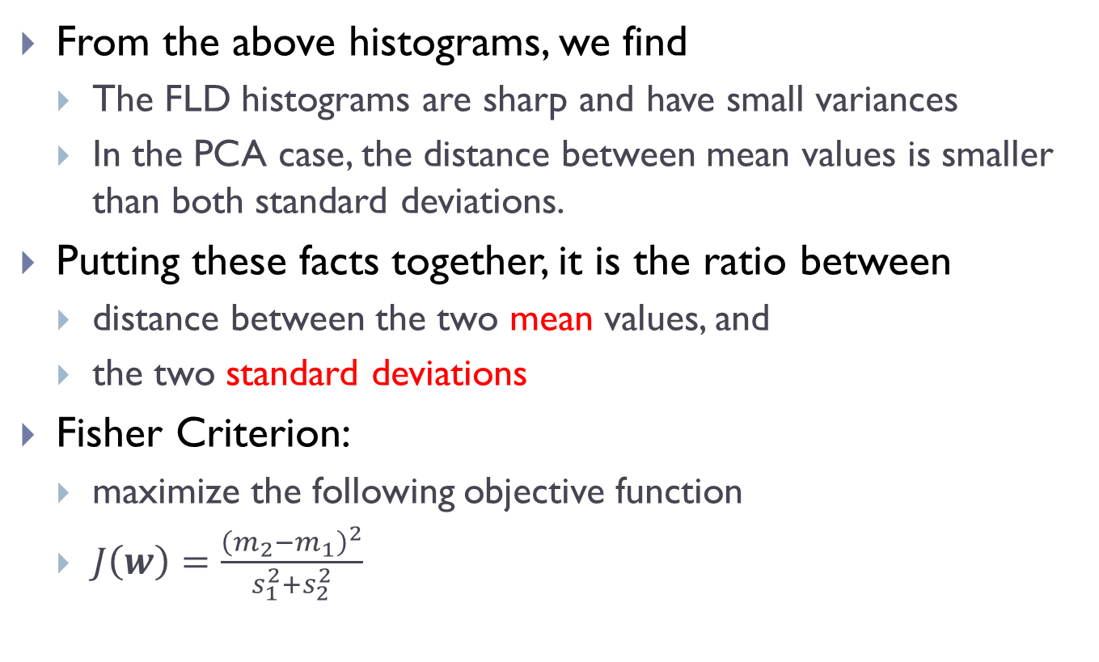

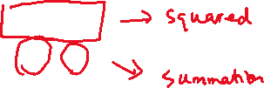

Objective: Fisher’s Criterion
From the above histograms, we find
The FLD histograms are sharp and have small variances
In the PCA case, the distance between mean values is smaller than both standard deviations.
Putting these facts together, it is the ratio between
distance between the two mean values, and
the two standard deviations
Fisher Criterion:
maximize the following objective function
$J\left(w\right)=\frac{{\left(m_{2}−m_{1}\right)}^{2}}{s_{1}^{2}+s_{2}^{2}}$

Slide 8
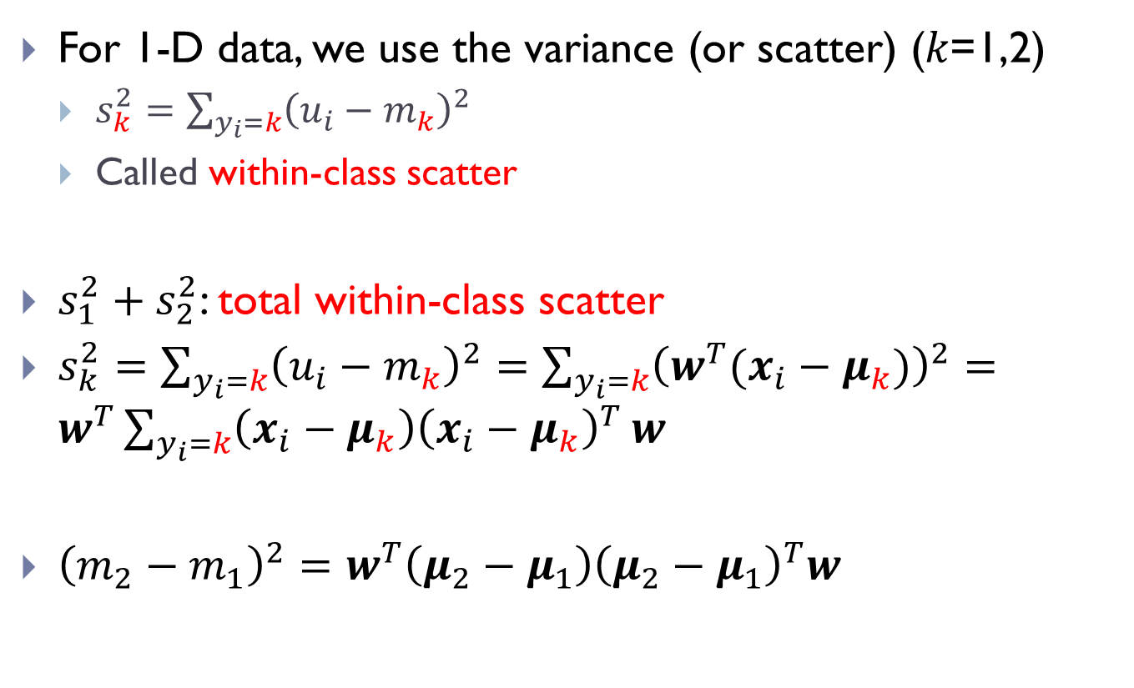




Measure of ‘separation’
For 1-D data, we use the variance (or scatter) (𝑘=1,2)
$s_{k}^{2}=\sum_{y_{i}=k}{{\left(u_{i}−m_{k}\right)}^{2}}$
Called within-class scatter
$s_{1}^{2}+s_{2}^{2}$: total within-class scatter
$s_{k}^{2}=\sum_{y_{i}=k}{{\left(u_{i}−m_{k}\right)}^{2}}=\sum_{y_{i}=k}{{\left(w^{T}(x_{i}−μ_{k})\right)}^{2}}=w^{T}\sum_{y_{i}=k}{\left(x_{i}−μ_{k}\right){\left(x_{i}−μ_{k}\right)}^{T}}w$
${\left(m_{2}−m_{1}\right)}^{2}=w^{T}\left(μ_{2}−μ_{1}\right){\left(μ_{2}−μ_{1}\right)}^{T}w$

Slide 9
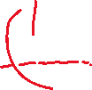
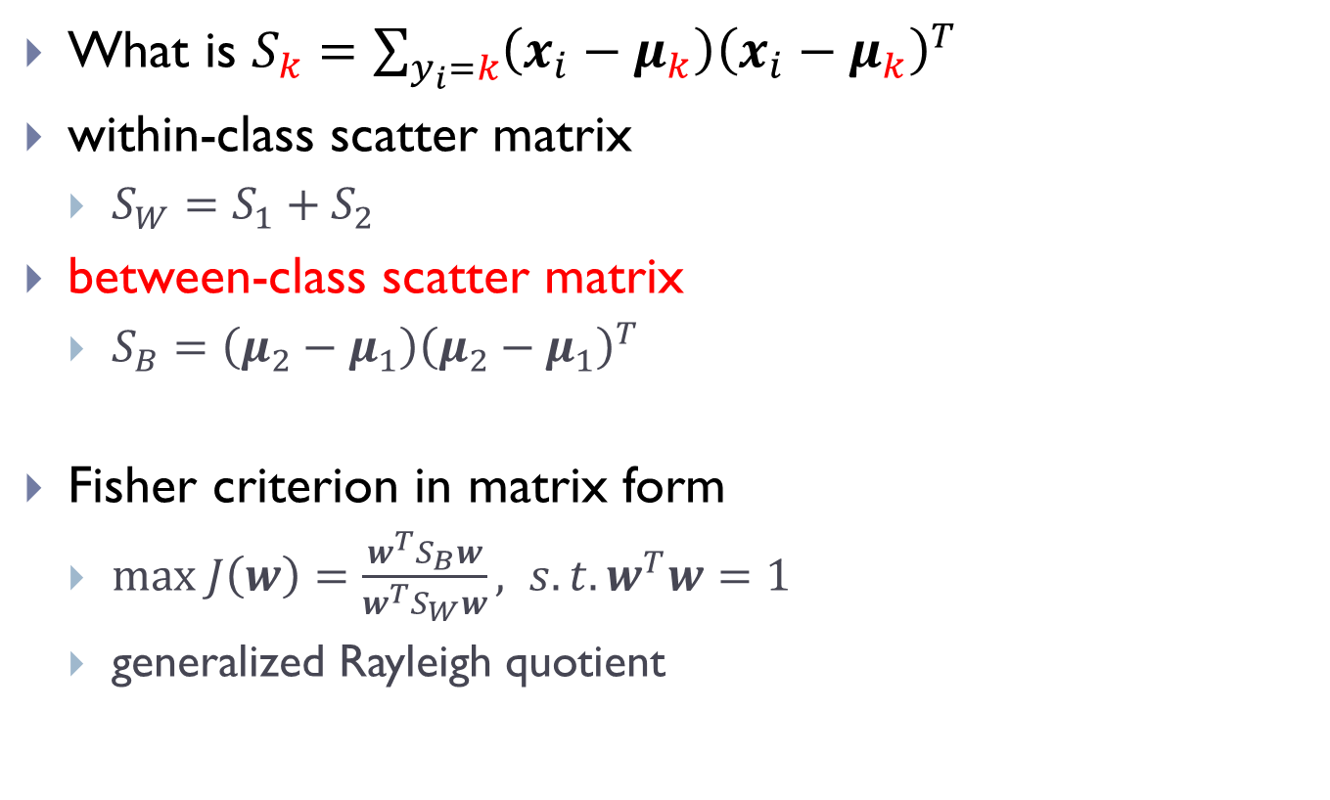




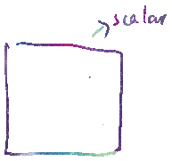

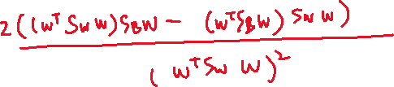


Scatter matrices
What is $S_{k}=\sum_{y_{i}=k}{\left(x_{i}−μ_{k}\right){\left(x_{i}−μ_{k}\right)}^{T}}$
within-class scatter matrix
$S_{W}=S_{1}+S_{2}$
between-class scatter matrix
$S_{B}=\left(μ_{2}−μ_{1}\right){\left(μ_{2}−μ_{1}\right)}^{T}$
Fisher criterion in matrix form
$max J\left(w\right)=\frac{w^{T}S_{B}w}{w^{T}S_{W}w}, s.t.w^{T}w=1$
generalized Rayleigh quotient

Slide 10
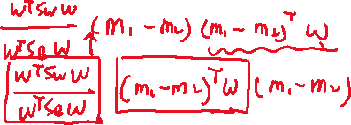
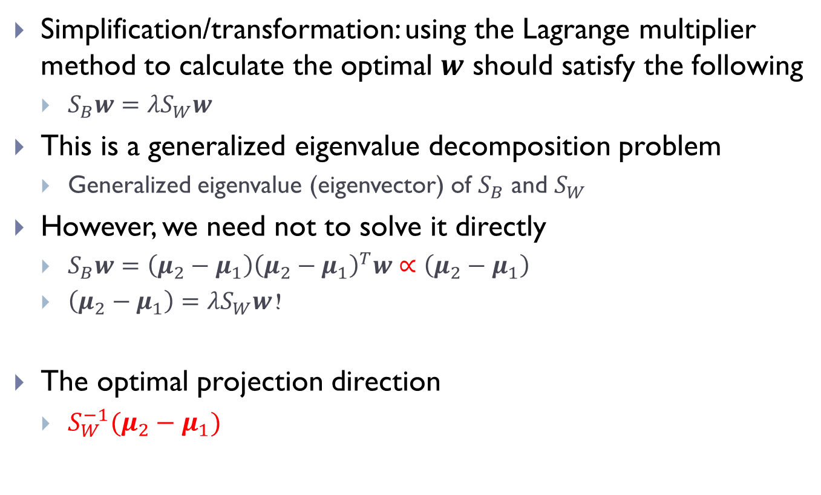





Optimization
Simplification/transformation: using the Lagrange multiplier method to calculate the optimal $w$ should satisfy the following
$S_{B}w={λS}_{W}w$
This is a generalized eigenvalue decomposition problem
Generalized eigenvalue (eigenvector) of $S_{B}$ and $S_{W}$
However, we need not to solve it directly
$S_{B}w=\left(μ_{2}−μ_{1}\right){\left(μ_{2}−μ_{1}\right)}^{T}w∝\left(μ_{2}−μ_{1}\right)$
$\left(μ_{2}−μ_{1}\right)={λS}_{W}w$！
The optimal projection direction
$S_{W}^{−1}(μ_{2}−μ_{1})$

Slide 11

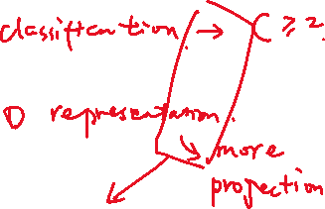



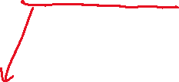
Procedure of FLD
Calculate $μ_{2}{,μ}_{1}$
Calculate $S_{W}$
Calculate $w=S_{W}^{−1}\left(μ_{2}−μ_{1}\right)$
Normalization：
$$w←\frac{w}{\left\|w\right\|}$$

Slide 12
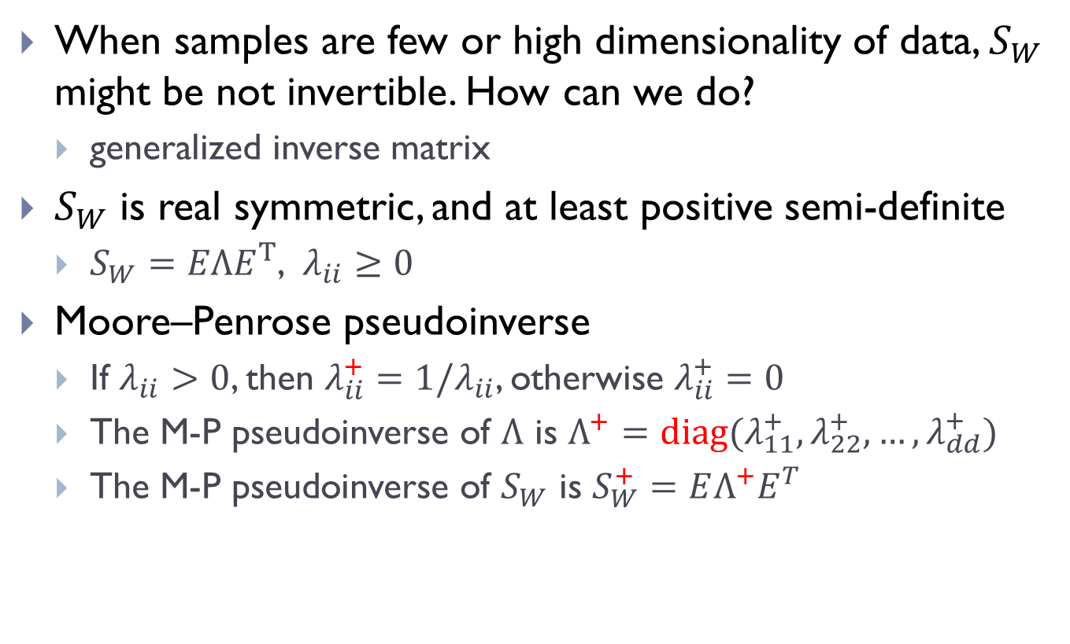



Discussion on $S_{W}$
When samples are few or high dimensionality of data, $S_{W}$ might be not invertible. How can we do?
generalized inverse matrix
$S_{W}$ is real symmetric, and at least positive semi-definite
$S_{W}={EΛE}^{T}$, $λ_{ii}≥0$
Moore–Penrose pseudoinverse
If $λ_{ii}>0$, then $λ_{ii}^{+}=1/λ_{ii}$, otherwise $λ_{ii}^{+}=0$
The M-P pseudoinverse of $Λ$ is $Λ^{+}=diag(λ_{11}^{+},λ_{22}^{+},…,λ_{dd}^{+})$
The M-P pseudoinverse of $S_{W}$ is $S_{W}^{+}=EΛ^{+}E^{T}$

Slide 13


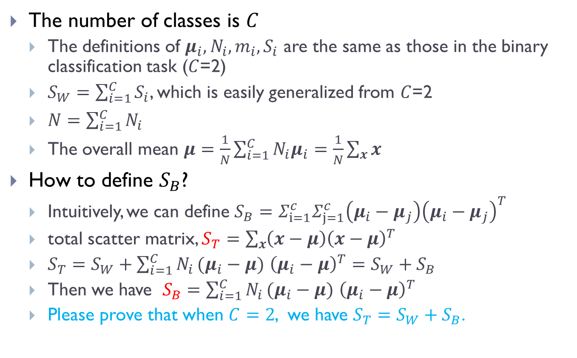
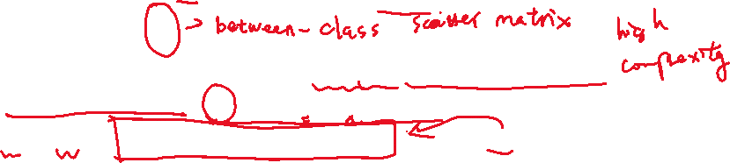
If more than 2 classes
The number of classes is $C$
The definitions of $μ_{i},N_{i},m_{i},S_{i}$ are the same as those in the binary classification task ($C$=2)
$S_{W}=\sum_{i=1}^{C}{S_{i}}$, which is easily generalized from $C$=2
$N=\sum_{i=1}^{C}{N_{i}}$
The overall mean $μ=\frac{1}{N}\sum_{i=1}^{C}{N_{i}μ_{i}}=\frac{1}{N}\sum_{x}{x}$
How to define $S_{B}$?
Intuitively, we can define $S_{B}=Σ_{ⅈ=1}^{c}Σ_{j=1}^{c}\left(μ_{i}−μ_{j}\right){\left(μ_{i}−μ_{j}\right)}^{T}$
total scatter matrix, $S_{T}=\sum_{x}{\left(x−μ\right){\left(x−μ\right)}^{T}}$
$S_{T}=S_{W}+\sum_{i=1}^{C}{N_{i}}(μ_{i}−μ)$ ${\left(μ_{i}−μ\right)}^{T}=S_{W}+S_{B}$
Then we have $S_{B}=\sum_{i=1}^{C}{N_{i}}(μ_{i}−μ)$ ${\left(μ_{i}−μ\right)}^{T}$
Please prove that when $C=2$, we have $S_{T}=S_{W}+S_{B}$.

Slide 14

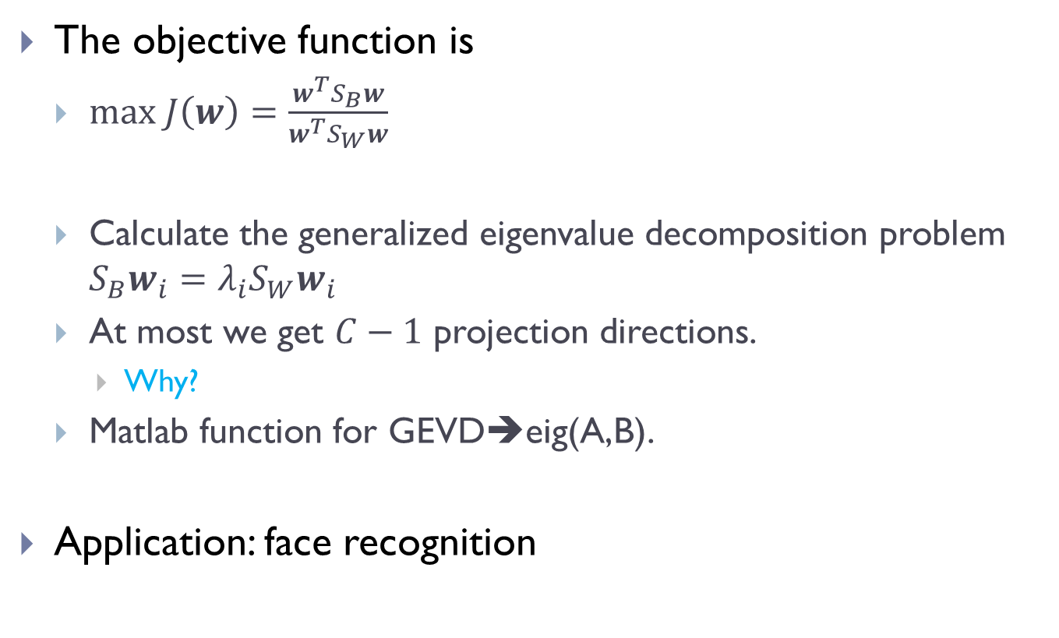


If more projection directions?
The objective function is
$max J\left(w\right)=\frac{w^{T}S_{B}w}{w^{T}S_{W}w}$
Calculate the generalized eigenvalue decomposition problem $S_{B}w_{i}={λ_{i}S}_{W}w_{i}$
At most we get $C−1$ projection directions.
Why?
Matlab function for GEVD➔eig(A,B).
Application: face recognition

Slide 15
These are all the contents for this chapter.
I will send you some source codes for your testing the FLD algorithm on face recognition.
Thank you.

