Slide 1
Support Vector Machine
Yong Peng
2021/04/15

Slide 2
Objectives
Understand and master the meaning, description and mathematical expression of the main ideas in SVM
How to formalize a good idea
Can apply SVM in real applications
Advanced objectives
Understand related derivation, and be able to complete the derivation independently with the help of literature
Understand the statistics by reading materials

Slide 3
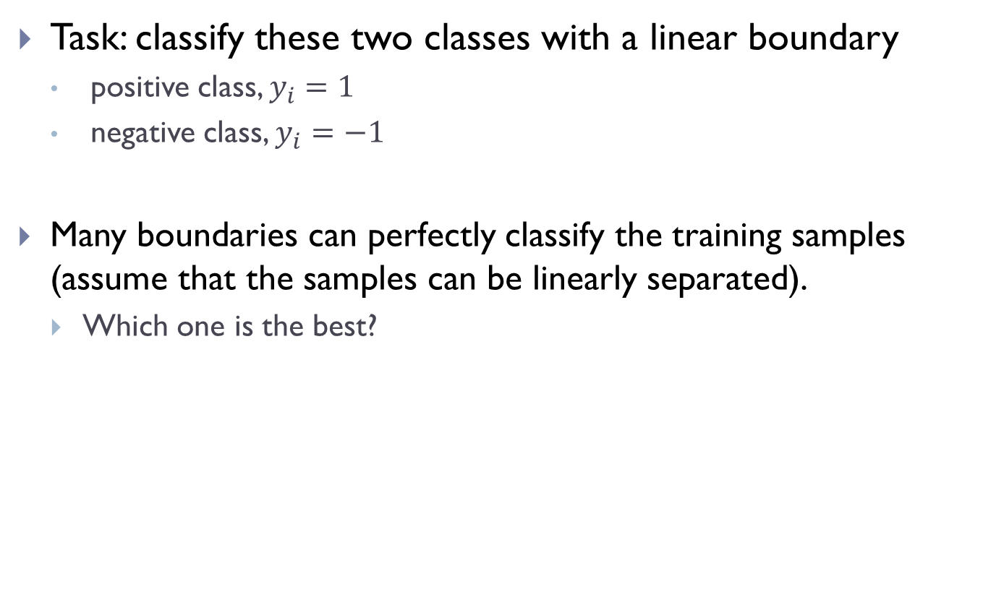
large margin
Task: classify these two classes with a linear boundary
positive class, $y_{i}=1$
negative class, $y_{i}=−1$
Many boundaries can perfectly classify the training samples (assume that the samples can be linearly separated).
Which one is the best?

Slide 4
margin
The margin of a sample is the perpendicular distance from it to the separating hyperplane;
SVM maximizes the minimal margin of samples
Support vectors: the samples which have the minimal margin;
SVM: Support vector machine

Slide 5

Geometry illustration
The separating hyperplane
${f\left(x\right)=w}^{T}x+b=0$, blue
Normal vector $w$, red arrow
For any sample $x$
What is its distance to the hyperplane?

Slide 6
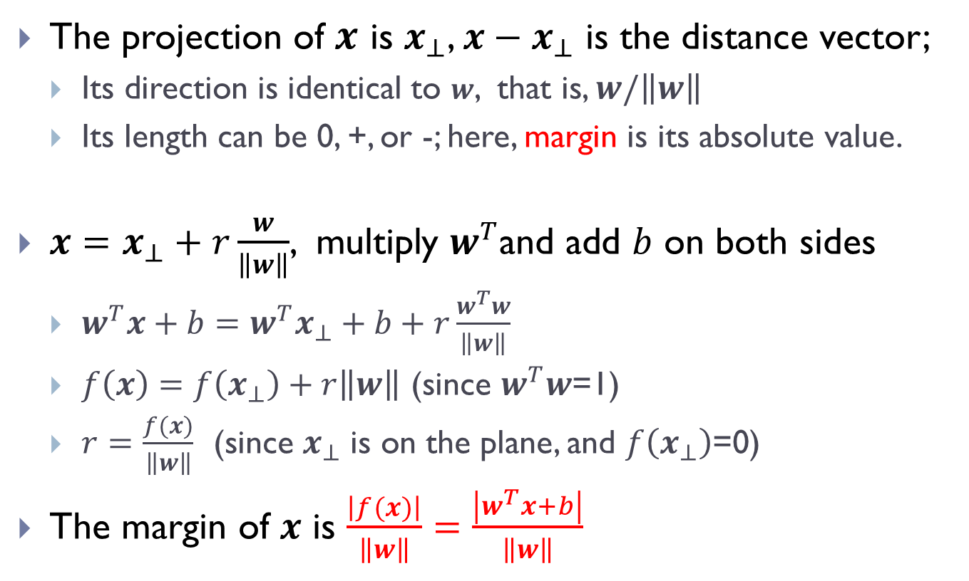
How to calculate the margin?
The projection of $x$ is $x_{⊥}$, ${x−x}_{⊥}$ is the distance vector;
Its direction is identical to $w$, that is, $w/\left\|w\right\|$
Its length can be 0, +, or -; here, margin is its absolute value.
$x=x_{⊥}+r\frac{w}{\left\|w\right\|}$, multiply $w^{T}$and add $b$ on both sides
$w^{T}x+b={w^{T}x}_{⊥}+b+r\frac{w^{T}w}{\left\|w\right\|}$
$f\left(x\right)=f\left(x_{⊥}\right)+r\left\|w\right\|$ (since $w^{T}w$=1)
$r=\frac{f(x)}{\left\|w\right\|}$ (since $x_{⊥}$ is on the plane, and $f\left(x_{⊥}\right)$=0)
The margin of $x$ is $\frac{\left|f(x)\right|}{\left\|w\right\|}=\frac{\left|w^{T}x+b\right|}{\left\|w\right\|}$

Slide 7
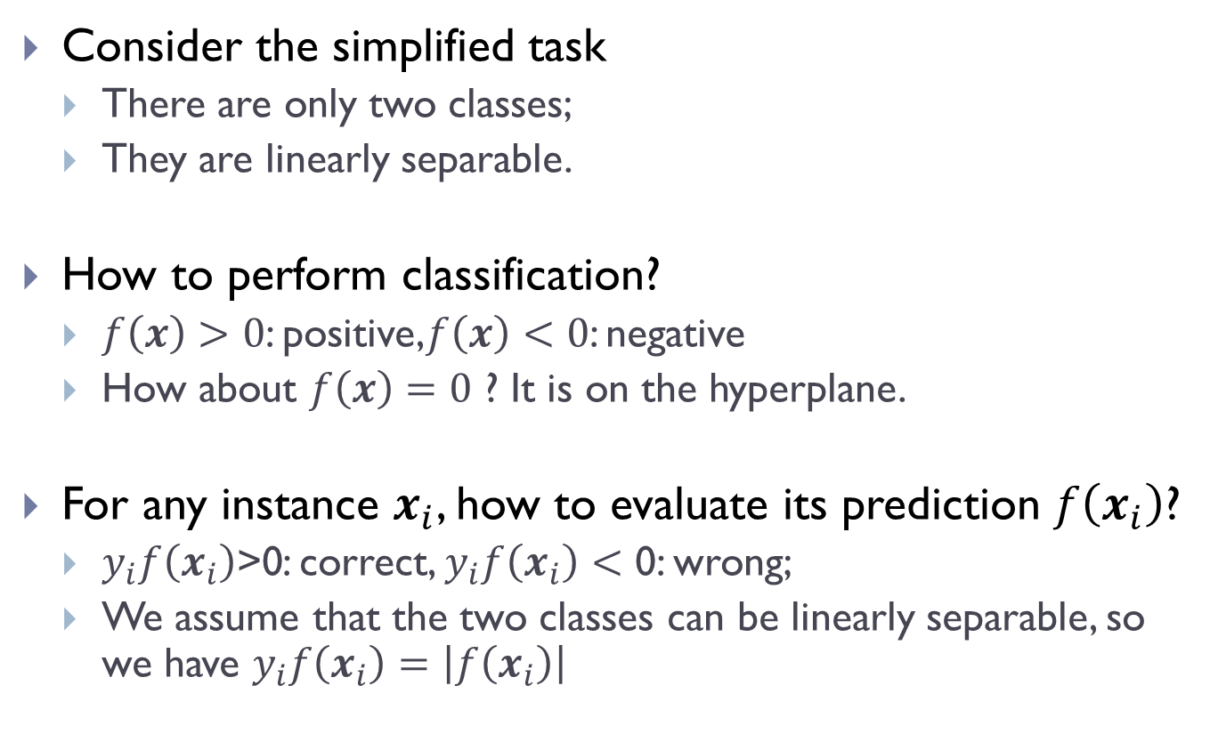
Classification & Evaluation
Consider the simplified task
There are only two classes;
They are linearly separable.
How to perform classification?
$f\left(x\right)>0$: positive,$f\left(x\right)<0$: negative
How about $f\left(x\right)=0$ ? It is on the hyperplane.
For any instance $x_{i}$, how to evaluate its prediction $f\left(x_{i}\right)$?
$y_{i}f\left(x_{i}\right)\text{>0}$: correct, $y_{i}f\left(x_{i}\right)<\text{0}$: wrong;
We assume that the two classes can be linearly separable, so we have $y_{i}f\left(x_{i}\right)=\left|f\left(x_{i}\right)\right|$

Slide 8
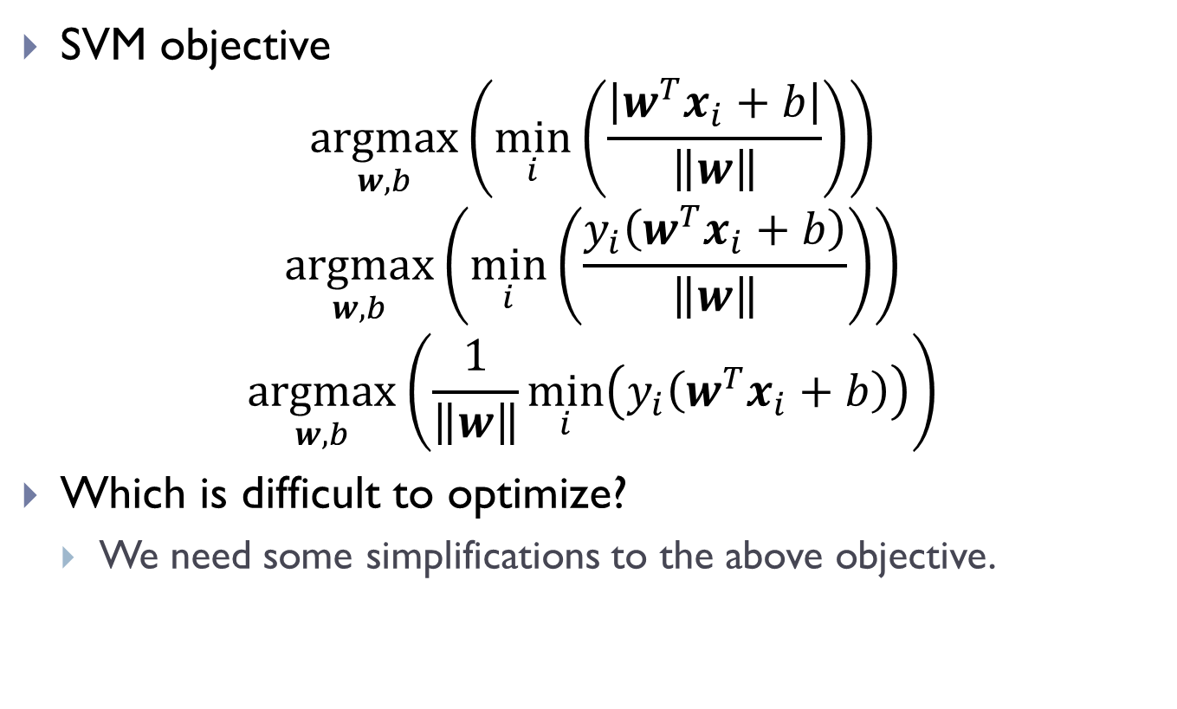
SVM Formalization
SVM objective
$$\underset{w,b}{argmax}\left(\min_{i}\left(\frac{\left|w^{T}x_{i}+b\right|}{\left\|w\right\|}\right)\right)$$
$$\underset{w,b}{argmax}\left(\min_{i}\left(\frac{y_{i}\left(w^{T}x_{i}+b\right)}{\left\|w\right\|}\right)\right)$$
$$\underset{w,b}{argmax}\left(\frac{1}{\left\|w\right\|}\min_{i}\left(y_{i}\left(w^{T}x_{i}+b\right)\right)\right)$$
Which is difficult to optimize?
We need some simplifications to the above objective.

Slide 9
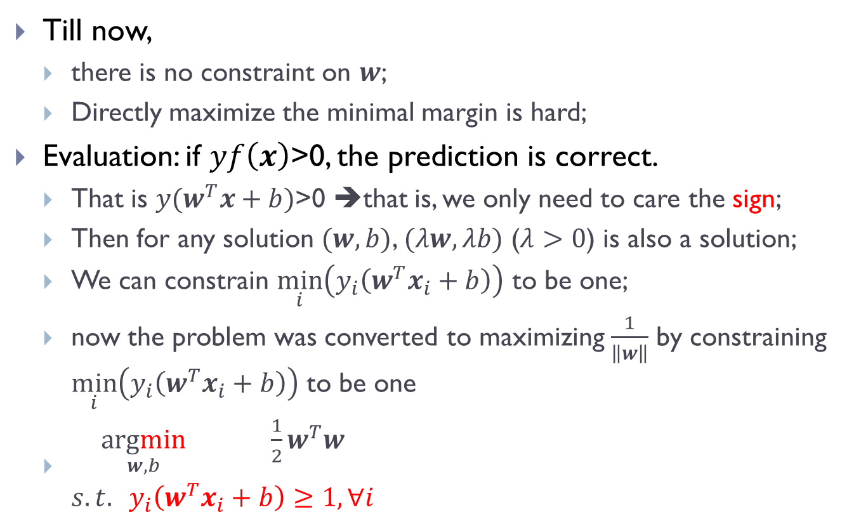
Simplification
Till now,
there is no constraint on $w$;
Directly maximize the minimal margin is hard;
Evaluation: if $yf\left(x\right)\text{>0}$, the prediction is correct.
That is $y(w^{T}x+b)\text{>0}$ ➔that is, we only need to care the sign;
Then for any solution $(w,b)$, $(λw,λb)$ ($λ>0$) is also a solution;
We can constrain $\min_{i}\left(y_{i}\left(w^{T}x_{i}+b\right)\right)$ to be one;
now the problem was converted to maximizing $\frac{1}{\left\|w\right\|}$ by constraining $\min_{i}\left(y_{i}\left(w^{T}x_{i}+b\right)\right)$ to be one
$\begin{matrix}\underset{w,b}{argmin}{ \frac{1}{2}w^{T}w} \\ s.t. y_{i}\left(w^{T}x_{i}+b\right)≥1, ∀i\end{matrix}$

Slide 10
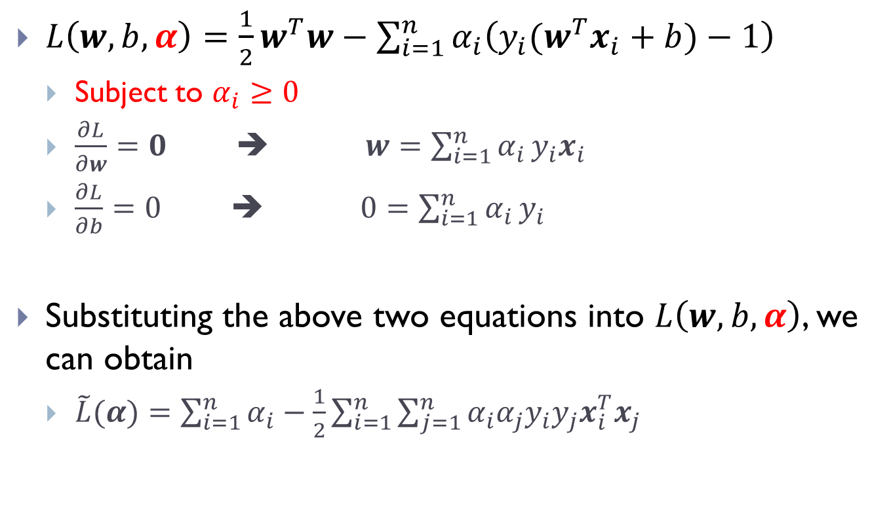
Lagrangian multiplier method
$L\left(w,b,α\right)=\frac{1}{2}w^{T}w−\sum_{i=1}^{n}{α_{i}\left(y_{i}(w^{T}x_{i}+b)−1\right)}$
Subject to $α_{i}≥0$
$\frac{∂L}{∂w}=0$ ➔ $w=\sum_{i=1}^{n}{α_{i}}y_{i}x_{i}$
$\frac{∂L}{∂b}=0$ ➔ $0=\sum_{i=1}^{n}{α_{i}}y_{i}$
Substituting the above two equations into $L\left(w,b,α\right)$, we can obtain
$\tilde{L}(α)=\sum_{i=1}^{n}{α_{i}}−\frac{1}{2}\sum_{i=1}^{n}{\sum_{j=1}^{n}{α_{i}α_{j}y_{i}y_{j}x_{i}^{T}x_{j}}}$

Slide 11
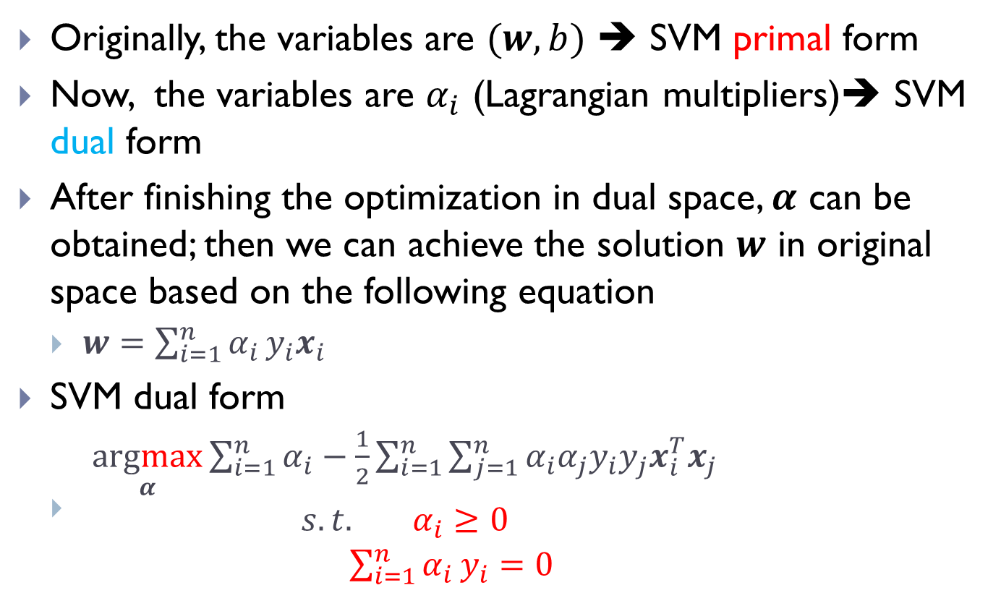
The dual form of SVM
Originally, the variables are $(w,b)$ ➔ SVM primal form
Now, the variables are $α_{i}$ (Lagrangian multipliers)➔ SVM dual form
After finishing the optimization in dual space, $α$ can be obtained; then we can achieve the solution $w$ in original space based on the following equation
$w=\sum_{i=1}^{n}{α_{i}}y_{i}x_{i}$
SVM dual form
$\begin{matrix}\underset{α}{argmax}{\sum_{i=1}^{n}{α_{i}}−\frac{1}{2}\sum_{i=1}^{n}{\sum_{j=1}^{n}{α_{i}α_{j}y_{i}y_{j}x_{i}^{T}x_{j}}}} \\ \begin{aligned}s.t. α_{i}≥0 \\ \sum_{i=1}^{n}{α_{i}}y_{i}=0\end{aligned}\end{matrix}$

Slide 12
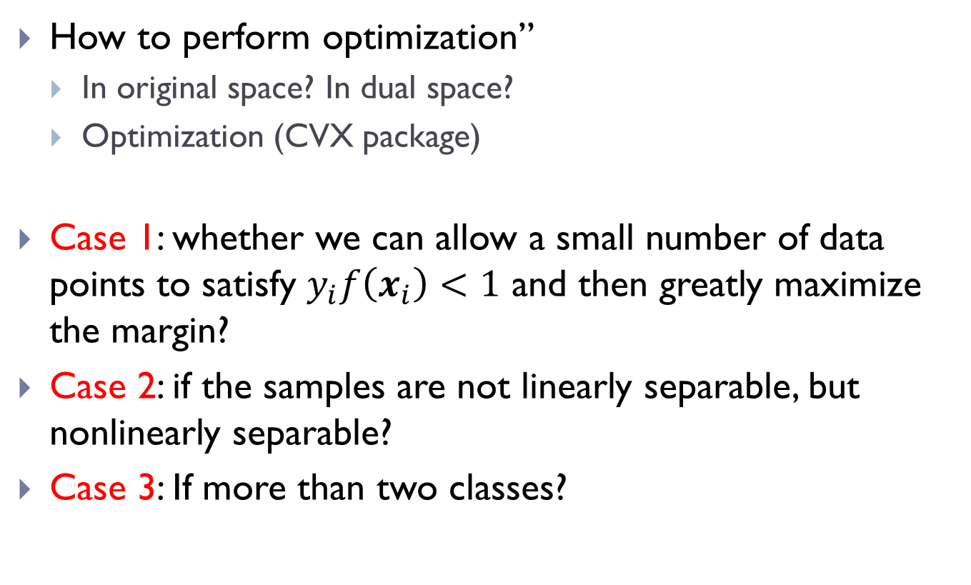
Remaining tasks
How to perform optimization”
In original space? In dual space?
Optimization (CVX package)
Case 1: whether we can allow a small number of data points to satisfy $y_{i}f\left(x_{i}\right)<1$ and then greatly maximize the margin?
Case 2: if the samples are not linearly separable, but nonlinearly separable?
Case 3: If more than two classes?

Slide 13
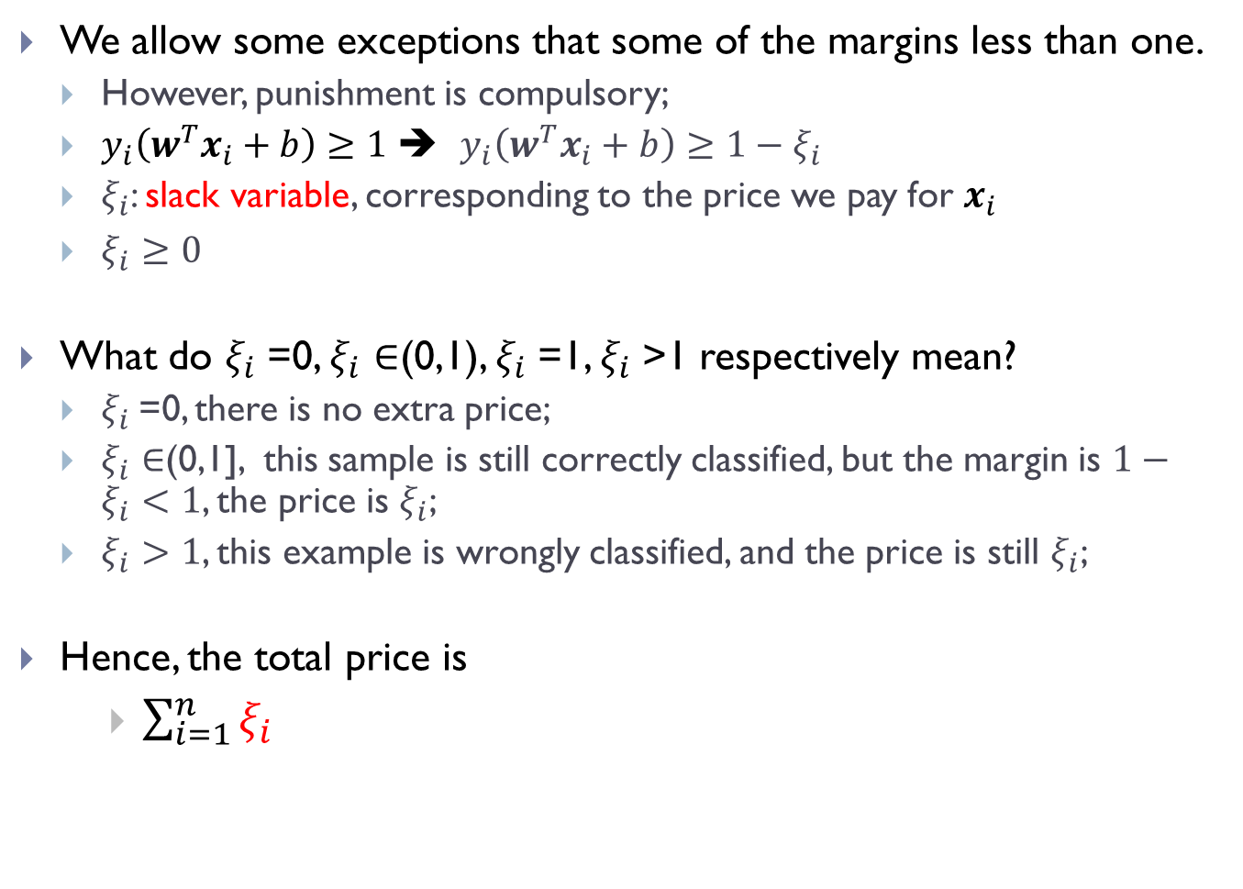
Soft margin
We allow some exceptions that some of the margins less than one.
However, punishment is compulsory;
$y_{i}\left(w^{T}x_{i}+b\right)≥1$ ➔ $y_{i}\left(w^{T}x_{i}+b\right)≥1−ξ_{i}$
$ξ_{i}$: slack variable, corresponding to the price we pay for $x_{i}$
$ξ_{i}≥0$
What do $ξ_{i}$=0, $ξ_{i}∈$(0,1), $ξ_{i}$=1, $ξ_{i}$>1 respectively mean?
$ξ_{i}$=0, there is no extra price;
$ξ_{i}∈$(0,1], this sample is still correctly classified, but the margin is $1−ξ_{i}<1$, the price is $ξ_{i}$;
$ξ_{i}>1$, this example is wrongly classified, and the price is still $ξ_{i}$;
Hence, the total price is
$\sum_{i=1}^{n}{ξ_{i}}$

Slide 14
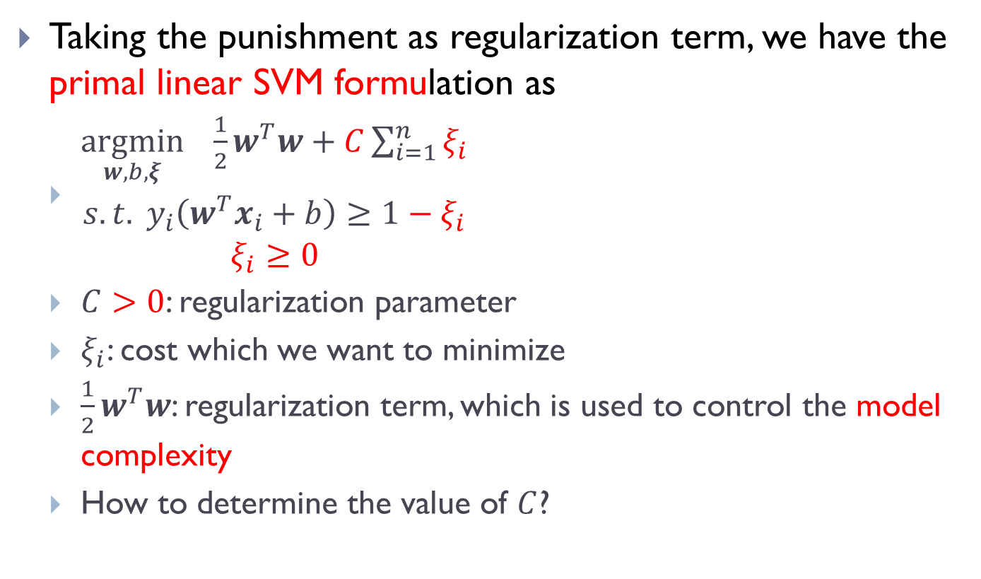
How to punish?
Taking the punishment as regularization term, we have the primal linear SVM formulation as
$\begin{matrix}\underset{w,b,ξ}{argmin}{ \frac{1}{2}w^{T}w+C\sum_{i=1}^{n}{ξ_{i}}} \\ \begin{aligned}s.t. y_{i}\left(w^{T}x_{i}+b\right)≥1−ξ_{i} \\ ξ_{i}≥0\end{aligned}\end{matrix}$
$C>0$: regularization parameter
$ξ_{i}$: cost which we want to minimize
$\frac{1}{2}w^{T}w$: regularization term, which is used to control the model complexity
How to determine the value of $C$?

Slide 15
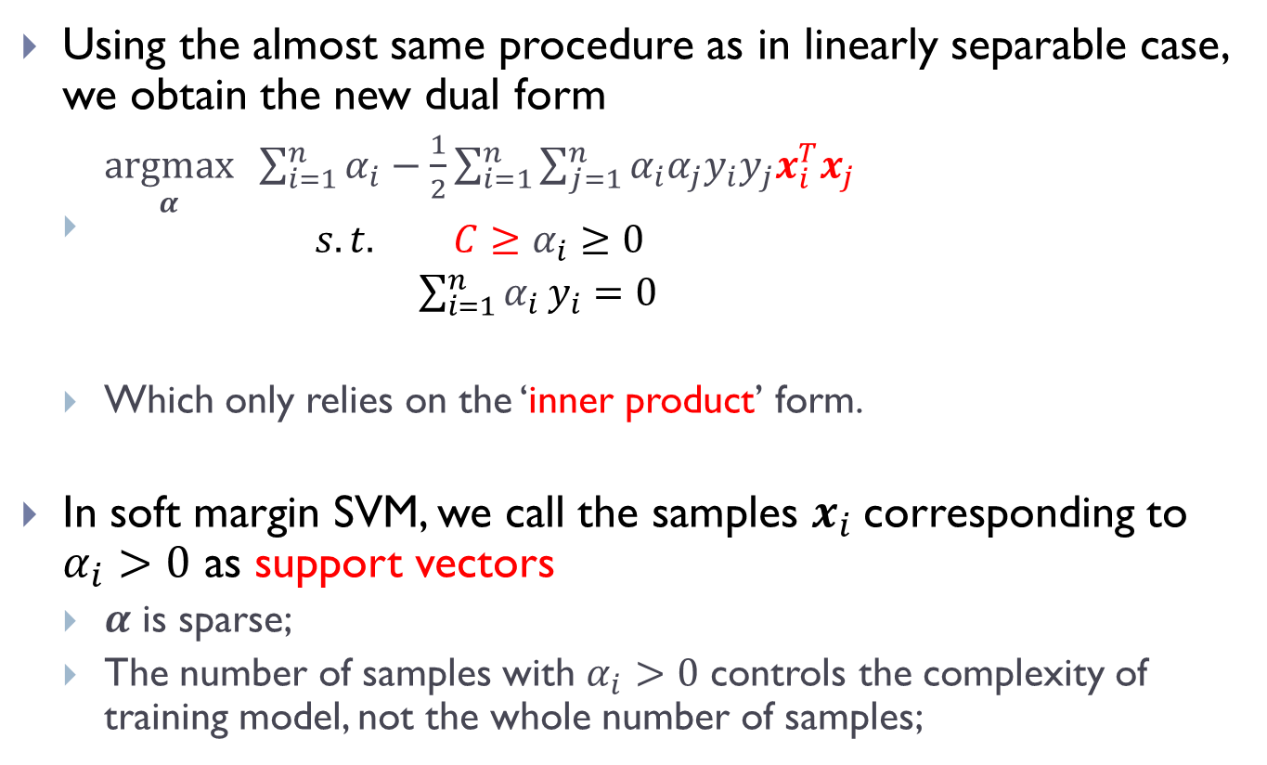
Soft margin: the dual form
Using the almost same procedure as in linearly separable case, we obtain the new dual form
$\begin{matrix}\underset{α}{argmax}{ \sum_{i=1}^{n}{α_{i}}−\frac{1}{2}\sum_{i=1}^{n}{\sum_{j=1}^{n}{α_{i}α_{j}y_{i}y_{j}x_{i}^{T}x_{j}}}} \\ \begin{aligned}s.t. {C≥α}_{i}≥0 \\ \sum_{i=1}^{n}{α_{i}}y_{i}=0\end{aligned}\end{matrix}$
Which only relies on the ‘inner product’ form.
In soft margin SVM, we call the samples $x_{i}$corresponding to $α_{i}>0$ as support vectors
$α$ is sparse;
The number of samples with $α_{i}>0$ controls the complexity of training model, not the whole number of samples;

Slide 16
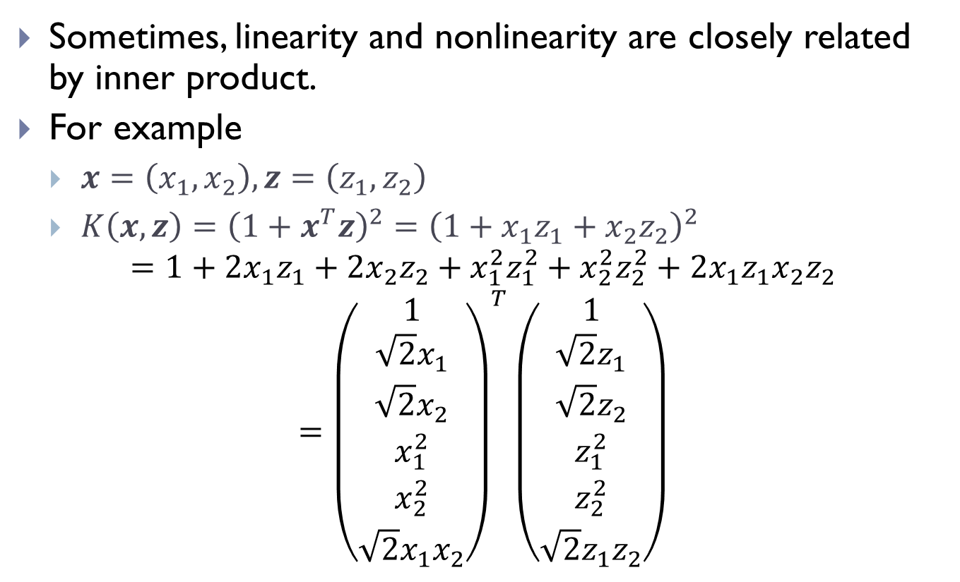
Inner product
Sometimes, linearity and nonlinearity are closely related by inner product.
For example
$x=\left(x_{1},x_{2}\right),z=\left(z_{1},z_{2}\right)$
$K\left(x,z\right)={\left(1+x^{T}z\right)}^{2}={\left(1+x_{1}z_{1}+x_{2}z_{2}\right)}^{2}$
$$=1+2x_{1}z_{1}+{2x}_{2}z_{2}+x_{1}^{2}z_{1}^{2}+x_{2}^{2}z_{2}^{2}+2x_{1}z_{1}x_{2}z_{2}$$
$$={\left(\begin{matrix}\begin{matrix}1 \\ \sqrt{2}x_{1} \\ \sqrt{2}x_{2}\end{matrix} \\ \begin{matrix}x_{1}^{2} \\ x_{2}^{2} \\ \sqrt{2}x_{1}x_{2}\end{matrix}\end{matrix}\right)}^{T}\left(\begin{matrix}\begin{matrix}1 \\ \sqrt{2}z_{1} \\ \sqrt{2}z_{2}\end{matrix} \\ \begin{matrix}z_{1}^{2} \\ z_{2}^{2} \\ \sqrt{2}z_{1}z_{2}\end{matrix}\end{matrix}\right)$$

Slide 17
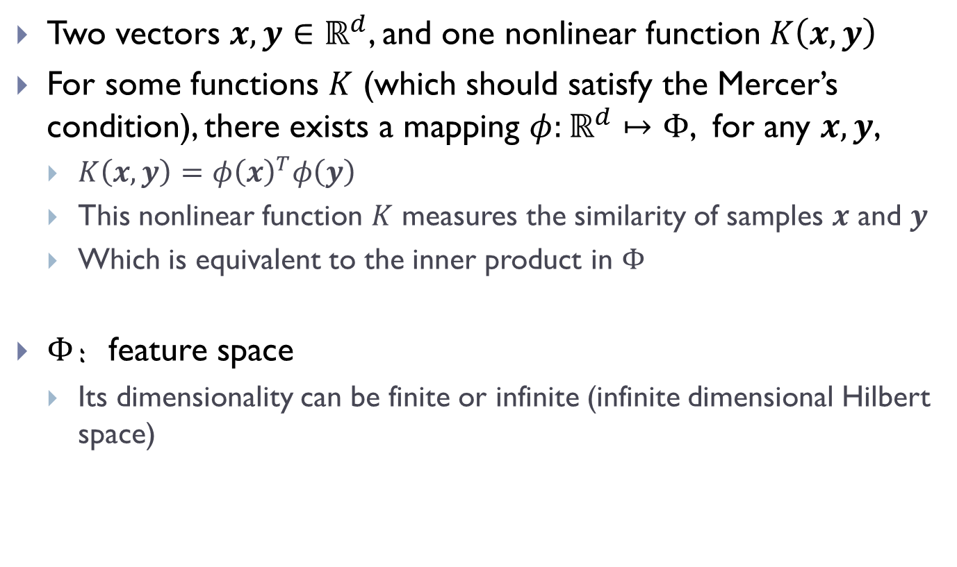
Kernel trick
Two vectors $x,y∈ℝ^{d}$, and one nonlinear function $K\left(x,y\right)$
For some functions $K$ (which should satisfy the Mercer’s condition), there exists a mapping $φ:ℝ^{d}↦Φ$, for any $x,y$,
$K\left(x,y\right)=φ{\left(x\right)}^{T}φ\left(y\right)$
This nonlinear function $K$ measures the similarity of samples $x$ and $y$
Which is equivalent to the inner product in $Φ$
$Φ$：feature space
Its dimensionality can be finite or infinite (infinite dimensional Hilbert space)

Slide 18
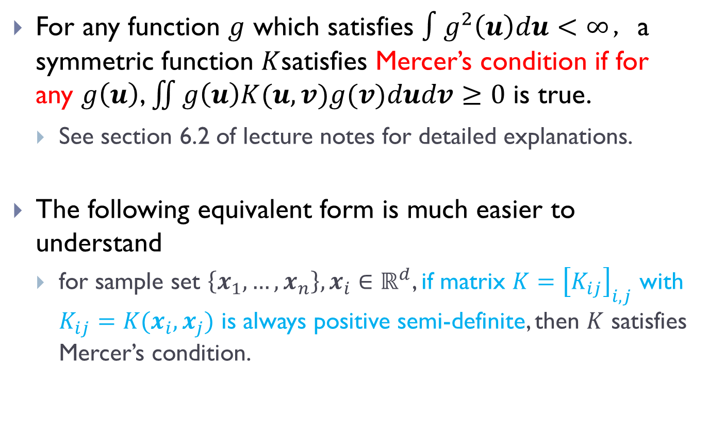
Mercer’s condition
For any function $g$ which satisfies $∫g^{2}\left(u\right)du<∞$，a symmetric function $K$satisfies Mercer’s condition if for any $g\left(u\right)$, $\iint{g\left(u\right)K(u,v)g(v)dudv}≥0$ is true.
See section 6.2 of lecture notes for detailed explanations.
The following equivalent form is much easier to understand
for sample set $\left\{x_{1},…,x_{n}\right\},x_{i}∈ℝ^{d}$, if matrix $K={\left[K_{ij}\right]}_{i,j}$ with $K_{ij}=K(x_{i}, x_{j})$ is always positive semi-definite, then $K$ satisfies Mercer’s condition.

Slide 19
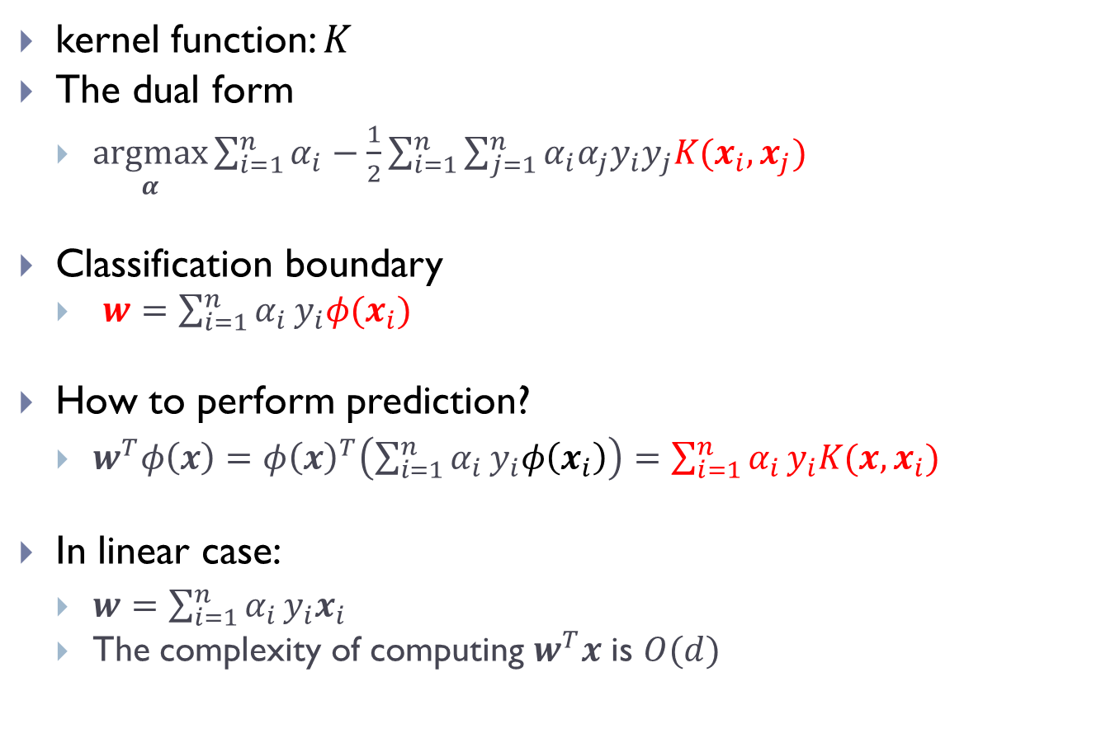
Kernel SVM
kernel function: $K$
The dual form
$\underset{α}{argmax}{\sum_{i=1}^{n}{α_{i}}−\frac{1}{2}\sum_{i=1}^{n}{\sum_{j=1}^{n}{α_{i}α_{j}y_{i}y_{j}K(x_{i},x_{j})}}}$
Classification boundary
$w=\sum_{i=1}^{n}{α_{i}}y_{i}φ(x_{i})$
How to perform prediction?
$w^{T}φ\left(x\right)=φ{\left(x\right)}^{T}\left(\sum_{i=1}^{n}{α_{i}}y_{i}φ\left(x_{i}\right)\right)=\sum_{i=1}^{n}{α_{i}}y_{i}K(x,x_{i})$
In linear case:
$w=\sum_{i=1}^{n}{α_{i}}y_{i}x_{i}$
The complexity of computing $w^{T}x$ is $O(d)$

Slide 20
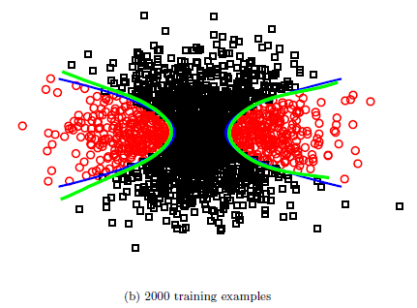
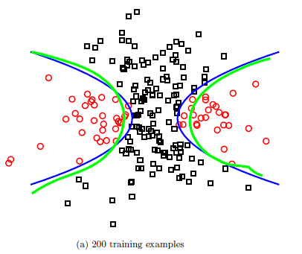

Nonlinear kernels
linear kernel, dot-product kernel：$K\left(x,y\right)=x^{T}y$
non-linear kernel
RBF(radial basis function)、Gaussian kernel:$K\left(x,y\right)=exp⁡(−γ{\left\|x−y\right\|}^{2})$
Polynomial kernel： $K\left(x,y\right)={\left(γx^{T}y+c\right)}^{d}$
The illustration of non-linear classifiers.

Slide 21
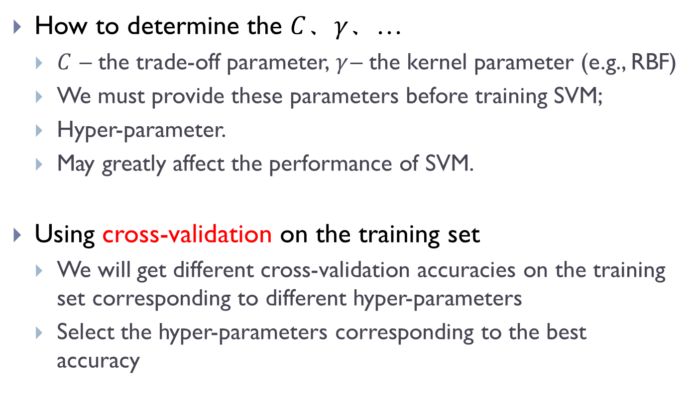
Hyperparameters
How to determine the $C$、$γ$、…
$C$ – the trade-off parameter, $γ$– the kernel parameter (e.g., RBF)
We must provide these parameters before training SVM;
Hyper-parameter.
May greatly affect the performance of SVM.
Using cross-validation on the training set
We will get different cross-validation accuracies on the training set corresponding to different hyper-parameters
Select the hyper-parameters corresponding to the best accuracy

Slide 22
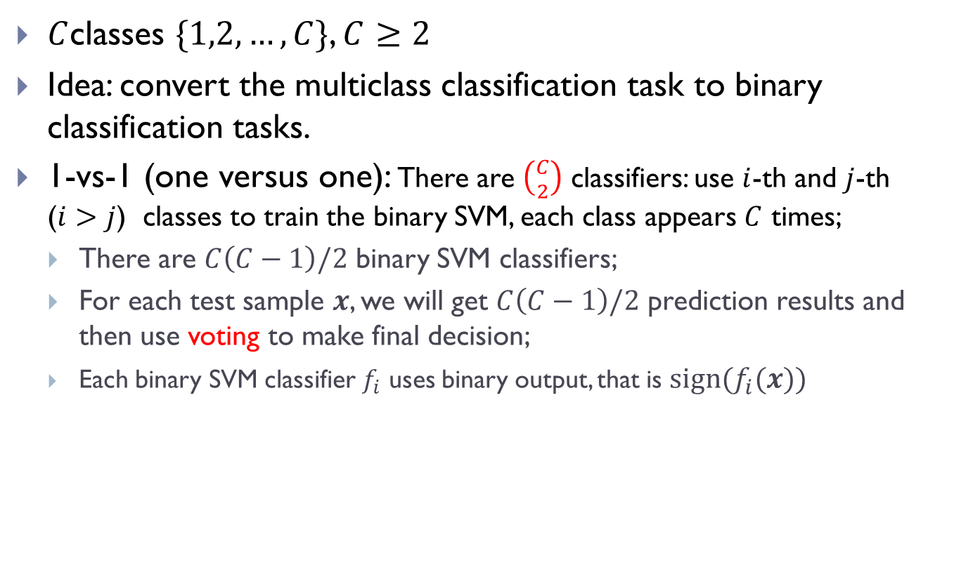
Multiclass SVMs
$C$classes $\{1,2,…,C\}$, $C≥2$
Idea: convert the multiclass classification task to binary classification tasks.
1-vs-1 (one versus one): There are $\left({C \atop 2}\right)$ classifiers: use $i$-th and $j$-th ($i>j$) classes to train the binary SVM, each class appears $C$ times;
There are $C\left(C−1\right)/2$ binary SVM classifiers;
For each test sample $x$, we will get $C\left(C−1\right)/2$ prediction results and then use voting to make final decision;
Each binary SVM classifier $f_{i}$ uses binary output, that is $sign(f_{i}(x))$
 | 1 | 2 | 3
1
2 | 1
3 | 1 | 3

Slide 23
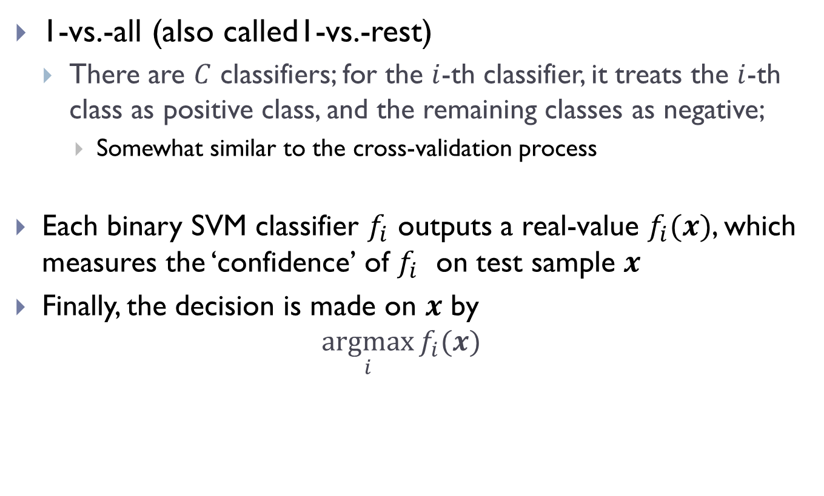
Multiclass SVMs
1-vs.-all (also called1-vs.-rest)
There are $C$ classifiers; for the $i$-th classifier, it treats the $i$-th class as positive class, and the remaining classes as negative;
Somewhat similar to the cross-validation process
Each binary SVM classifier $f_{i}$ outputs a real-value $f_{i}(x)$, which measures the ‘confidence’ of $f_{i}$ on test sample $x$
Finally, the decision is made on $x$ by
$$\underset{i}{argmax}{f_{i}(x)}$$

Slide 24
Appendix
Please check my lecture notes for details on the derivation or optimization on the SVM objective if you want to know more;
On its implementation:
LIBSVM is a widely used software package for learning kernel SVM classifiers and regressors. LIBSVM also has an accompanying page that collects datasets.
Download the LIBSVM software package from http://www.csie.ntu.edu.tw/~cjlin/libsvm/. Read the instructions and compile the software from the source code.
Thanks.

