Slide 1

Adaptive Prior-Dependent Correction Enhanced Reinforcement Learning for Natural Language Generation
Wei Cheng, Ziyan Luo#, Qiyue Yin∗
weicheng5993@foxmail.com, z5luo@ucsd.edu, qyyin@nlpr.ia.ac.cn
#Presenting author ∗Corresponding author

Slide 2
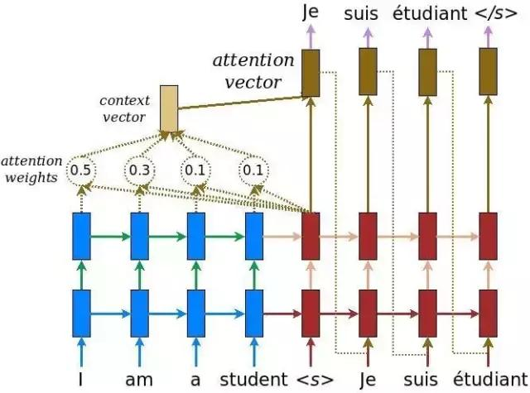
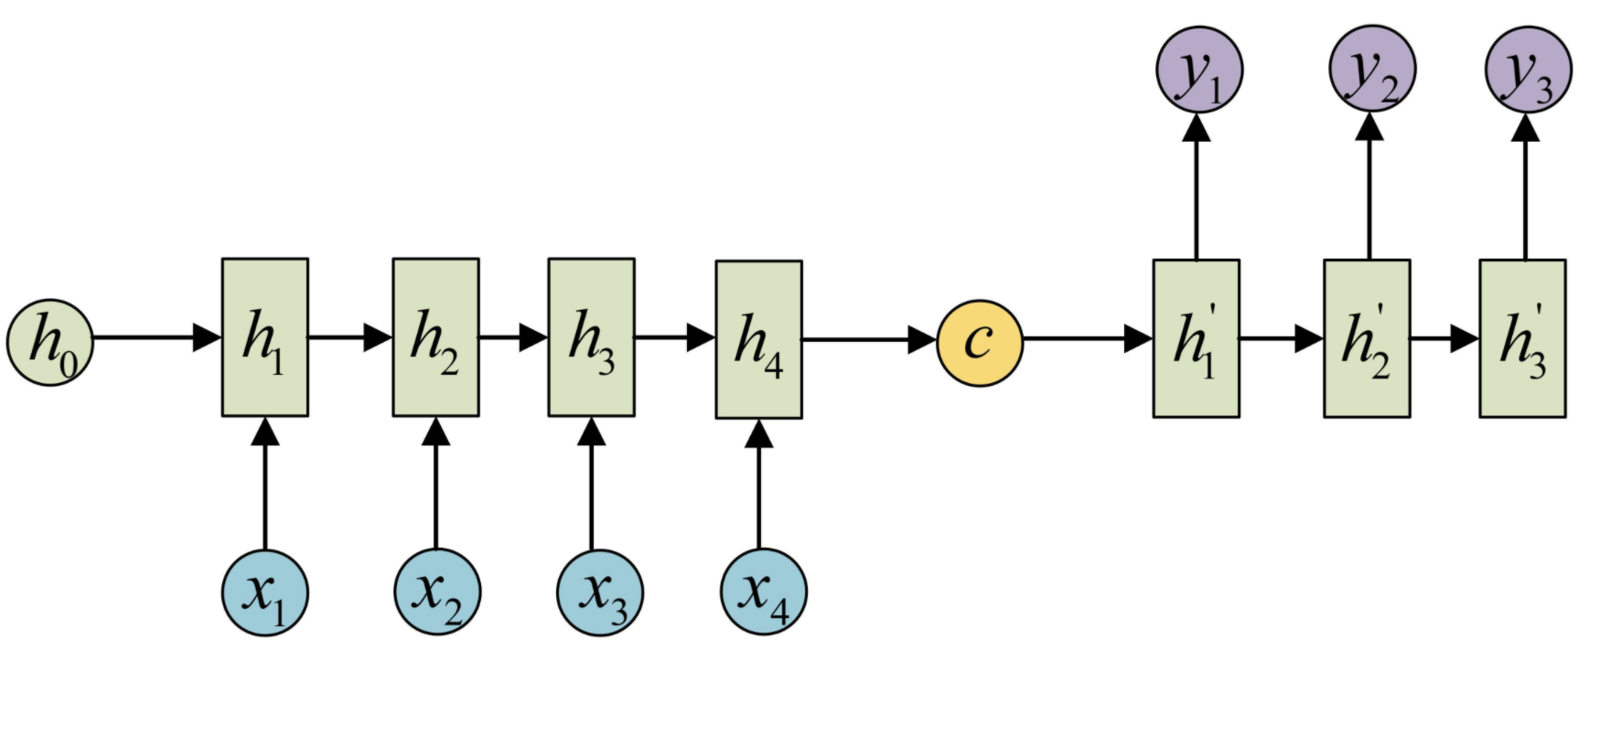
Natural Language Generation
Neural natural language generation (NLG) aims to generate a piece of new text
neural machine translation (NMT)
image captioning
text summarization
…
NLG models have recently shown remarkable progress in language fluency and coherence
We focus the training of Seq2Seq NLG models

Slide 3
Motivation
Advantages of RL-based methods:
using the current output as the input of next step
directly optimizing the evaluation metric
avoiding the issues of loss inconsistency and exposure bias
 | MLE | Other RL methods | Ours
loss inconsistency | √ | - | -
exposure bias | √ | - | -

Slide 4


RL for NLG
To address the loss inconsistency and exposure bias issues, reinforcement learning (RL) methods have been adopted to train NLG models
Formulation the problem as a Markov Decision Process
Agent (NLG models)
State
(Generated
Sentence)
Reward (BLEU)
Action
(Tokens)
Environment (Vocabulary, Source sentences)
MDP Formulation and trial-and-error learning

Slide 5
Motivation
Advantages of RL-based methods:
using the current output as the input of next step
directly optimizing the evaluation metric
avoiding the issues of loss inconsistency and exposure bias
However, the reward, such as BLEU/ROUGE, assign the same score to the different incorrect generated tokens, which is called deviation ignorance
 | MLE | Other RL methods | Ours
loss inconsistency | √ | - | -
exposure bias | √ | - | -
deviation ignorance | √ | √ | -

Slide 6
Deviation Ignorance
The models fail to understand how much the prediction distribution deviates from a prior distribution related to the ground-truth at token-level
The metrics such as BLEU and ROUGE assign the same scores for the totally different predictions
Ground Truth: “the boy is eating an apple”
Predictions:
“the kid is eating an apple” √
“the boy is having an apple” √
“the cat is eating an apple” ×
“the boy is eating an pear” ×
kid
label [ 0 , 1 , 0 , 0 , ···]
output [ 0.4 , 0.2 , 0.2 , ···]
boy cat
apple
label [ 0 , 1 , 0 , 0 , ···]
output [ 0.7 , 0.1 , 0.1 , ···]
pear fruit
Notes:
(always at the back of the sentence)

Slide 7
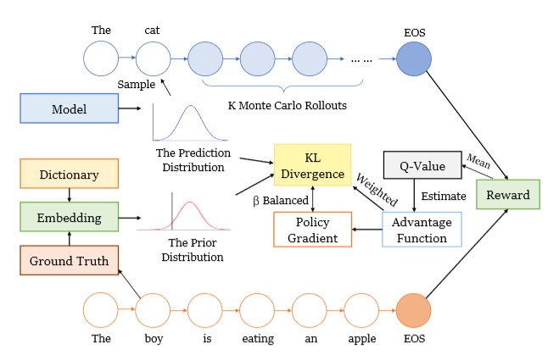

Methodology
APDC: To alleviate deviation ignorance issue, we enhance the RL objective with a KL term with an adaptive factor:
Adaptive Factor: negatively correlated to advantage function
The prior distribution:

Slide 8
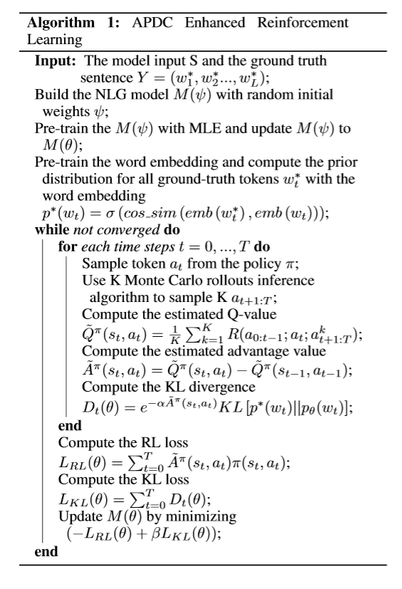


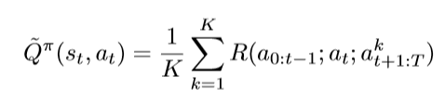
Methodology
APG: to reduce variance, we estimate the advantage function per step using the prior knowledge that the transition p(s’|s, a) is determined (≡1 if s’ is observed)
Leverage K Monte-Carlo rollouts to estimate Q-values

Slide 9
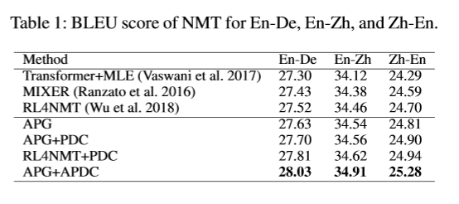
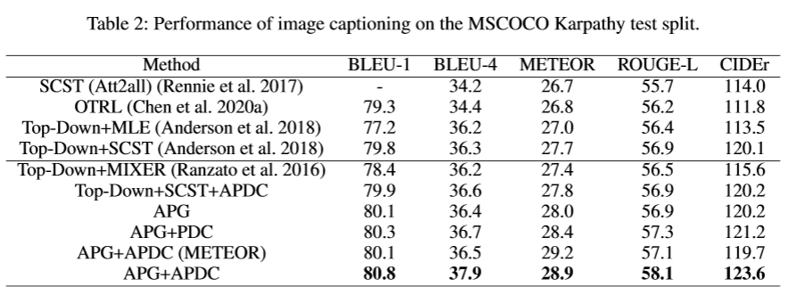
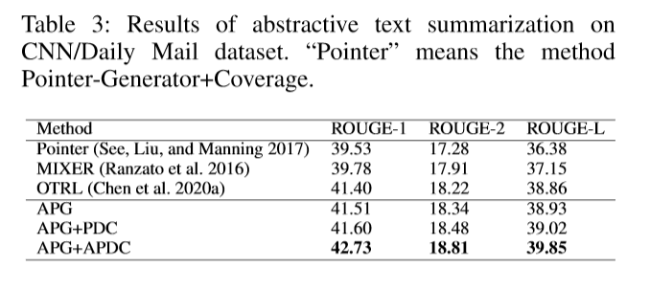
Experiments
We evaluate our algorithm in three tasks of NLG
Neural Machine Translation
Image Captioning
Abstractive Text Summarization

Slide 10
Experiments Comparison Approaches
APG performs better than other RL-based methods

Slide 11
Experiments
APDC can also enhance other RL-based methods
APDC performs better than PDC (APDC without adaptive mechanism)

Slide 12
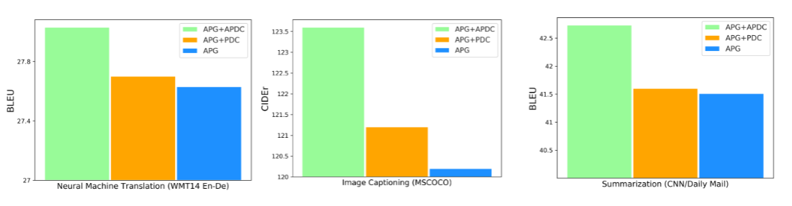
Experiments Ablation Study illustration
APG+APDC > APG+PDC > APG

Slide 13
Summary
Formulate the NLG problem as a Markov Decision Process and use an RL to solve the exposure bias and loss inconsistency issues
Propose a novel technique: adaptive prior-dependent correction to further address the deviation ignorance issue
Combine some advantage function estimation techniques
Enhancing APG with APDC can strike a balance between token-level and sequence-level optimization
Extensive experiments show that, on three tasks, our method consistently outperforms the state-of-the-art approaches

Slide 14
Thank you
for your careful listening!

