Slide 1



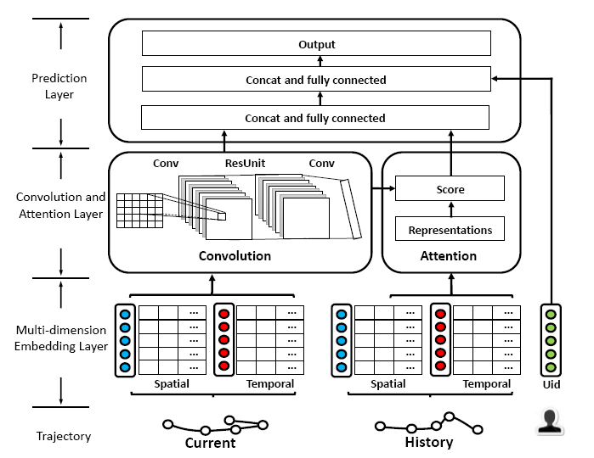
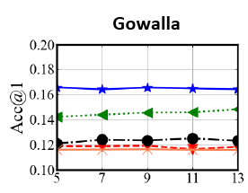
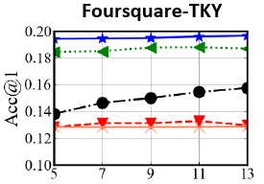
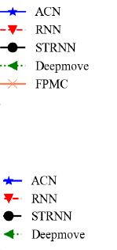
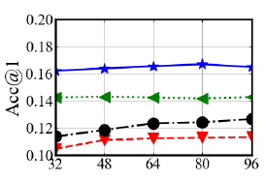
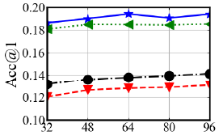
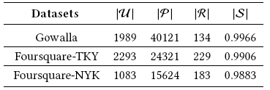

Predicting human mobility via Attentive Convolutional Network
Congcong Miao, Ziyan Luo, Fengzhu Zeng, Jilong Wang
Department of Computer Science & Technology, Tsinghua University, China
Institute for Network Sciences and Cyberspace, Tsinghua University, China
Beijing National Research Center for Information Science and Technology, China
Background & Motivations
Experiments & Results
Predicting human mobility is an important trajectory mining task for various applications, ranging from smart city planning to personalized recommendation system.
While most of previous works adopt GPS tracking data to model human mobility, the recent fast-growing geo-tagged social media (GTSM) data brings new opportunities to this task.
Three challenges predicting geo-tagged social media (GTSM) data: 1) extreme data sparsity; 2) high order sequential patterns of human mobility and 3) evolving preference of users for tagging.
The main motivation of our research is that the state-of-the-art models to predict human mobility are RNN based, which has many constraints.
Inspired by many methods in NLP and sequence modeling, we want to have a try with CNN.
Experiment 1: Our model vs. Baselines
Results shows that ACN consistently outperforms the existing state-of-art methods on a variety of common evaluation metrics.
Experiment 2: Impact of key hyperparameters
We exam the impact of the key hyperparameters one at a time by holding the remaining hyperparameters at the optimal settings.
Gowalla | MC | MF | FPMC | RNN
Acc@1 | 0.1151 | 0.0555 | 0.1163 | 0.1191
 | ST-RNN | Deepmove | Ours | Improve
Acc@1 | 0.1249 | 0.148 | 0.1668 | 12.70%
Foursquare TKY | MC | MF | FPMC | RNN
Acc@1 | 0.1281 | 0.1299 | 0.1281 | 0.1325
 | ST-RNN | Deepmove | Ours | Improve
Acc@1 | 0.1572 | 0.1881 | 0.1966 | 4.52%
Table 2: Performance comparison on public GTSM datasets.
Methods
Fig 3: Impact of key hyperparameters. (a) ACC@1 vs. the length of trajectory. (b) ACC@1 vs. the embedding size.
Experiment 3: Ablation study
We conduct experiments to analyze each component while keeping all hyperparameters at the optimal settings. ACN-s denotes ACN with ss-conv, ACN-d denotes ACN with dilated conv, ACN-no denotes ACN without ss-conv or dilated conv, ACN-sd denotes ACN with both dilated conv and ss-conv.
Fig 2: The Architecture of ACN.
We propose an attentive convolutional network (ACN) model to predict human mobility from sparse and complex GTSM data.
Specifically, we regard the embedded trajectory as an image and use convolution filters to search for sequential patterns as local features of the image.
We design HSC which is combined of Hybrid dilated convolutions and Shared and Separable Convolutions in convolution module.
The former increases the receptive fields exponentially to capture high order sequential patterns from lengthy trajectory, while the latter is a powerful degridding method to preserve local information consistency.
We propose using an attention mechanism to learn long-term preferences of users from history trajectory.
Gowalla | ACN-s | ACN-d | ACN-no | ACN-sd
Acc@1 | 0.1568 | 0.1563 | 0.1563 | 0.1668
macro-F1 | 0.0947 | 0.0944 | 0.0946 | 0.1047
Foursquare TKY | ACN-s | ACN-d | ACN-no | ACN-sd
Acc@1 | 0.1936 | 0.1931 | 0.1914 | 0.1966
macro-F1 | 0.0865 | 0.0876 | 0.0866 | 0.0888
Table 3: The contribution of ACN’s components.
Conclusion & Future work
We propose a novel solution to predict human mobility on sparse and complex GTSM data.
Our experiments on three GTSM datasets suggest ACN consistently outperforms the existing state-of-art methods on a variety of common evaluation metrics.
We want to conduct more experiments and focus more on the explainability of our model in the future.
Statistics of the dataset
Email: mcc15@mails.tsinghua.edu.cn

