Slide 1
Predicting Human Mobility via Attentive Convolutional Network
Congcong Miao, Ziyan Luo, Fengzhu Zeng, Jilong Wang
Department of Computer Science and Technology, Tsinghua University

Slide 2
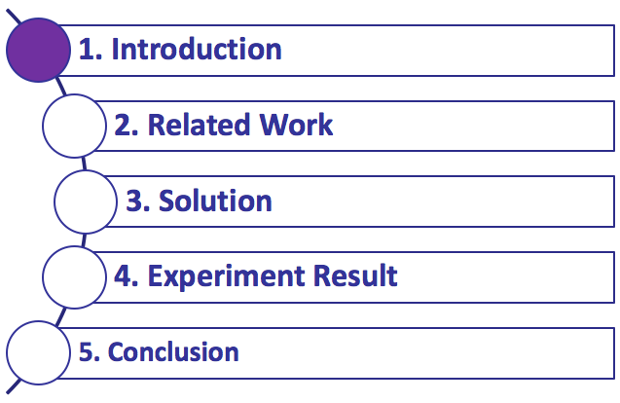

Slide 3
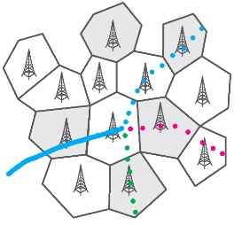

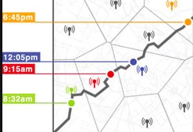
1. Introduction
Human mobility prediction is of great importance for various applications.
Intelligent traffic management
Smart city planning
Personalized recommendation
Mobility management
Estimating travel demand
Recommendation
Notes:
Human mobility prediction is of great importance for various applications, ranging from traffic management, city planning to personalized recommendation.

Slide 4
1. Introduction
Three unique characteristics on geo-tagged social media (GTSM) data
Extreme data sparsity: low-sampling and generated only when the users want to share their locations
High order sequential patterns: containing complex dependency relationships of human mobility and not all adjacent GTSM data has dependency relationships.
Evolving preference: human taste (i.e., long-term preference) for tagging is changing over time
Notes:
While most of previous works usually adopt the intensively collected GPS tracking data to predict human mobility, the GTSM data introduces three unique characteristics:
First, extreme data sparsity: the GTSM data is low sampling and generated only when users want to share their locations. Second, high order sequential patterns: Not all adjacent GTSM data has dependency relationships. For example, the user took a trip and tagged in airport, museum, bar and the Great Wall sequentially. The Great Wall is closely related to the airport and museum, while the bar is tagged only on a whim. Third, evolving preference for tagging: The general preference of a user for tagging is not static and keeps evolving over time.

Slide 5
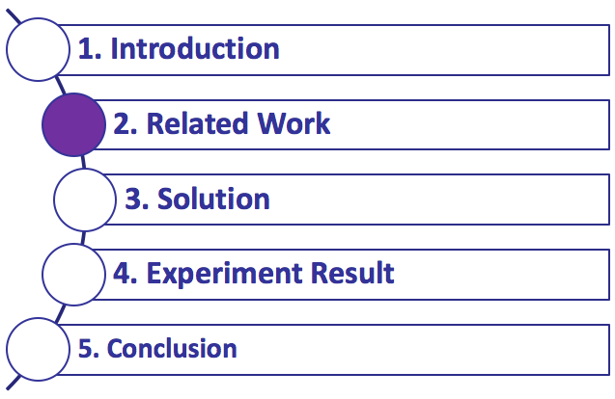

Slide 6
2. Related work
Human mobility prediction
Pattern based approach:
Matrix factorization (non-negative MF, WMF)
Tensor factorization (TF)
Ignore sequential transition regularities and long-term preference
Model based approach:
Markov models (MC, HMM)
Recurrent neural network (ST-RNN, DeepMove)
Unable to model high-order sequential pattern
Notes:
The previous works mainly focus on pattern-based approaches, such as MF and TF. However, they ignore sequential transition regularities that are critical for mobility prediction. The model-based approaches try to learn sequential models, such as Markov models and RNN. However, the GTSM data with high order sequential patterns brings big challenges.

Slide 7
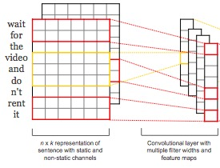
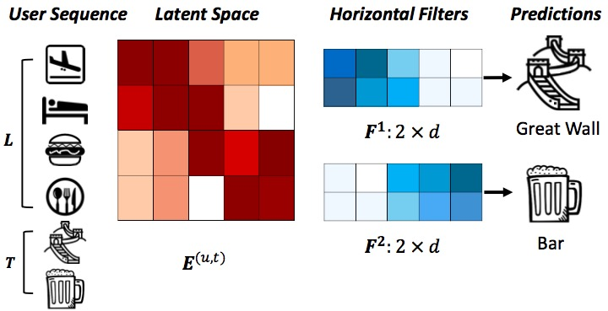
2. Related work
Convolutional Neural Network (CNN)
Sequential modeling
Natural language processing (NLP)
Item recommendation
NLP
Recommendation
Notes:
The convolutional neural network has subsequently been shown to be effective for sequential modeling, such as natural language processing and next item recommendation. The main process of these works is to map each word (or item) with a d-dimensional vector and represent a sequence with length L as an L times d “image”. Then convolution operation is applied to search for sequential patterns as local features of the image. Inspired by location embedding , we could regard a trajectory as an image and then search for sequential patterns using convolutional filters.

Slide 8
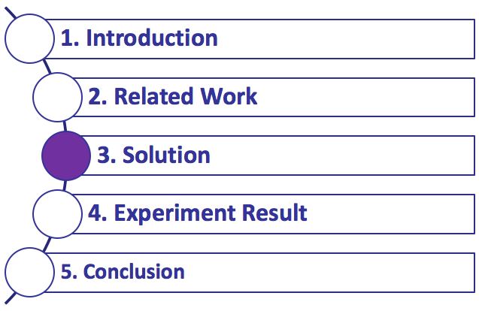

Slide 9
3. Solution
DEFINITION 1 (Trajectory Sequence)
We define a spatio-temporal point q as a tuple of location p and time t, e.g. q = (p,t). For a user ID u, trajectory sequence T is the aggregation of spatio- temporal points, i.e., Tu = q1q2···qn.
DEFINITION 2 (Trajectory)
Given a trajectory sequence Tu for a user u, trajectory is a subsequence of Tu. The k-th trajectory with length L can be represented as Tu,k = qkqk+1 ···qk+L-1.
Notes:
First, we collect all spatio-temporal points of a user to generate the Trajectory sequence and then transform it into subsequence to generate trajectory.

Slide 10
3. Solution
Problem description
Given the trajectory Tu,k, predict the next spatial context: Location.
The trajectory sequence of each person is divided into two parts: current trajectory and up-to-date historical trajectory
predict the next location of the current trajectory with the help of current trajectory and historical trajectory.
Notes:
Our problem can be regarded as predicting next Location. Specifically, the trajectory is divided into two parts: current trajectory and historical trajectory: predicting the next location of the current trajectory with the help of current and historical trajectory.

Slide 11



3. Solution
CNN based mobility prediction
Trajectory embedding → Trajectory map
Use convolution operation to search for sequential patterns as local features of the image.
Embedding
Concatenate
Spatial Channel
Trajectory
Temporal Channel
Two-channel trajectory image
Notes:
The main idea of our model is to generate a two-channel trajectory image through spatial and temporal embeddings, and then use convolution operation to search for sequential patterns as local features of the image.

Slide 12
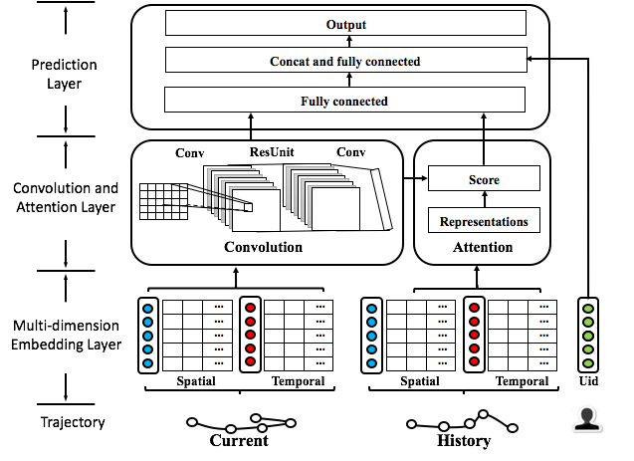
3. Solution
Architecture of attentive convolutional network (ACN)
Notes:
Our proposed attentive convolutional network consists of four major components: Multi-dimension Embedding Layer, Convolution module, Attention module and Prediction Layer.

Slide 13
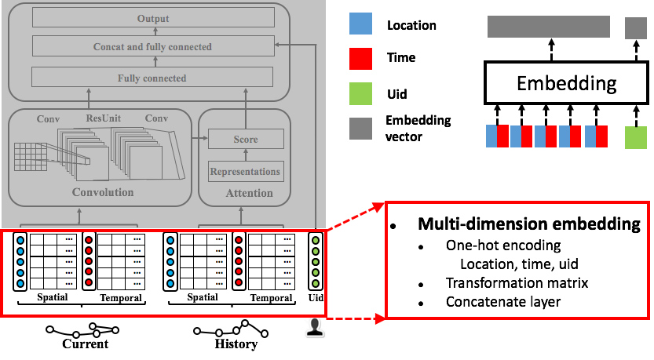
3. Solution
ACN—Multi-dimension Embedding
Notes:
In multi-dimension embedding layer, we first encode location, time and user id with one-hot vector, and then transform them into semantic dense representation by multiplying transformation matrix. Then the embedded spatio-temporal trajectory is concatenated to generate a two-channel trajectory map. The user of that trajectory is also embedded into a lower dimension vector.

Slide 14
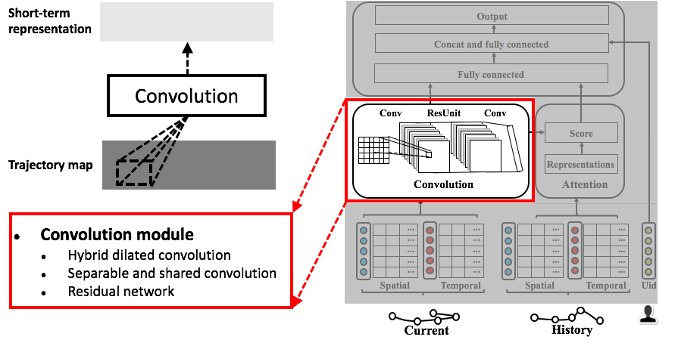
3. Solution
ACN—Convolution module
Notes:
The convolutional module takes the trajectory map as input and generates short-term representation as output using convolution operation. It is combined of several stacked residual units. In each residual unit, hybrid dilated convolutions and separable and shared convolutions are used to search for high order sequential pattern.

Slide 15
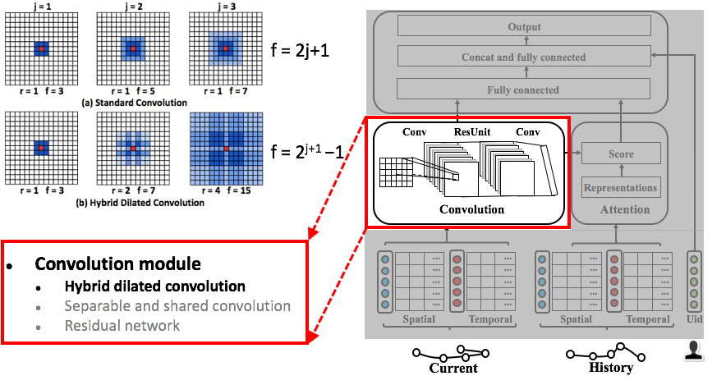
3. Solution
ACN—Convolution module
Notes:
The standard convolution filter is only able to increase receptive field f linearly with the depth j of network. This makes it difficult to handle lengthy trajectory since it uses pooling method in downsampling layer to expand receptive field which results in the reduction of sequential orders.

Slide 16
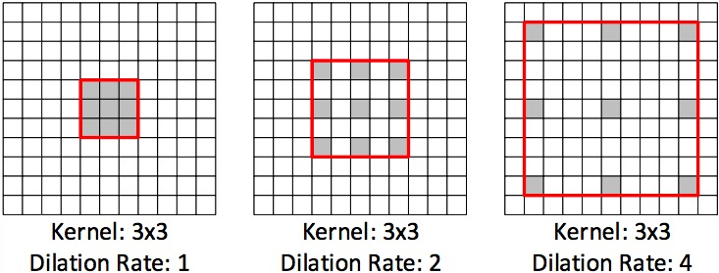
3. Solution
ACN—Convolution module
Notes:
The dilated convolution with a dilation rate r introduces r minus 1 zeros between the weights, thus it allows to adaptively change the receptive fields by changing the rate value. Therefore, hybrid dilated convolution allows for exponential increases of receptive fields if the dilation rates of consecutiveconvolution layers are set to 1, 2, 4 respectively. We can effectively capture sequential patterns even if the trajectory is lengthy.

Slide 17
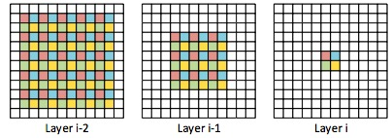
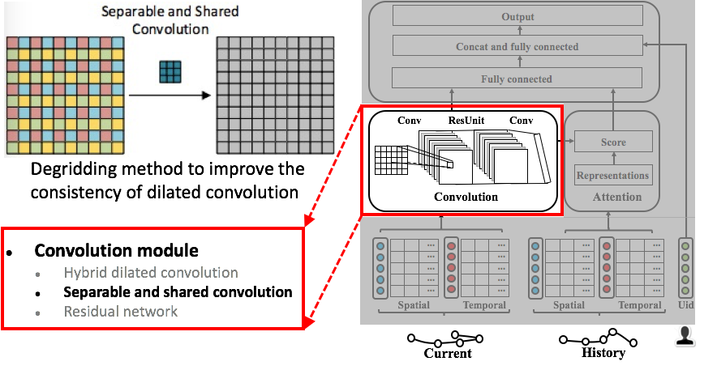
3. Solution
ACN—Convolution module
An illustration of gridding artifacts. Dilated convolutions with kernel size of 3 × 3 and a dilation rate of r = 2
Notes:
However, directly using dilated convolution may result in the so-called “gridding artifacts” which means that adjacent units in the output are computed from completely separate sets of units in the input.

Slide 18
3. Solution
ACN—Convolution module
Notes:
In order to alleviate the gridding artifacts, we adopt separable and shared convolution, which incorporates the local information with a group interaction layer, to smooth the dilated convolution and improve the consistency of dilated convolution .

Slide 19
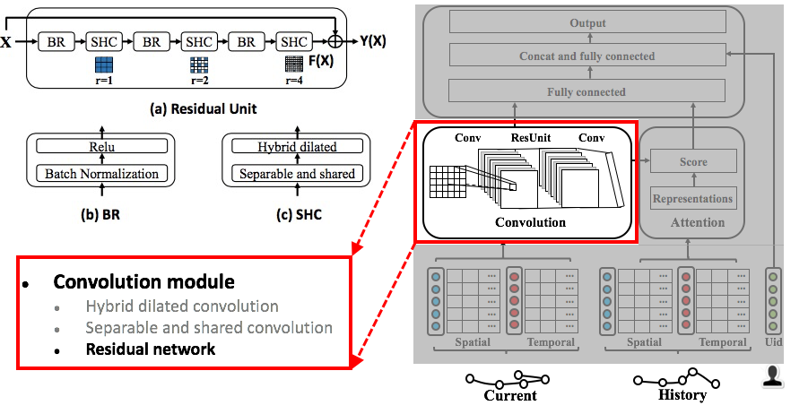
3. Solution
ACN—Convolution module
Shortcut
Notes:
However, increasing the depth of network layers may result in the vanishing gradient problem. To avoid this problem, residual learning has been proposed for deep networks. Each residual unit is combined of few stacked convolution layers as a building block and a shortcut connection which directly links input to the output of the stacked layers. For each building block in the residual unit, there are three consecutive dilated convolution layers with different dilation rates. Furthermore, we use batch normalization and ReLU function to accelerate training process.

Slide 20
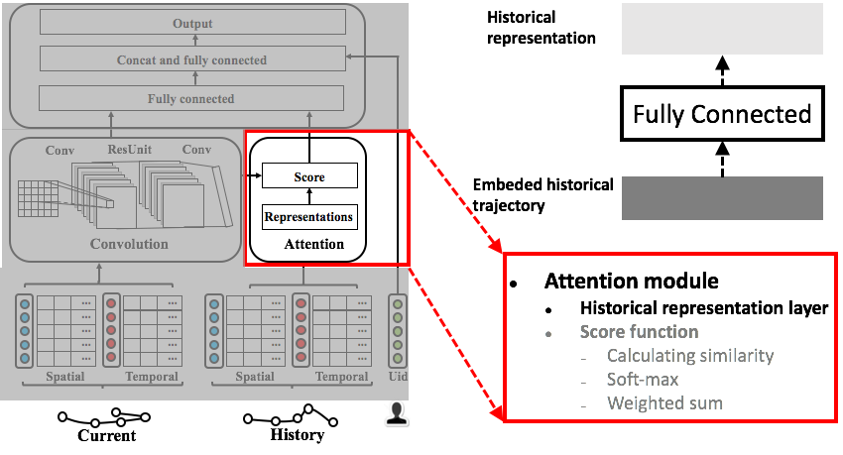
3. Solution
ACN—Attention module
Notes:
Despite the good learning of convolution module to model short-term sequential patterns, it is unable to capture the user long-term preferences. We propose to use attention mechanism to augment deep neural networks in capturing long-term dependencies.
We take the embedded up-to-date historical trajectory as input and generate history representations with fully connected module.

Slide 21
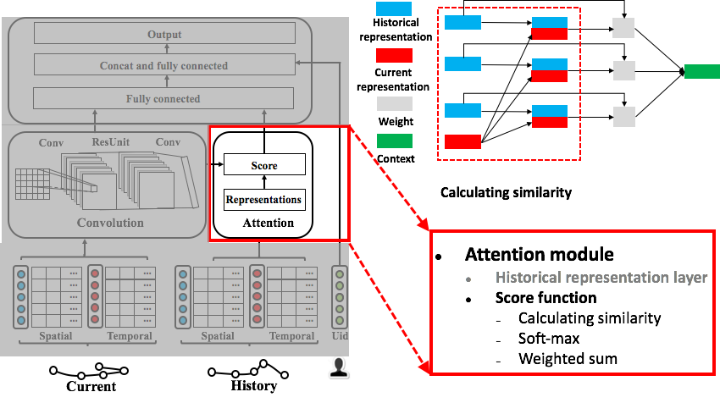
3. Solution
ACN—Attention module
Notes:
Then it takes the history representations as the input and computes the similarity of historical representations when queried by current representation from convolution module to generate an attention weight. Note, the dimension of historical representations and current representation should be the same.

Slide 22
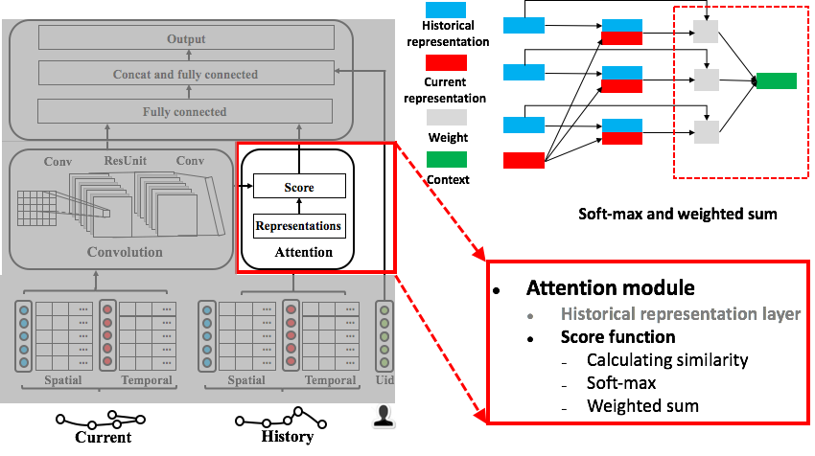
3. Solution
ACN—Attention module
Notes:
Then, it normalizes the attention weight by soft-max function and computes user long-term context as a sum of historical representations weighted by the normalized weight.

Slide 23
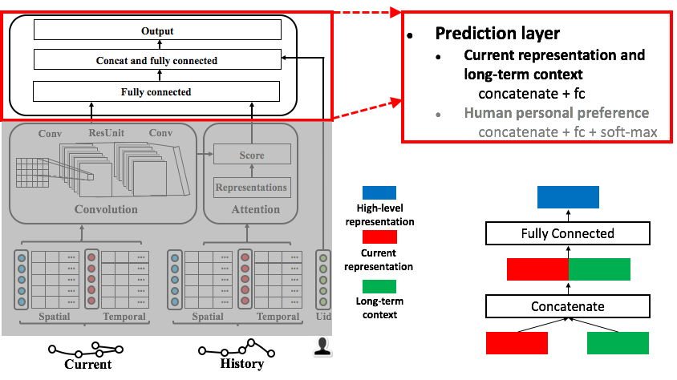
3. Solution
ACN—Attention module
Notes:
The prediction layer mainly consists of two concat and fully connected modules. In the first module, the current representation and long-term context are concatenated and fed into a fully connected layer to get more high-level representations.

Slide 24
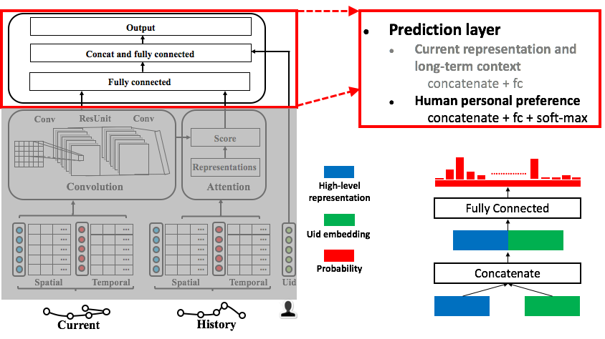
3. Solution
ACN—Attention module
Notes:
The second module considers human personal preference. The embedded user id and high-level representations are concatenated and then we project them into an output layer associated with the probability of each location to conduct prediction.

Slide 25
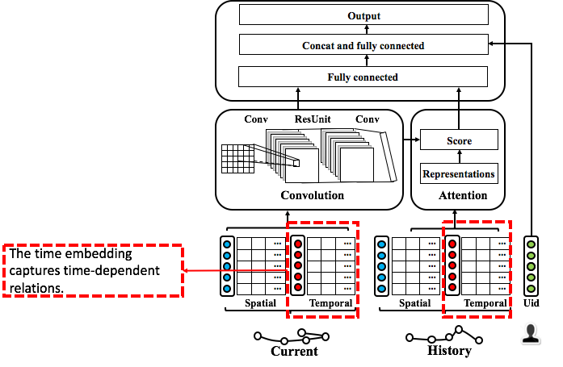
3. Solution
ACN
Notes:
Our ACN module consider time embedding to capture time-dependent relations.

Slide 26
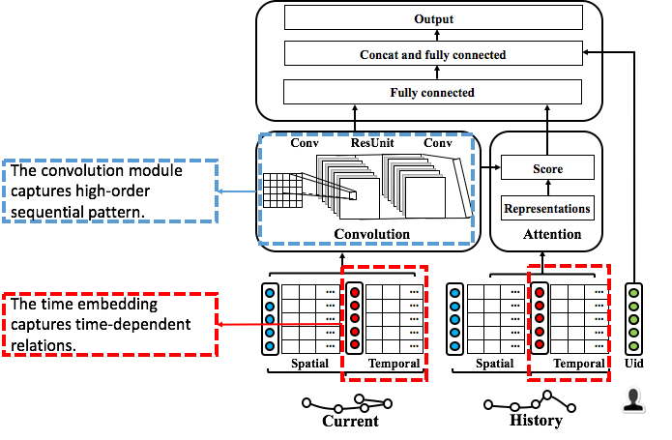
3. Solution
ACN
Notes:
The convolution module is used to capture high-order sequential pattern.

Slide 27
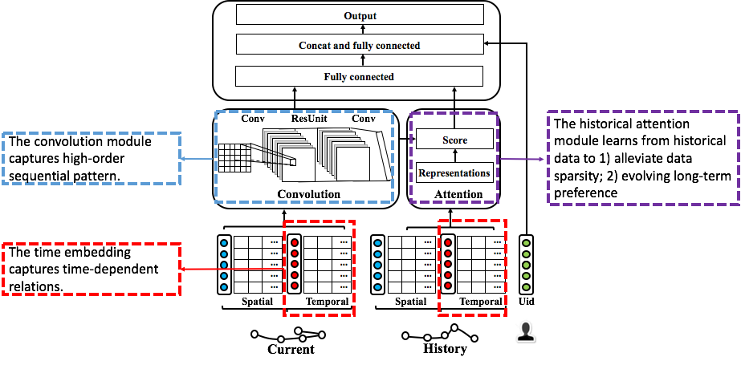
3. Solution
ACN
Notes:
The historical attention module learns from historical data to not only alleviate data sparsity, but also capture evolving long-term preference

Slide 28
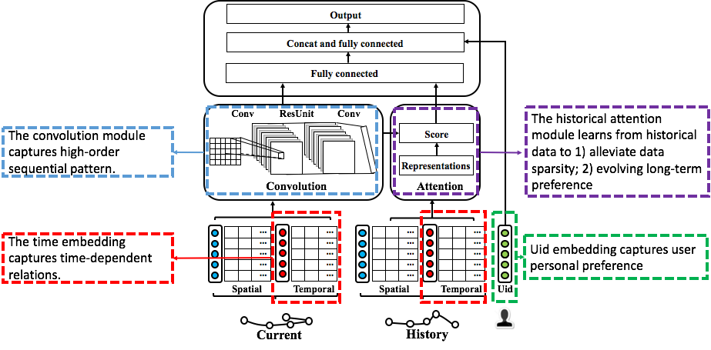
3. Solution
ACN
Notes:
We further consider uid embedding to capture user personal preference

Slide 29
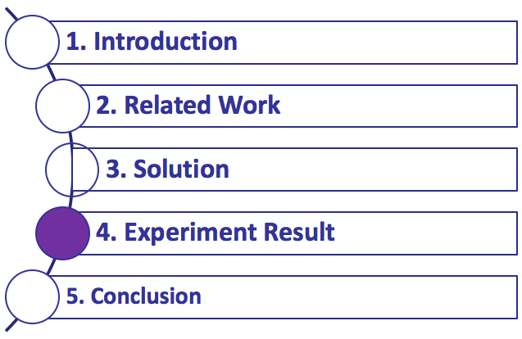

Slide 30
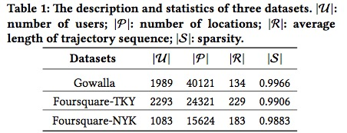
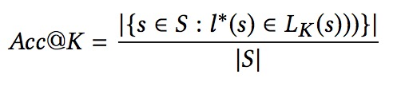

4. Experiment Results
Dataset:
Evaluation metric:
Notes:
We conduct experiments on the three publicly available GTSM datasets, as shown in the table.
We use two evaluation metrics Acc@K, a ranking based accuracy which is considered “correct” if the ground truth location lies within the top-k results, and macro-F1, a harmonic mean of the precision and recall.

Slide 31
4. Experiment Results
Baselines:
Traditional:
MC: widely used mobility model working with state transition matrix
MF: factorizes users-locations matrix to generate user general preferences
FPMC: subsumes both MC and MF for mobility prediction.
RNN-based:
RNN: a basic deep neural network for sequential modeling
ST-RNN: extends RNN to model continuous spatio-temporal contexts
Deepmove: an enhanced version of RNN with history attention mechanism
Notes:
We compare ACN with classic methods, markov chain, matrix factorization and Factorization personal markov chain and recent state-of- art RNN models, including extends of RNNk,such as spatio-temporal RNN and attentional RNN.

Slide 32
4. Experiment Results
Experiment design:
Question1: what is the performance of our model as compared to other state-of-art methods?
Question2: what is the effect of the key hyper-parameters, such as length of trajectory and embedding size?
Question3: what is the influence of each of ACN’s components?
Notes:
Our experiments are designed to answer the following research questions: 1) what is the performance of our model as compared to other state-of-art methods? 2) what is the effect of the key hyper-parameters, such as length of trajectory and embedding size? 3) what is the influence of each of ACN’s components?

Slide 33
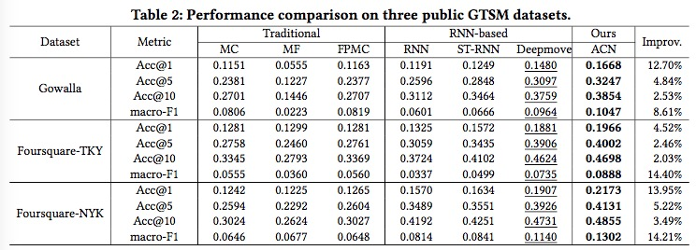
4. Experiment Results
Question1:
Traditional < RNN-based < CNN
Notes:
As for question one, RNN-based approaches outperform the traditional approaches, because of its powerful sequence modeling ability. Our model use CNN to capture high order sequential patterns and takes advantage of attention mechanism to capture long-term dependencies. Therefore, ACN outperforms all the competitors with significant advantages.

Slide 34
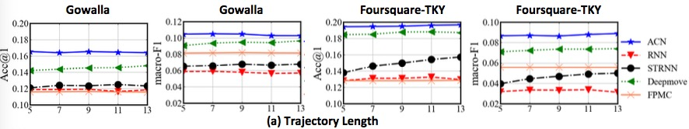
4. Experiment Results
Question2:
Our model outperforms all other baselines on all lengths of trajectory.
The metrics Acc@1 and macro-F1 increase when the length of trajectory increases, however decrease when the trajectory becomes longer. This can be explained by the reason that for extremely sparse dataset, a longer trajectory tends to introduce extra information and more noises.
Notes:
As for question two, we exam the impact of length of trajectory and embedding by holding the remaining hyperparameters at the optimal settings. We observe that our model outperforms all other baselines on all lengths of trajectory. The values of metrics increase when the length of trajectory increases, however decrease when the trajectory becomes longer. This can be explained by the reason that for extremely sparse dataset, a longer trajectory tends to introduce extra information and more noises.

Slide 35
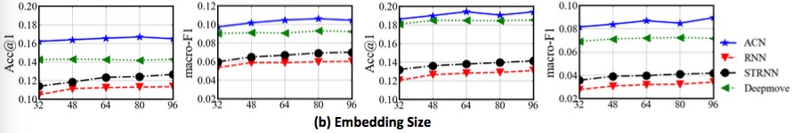
4. Experiment Results
Question2:
Our proposed model consistently outperforms all other baselines on all embedding sizes.
A larger embedding size does not necessarily lead to better performance because of overfitting issue. A model achieves its best performance when dimension size is properly chosen.
Notes:
As for embedding size, similarly, our model consistently outperforms all other baselines on all embedding sizes.

Slide 36
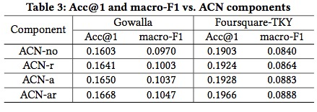
4. Experiment Results
Question3:
For x ∈ {no, a, r , ar }, ACN-x denotes ACN with component x enabled where a denotes attention mechanism and r denotes residual network.
ACN-ar achieves the best performance by jointly using all parts of ACN.
Notes:
As for question three, we consider each component in our model. We firstly consider the component attention mechanism and residual network. We observe ACN-ar achieves the best performance by jointly using all parts of ACN.

Slide 37
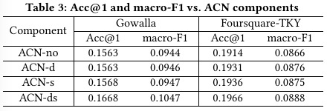
4. Experiment Results
Question3:
For x ∈ {no, d, s, ds }, ACN-x denotes ACN with component x enabled where d denotes hybrid dilated convolution and s denotes separable and shared convolution.
ACN-ds achieves the best performance by jointly using all parts of ACN.
Notes:
Similarly, we consider the convolutions in residual network: hybrid dilated convolution and separable and shared convolution. We observe ACN-ds achieves the best performance by jointly using all parts of ACN.

Slide 38
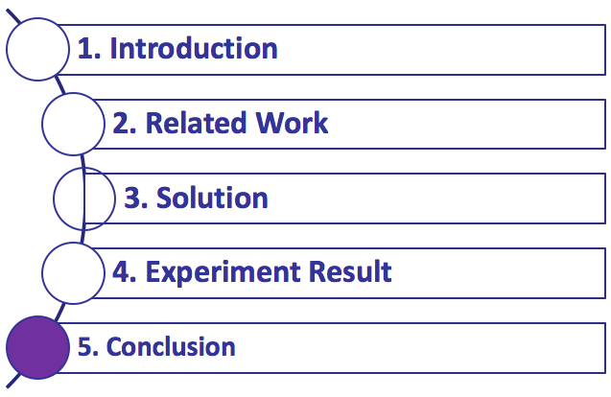

Slide 39
5. Conclusion
We are firstly to propose a novel attentive convolutional network on sparse GTSM data
Regard the embedded trajectory as an image, using convolution filters to search for sequential patterns as local features of the image.
Design HSC which is combined of Hybrid dilated convolutions and Separable Convolutions to model high-order sequential patterns.
Use an attention mechanism to learn long-term preferences of users from history trajectory.
Interesting future directions
Consider external feature like Point of interest and tweets to conduct semantic mobility prediction.
Notes:
We are firstly to propose a novel attentive convolutional network on sparse GTSM data. We regard the embedded trajectory as an image, using convolution filters to search for sequential patterns. And then we design Hybrid dilated convolutions and Separable Convolutions to model high-order sequential patterns and use an attention mechanism to learn long-term preferences of users from history trajectory.
In future work, we are considering external feature like Point of interest and tweets to conduct semantic mobility prediction.

Slide 40
Thanks！

