Slide 1



Match Plan Generation in Web Search with Parameterized Action Reinforcement Learning
Ziyan Luo∗, Linfeng Zhao∗, Wei Cheng∗, Sihao Chen, Qi Chen, Hui Xue,
Haidong Wang, Chuanjie Liu, Mao Yang, Lintao Zhang
discat@foxmail.com, zhao.linf@northeastern.edu, weicheng5993@foxmail.com, sihao@berkeley.edu
{cheqi,xuehui,haidwa,chuanli,maoyang,lintaoz}@microsoft.com
∗Equal Contribution

Slide 2

Introduction
The application of RL on match plan generation problem in Microsoft Bing Inverted Index system
Aims:
1. Good result quality
2. Short query response time
Search engines use match plans to help retrieve relevant documents from billions of web pages
Microsoft Bing

Slide 3
Match Plan Plays critical role in Web Search
Help to retrieve top candidates in milliseconds.
Decide the resource allocation for a query.
Make the trade-off between relevance and efficiency.
It’s a secret for search companies.
No publication, no open source.
Open toolkits (e.g. Lucene, Elasticsearch) do not have similar strategy.

Slide 4
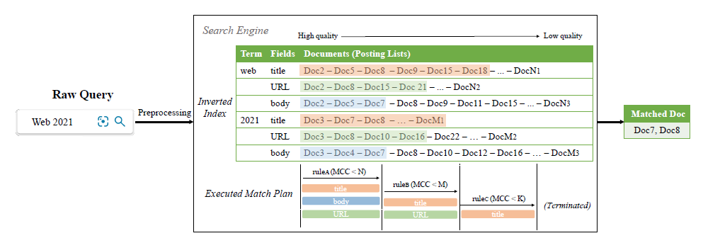
Introduction
After preprocessing, multiple posting lists representing different terms and fields are retrieved from the inverted index in which documents are organized in the descending order of quality.
The search engine scans the posting lists by executing a match plan which is composed of a sequence of match rules.
A match rule defines how the search engine matches documents over a period of time.
It is made up of a discrete match rule type (e.g.𝑟𝑢𝑙𝑒_{𝐴}) and several continuous stopping quotas (e.g. 𝑀𝐶𝐶<𝑁, where “MCC” stands for matched candidate count).
Different match rules have different execution costs.

Slide 5
Why generating match plans is hard?
Need a learning method to dynamically generate corresponding match plan for each query.
The complexity of the system environment
Increasing number of match rule types and quota types
Diverse data distribution across a large number of machines
Frequent updates of documents
Static design cannot dynamically revise the match plan
Multiple objects optimization (e.g. NDCG, latency)
Sequence decision making (instead of one-time decision)
Apply in thousands of machines and should be very fast
Notes:
2.
a mass amount of web documents are distributed over many machines and the data distribution of the Inverted Index varies a lot among different machines.

Slide 6
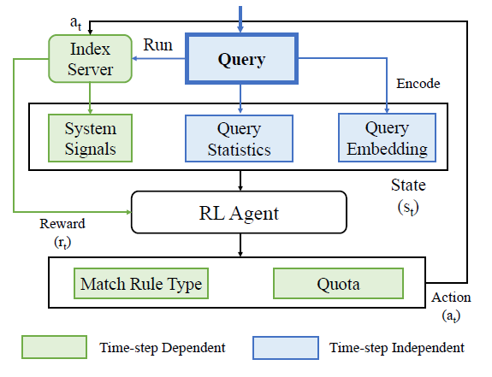


Problem Formulation
A POMDP, a tuple: (S,A,P,R,Ω,O,γ)
State:
Intermediate Signals fetched from Bing’s system (few)
Query Embeddings
Action: (why to use such formulation?)
Discrete: m types of predefined match rules + Stop
Continuous (shared): n dims of Quotas
Reward: a scalar function weighted by:
Performance: “Relevance Scores” (RS) of top k matched documents (From Bing’s server)
Latency: “Index Block Accesses” (IBA) of the match plan in the system
Environment: Bing’s index server (wrapped)

Slide 7
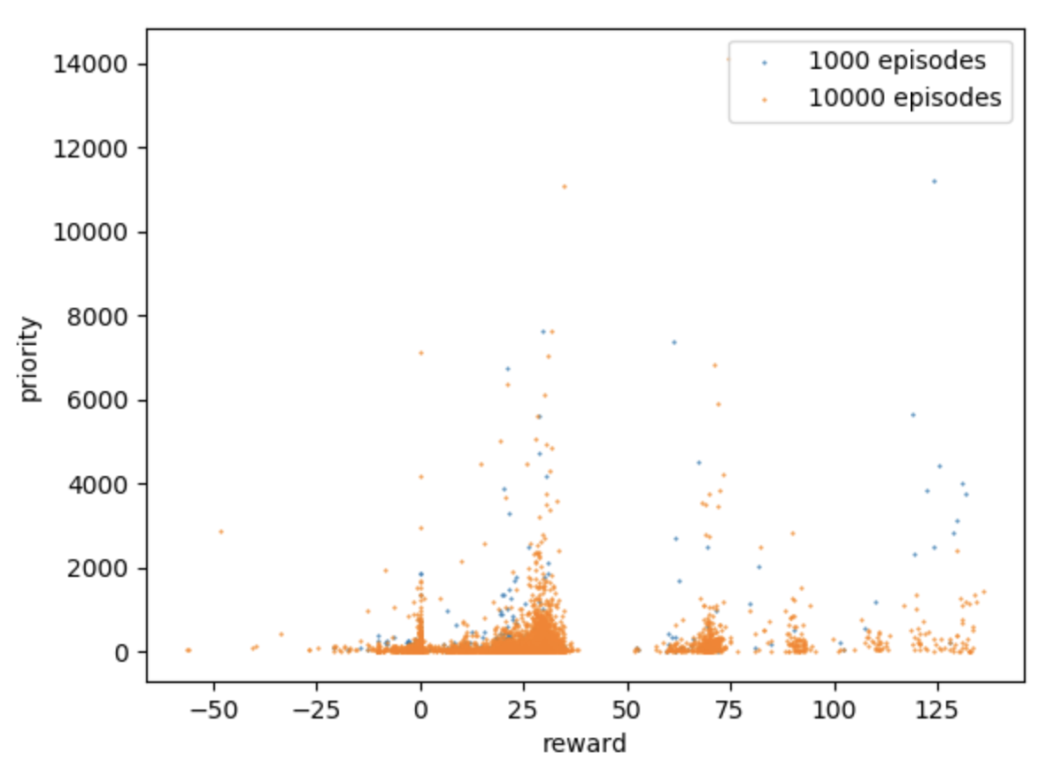
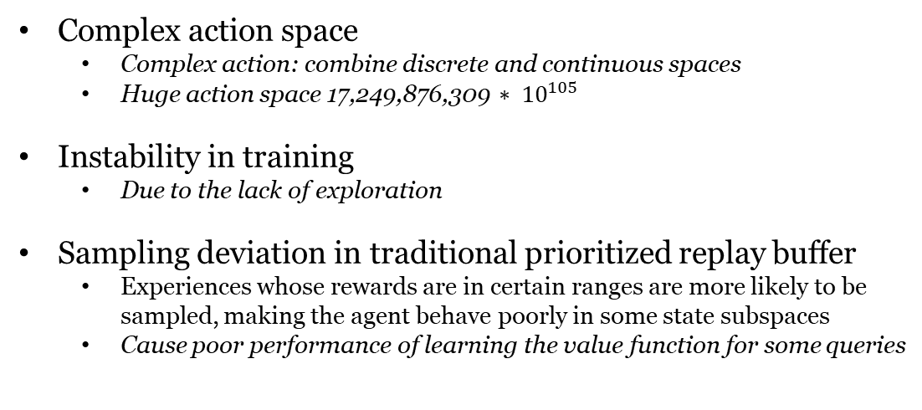
Could We Use Existed RL Algorithm?
Algorithm | DQN | TD3 | SAC | PA-DDPG | What we expect
Discreate action | √ | × | √ | √ | √
Continuous action | × | √ | √ | √ | √
Discreate & Continuous action | × | × | × | √ | √
Stability | × | × | √ | × | √
Performance (better than production) | × | √ | √ | × | √
Complex action space
Complex action: combine discrete and continuous spaces
Huge action space 17,249,876,309 $∗ {10}^{105}$
Instability in training
Due to the lack of exploration
Sampling deviation in traditional prioritized replay buffer
Experiences whose rewards are in certain ranges are more likely to be sampled, making the agent behave poorly in some state subspaces
Cause poor performance of learning the value function for some queries
high priority
high priority
Figure 4. The deviation in original PER.

Slide 8
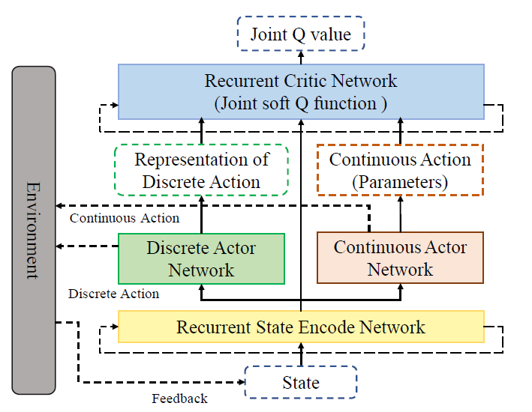



Parameterized Action Soft Actor-Critic
Challenges
Parameterized action space
Complex environment, large state/action space
Sparse reward, partial observability
PASAC:
1. Optimize a stochastic policy of the complete action: discrete match rules (Categorical dist.) and continuous quotas (Gaussian dist.), meanwhile maximize both entropies
2. Soft Q network: estimate a joint soft Q-value function for the complete action

Slide 9
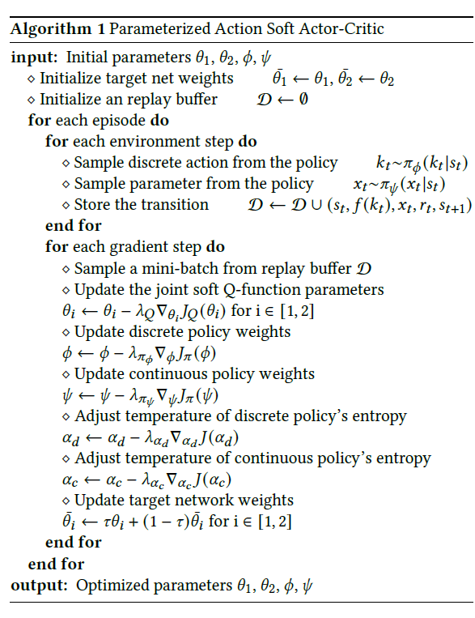
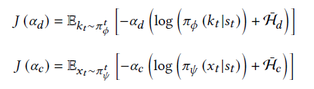
Parameterized Action Soft Actor-Critic
Implementation Details:
Exploration: double alpha tuning to control the different exploration rate at the discrete and continuous action spaces
Recurrent state head: dynamic LSTM to solve the Partially Observation problem

Slide 10

We further proposed Stratified Prioritized Experience Replay (SPER) to address the “skewed prioritizing” issue:
skewed prioritizing: experiences whose rewards are in certain ranges are more likely to be sampled, making the agent behave poorly in some state subspaces (some queries are inherently easy/hard to train)
buffer stratifying: the replay buffer is divided into several bins (strata) according to reward range. The same number of samples are sampled from each bin by important sampling.
priority with TD-error and policy loss:
Transactions with larger improvement potential more likely to be sampled
Stratified PER
high priority
high priority
bin1
bin2
bin3
bin4

Slide 11
Experiments
Q1. Does the proposed algorithm work better than the heuristic hand-crafted method tuned by engineers, or other RL algorithms?
Q2. Is it more appropriate that we formulate the problem into a PARL problem, instead of discretizing the action space?
Q3. How is the improvement of our method in real search scenes?
Q4. How is the effect of applying SPER, and its components?
Q5. Does the proposed agent work well on other PARL benchmarking baselines?

Slide 12

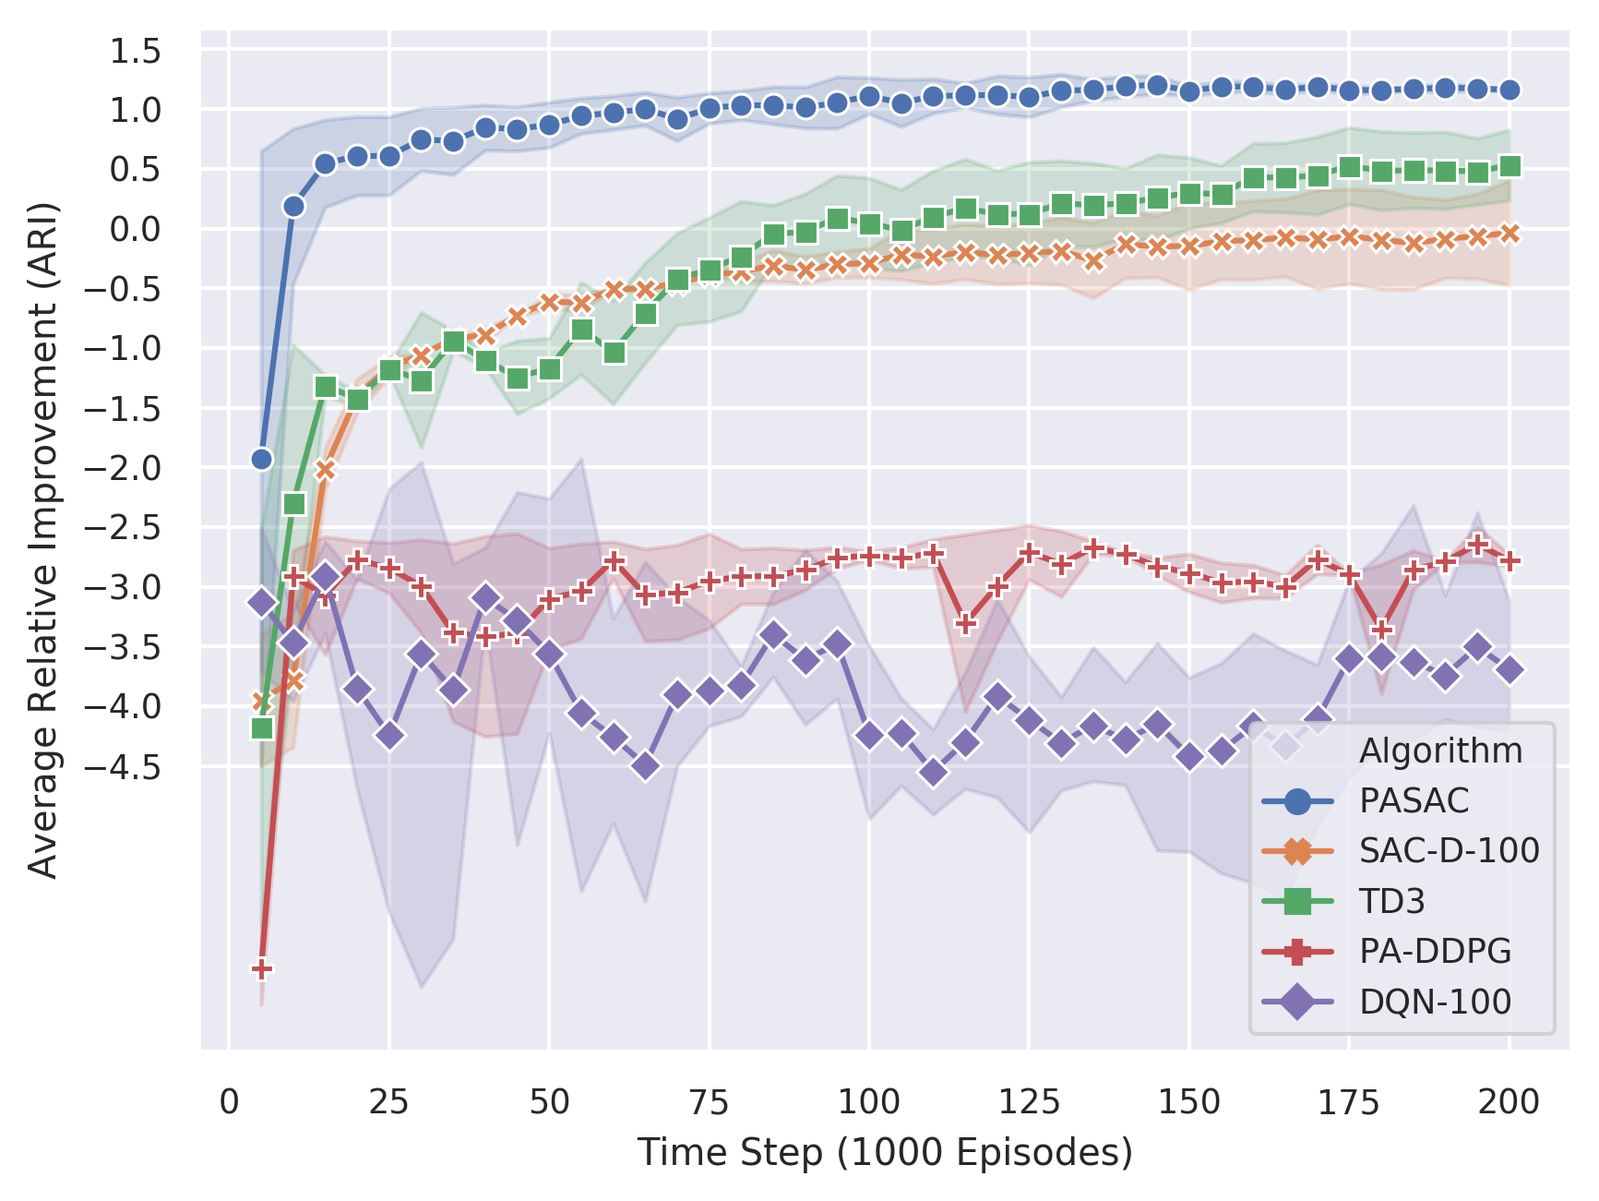
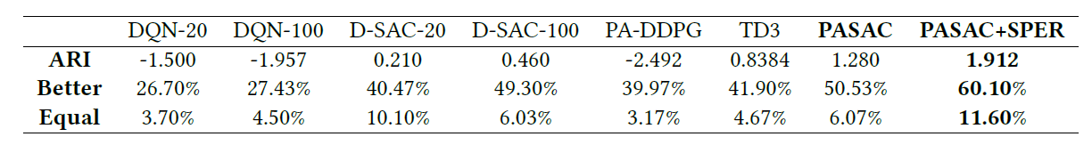
Experiments
Q1,2,3: Some comparative experiments with the same condition (3,000 test queries in total)
For different RL agents (Figure on ARI)
For different RL agents (Table)
PASAC agent apparently outperforms other SOTA agents in both stability and efficiency in our scene

Slide 13
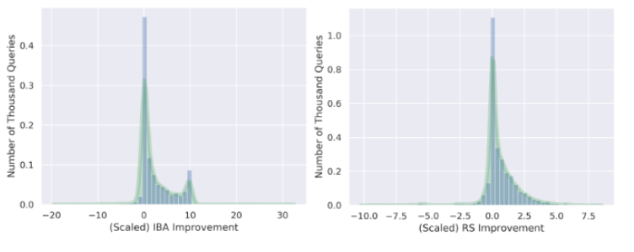
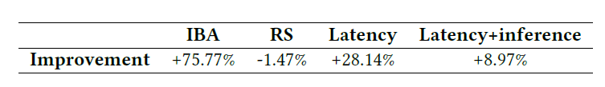
Performance Improvements for Production
Significant reduction of index block accesses with relevance on-par
Manually defined match plans cannot flexibly control the quotas
Match plans generated by model are typically shorter than production
Production rules are generalized to all queries in a category, leading to some redundancy rules for a single query

Slide 14
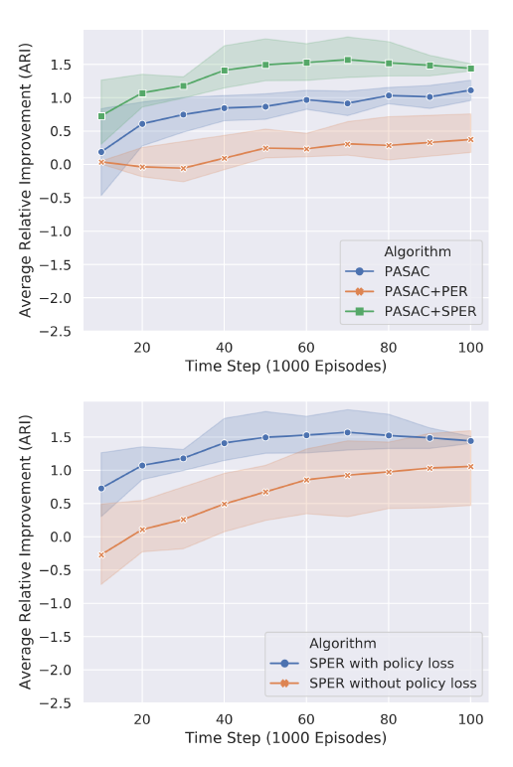
Experiments Ablation Study
Q4. How is the effect of applying SPER, and its components?

Slide 15
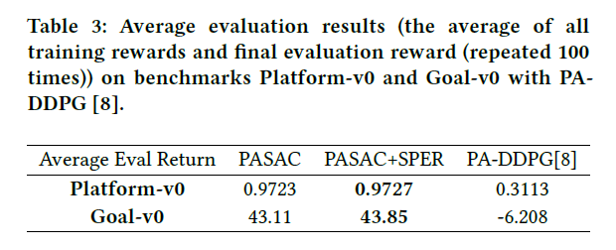
Experiments
Benchmark Games
Q5: Does the proposed agent work well on other PARL benchmarking baselines?
We evaluate our agent in a broader context
PASAC performs much better than PA-DDPG.
Stratified sampling may better fit the environment with skewed prioritizing issue if PER is applied.

Slide 16
Summary
Formulate the match plan generation task to the general PARL framework
Propose a novel algorithm, Parameterized Action Soft Actor-Critic
To address the skewed prioritizing issue of PER, Stratified Prioritized Experience Replay (SPER) is applied
Experiment results show that our learned match plan significantly outperforms the production baseline in terms of resource-saving
Future works include further optimize the model reference time, and inventing more delicate strategies in exploring the parameterized action space

Slide 17
Thank you
for your careful listening!

