Slide 1
Joust
By Brian Chan and Veronica Kleinschmidt

Slide 2


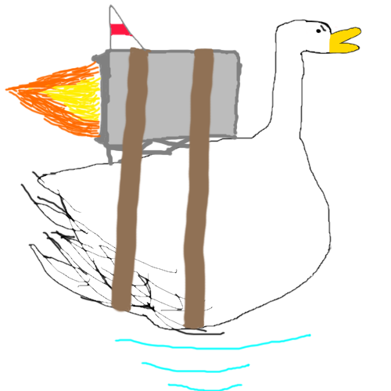



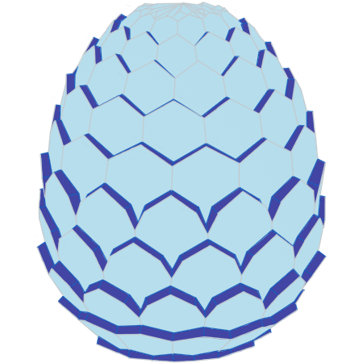
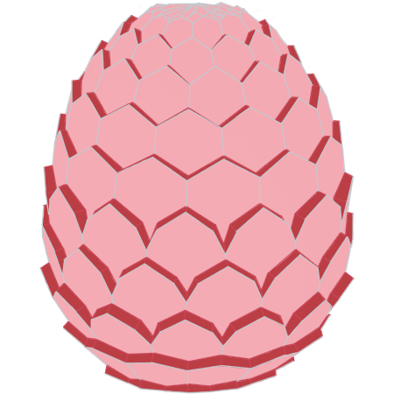
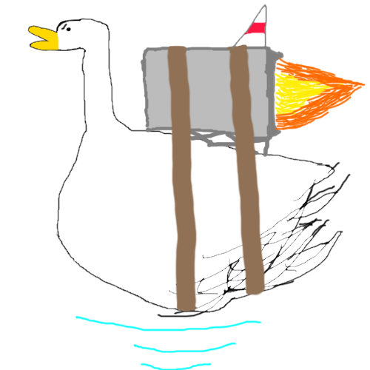
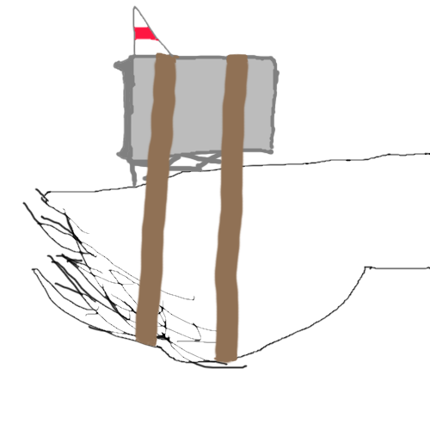
Sprites

Slide 3
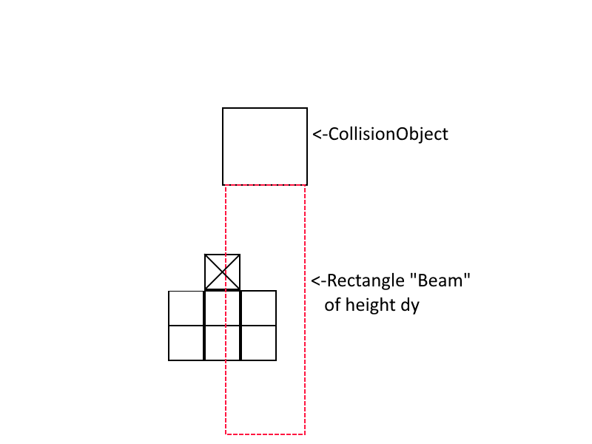
Collisions

Slide 4
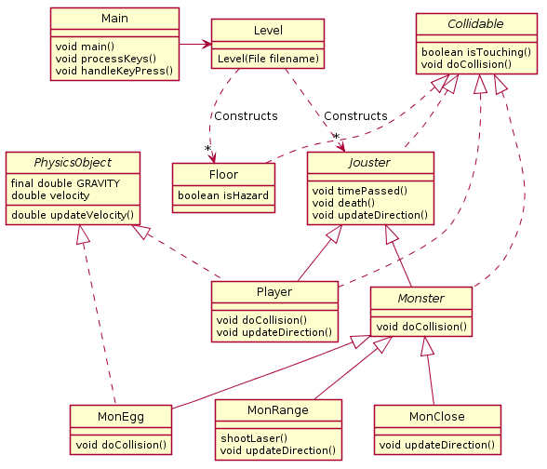
Original uml

Slide 5
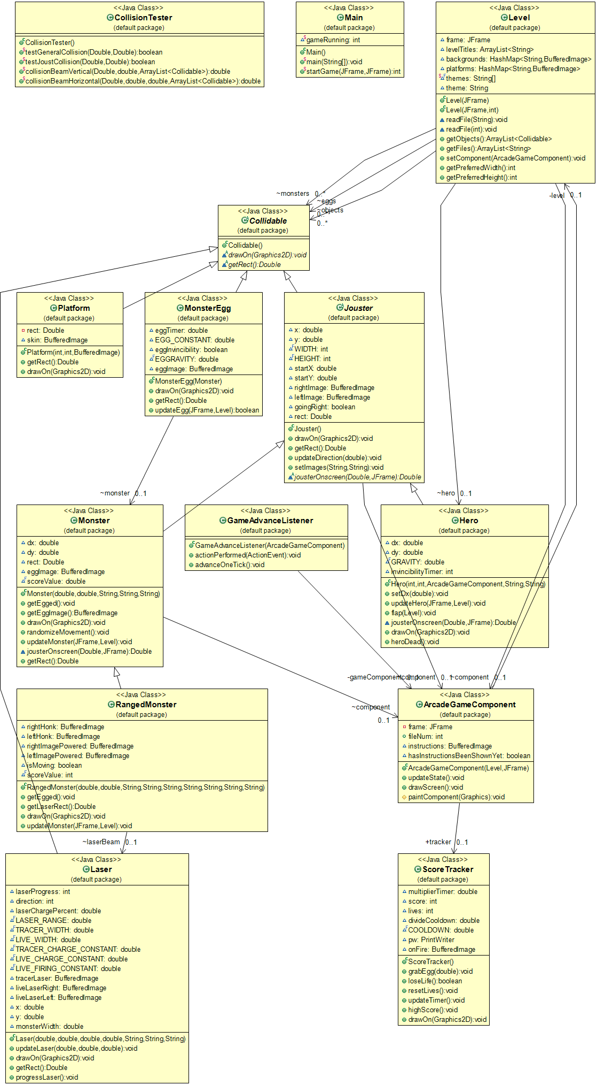
Final uml

Slide 6
Commits: All 246 of them
JWFKWJF;LAKSDJF;AWKJOFWH;KFD;AKW;FLWAJ;OFI;OFHWAFEH;AODKF;HALKEW;OHFIWH;FELWKAH;OFEWKHA
blah
Added my name to author and changed the print statement
balkjlksaflwejfalwke
Fixed merge error
Changing statement
lks;jfkjfdsa
This is a test for my hot keys
This is the second test message
Ok I promise this is the last test probably
Last test for real now.
This is the final test message
added sampleLevel1.txt
removed test messages, added sampleLevel1.txt
keyListening
stuff
more stuff
updating hero
updated hero
platforms and hero
message
fixed testLevel1
removed the writeFile() method
printing char values
...
Updated level select
added an advance listener to call the component
Level gets a frame!!!
added drawScreen() method to ArcadeGameComponent
derpy message for testing
giving ArcadeGameCompononnenentnetnt a level
doing stuff
push attempt #2
made interface Collidable
update level to include Collidable
added platform
getting a nullpointerexception
fixed exception
added method
updated a whole bunch of stuff
removed getObjects
added a size to the frame but it isn't working
commenetentned out the pack
fixed partial sizing
sizing
doo-doo-doo
test push
messing with hero
help
fixed stuff
yoooo we got the hero thing to move
stuff that I honestly don't know what I changed
fixing dir
adding Timer to main
It MOOOOOOOOOOOOOVVVVVVVEEEEEEEEEESSSSSSSSSSSSSSSSSSSSSSSSSSSSSSSSSSSSSSSSSSSSSSSSSSSSSSSSSSSSS
minor
commit message
It MOOOOOOOOOOOOOOOOOOOOVVVVEEEEEEEEESSSSSSSSSSSS
It MMMMOOOOOOOOOOOOOOVVVVVVVVVEEEEEEEEEEEESSSSSSSSSSSS
minor
more minor
mmmm
will this fix it
removed a singular space...
removed current time printer
removed hero from objects
added collision
.
..
maybe i changed something?
removing nullpointerexception by avoiding the problem; fix this
testcollision
gravity too stromnk
.
test push
newwwwwm
blah
functional
fixed stuff
collisions mostly work??
ok
unstaticced
new one
Fixed the things
fixed collisions getting you stuck in blocks, added new bug i mean feature where you can now teleport if you are touching a side of a platform and press the opposite movement key
random teleportation is now much less likely to occur
fixed the NYOOOOOOM effect and collisions
misc testing "improvements"
uhhh i think i fixed the bottomCollision sticking its now super slippery near the edges tho yea
fixing merge conflicts
testing
newmmmmmm
made new temp class for collision methods
COBWEB PLATFORMS!!!!
updated some not working methods to keep them not working for now
stuff was changed please pull
working on collisions in hero
removing blank lines
trying out CollisionTester fixing
dir is gone ***crab rave***
jump machine broke (temporarily, but side machine fixed?)
removed bad extraneous variables
fixing ground side collisions
...help
push
collision machine broke even more
YOOOOOOO BOTTOM COLLISIONS
at least you dont teleport through blocks anymore aka MINECRAFT HORSE MODE
removed unnecessary test file
flapping somewhat fixed
new expanded test level
10x50 testLevel
removed unnecessary print statements, added hero to test level
merrrrrrrge
test for merrrrrrrge
jump machine fine, run machine v broke, also levels are larger now
indented level
fixed??
added new experimental method for (vertical) collision testing
added comment to new experimental method
added a case for the dy beam not finding any rects aka freefall
I have no clue how to fix collisions
fixed the hero getting spiked downward by gravity if it left a platform
methods that arent in use yet are being updated
trying to get it to stay onscreen, but no more nyyyooooooomm
finished "beam" collision methods
removed side collisions
floor and ceiling collisions are mostly fixed
print debugging in progress
forgot to stage hero
collisions are good enough for now
sidewalk cracks break yo momma's back
speed nerf
huh?
uh oh merge conflicts
tried to re fix flap
hey hey hey guess what i fixed collisions for real this time
nevermind ceiling collisions are still kinda wonk
rainbow hero
merge conflicts
added monster class
added some comments and added frame collisions to monsters
made hero bigger for testing, commented out unused methods
platform nyooms have hereby been fixededed
added comments about collisions in monster
made Jouster
abstracts
added veryveryvery rudimentary monster
more abstracts
even more abstracts
working version of monster
working copy
hero update
now hero updated
fixed monster if statement
...abstract
minor details
updated randomness for dx and dy
monster update #48
monsters workee now
more monsters
added shell of RangedMonster class - implement me later
monsters
misc changes to rangedmonster
removed extraneous comments from monster
preliminary laser uppage
adding a single ranged monster to the test level
stupid merge conflicts
ranged monster has laser now muhauuahaaha
working version of ranged dude
magenta ranged dudeham
push flap good now
lasers implemented, now for laser firing cycle and laser hitbox
fixed everything pretty much, print statements are gone **crab rave** also comments are gone **crab rave #2 electric boogaloo** random spaces removed and hero actually stays on screen for once in its life
you broke it
merge conflicts and laggy game??
lasers are finally implemented but sometimes the tracer laser doesn't show up, this is totally an intended feature and just tests players' skill in detecting when a ranged enemy has stopped moving and is preparing an attack that just so happens to be hidden. y'know, every now and then an enemy is gonna try to 360 no scope ya boy and hes just gotta be prepared for that day that is now the in lore reason why the tracer doesn't show up the enemy just got a random burst of skill and decided to turn off his targeting controls and fire blindly but the laser still needs charging up so he just sits there silently for a bit then quickdraws and fires in an unpredictable fashion. git gud, he retorts, as the enemy dude turns around and explosions happen behind him. This occurence happens approximately once every 20 laser firings, and usually occurs around the left side of the map. It is also good to note that the code causing this 1 in 20 bug i mean feature is pretty much exactly the same as the full-power laser but with a different width and color. there is currently no reason for this code to act out of line and when found it will be severly punished. reward: my sanity at 3am, dead or alive.
uhh so apparently theres a second compeletely intended feature in which the lasers fire both ways at once very competely intended yes its a test of player skill
fixed monsters not despawning when switching stages, also randomized movement more for monsters
monster placement in levels edited
fixing spacing, random comments, and that one final long that we have no clue what it is
making a monsterOnscreen method for better functionality
merge
fixed merge stuff
fixing hyperspeed due to merge
misc comment for when monster die
starting X and Y
fixed laser collisions and removed error messages
added egg
may I offer you an egg in these trying times
nom nom nom them eggo my leggos
chonky boi
added death msgs
commented a section that gets called when hero loses joust
making sure hero is flush with frame side when trying to go offscreen
making things better with abstract methods
made commit message list up to date till now
chanb's AVATAR: THE LAST AIRBENDER
hero can now die in peace
death is better now and ranged monsters don't pop out of eggs guns blazing
print statements are gone ***crab rave vol 2***
removing extra lines and failing to figure out how to avoid type-predicated code
added temp sprites to monsters
EGG
big change push because i got lazy with pushing since vk's laptop died, rip. lasers now face both directions, ranged monster "animation" yet to be implemented uhhh eggs work but theyre kinda pixelated cause they smol af updated level's constructor calls to handle the extra image files n stuff y'know
updating commit list on loaner laptop :(
quack quack coding duck has joined the battle!
slightly larger and less pixellated
goose laser better slightly
forgot to stage laser
misc changes to homnking
backgrounds!!!
it's the great pumpkin, Charlie Brown!
random themes
had forgotten to do the same for the other constructor
changed platform color
added frankenducks
added platform textures **spooooky**
updated goose tracer to be more visible, goose jetpack sprtes still work in progress
platform skins now match level backgrounds
new level layout
ROCKET GEESE MOVE AT VERY FAST (average) SPEED
Folders upon folders upon folders
new level, timer speed up, uhhh goose go faster now
redone levels
bottom platforms onscreen
hero invincibility on spawn/respawn
raw sekelekeketon scoreabords aseddded now typings ihard ok
lives sorta work but dont reset game yet
temporarlayary gaemaover screeen skind workas
SCORE WORKEKEE NOW IM BOUTTA GET LESS SLEEP THAN A NAP WOULD GIVE ME
added blinky blinky effect to laser, nerfed geese
minor changes to make score multiplier cooldowns more or less harsh, increased i-frames, made it so you can't kill stuff during i-frames, if you want to impeleljlemtn a power up later that uses i-frames just override it with an or statement
high score implementation in progress
uml stuff
doodoodoo
tracker buggy
level UPs work now, but scoreTracker doesn't display
This Tracker is on FIREEEE!!
fixed pickup eggs not givning score
fixed scores better
last level added, pseudo boss battle pretty much, updated level naming
stuff
added instructions
powerpoint
added codingduck to presentation

