Slide 1
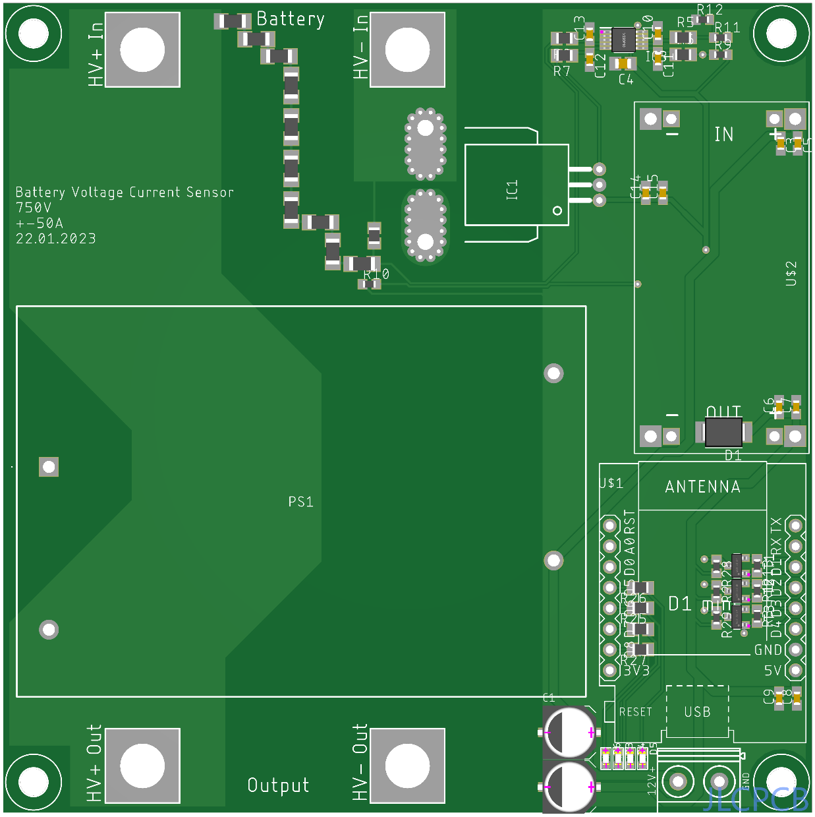
High Voltage Measurement Path
High Voltage Input Positiv
High Voltage Input Positiv
Current Sensor Hall Effect
DC-DC Converter
12DC → 5VDC
DC-DC Converter
1000VDC → 12VDC
Microcontroller (WiFi)
High Voltage Output Positiv
Power Output 12V 15W
High Voltage Output Negative
+ -

Slide 2
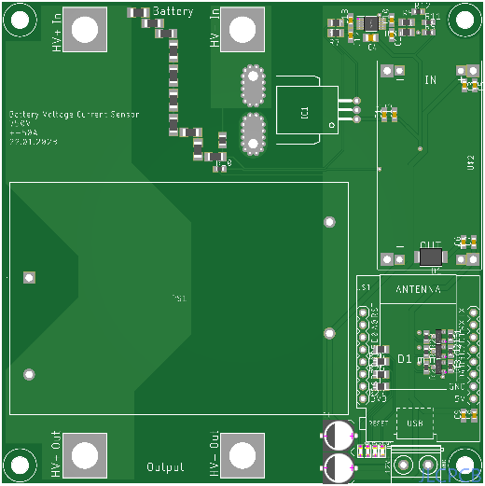
Battery
600V
30A
+
-
EasyBMS
Master
+
-
Inverter

