Slide 1
Sleep Stage Classification Using Deep Learning
(BIO3609) Biomedical Signal Processing
Team 9
ليان عمرو – رقية مختار – هيا غراب

Slide 2
Problem Statement
Sleep staging is important in diagnosing diseases that are linked to cardiovascular diseases and fatigue.
The standard method uses polysomnography that includes EEG, ECG, EOG, and EMG signals.
The problem is that it is expensive, uncomfortable, and not practical for long-term monitoring.
Deep learning models can be built to automate the classification process.

Slide 3
Project Idea
“Can we classify sleep stages using ECG signals only?”
ECG signals are easy to measure and can be made into wearable devices that could enable home monitoring.
It would classify the stages into 4 classes:
Wake
Light sleep (N1+N2)
Deep sleep (N3)
REM

Slide 4
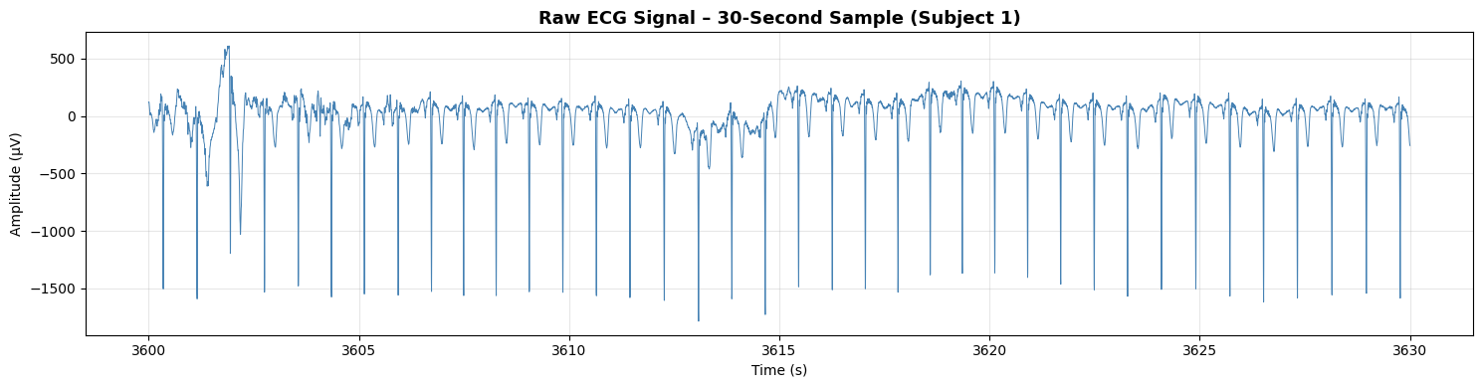
MESA Sleep Study Dataset
ECG sampled at 256 Hz.
Divided into signals (.edf) and annotations (.xml).
Signals split into 30-second epochs.
10 subjects are used (major limitation).

Slide 5
Pipeline Overview
Dataset Access & Loading
Signal Preprocessing
Multi-Scale Feature Extraction
Data Balancing
Hybrid Architecture
Advanced Optimization
Performance Evaluation

Slide 6
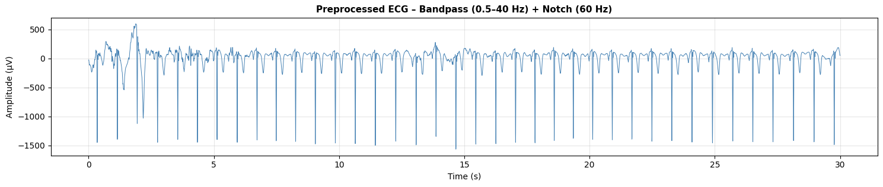
Signal Preprocessing
Bandpass filter (0.5-40 Hz) to remove baseline drift.
Notch filter (60 Hz) to remove powerline noise.
Normalization to standardize amplitudes.

Slide 7
Signal Segmentation
Signals are split into 30-second epochs (standard in sleep scoring).
Context window is 11 epochs (5 previous + current + 5 future).
Neighboring epochs are useful as sleep stages transition gradually.

Slide 8
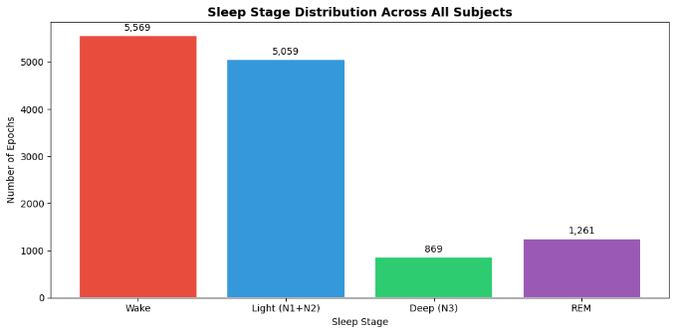
Data Splitting & Imbalance
Total epochs: 12,758
Train: 8561 Epochs
Val: 2,998 Epochs
Test: 1,199 Epochs
Subject-wise split:
Training: 7 subjects
Validation: 2 subjects
Testing: 1 subject

Slide 9
Model Architecture
Three-branch architecture:
1. Epoch CNN (Waveform features)
Effective for automatic feature extraction from raw physiological signals.
2. 2-layer Bidirectional LSTM
Learns transitions and uses previous and future context.
3. Attention mechanism
Focuses on informative epochs which reduces irrelevant temporal information.

Slide 10
Multi-scale Feature Extraction
In addition to extraction of raw waveforms, we used Heart Rate Variability (HRV) as well.
It measures the time gap between heartbeats. It helps classify REM and deep sleep stages better:
REM: irregular heartbeats
Deep sleep: steady/regular heartbeats
Combining them provides complementary information.

Slide 11
Comparison
Old Version:
Used CrossEntropyLoss with label smoothing
Standard random shuffling during training
Used constant learning rate
HRV context window 30 secs (1 epoch)
Final Version:
Used Focal Loss for imbalance handling
Added WeightedRandomSampler
Used Cosine Annealing Warm Restarts scheduler
Expanded HRV context window to 5.5 minutes (11 epochs)

Slide 12
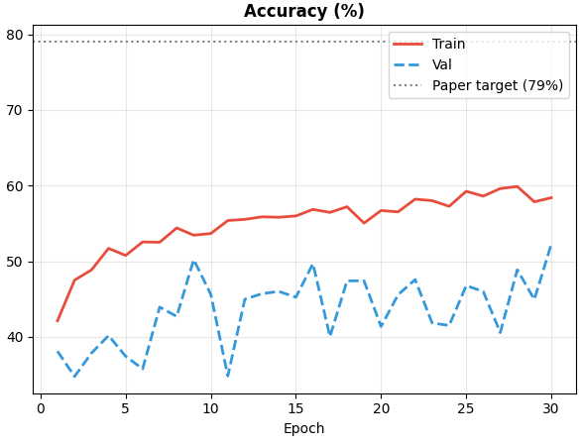
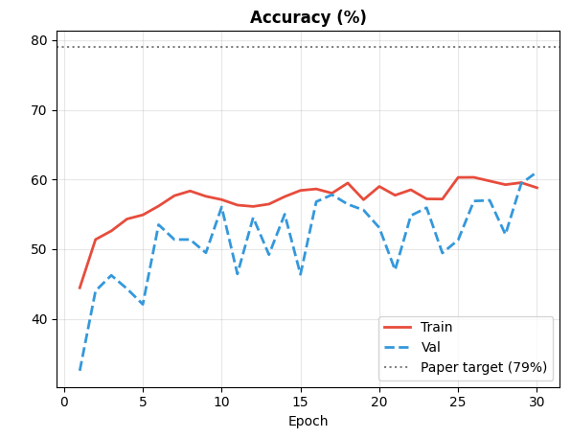
Results
Previous version
Final version
Notes:
Training improved steadily
Validation fluctuated
Gap indicates overfitting
Because only 10 subjects
imbalance
ECG variability

Slide 13
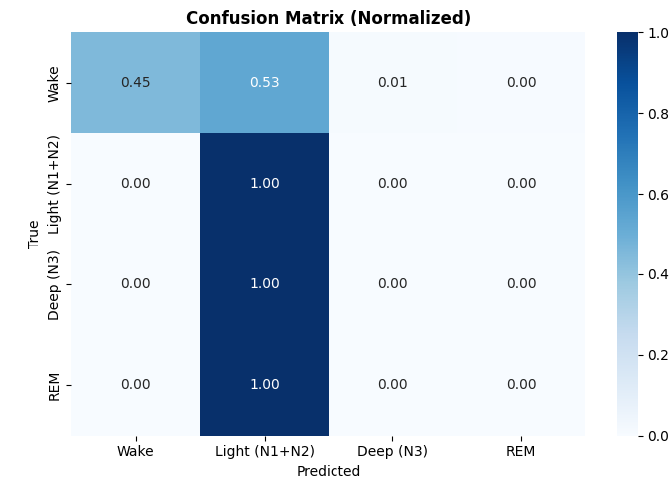
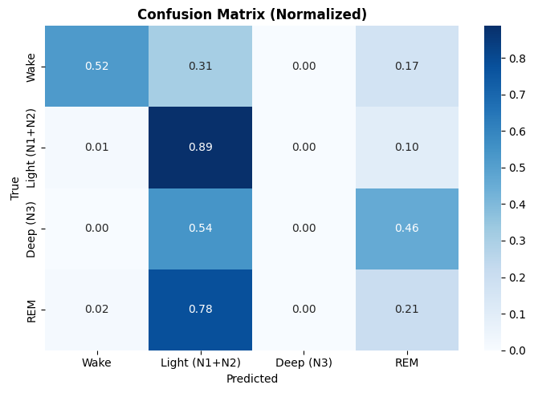
Results
Previous version
Final version
Notes:
Training improved steadily
Validation fluctuated
Gap indicates overfitting
Because only 10 subjects
imbalance
ECG variability

Slide 14
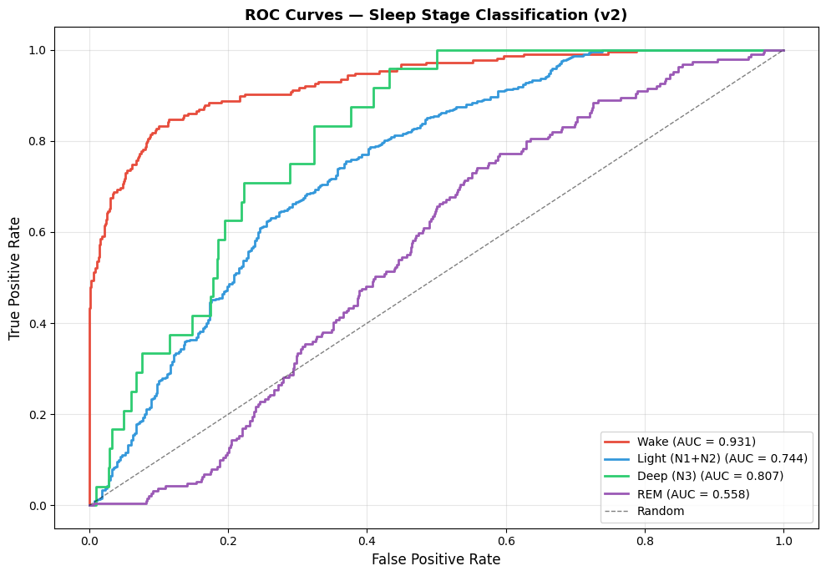
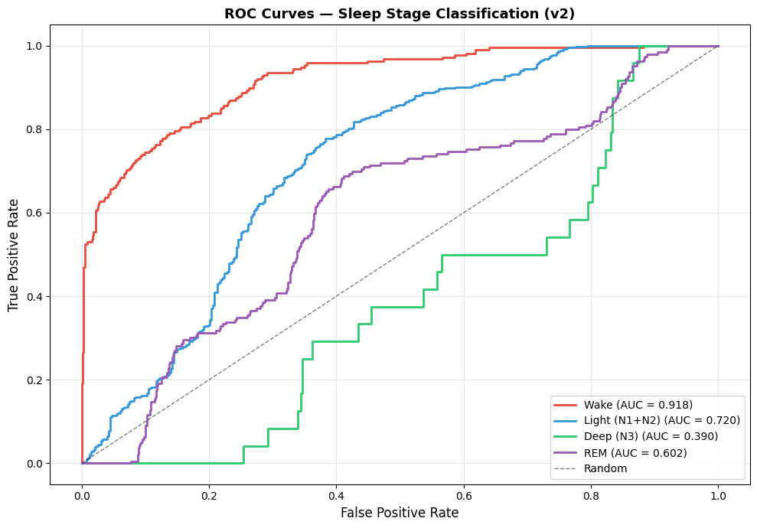
Results
Previous version
Final version
Notes:
Training improved steadily
Validation fluctuated
Gap indicates overfitting
Because only 10 subjects
imbalance
ECG variability

Slide 15
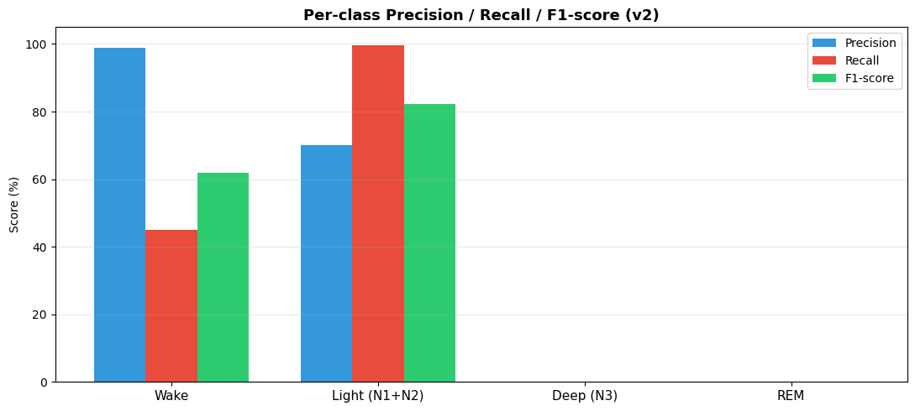
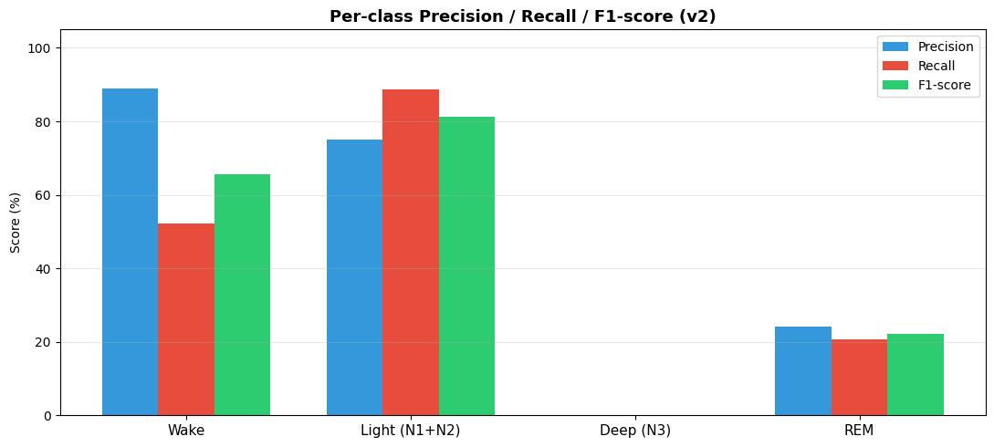
Results
Previous version
Final version
Notes:
Training improved steadily
Validation fluctuated
Gap indicates overfitting
Because only 10 subjects
imbalance
ECG variability

Slide 16
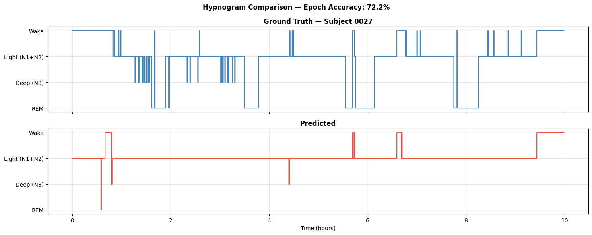
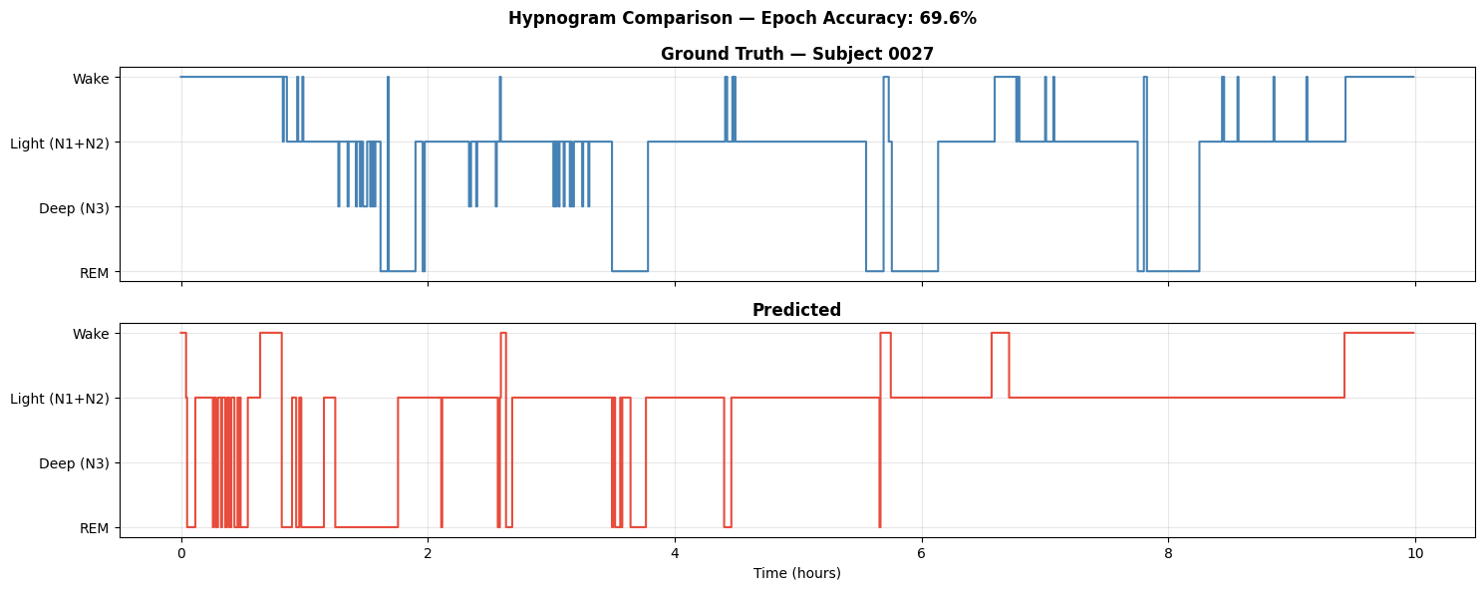
Results
Previous version
Final version
Notes:
Training improved steadily
Validation fluctuated
Gap indicates overfitting
Because only 10 subjects
imbalance
ECG variability

Slide 17
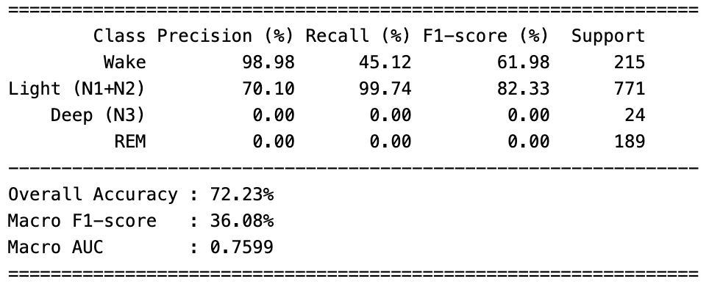
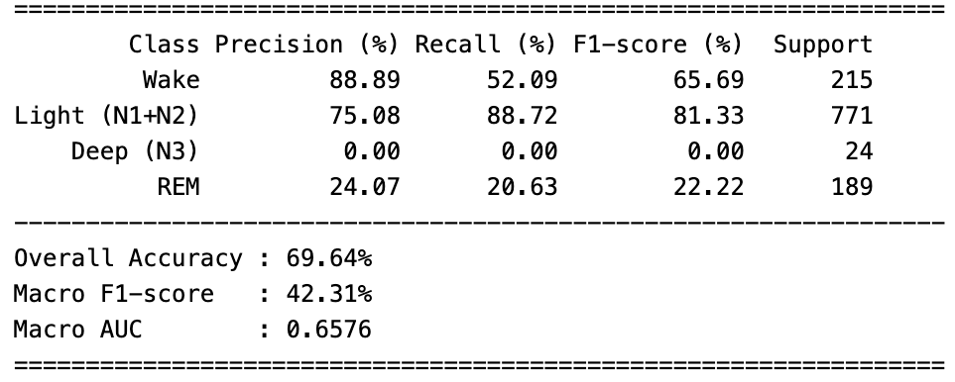
Results
Previous version
Final version
Notes:
Training improved steadily
Validation fluctuated
Gap indicates overfitting
Because only 10 subjects
imbalance
ECG variability

Slide 18
Limitations Future Improvements
Small dataset
Severe class imbalance
Overfitting
Subject variability
More subjects
Better class balance
Multimodal signals

Slide 19
Thank you :)

