Slide 1
Project Presentation API_ TESTING Batch Code : QDE-AWAAID-M7
Team Members : RAJASHRI DASI
SNEHAL PURANIK
MAYURI KADAM
PRATIKSHA PATIL
GUIDE BY : NIRBHAY SIR

Slide 2
Website : www.shoppersstack.com
Objectives : [ Correctness , Reliability, Security, Efficiency]
Functional Testing : Verify that each API endpoint (e.g., Shopper Profile, Shopper address, cart management, user authentication )
Data Integrity : Ensure that data transmitted via APIs is accurate, complete, and consistent .
Performance Testing : Evaluate the API's response time, throughput, and scalability under different load conditions.

Slide 3
Project Domain
Ecommerce :
Testing APIs for online shopping platforms involves verifying functionality which includes
User Profile
Cart Management
User Authentication
Placing Order
Payments
Order Processing

Slide 4
Tools and Environments
POSTMAN
Postman is a popular tool used for API development and testing. It provides a user-friendly interface to make HTTP requests, organize API endpoints, automate testing, and collaborate with team members.
Features Of POSTMAN
1) API Requests 4) Testing
2) Collections 5) Mock Server
3) Environment Variables 6) Documentation

Slide 5
Postman Environment
Development : Developers use Postman during API development to test endpoints locally before deploying changes.
Testing : Quality assurance (QA) teams use Postman for functional testing, regression testing, and performance testing of APIs.
Documentation and Sharing : Postman is used to generate and share API documentation with stakeholders, including developers, testers, and external consumers of APIs.

Slide 6
FLOW_DIAGRAMS
Shopper Login
Registration
Find Shopper
Shopper Profile
Update Shopper details
Set the password
Generate URL for forgot password

Slide 7
Add new address
Get all the addresses
Get a particular address by address Id
Shopper Address
Update an address
Delete an address

Slide 8
Add Product to the cart
Get all the product from cart
Shopper Cart
Update product in the cart
Delete the product

Slide 9
Place order from cart
Display order history
Shopper Order
Update order status
Generate Invoice copy

Slide 10
Get all the reviews of product
Add a review to delivered product
Shopper Product Review
Update an review
Delete an added review

Slide 11
Create a new card
Update Card Balance
Shopper Bank Cards
Validate Bank Card with amount
Validate Bank Card

Slide 12
Save the card data
Get the card data
Shopper Profile Card
Returns all shopper cards
Delete card data

Slide 13
Create Bank Account
Get all account of shopper
Shopper Bank Account
Update Bank Account balance
Validate bank account

Slide 14
ANALYSIS
POSITIVE TESTING: Positive testing in API testing involves testing scenarios where the system is expected to behave as intended with valid inputs and conditions. Despite focusing on expected behavior, positive testing can still uncover defects.
Defect:
1) Defect Occur in the Shopper Profile Module , When user want to resets the password , that API doesn’t work as expected.
Example: Expecting a 200 OK but receiving a 403 Forbidden

Slide 15
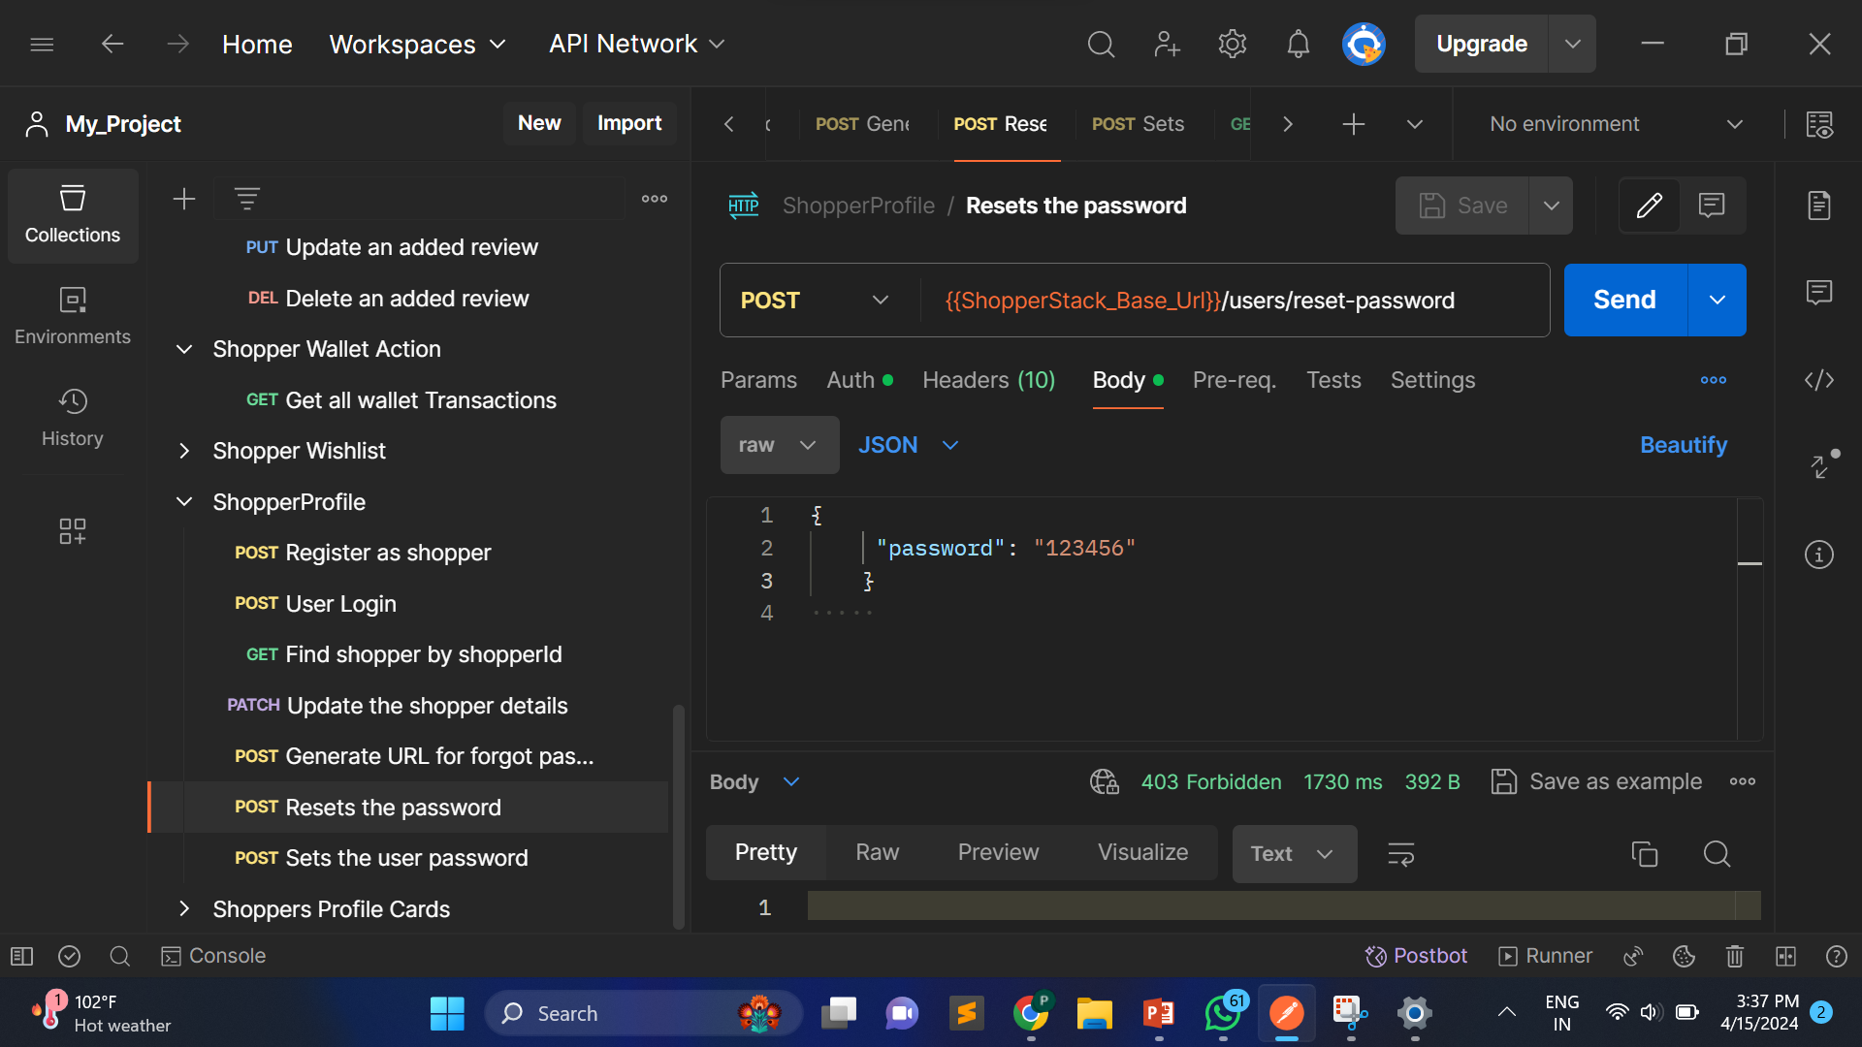
Here we see instead of giving the right data inputs still we get the defect like 403 Access forbidden code.
So, this example shows positive testing defects.

Slide 16
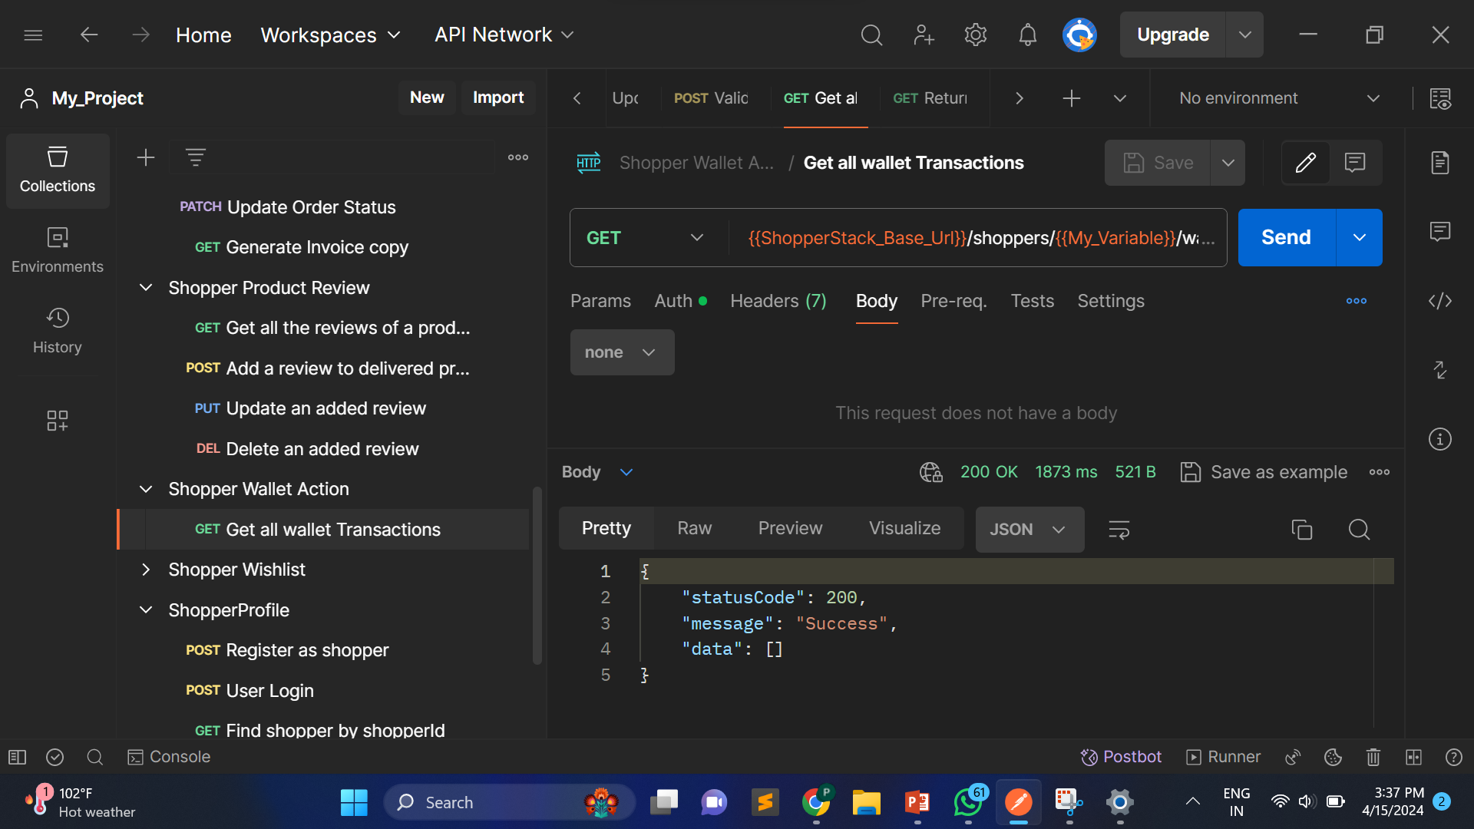
2) Defect Occur in the Shopper Wallet Action Module , when user send the request in this module the expected status code generated but there not showing any data means it show null data.

Slide 17
NEGATIVE TESTING : Negative testing in API testing involves deliberately testing the system with invalid inputs, unexpected conditions, or erroneous scenarios to uncover defects that might not be revealed during positive testing. Defect: The API fails to handle invalid input data gracefully. Example: Sending invalid data types (e.g., a string instead of an integer).

Slide 18
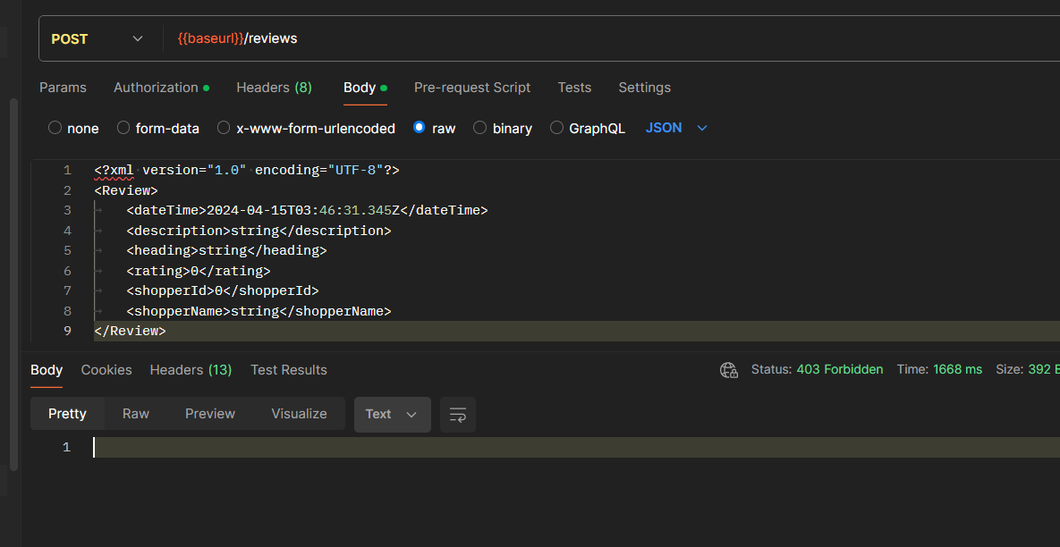
Here we can see that the data given to the input was deliberately given in HTML format instead of JSON format.
So, we got the expected error that is 403 forbidden status code.

Slide 19
Security: When conducting API testing using Postman or similar tools, it's crucial to include security testing as a part of your overall testing strategy. Testing for security vulnerabilities helps identify potential weaknesses that could be exploited by attackers.
Defect: Weaknesses in authentication mechanisms, such as improper session management or weak password policies.
Example: Testing for default credentials, session fixation, or weak password enforcement.

Slide 20
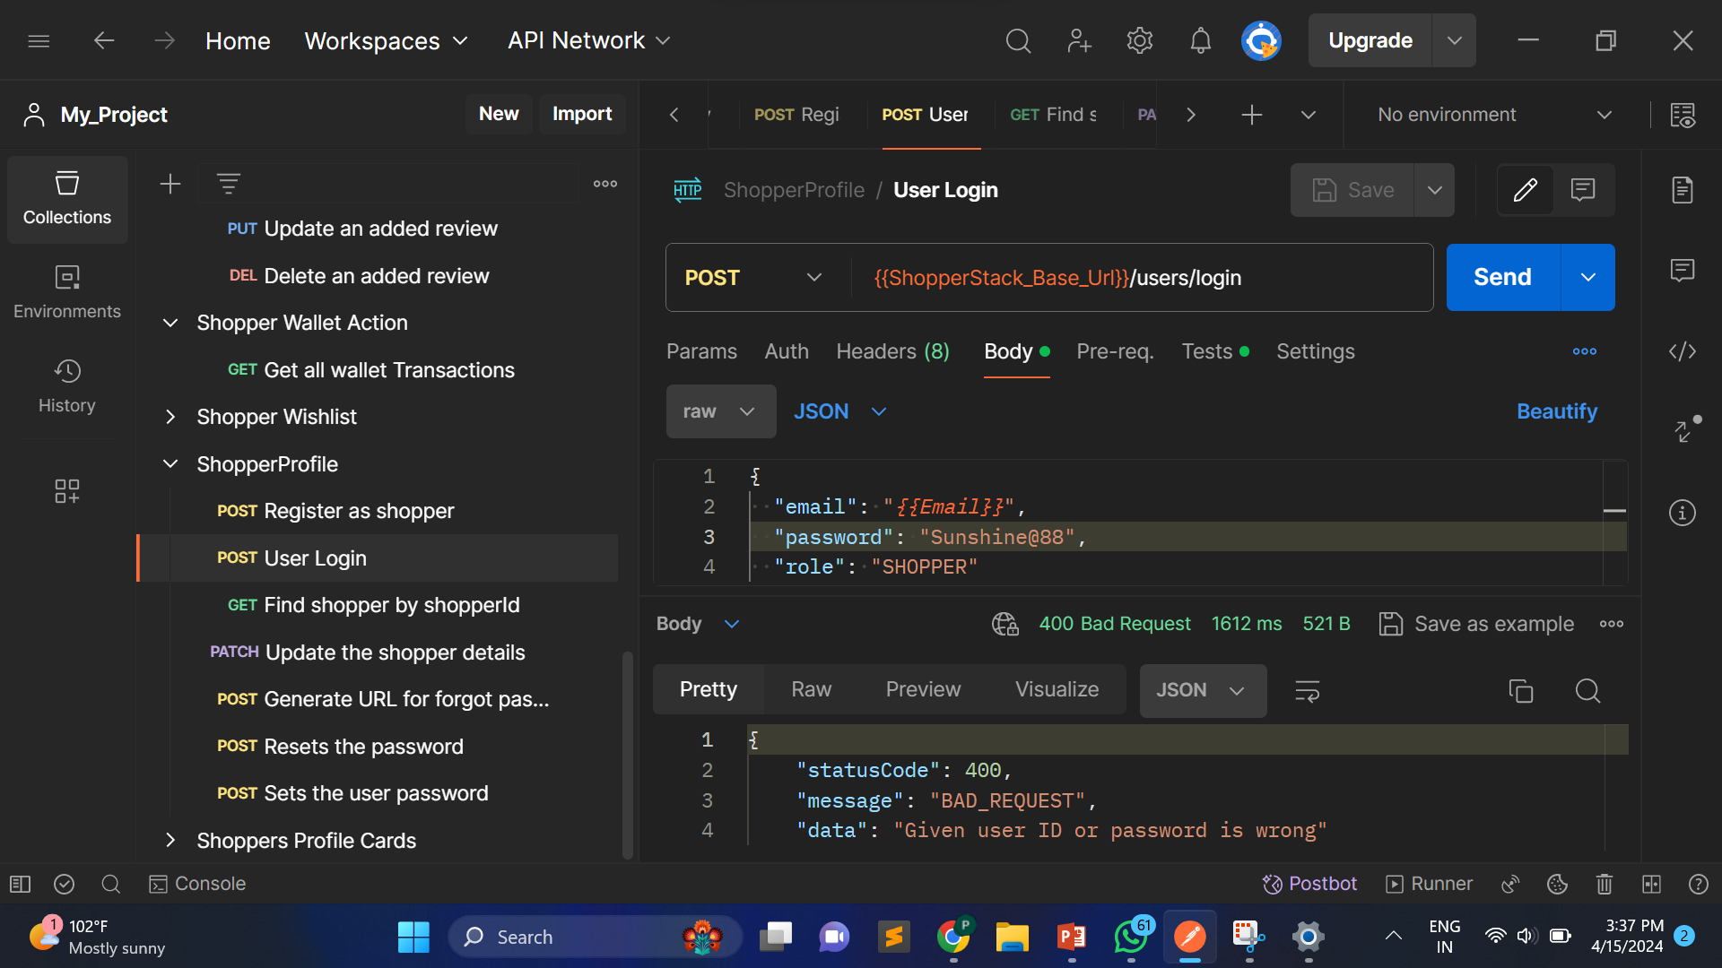

Slide 21
THANK YOU!!!

