Slide 1


QSPIDERS PUNE SQL PROJECT PRESENTATION BY SQL ASPIRANTS
GUIDED BY –
Mr. VIKAS SIR
Mr. RAVITEJA SIR

Slide 2


FROM SQL ASPIRANTS
Mr. CHETAN SONTAKKE (B.E)
Miss. RAJASHRI DASI (BTECH)
Miss. SNEHAL PURANIK (B.E)
AND
Miss. PRATIKSHA PATIL (MCA)
Mr. CHETAN SONTAKKE (B.E)
Miss. RAJASHRI DASI (BTECH)
Miss. SNEHAL PURANIK (B.E)
AND
Miss. PRATIKSHA PATIL (MCA)

Slide 3

Title : EXAMHUB : Precision In Excellence
Objective :
“ExamHub : Precision in Excellence” introduces the design and implementation of a robust database for an Exams Management System (EMS), aimed at facilitating the efficient administration of examination processes in educational institutions. The EMS database is engineered to handle the complex requirements of exam scheduling, student registration, question paper management, grading, and results processing, ensuring data integrity, security, and accessibility.

Slide 4
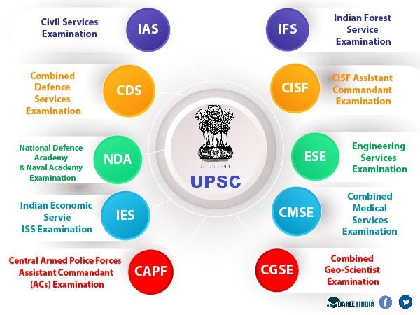


TODAY’S COMPITATIVE WORLD Today’s dynamic and competitive environment, adaptability, continuous learning, and a proactive approach to change are vital for success.
Please
Store
my
Data!!!!!!!!

Slide 5


Project Need : 1. One Student , Many Exams 2. Easy Conduction of Diverse Exams 3. Data Should be Secured 4. Data Management 5. To Reduce the Workload

Slide 6

Components (TABLES ) of the Project
1. EXAMS
2. EXAMINEES Result Exams
3. EXAM_REGISTRATION Examinees
4. EXAM_CENTERS
5. EXAM_SHEDULE
6. SUPERVISOR Exam_Registration
7. RESULT Supervisor Exam_Shedule Exam_Centers

Slide 7
1. Exams : TABLE CREATION CREATE TABLE Exams ( EXAMID INT PRIMARY KEY, EXAMNAME VARCHAR(50) NOT NULL, EXAMTYPE CHAR(3) CHECK (EXAMTYPE IN ('GOV', 'PVT')) NOT NULL, EXAMMODE VARCHAR(10) CHECK (EXAMMODE IN ('ONLINE', 'OFFLINE')) NOT NULL ); DATA INSERTION SQL> INSERT INTO EXAMS (EXAMID, EXAMNAME, EXAMTYPE, EXAMMODE) 2 VALUES(& EXAMID,&EXAMNAME,&EXAMTYPE,&EXAMMODE); Enter value for EXAMID: 1 Enter value for EXAMNAME: 'UPSC' Enter value for EXAMTYPE: 'GOV' Enter value for EXAMMODE: 'ONLINE' old 2: VALUES(& EXAMID,&EXAMNAME,&EXAMTYPE,&EXAMMODE) new 2: VALUES(1,'UPSC','GOV','ONLINE')

Slide 8
2. Examinees : TABLE CREATION CREATE TABLE EXAMINEES ( EXAMINEEID INT PRIMARY KEY, FIRSTNAME VARCHAR(50) NOT NULL, MIDDLENAME VARCHAR(50), LASTNAME VARCHAR(50) NOT NULL, EMAIL VARCHAR(50) UNIQUE CHECK (EMAIL LIKE '%@%') NOT NULL, CONTACTNO CHAR(10) UNIQUE CHECK (LENGTH(CONTACTNO) = 10) NOT NULL, AGE INT NOT NULL, ADDRESS VARCHAR(200) NOT NULL );

Slide 9
2. Examinees : DATA INSERTION: SQL> INSERT INTO EXAMINEES (EXAMINEEID,FIRSTNAME,MIDDLENAME,LASTNAME,EMAIL,CONTACTNO,AGE,ADDRESS) 2 VALUES(&EXAMINEEID,&FIRSTNAME,&MIDDLENAME,&LASTNAME,&EMAIL,&CONTACTNO,&AGE,&ADDRESS); Enter value for EXAMINEEID: 1 Enter value for FIRSTNAME: 'PRATIKSHA' Enter value for MIDDLENAME: 'GANESH' Enter value for LASTNAME: 'PATIL' Enter value for EMAIL: 'pratiksha@gmail.com' Enter value for CONTACTNO: 9022011024 Enter value for AGE: 22 Enter value for ADDRESS: 'BULDANA' old 2: VALUES(&EXAMINEEID,&FIRSTNAME,&MIDDLENAME,&LASTNAME,&EMAIL,&CONTACTNO,&AGE,&ADDRESS) new 2: VALUES(1,'PRATIKSHA','GANESH','PATIL','pratiksha@gmail.com',9022011024,22,'BULDANA') 1 row created.

Slide 10
3.Exam_Registration : TABLE CREATION: DATA INSERTION CREATE TABLE EXAM_REGISTRATION ( REG_ID INT PRIMARY KEY, EXAMID INT, EXAMINEEID INT, REG_DATE DATE NOT NULL, REG_STATUS VARCHAR(20) NOT NULL CHECK (REG_STATUS IN('CONFIRMED','PENDING','CANCELLED')), CONSTRAINT EXAMID_FK FOREIGN KEY (EXAMID) REFERENCES EXAMS (EXAMID), CONSTRAINT EXAMINEE_FK FOREIGN KEY (EXAMINEEID) REFERENCES EXAMINEE (EXAMINEEID)); Table created
INSERT INTO
EXAM_REGISTRATION
(REG_ID, EXAMID, EXAMINEEID, REG_DATE, REG_STATUS)
VALUES (1, 1, 1, TO_DATE('07-JUL-24', 'DD-MON-YY'), 'CONFIRMED');

Slide 11
4. Exam_Centers : TABLE CREATION: DATA INSERTION CREATE TABLE EXAM_CENTERS ( CENTERID INT PRIMARY KEY, CENTERNAME VARCHAR(50) NOT NULL, CENTERLOCATION VARCHAR (50) NOT NULL, EXAMINEE_CAPACITY INT NOT NULL ); Table created.
SQL> INSERT INTO EXAM_CENTERS(CENTERID,CENTERNAME,CENTERLOCATION,EXAMINEE_CAPACITY)
2 VALUES(&CENTERID,&CENTERNAME,&CENTERLOCATION,&EXAMINEE_CAPACITY);
Enter value for centerid: 1
Enter value for centername: 'QSPIDERS'
Enter value for centerlocation: 'PUNE'
Enter value for examinee_capacity: 5000
old 2: VALUES(&CENTERID,&CENTERNAME,&CENTERLOCATION,&EXAMINEE_CAPACITY)
new 2: VALUES(1,'QSPIDERS','PUNE',5000)
1 row created.

Slide 12
5. ExamShedules : TABLE CREATION: CREATE TABLE EXAMSHEDULES ( SHEDULEID INT PRIMARY KEY , EXAMID INT, CENTERID INT, EXAM_DATE DATE NOT NULL, TIME_SLOT VARCHAR(50) NOT NULL, FOREIGN KEY (EXAMID) REFERENCES EXAMS(EXAMID), FOREIGN KEY (CENTERID) REFERENCES EXAM_CENTERS(CENTERID) );
DATA INSERTION
SQL> INSERT INTO EXAMSHEDULES (SHEDULEID,EXAMID, CENTERID,EXAM_DATE,TIME_SLOT)
2 VALUES (&SHEDULEID,&EXAMID,&CENTEID,&EXAM_DATE,&TIME_SLOT);
Enter value for sheduleid: 1
Enter value for examid: 1
Enter value for centeid: 1
Enter value for exam_date: '07-JUL-24'
Enter value for time_slot: 9.00-12.00
old 2: VALUES (&SHEDULEID,&EXAMID,&CENTEID,&EXAM_DATE,&TIME_SLOT)
new 2: VALUES (1,1,1,'07-JUL-24',9.00-12.00)
1 row created.

Slide 13
6. Supervisor : TABLE CREATION: CREATE TABLE SUPERVISOR ( SID INT PRIMARY KEY, SNAME VARCHAR(50) NOT NULL, SEMAIL VARCHAR(50) UNIQUE CHECK (SEMAIL LIKE '%@%') NOT NULL, SCONTACTNO CHAR(10) UNIQUE CHECK (LENGTH(SCONTACTNO) = 10) NOT NULL, EXAMID INT, CENTERID INT, FOREIGN KEY (EXAMID) REFERENCES EXAMS(EXAMID), FOREIGN KEY (CENTERID) REFERENCES EXAM_CENTERS(CENTERID));
DATA INSERTION
SQL> INSERT INTO SUPERVISOR(SID,SNAME,SEMAIL,SCONTACTNO,EXAMID,CENTERID)
VALUES (&SID,&SNAME,&SEMAIL,&SCONTACTNO,&EXAMID,&CENTERID);
Enter value for SID: 1
Enter value for SNAME: ‘PRATIKSHA PATIL’
Enter value for SEMAIL: ‘Pratiksha@gmail.com’
Enter value for SCONTACTNO: 9022011024
Enter value for EXAMID: 1
Enter value for CENTERID:1
1 row created.

Slide 14
7. Result : TABLE CREATION: CREATE TABLE RESULT ( RESULTID INT PRIMARY KEY, Reg_Id INT Not Null , MARKS_OBTAINED DECIMAL(5, 2) NOT NULL, TOTAL_MARKS INT NOT NULL, PERCENTAGE FLOAT NOT NULL, RESULT_STATUS VARCHAR(5) CHECK (RESULT_STATUS IN ('PASS', 'FAIL'), FOREIGN KEY Reg_Id) REFERENCES EXAM_Registration(Reg_Id), );
DATA INSERTION
SQL> INSERT INTO RESULT(RESULTID,EXAMID,EXAMINEEID,MARKS_OBTAINED,TOTAL_MARKS,PERCENTAGE,RESULT_STAT
US)
2 VALUES(&RESULTID,&EXAMID,&EXAMINEEID,&MARKS_OBTAINED,&TOTAL_MARKS,&PERCENTAGE,&RESULT_STATUS);
Enter value for resultid: 1
Enter value for exami Reg_Id: 1
Enter value for marks_obtained: 80
Enter value for total_marks: 100
Enter value for percentage: 80
Enter value for result_status: 'PASS'
old 2: VALUES(&RESULTID,&Reg_Id,&MARKS_OBTAINED,&TOTAL_MARKS,&PERCENTAGE,&RESULT_STATU
new 2: VALUES(1,1,1,80,100,80,'PASS')

Slide 15
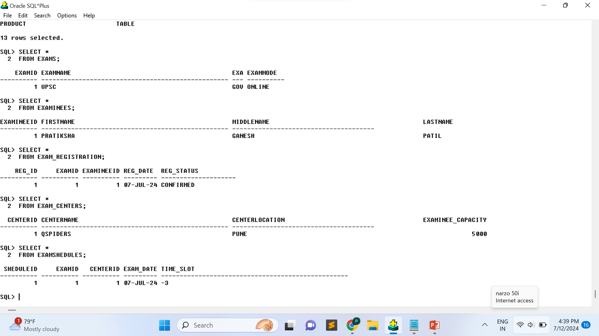
EXAMHUB:

Slide 16
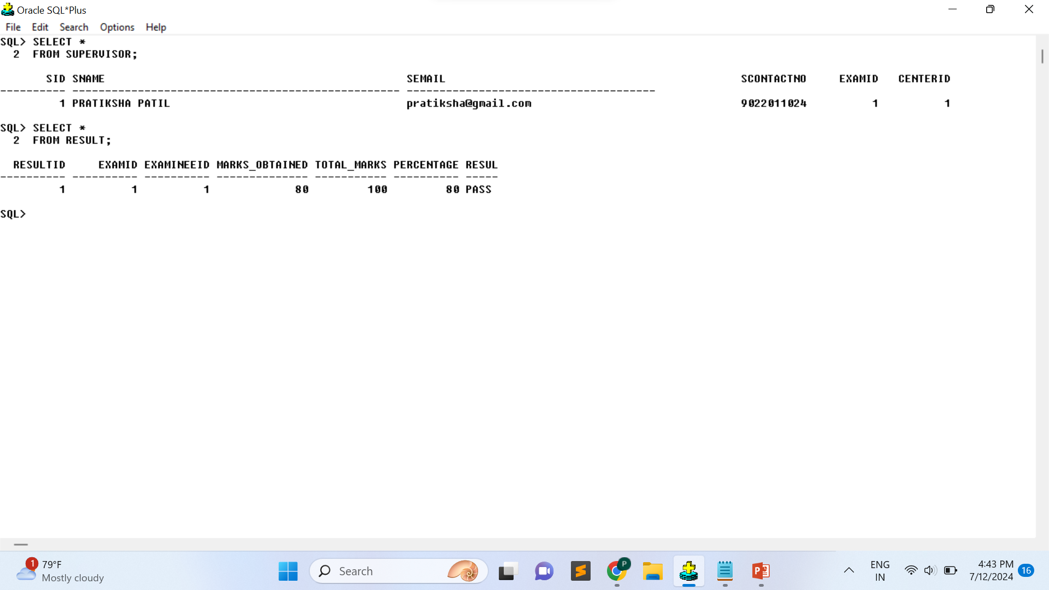
EXAMHUB:

Slide 17

CONCLUSION 1.Automation and Efficiency: Scheduling: Automates the scheduling of exams, reducing administrative overhead. 2.Data Management: Centralized Database: Data Integrity: 3.Enhanced Security: 4.Accuracy and Fairness: 5.Student Convenience:

Slide 18

ANY QUESTION ?????

Slide 19

THANK YOU !!!!!!!

