Slide 1
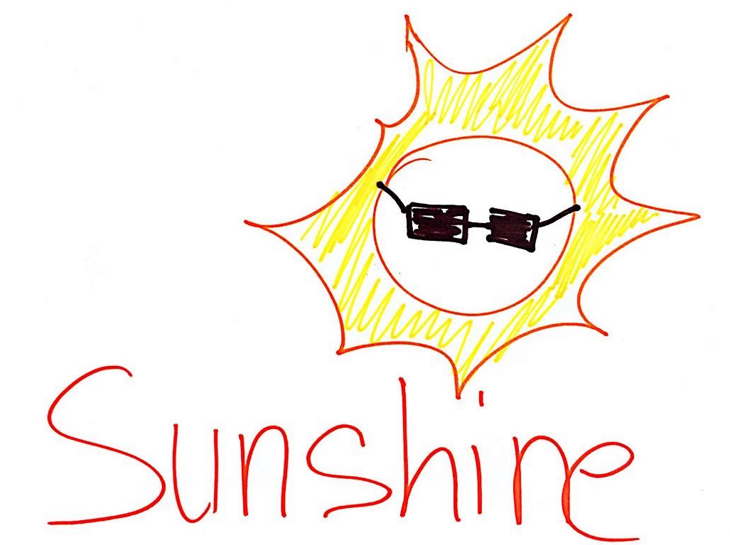
Sunshine Dapp – science validated skin health

Slide 2
Sunshine - self monitoring skin cancer D-App that supports individuals, GPs and Outpatients clinics make evidence validated decisions.

Slide 3
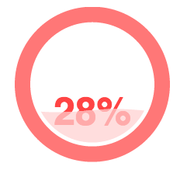
The Problem - Motivation
Reducing the number of visits to GPs, making the waiting lists for dermatologist referrals shorter.
Incentive to self monitor
Real time monitoring with snapshots
* source: Graham

Slide 4
Patient
Mole Picture
NHS Data
Extra Factors
ML
Request extra permission
GP
Request extra permission
Clinician

Slide 5
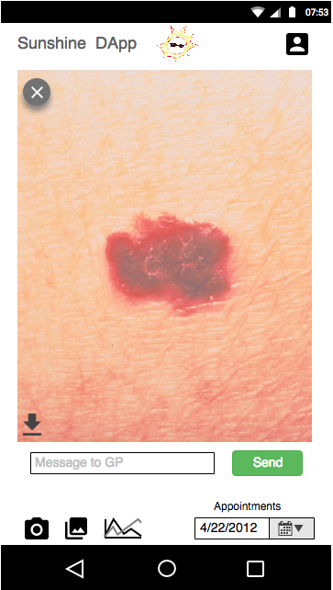
How
Instead of going to GP to show suspicious skin cancer, share picture via app.
Data-sharing (pictures, history, raw app data secured with block-chain algorithm)
GP gets summarising statistics

Slide 6
Stats

Slide 7
ML output
GP’s Decision
Risk Factor
~ 2 charts doctors can make sense of
Referral to dermatologist
Continue self-monitoring
Ask for permissions for more data

Slide 8
Target Audience
People who feel under the risk of skin cancer
GPs and clinicians to use the app
Patients with (family) history of skin cancer

Slide 9
Workflow - tech - incentives
Better Outcomes
More accuracy - timely use of clinics/NHS
Less demand GP
Less referrals clinics
Less cost society, health budgets
Holistic Machine learning
Works across all Dapps data
Open to any data science analysis

Slide 10
Business
Lowering the cost of GP visits,
More data and time created to help people in need
Pricing:
per GP analytic snapshot,
profit of successful referrals and clinician decisions

Slide 11
Summary
Gains for everyone – the incentives
Accuracy of decision making improves
Empower individuals to self monitor
Profitable way to improve health care

Slide 12
Mock Ups
Patient Interface

Slide 13
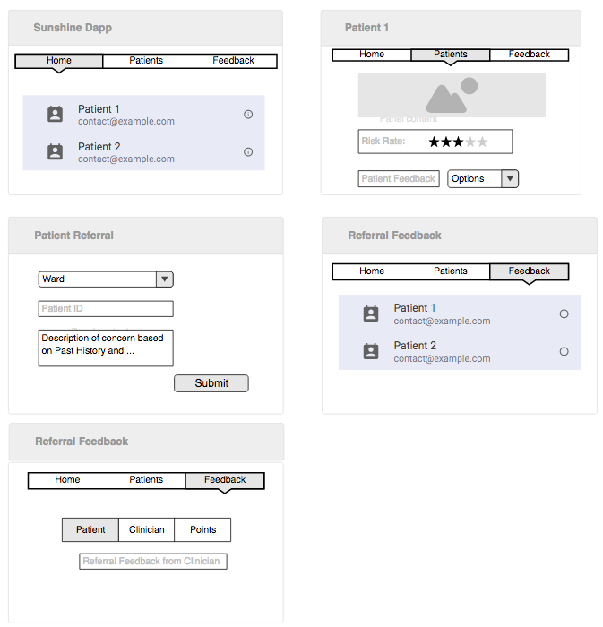
GP/Clinician Interface

Slide 14
Tech
Dapps
OUTCOME
data
Self Monitoring
Crypto-storage
Data
Science
ML services
Machine Learning
Blockchain security, permissions & coordination
Research

Slide 15
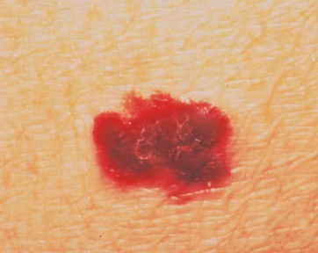
Patient Data
Mole Picture
NHS Data
Extra Factors
Previous visits to NHS
Allergies
Cured cancer
History of prescriptions
Wellbeing
Location
Weather
Mole Growth
Mole colour change
Etc.

Slide 16
Incentives
Individual:
GPs:
Points-based reward system
Clinicians
Economic
£
£

