Slide 1
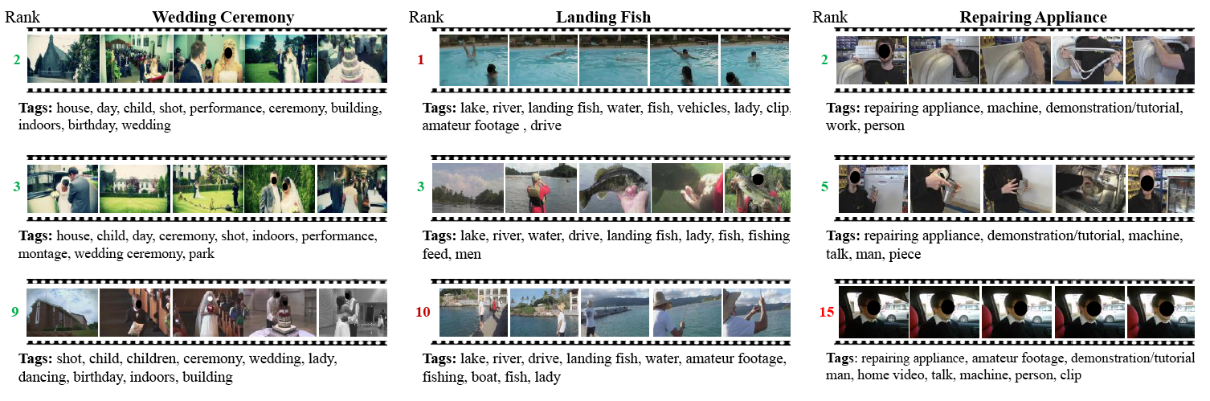
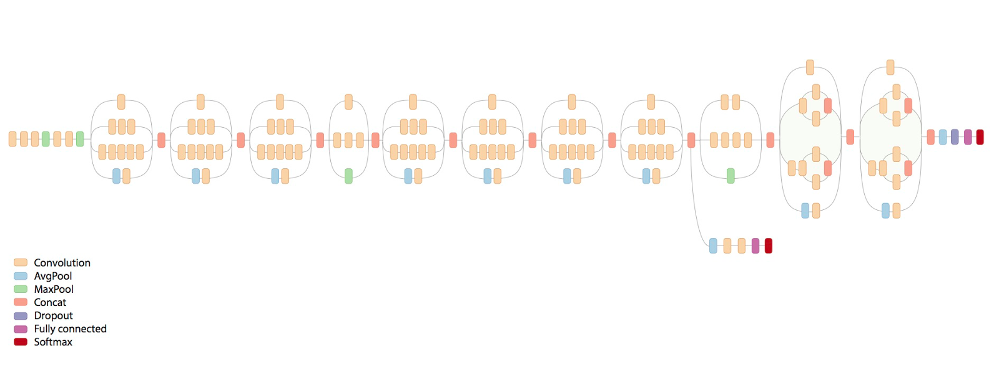
Rock On
TBA: Andy Sun, Jacob Patenaude, Paul Westlund, Siddhant Agrawal, Wilson Lee
Simon Fraser University
SIFT - Scale-Invariant Feature Transform
Feature Detection Algorithm by David Lowe
Images transformed into scale-space by creating image pyramid, at each level, difference-of-Gaussian (DOG) is found for image
Using DOG, keypoints are computed by comparing each pixel to its 26 neighbours to find areas of high curvature or contrast
Keypoint descriptors are calculated by sampling regions around keypoint and calculating image gradient per sample
Regions are then clustered together to form orientation histograms; orientation vector is then normalized along the largest gradient sample to achieve local rotational invariance
Keypoints can then be matched based on Euclidean distance of descriptors, allowing for recognition of model objects
SIFT on Rock, Paper, Scissors
Theory: Hand gestures such as Rock, Paper, and Scissors have salient curvature-based features for SIFT to pick up
Practice: True, but keypoints are few per pose, average ~10.
MOTIVATION
Neural Network
Started with baseline network (further explanation needed)
Came up with some ways to tweak: size, num layers, dropout layers, loss function tweaks, optimizer tweaks, rates, momentum, etc.
some networks redundant, little tweaks that made no improvements
classification scores for almost all images were 1 for predicted class and 0 for everyuthing else => really steep softmax result, when wrong it was really wrong (not even close)
training acc was almost always 100% for every network, validation accuracy hovered around 80% for most networks, validation accuracy found to oscillate quite a bit around 80-90% range -> used momentum, above 90% validation accuracy rare (possibly stuck in local minima), hard to get past due to small sample data size
Network7 (Explain what network 7 is) is the best - 215/215 training, 177/196 test
300 epochs using all 215 training samples per, validating against all test samples per
Compare existing gesture/object detection method against a neural network
Play rock paper scissors
HAND PICS
HAND PICS
TECHNICAL
PIC
TECHNICAL
DESC
CONCLUSIONS
at least its better accuracy than sift
But slower
small sample data size -> could use data augmentation to increase (supported by keras, dunno how 2 do
TECHNICAL
DESC

